Slide 1
Varying you sentence types
AO4(iii) On the mark scheme

Slide 2
Relevant mark scheme content
AO4(iii) Varied and sophisticated sentence structures used to impressive effect.

Slide 3
Learning Objectives
LO1 – Students revise and learn different sentence types.
LO2 – Students link their knowledge to relevant section of the mark scheme.

Slide 4
Introduction
There are many different types of sentences.
The main three types of sentences that you need to know are:
Simple
Compound
Complex
Have you heard of these sentence types, and are you able to exemplify them?

Slide 5
Basic Task – Ten minutes
Write a paragraph about an imagined memory of a walk through your local park.
Write it in past tense.
Keep this in front of you until later.

Slide 6
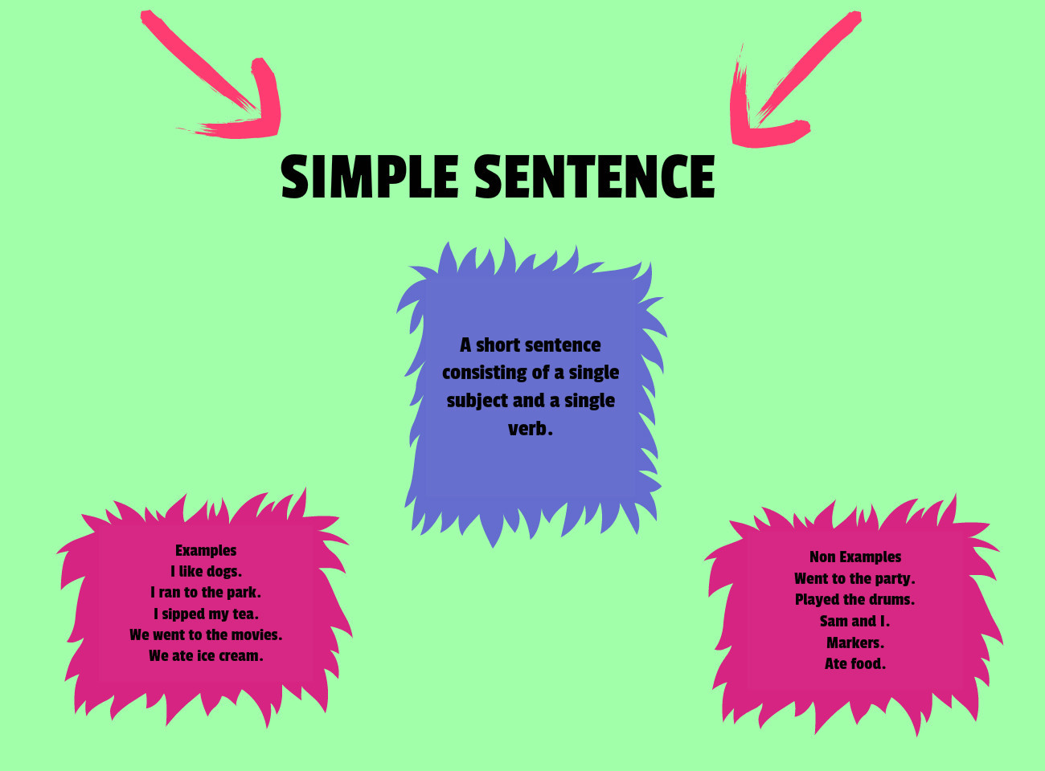

Slide 7

The cat sat on the mat

Slide 8
The cat sat on the mat
This is probably the most OVERUSED simple sentence in history. Millions of English teachers around the world use this simple sentence to explain how they work.
TASK – Identify the subject and verb.
It is boring, so can you suggest something a bit more interesting please?

Slide 9
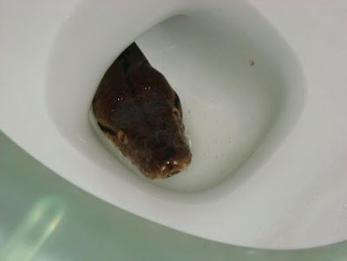
My Version
The snake hid in the toilet.
TASK - Identify the subject and verb.

Slide 10

Clauses
In order to understand how different types of sentences work, we need to talk about clauses.
Effectively, clauses are the individual units WITHIN a sentence which provide us with additional pieces of information.
‘The snake hid in the toilet’ is one single piece of information.
Therefore, we know that SIMPLE SENTENCES are made up of one stand-alone CLAUSE – known as a PRIMARY CLAUSE because it makes sense all on its own.

Slide 11
Task – Five minutes
Write out FIVE simple sentences based on what you have learned so far.

Slide 12
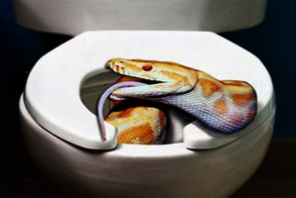
Adding a clause
The snake his in the toilet = primary clause. It makes sense on its own.
However, look at this next sentence…
The snake hid in the toilet, whilst licking the seat.

Slide 13
The problem…
We now have TWO pieces of information/clauses
The snake hid in the toilet
AND
Whilst licking the seat

Slide 14
We now have TWO pieces of information
The snake hid in the toilet = makes sense on its own
AND
Whilst licking the seat = does not make sense on its own

Slide 15
Whilst licking the seat
We call this clause the ‘subordinate’ clause. This means that, whilst it gives us more information, it only makes sense if it is attached to a primary clause.
Sentences which contain more than one clause, such as this, are known as COMPLEX sentences.

Slide 16
Task 2 – Five minutes
Turn your FIVE simple sentences into COMPLEX sentences based on what you have learned so far. I will come around and check that you are doing things correctly.

Slide 17
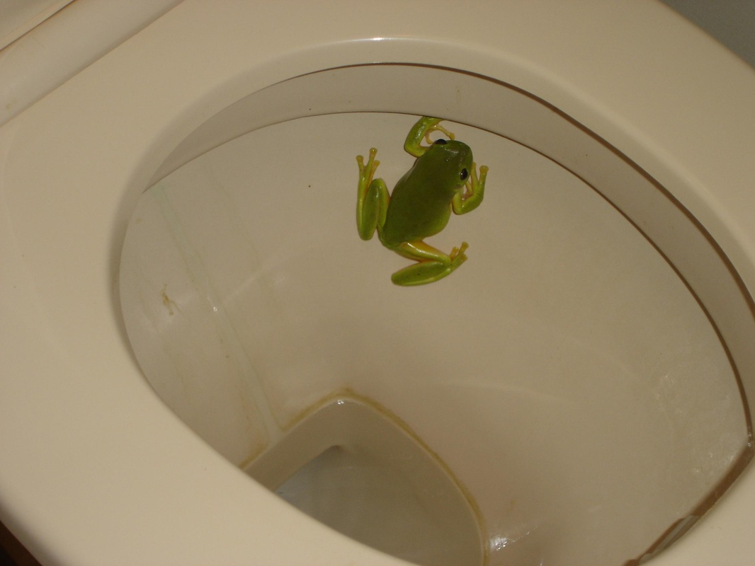
Another type of sentence?
The snake hid in the toilet and the frog had no idea.

Slide 18
In this instance…
…we still have two clauses. However, you will notice that they both make sense on their own. They are simply joined together by the connective ‘and’.
Sentences such as this, where ‘primary’ clauses are joined by a connective, are known as COMPLEX sentences.

Slide 19
Summing up
In order to hit the TOP bullet point for AO4(iii) on the mark scheme, you must include a variation of all of these types of sentences.
(as well as varying the lengths for effect)

Slide 20
Final task…10 minutes
Take the paragraph which you wrote at the start of the lesson and check to see if you have included examples of all of these sentence types.
Re-write it so that you have!

Slide 21
Feedback – Reading Out
I am now going to choose some people to read out their paragraphs. I will ask you to identify all three sentence types in your own work.

