Slide 1
Creative writing
Writing with still frames

Slide 2
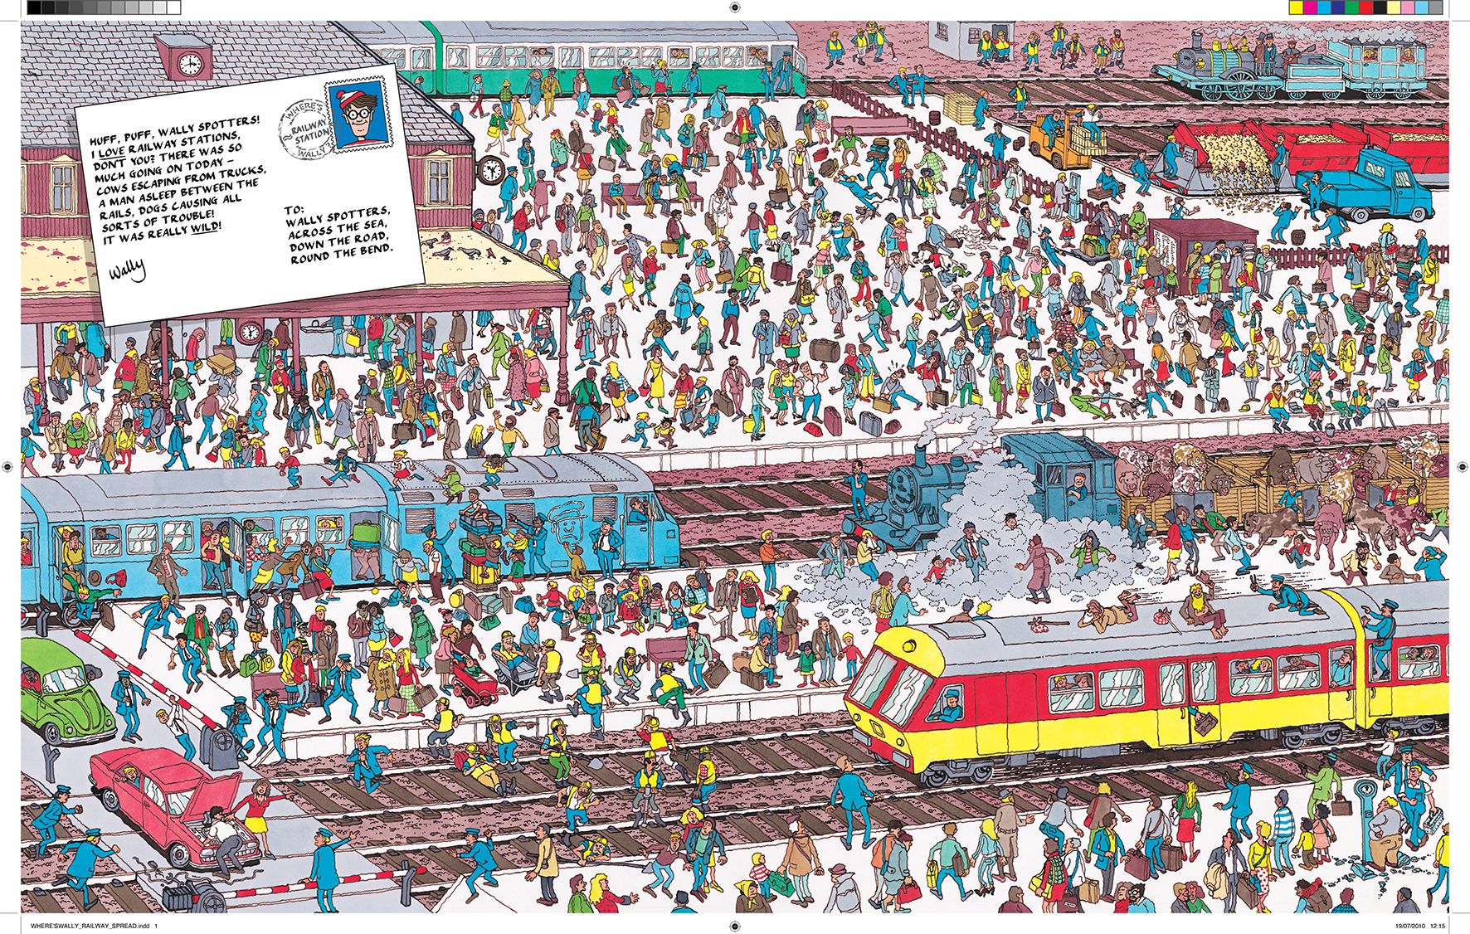
Starter

Slide 3
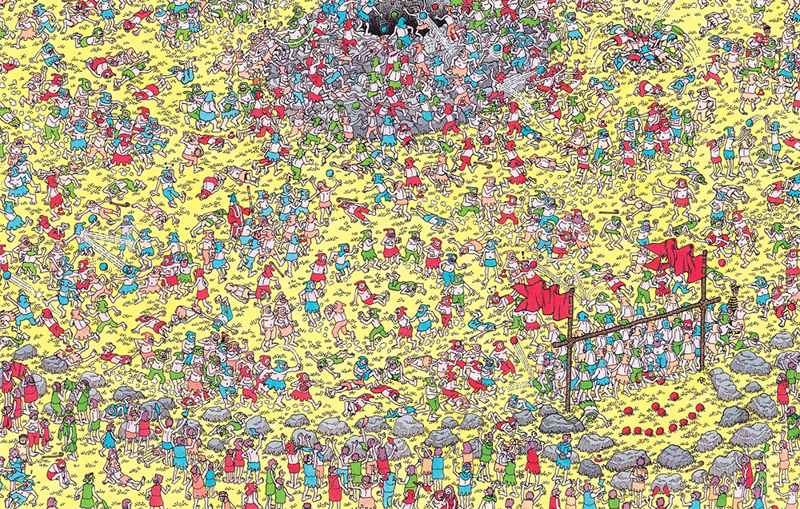

Slide 4


Slide 5
Learning Objectives
Students will re-cap their knowledge of rhetorical devices and other key features from the mark scheme.
Students will demonstrate their knowledge and understanding of creating suspense and tension from the previous lesson, focusing upon still frames and images to put together a number of imaginative, effective paragraphs.

Slide 6
Re-cap – Setting
How do we enable our reader to engage imaginatively with our setting?
Zooming in on small features – DETAILED description of specific items, sounds, movements.
Rhetorical devices – simile, metaphor, personification.
First person perspective – your emotional response

Slide 7
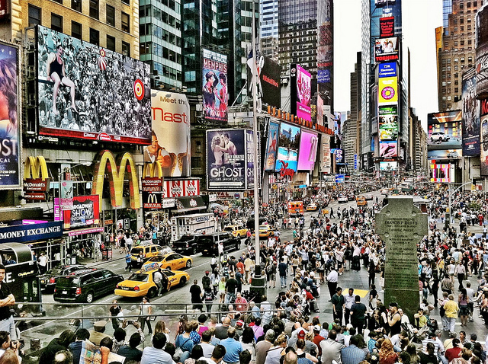
TASK:
Imagine you are part of this crowd.
Describe the setting and your emotions as you walk around.
Think about the key techniques we have explored.

Slide 8
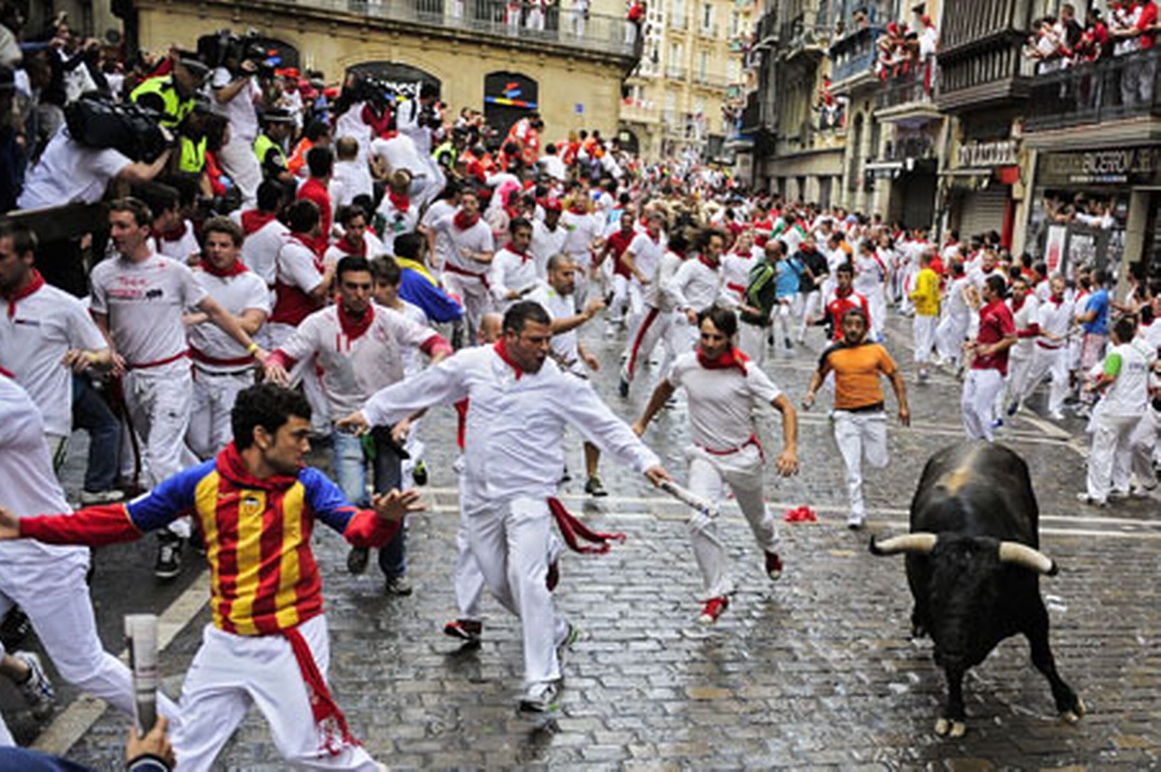
Plan a three part response to this scene:
The moments before the event.
The bull run – the main action. Cliffhanger?
What happens next? End of the event.
Think about HOW you can create tension and suspense.
Rhetorical devices.
Key features from yesterday’s lesson.

Slide 9
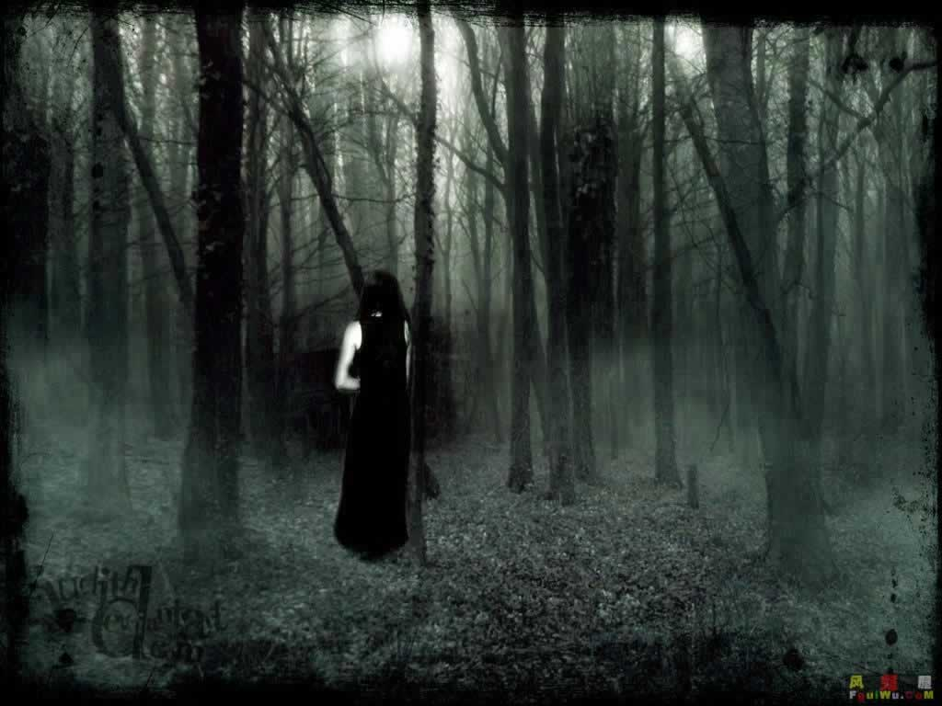
TASK
Examine the still-frame.
Look closely at the features.
Imagine you have discovered this person during your travels. Write TWO paragraphs – think about those key terms:
First person perspective
Emotional response
Small features – tension/suspense
Discovery of this person. Cliffhanger.
What happens next? Release of tension.

Slide 10
Plenary
Students will re-cap their knowledge of rhetorical devices and other key features from the mark scheme.
Students will demonstrate their knowledge of creating suspense and tension from the previous lesson, focusing upon still frames and images to put together a number of imaginative, effective paragraphs.

Slide 11
Learning Objectives
Students will re-cap their knowledge of rhetorical devices and other key features from the mark scheme.
Students will demonstrate their knowledge of creating suspense and tension from the previous lesson, focusing upon still frames and images to put together a number of imaginative, effective paragraphs.

