Slide 1
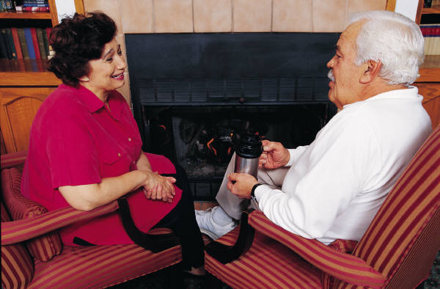

Spoken language terminology

Slide 2
Contractions
One or two words made shorter, usually by removing a letter and adding an apostrophe, to make one new word.

Slide 3
Pauses
Short gaps between words or sentences that show a break in someone’s speech (often marked out with a number to show how long the pause is). This can make a script sound more believable, as if the characters are thinking about what to say next.

Slide 4
Paralinguistic features
Any kind of communication that is not an actual word. Paralinguistic features may include facial expressions and eye movements, but also sounds that show emotion or reaction.

Slide 5
Overlaps/interruptions
When two speakers’ words overlap, and they speak at the same time. This is a common feature of real conversations.

Slide 6
Formal language
Language appropriate for conversations between people who do not know each other, or in formal situations where at least one person is in authority.

Slide 7
Relationships/power between speakers
The relationship between speakers can be seen in the way they talk to each other and the types of words they choose to use. Sometimes the number of interrogatives they use is also a key clue.

Slide 8
Homework
Grice’s Maxims of conversation – who is he, what did he have to say about the language of conversations.
Either write out the answer on a piece of paper or print out your research.
In for next Monday

