Slide 1
socialisation
Lesson Objective: Understand the process of socialisation and how it affects people as they grow.
Key Words:
Socialisation
Agents of socialisation
Primary socialisation
Secondary socialisation
Learning Outcomes:
Define the socialisation process
Identify the different agents of socialisation
Explain the difference between primary and secondary socialisation.

Slide 2
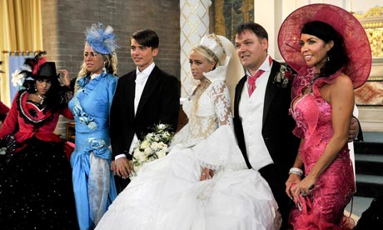
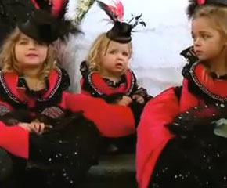
Starter – My Big Fat Gipsy Wedding
Brainstorm all the norms and values you have see in the pictures.
Extension: Where do you think they learnt these norms and values?

Slide 3
What is socialisation?
Socialisation is the process through which we learn about our culture.
Who do you think is responsible for teaching us our culture?
Notes:
Who taught the people in ‘My Big Fat Gipsy Wedding’ there norms and values around wedding customs?

Slide 4
Agents of Socialisation
Our culture is taught to us by the agents of socialisation.
Task 1. In pairs discuss who these ‘agents’ may be and list them in books?
Extension: Rank them in order of importance.

Slide 5

Family
The Media
Peers
Schools
Religion
Social groups
The Government
The Workplace

Slide 6
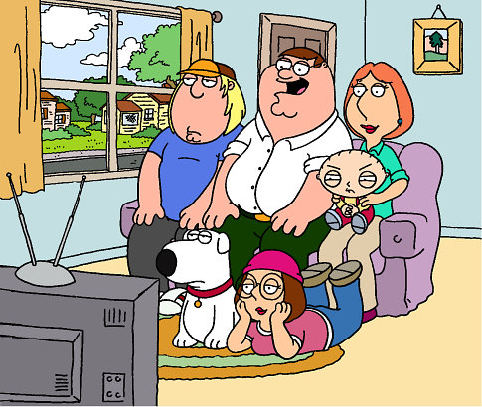
Primary Socialisation
It is the process by which children learn the cultural norms of the society to which they are born.
Which are the main agents responsible for the primary stage of socialisation?
Task. Which members of your family had the most influence on you during this stage? Did anyone outside the family have a major influence on you?

Slide 7



Secondary Socialisation
This takes place outside the home. It teaches people ways to behave in different situations.
What agents do you think are at work in the secondary socialisation process?

Slide 8
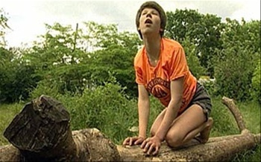
So… Do our social experiences teach culture and survival skills?
Plenary: Exit pass. Discuss one agent of socialisation and the stage it occurs? Write it down on post it notes and hand in to leave!

