Slide 1
What is Sociology?
The study of how society is organized and how people interact and experience life.

Slide 2
How do we study it?
Sociologists investigate the structure of groups, social institutions (like the family, school, prisons, etc) and how people interact within these settings.
Methods used: theoretical analysis, stats, and observation.

Slide 3
4 MAIN THEORIES TO KNOW
(Sociology theories are just different views about how society works)
1) Functionalism
2) Marxism
3) Feminism
4) Interactionism

Slide 4

Functionalist Perspective
Functionalists believe we each have a ROLE/FUNCTION [a job to do] and we are interdependent upon each other to contribute to society functioning as a whole (MACRO/big picture).
We each have a role and a piece in the big puzzle.
We share values, norms, attitudes and beliefs (consensus)
Change is generally viewed as disruptive and gradual.
Example: The Macro BIG PICTURE of our Education system:
*Role of all teachers = to educate & enforce proper behaviour and a life skill-set so that all students will be prepared for adulthood.

Slide 5


Marxist Perspective (Macro)
Society is dominated by the ruling class (the big wigs at the top of the food chain have the power).
Power = control, money, access, prestige, privilege, authority, respect…
Society based on conflict: the WORKING CLASS [called the proletariat] are in conflict with the RULING CLASS [called the bourgeoisie/elite]).

Slide 6

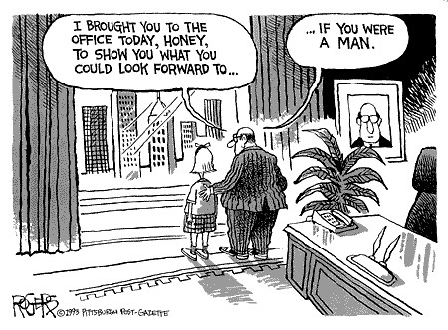
Feminist Theory (Macro)
Feminism is considered to be a “structural theory” (we are all passive puppets manipulated by society to perform our roles) and women are primarily at a disadvantage to men in today’s Patriarchal (male dominated and empowered) society.
(macro level structural theory)

Slide 7
Feminists believe women function in the family as subordinate members because their role is reduced to…
1) Reproducing the labour force (populating and nurturing children)
2) Performing “unpaid/free labour” services in the home.
3) Absorbing the anger/stress of the family and their partner (women are pressured to create a stable and stress free home environment).
4) Serving the needs of men within marriage (sexually; as the nurturer; providing free domestic work and primarily in charge of the household; main child care provider, etc).

Slide 8
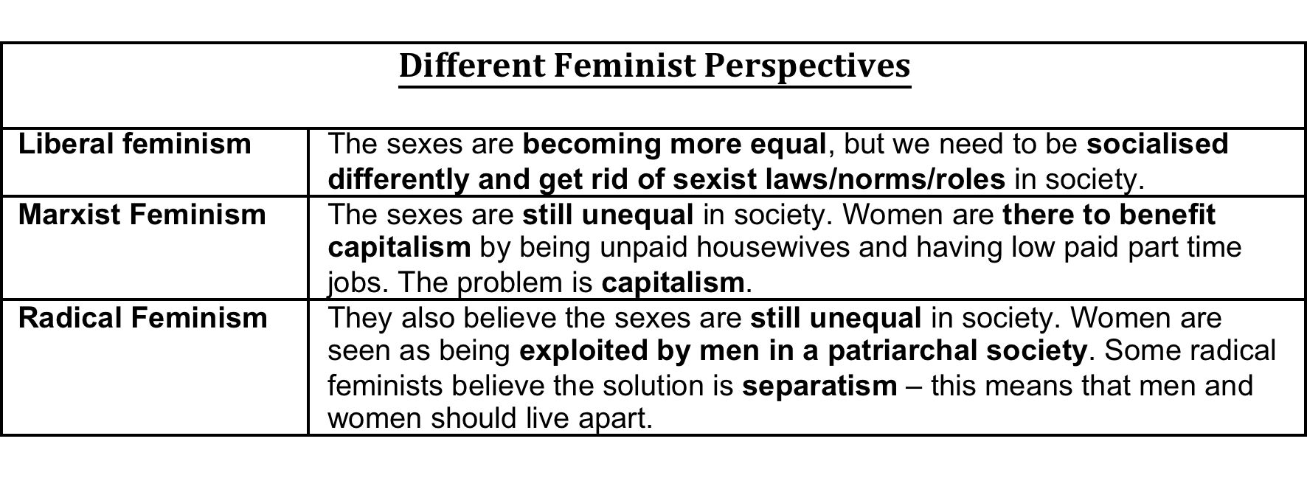

Slide 9
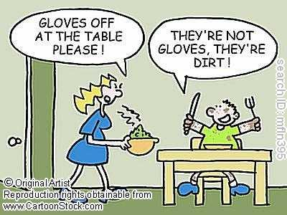
Interactionist Perspective (Micro)
Studies society through interactions within individual and small (micro scale) groups.
Interaction between individuals is negotiated through shared symbols, gestures and verbal + nonverbal communication
Interactionists ask questions like:
How do individuals experience one another?
How do they interpret the meaning of these interactions?
How do people construct a sense of self identity through this?

