Slide 1
Unit 12 Superstars!
Erin Gerrard
Jack Lowrie
Yve Johnson
Lucy Copple

Slide 2
Unit 13
Preparation 11.2.21
Project 24.2.21 - 7.6.21
Unit Aim: To enable the candidate to take responsibility for their own learning by demonstrating their achievement in proposing and realising a project which integrates contextual perspective, research, problem solving, planning and organization, evaluation and reflection, and practical, technical and presentational skills.

Slide 3
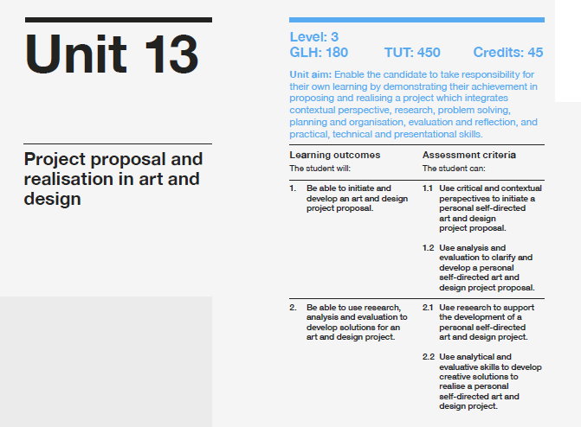

Slide 4
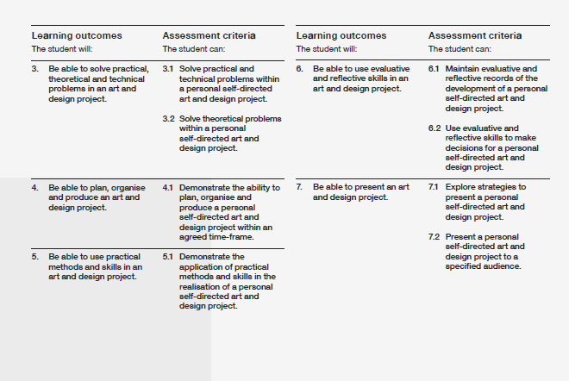

Slide 5
Self initiated project
Culmination of all skills/ strengths developed on UAL Extended Diploma in Art and Design
You will be fully supported by tutors by tutorials , critiques etc (which you must record and reflect upon within documentation)
Daily diary in your powerpoints to record process and reflect
You will required to document evidence for the assessment criteria in individual folders.
Full attendance and engagement required
Strive to be the best that you can be!

Slide 6
Self initiated project
14 college weeks
Final hand in 4pm Monday 7th June
(One drive folders, forms and exhibition (probably online)

Slide 7
Self Initiated Project
Needs to be an exploration
You need to solve a problem, answer a question
The project needs to be a journey

Slide 8
Preparation for your Unit 13 project from today
Begin to engage and complete all tasks recommended on this presentation and present (select your way to document)
Read through the UAL Extended Diploma Specification. Ensure you fully understand assessment criteria and follow guidance given.
Select your specialism on Connect 22.2.21
Book tutorials from March 2nd with your tutor to discuss initial ideas (document all discussion)
Week beginning 1st March. Bring your context research to a 1:1 tutorial with specialist tutor and discuss possible (well researched) project directions and problems. Proposals and plans will be generated on 4th March 2021.
Remember 14 weeks project = substantial body of work

Slide 9
Project Proposal and Realisation in Art & Design
Context
Research
Problem Solving
Planning and Production
Practical Skills
Evaluation and Reflection
Presentation
You will be assessed and graded for each of the assessment criteria. Your final unit grade will be that of the lowest grade you received in any criteria.
For example : 1.1 PASS 2.1 PASS 2.2 PASS 2.3 DISTINCTION 2.4 DISTINCTION 3.1 REFERRAL
Overall grade for the year = Referral

Slide 10
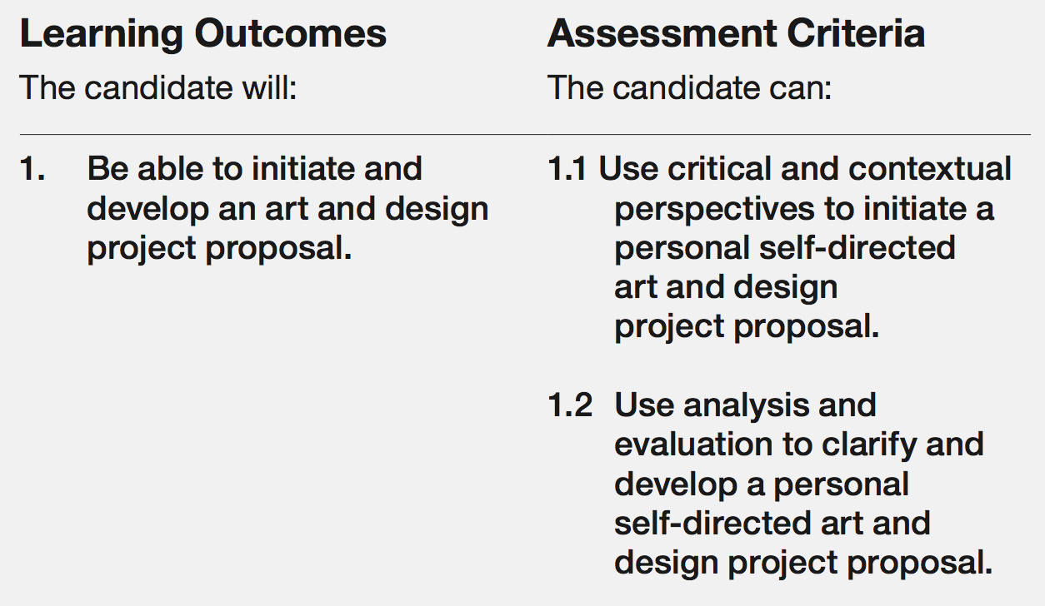
Context

Slide 12
Task 1
2 x brainstorms - What needs to be included in a self initiated project? Or just a self iniated project? Or creating my own brief/ problem?
Consider….
Starting points ? Where do I begin? How do I begin?
Subject specialism selection , why? Characteristics of specialism? Output? Audience? Presentation related to specialism?
Phases/ steps of project
Student attributes. Personal goals. How can I ensure success?
Assessment criteria I need to cover. Strengths and weaknesses
Use of staff support/ facilities
2nd Brainstorm – research sources – what research sources can you consider for this project?

Slide 13
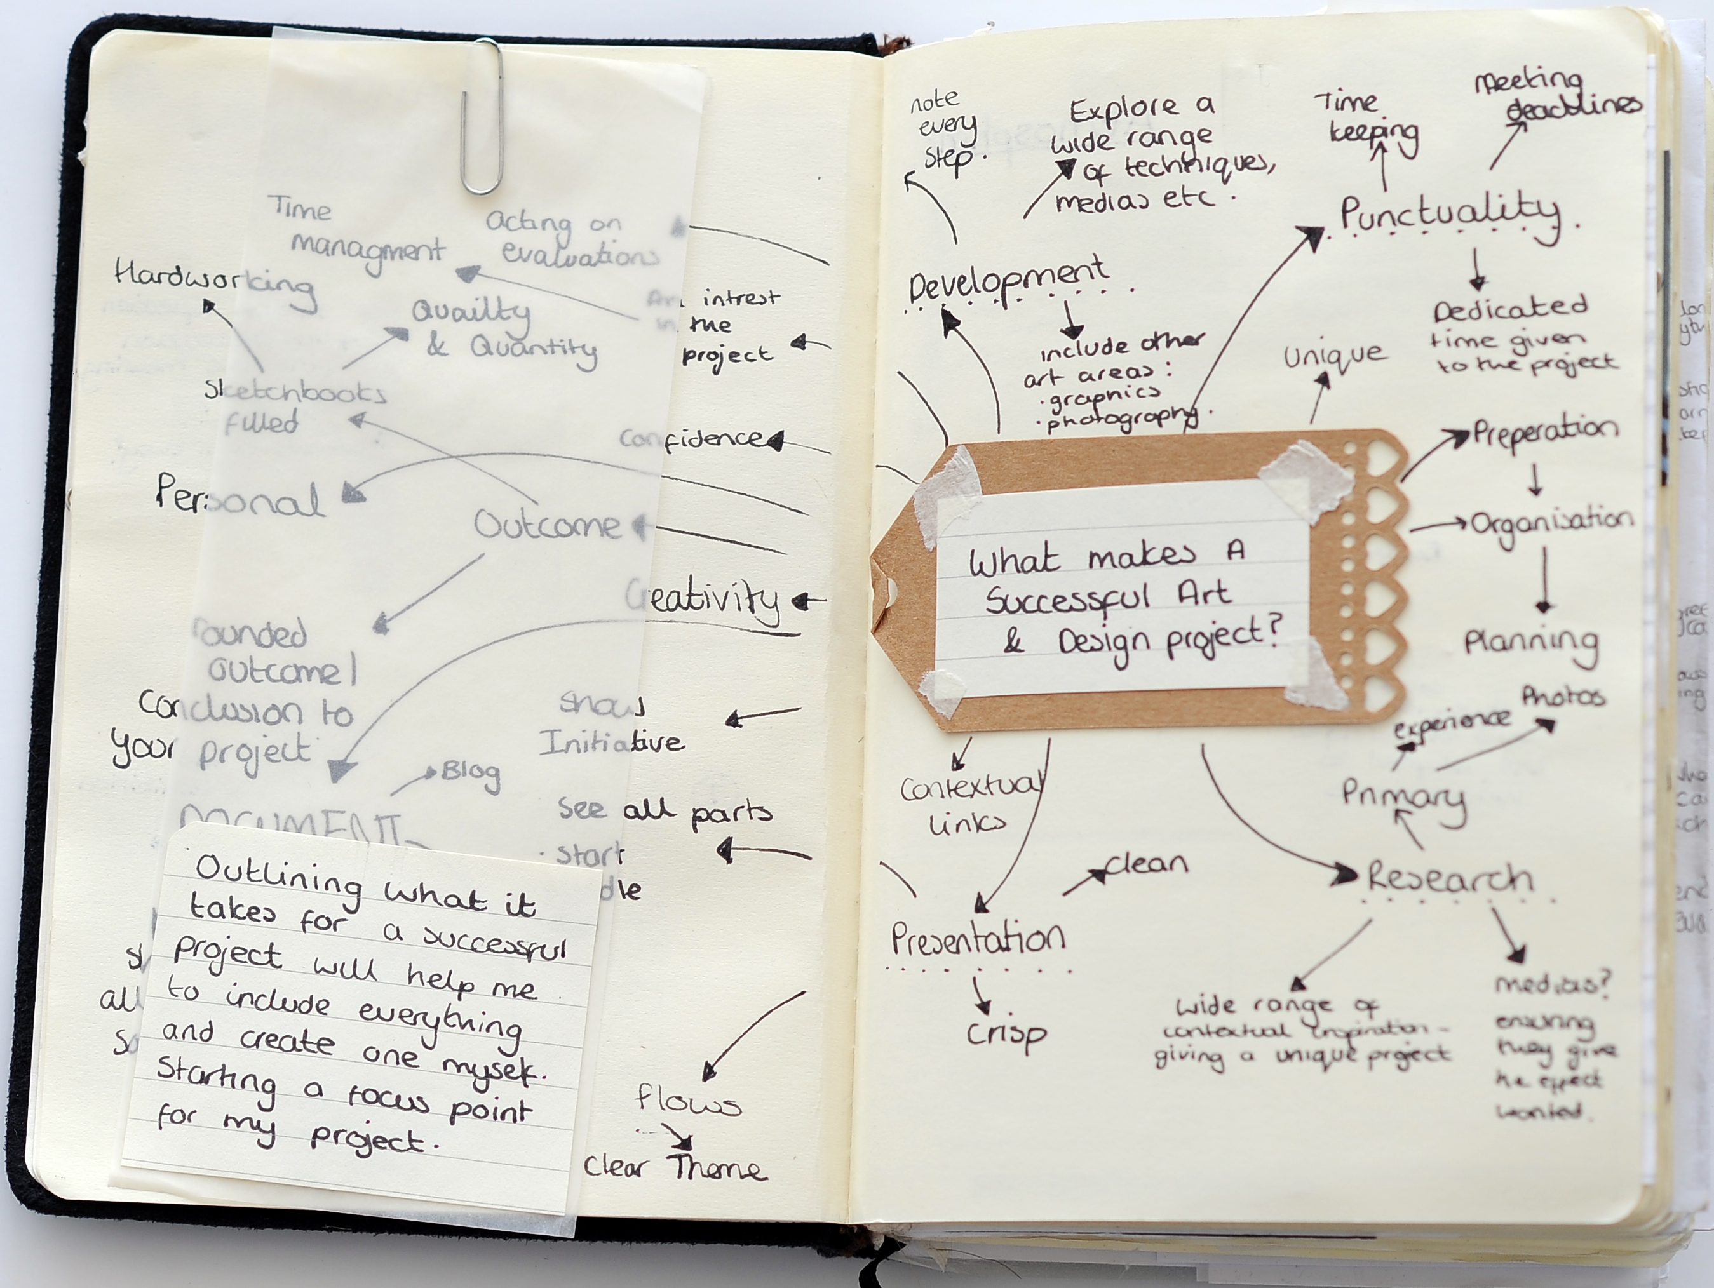

Slide 14
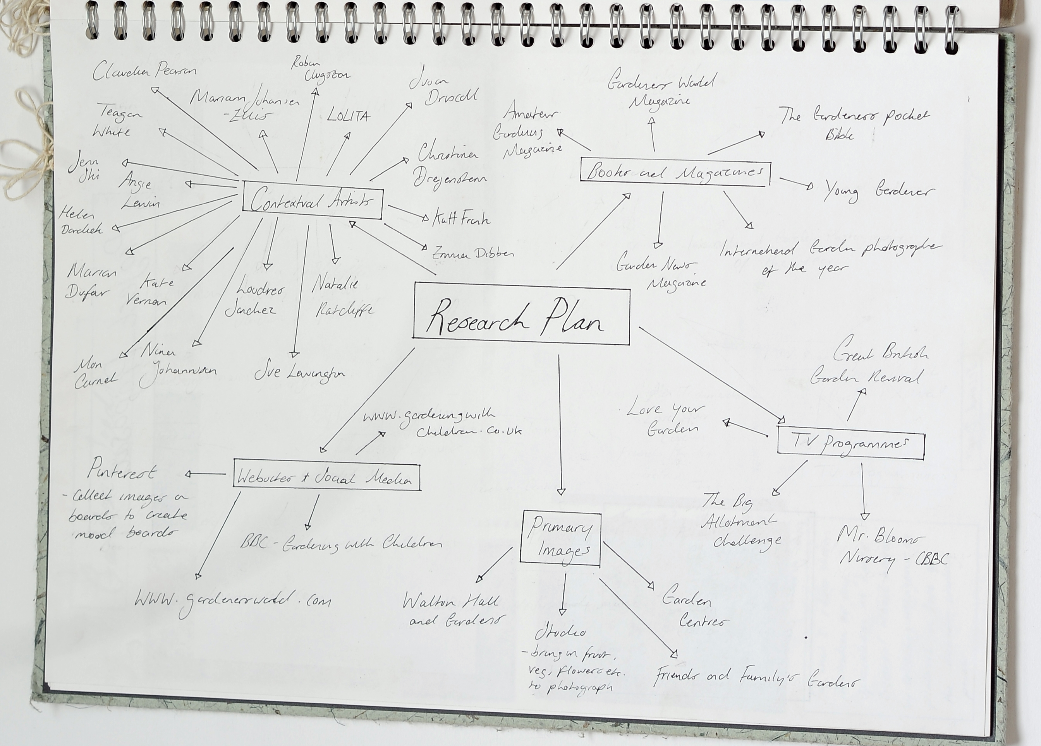

Slide 15
Task 2 – Recording personal research tasks - reflection
Create a chart/ paragraphs/ mini mind maps evaluating your influential projects completed to date focusing on areas of strengths…. Techniques, processes, outcomes – reflect why was the project so successful? What was the starting / point theme? Do you have further ideas related to this starting point or the research generated? Could you develop this project further?
Identify strengths and successful techniques to use in your Unit 13 project.
*Include images of project work*

Slide 16
Task 3: Updated portfolio
Include in your PowerPoint a link to your updated portfolio
Write a reflection on this. Why did you select these examples as a representation of you as an artist?

Slide 17
Task 4: Record context
Reference here any resources that you have accessed/engaged with as part of your personal research. Either to develop your skill base or to learn about practitioners in your chosen specialist area.
Record the link and include a screenshot and reflection about what you have learned from accessing this resource.

Slide 18
Optional mini project
If you have created a mini project as a stretch and challenge activity then you will need to record this in your pp. There is no restriction on how many slides this is.

Slide 19
Task 5 – research
(General )Inspiring contextual research gathered from relevant online exhibitions/ museums/ cultural spaces/ existing products etc. (Detailed analysis of min. 6 relevant pieces of work/ products and discuss relevance to possible projects e.g. techniques, subject matter/ ideas/ theme or display/ audience/ vehicle).PRESENT WITH IMAGES IN YOUR POWERPOINT
Delve deeper into your specialism. Demonstrate your understanding. Generate possibilities!
Why are they interesting, exciting….. What project ideas spring to mind?
*This is separate to mood boards and all examples require in depth analysis – Use to develop ideas*
Take at least 30 photos throughout the day that capture imagery you find inspirational. These can be taken inside your house or on a walk. Consider all of your surroundings all of the time. Ensure you capture good quality images for every shot
Print a contact sheet of all 30 images identify your 10 most inspirational images. Say why???? (present in your own way)

Slide 20
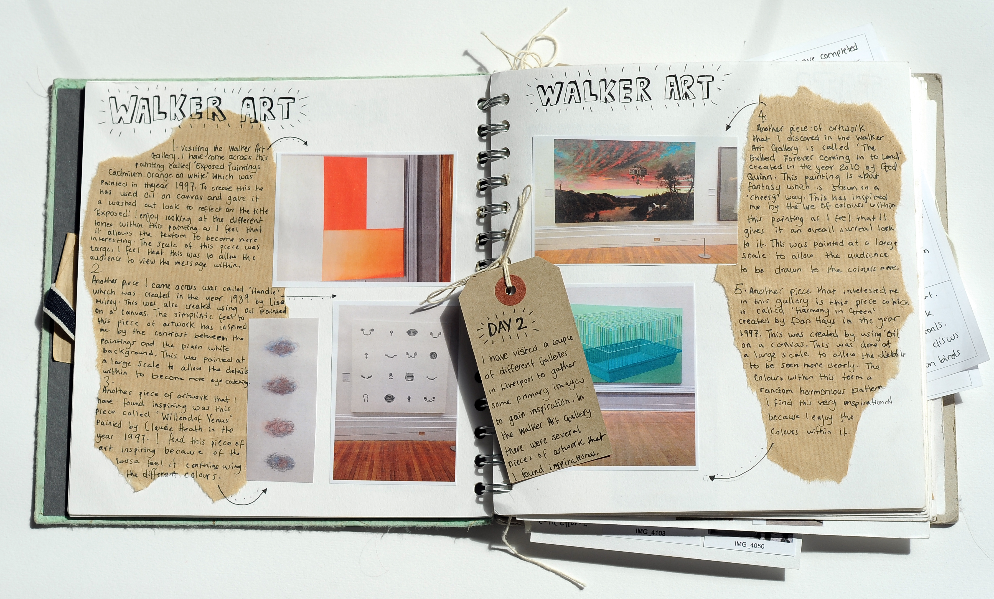

Slide 21
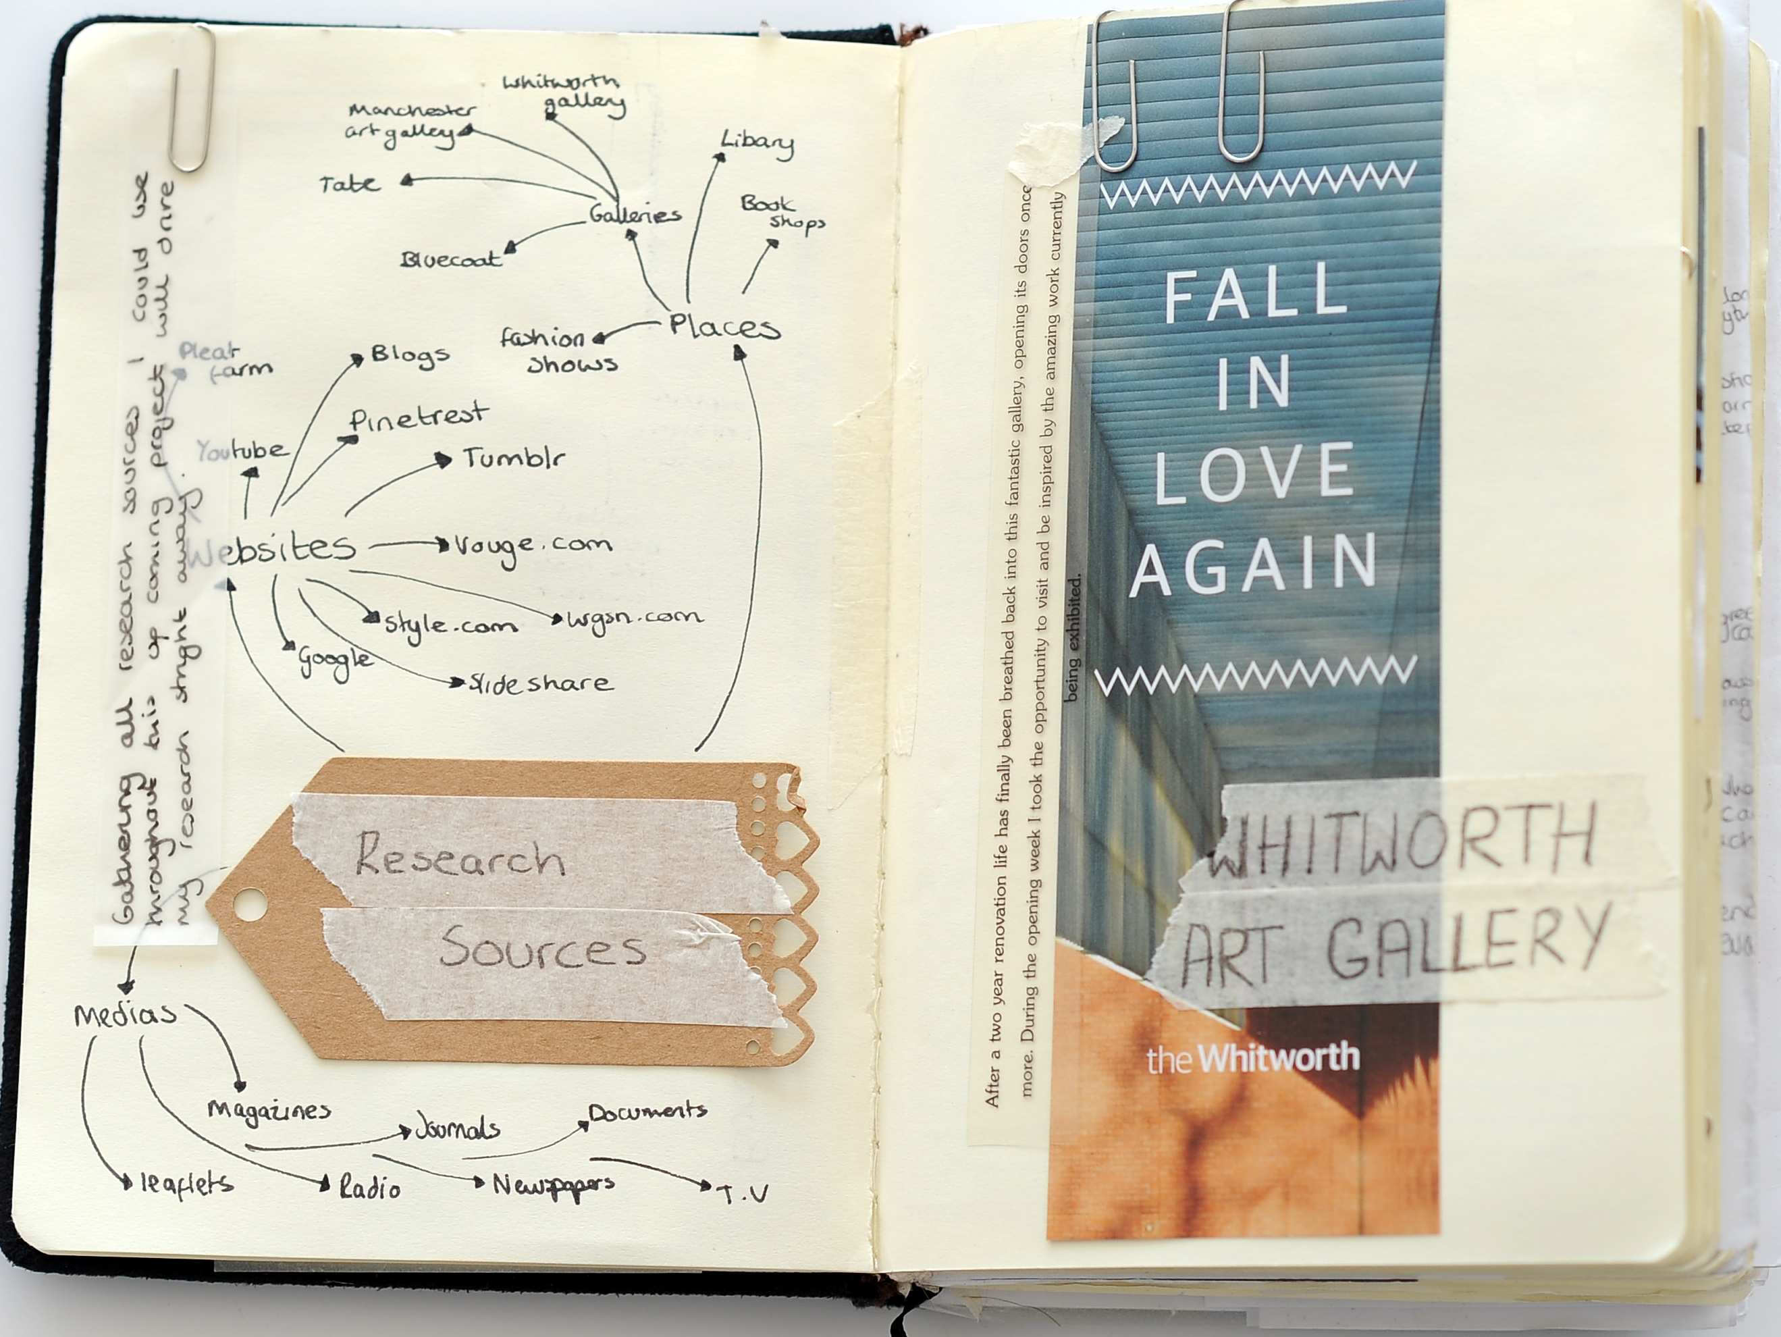

Slide 22
1st March - Task 6
Create a detailed Brainstorm and a visual mood board (secondary / contextual images boards for 2-3 ideas/ starting points (If relevant include images of your own project work)
Consider presentation
*Include wide ranging, relevant research from a range of sources. See tutor pinterest boards, specialist magazines/ books (library and class rooms), documentaries, films etc*

Slide 23
Tuesday 2nd March start tutorials
We will be booking students in from this date to discuss potential ideas for your projects.
We will be asking you to present / share your research so far as part of the discussion so you will need to have that ready to share.

Slide 24
Wednesday 3rd March
One to one tutorials to discuss project ideas.

Slide 25
Thursday 4th March
Proposal and plan introduction.
Students to write proposals and plan
Submit first drafts Friday 5th March.

Slide 26
Friday 5th March
Submission of first draft of proposal on Teams
Submission of all initial context and research tasks on Teams.

Slide 27
Self Initiated Project Advice
Needs to be an exploration
You need to solve a problem
The project needs to be a journey

Slide 28
Unit 13 Advice
Evaluate your strengths and create a project which will develop and utilise your strengths to create a project which you feel passionate and interested in.
Take time to research and develop ideas for your project context/ proposal.
Look through past projects and create a project which will challenge and incorporate a wide range of creative activity
Be wary of gimmicks for final presentation

Slide 29
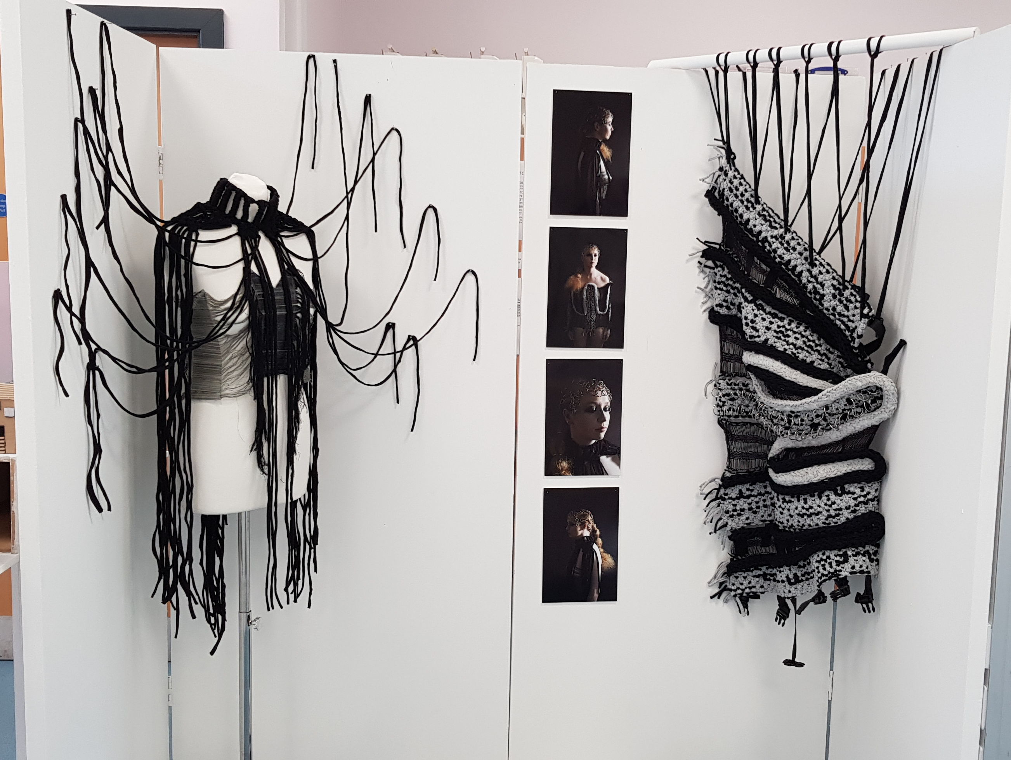

Slide 30
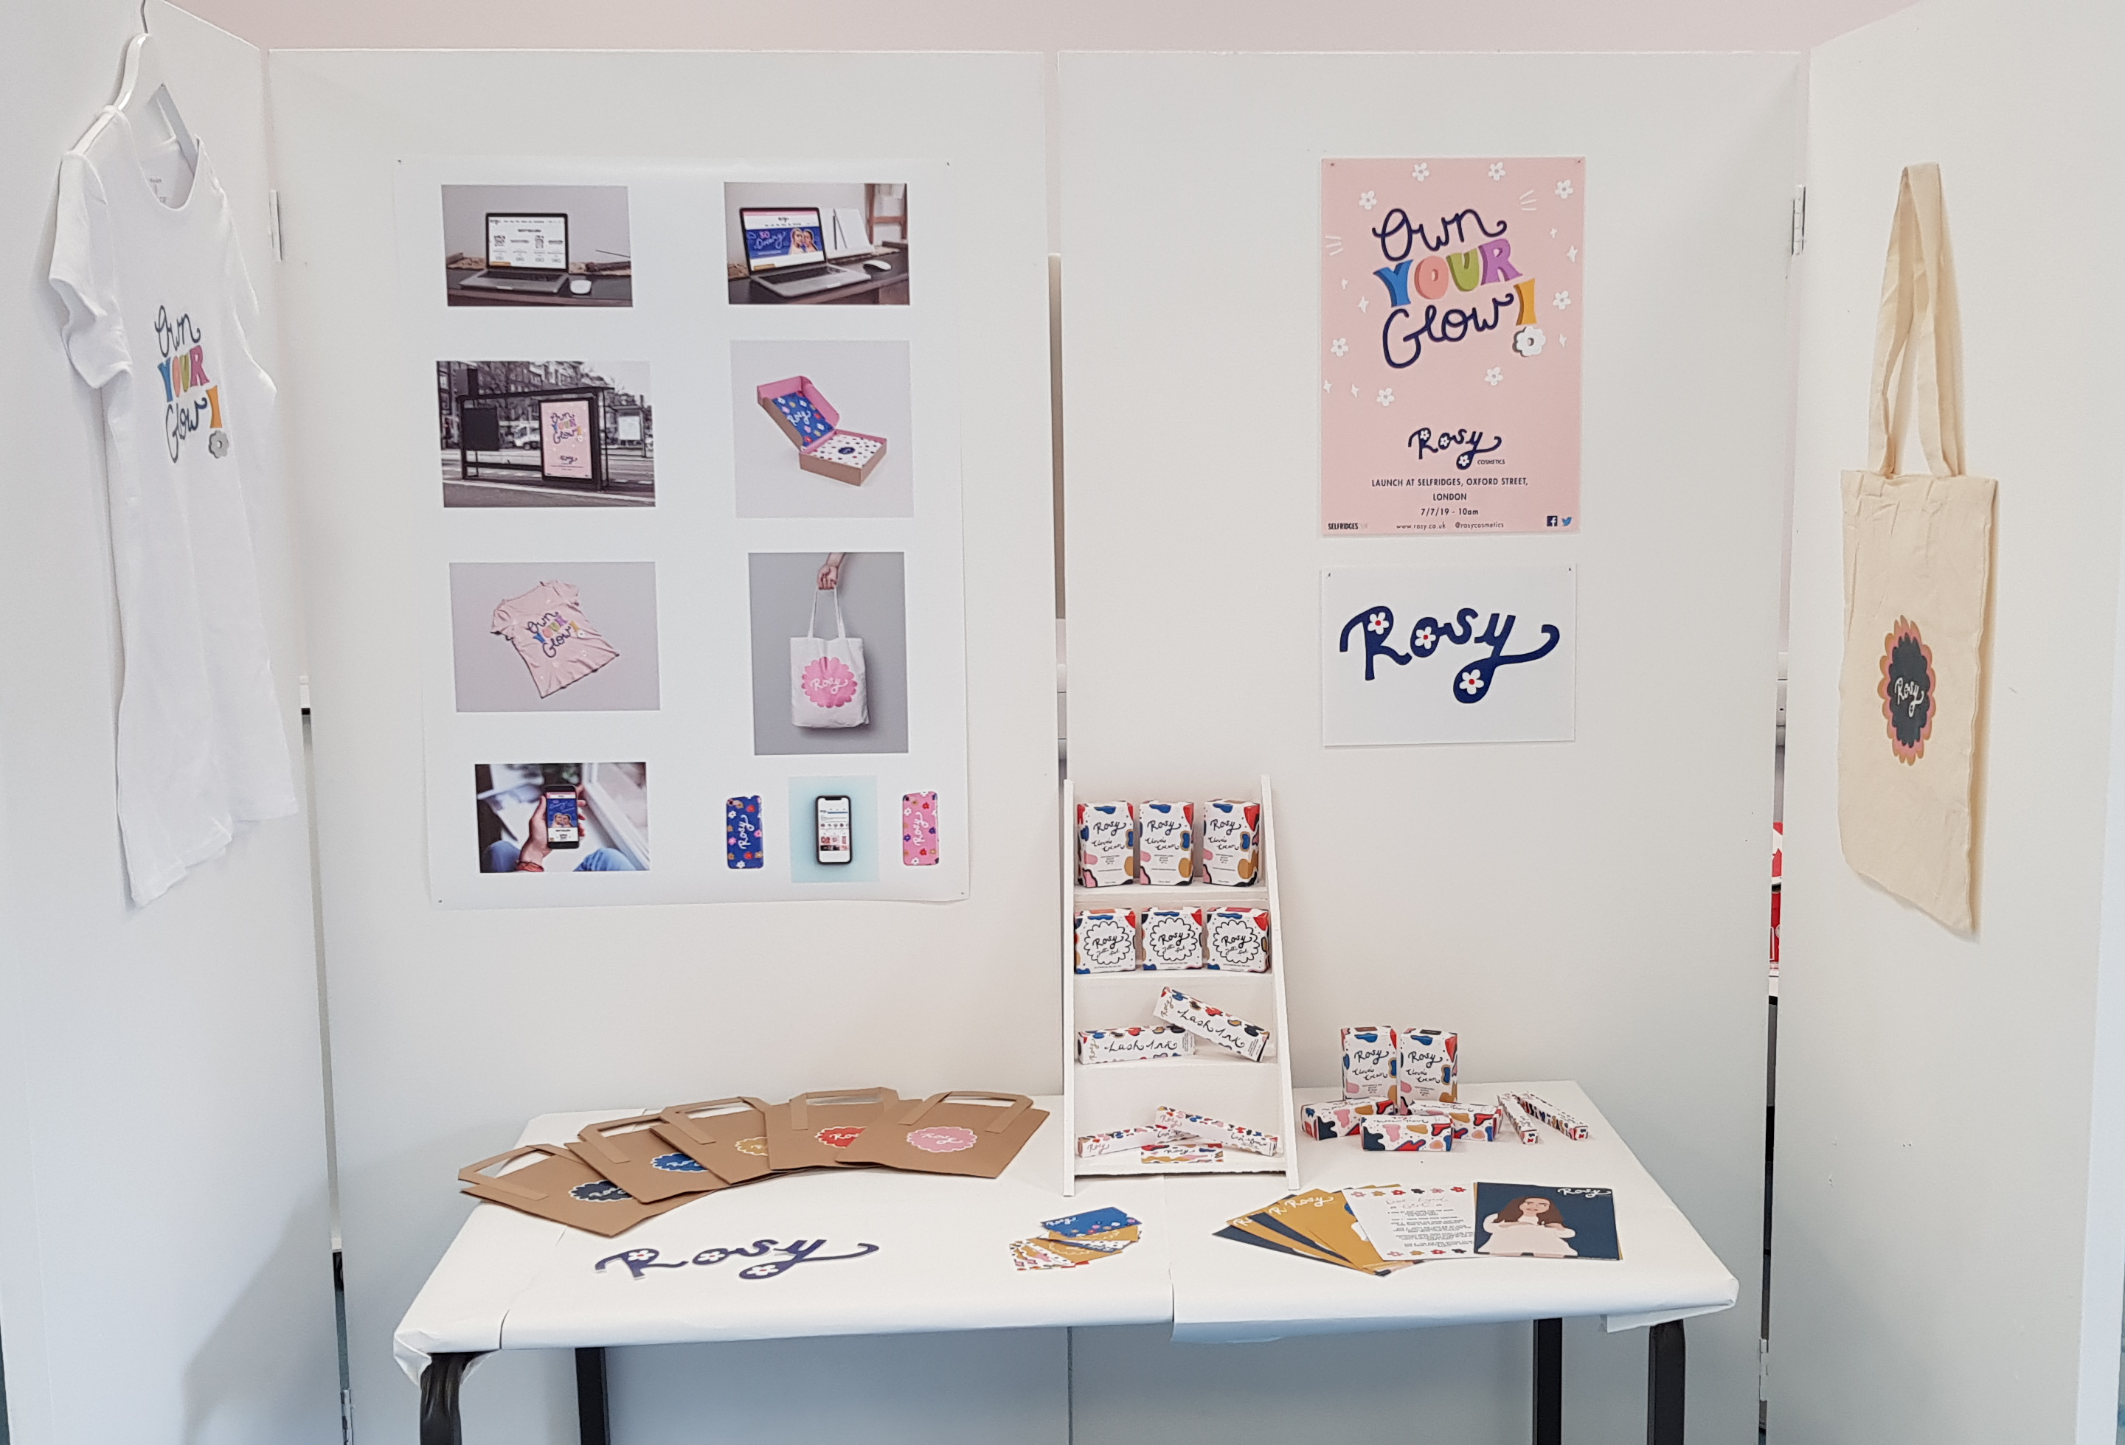

Slide 31
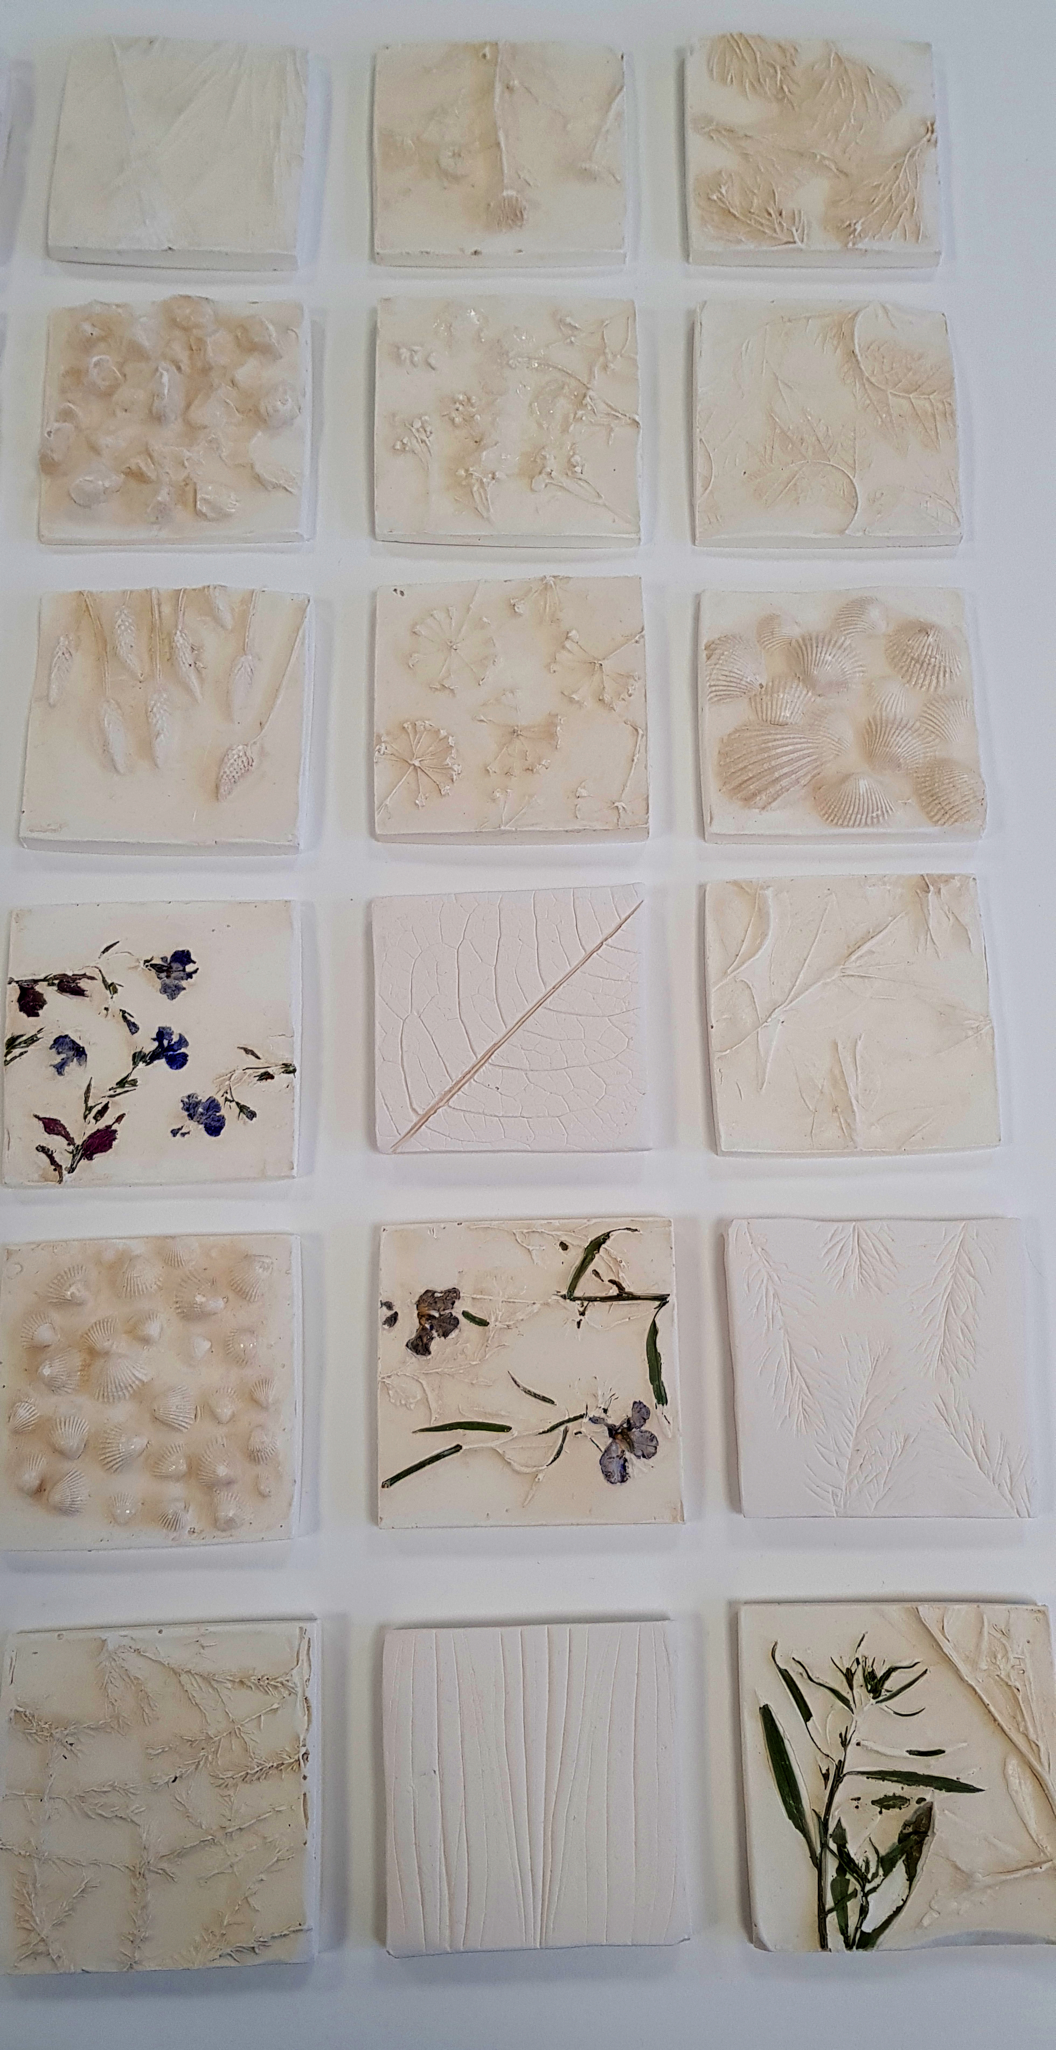
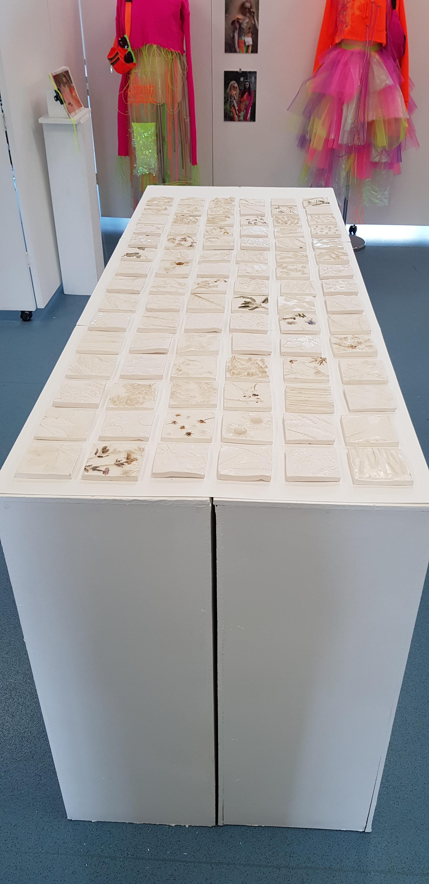
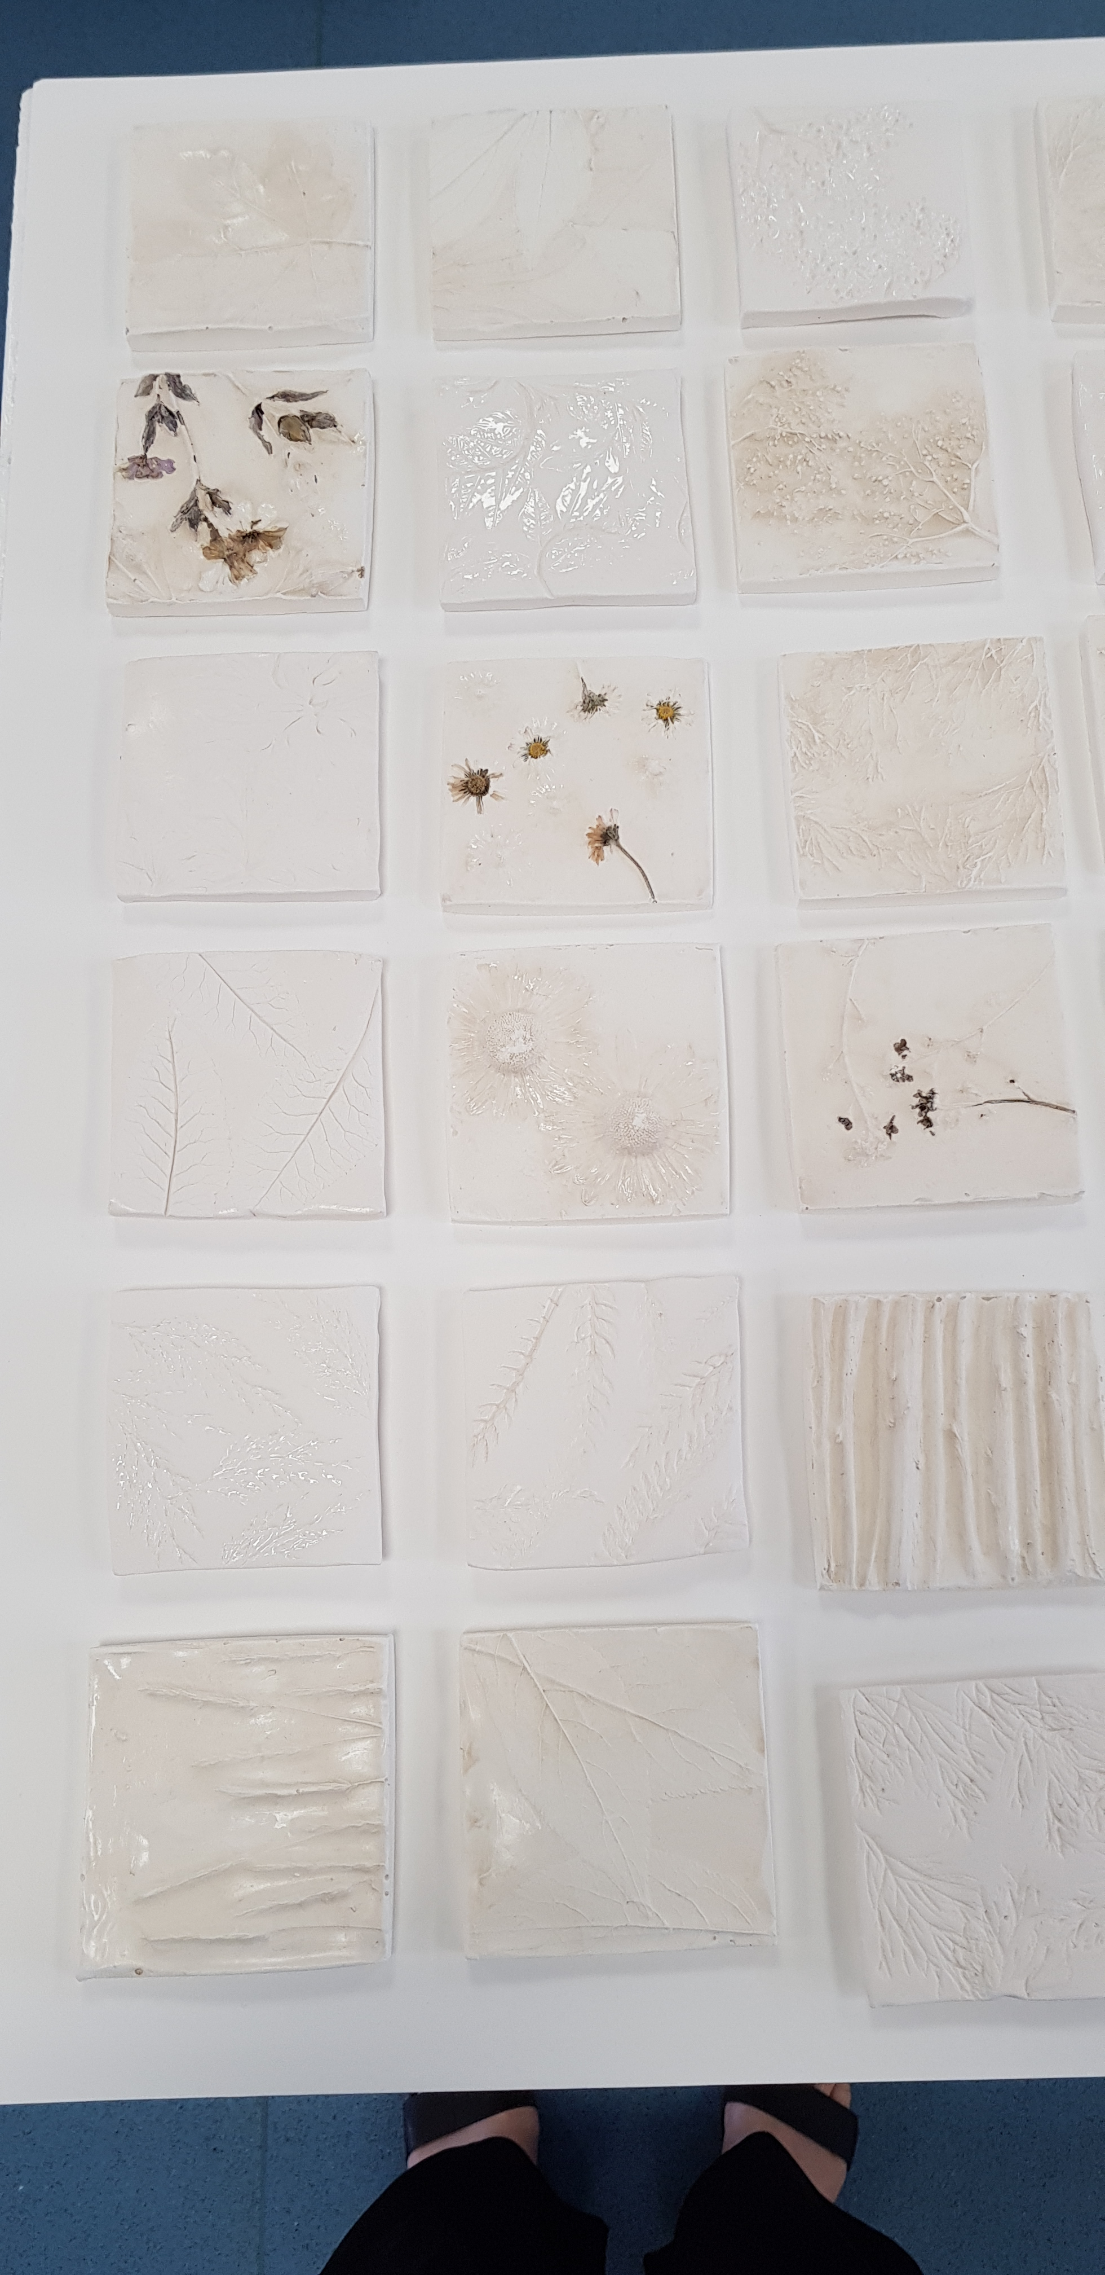

Slide 32
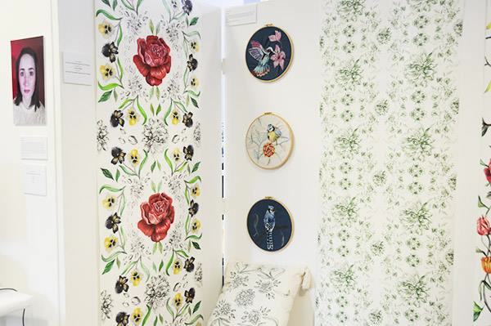

Slide 33
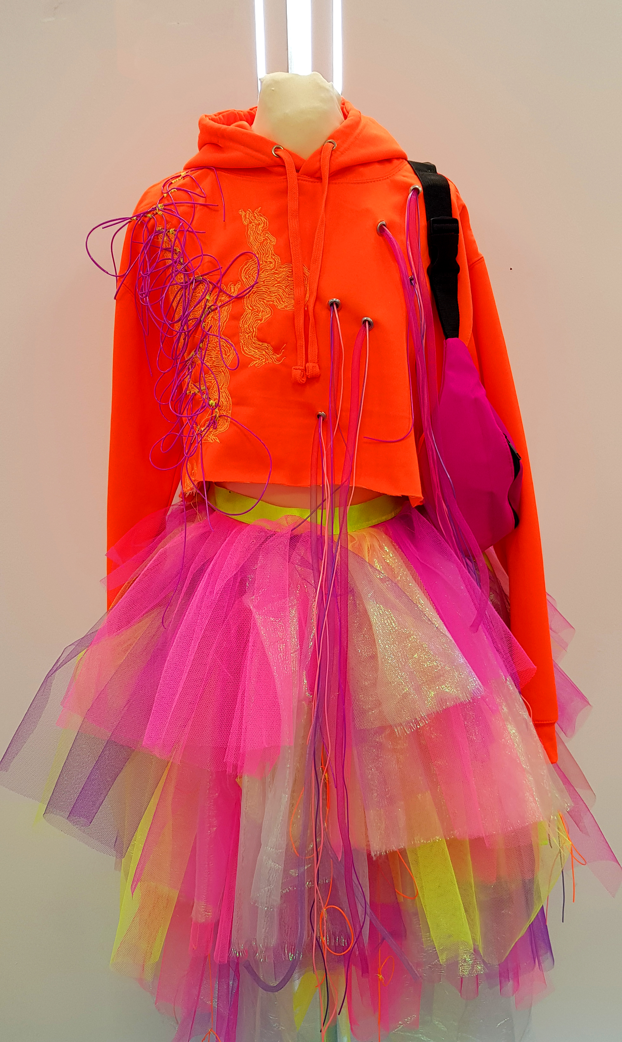
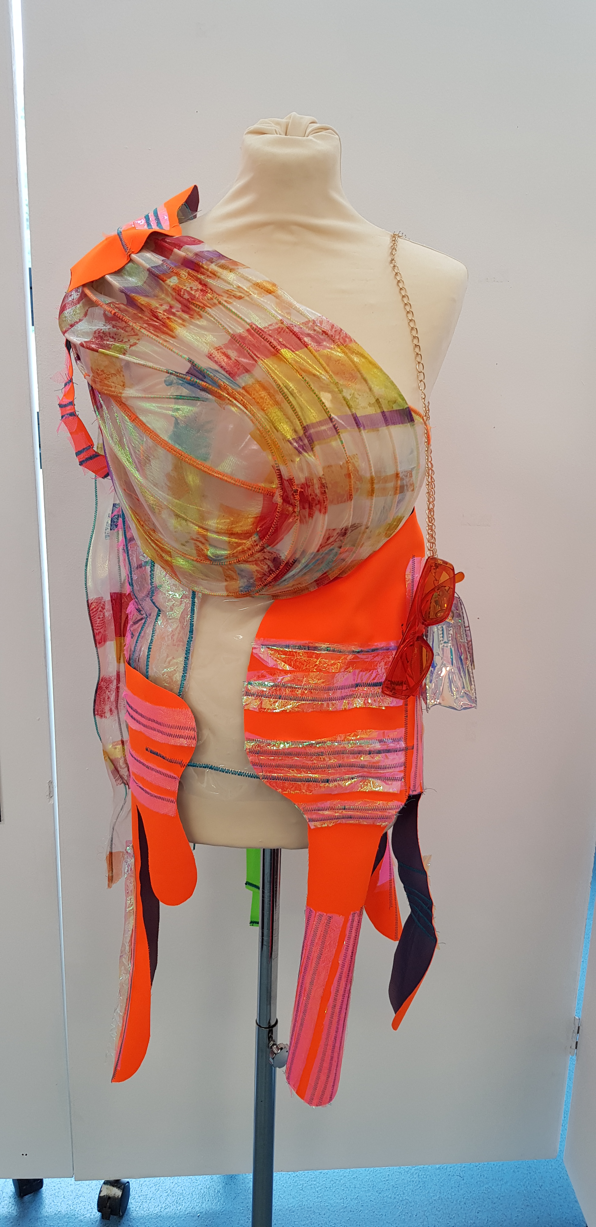
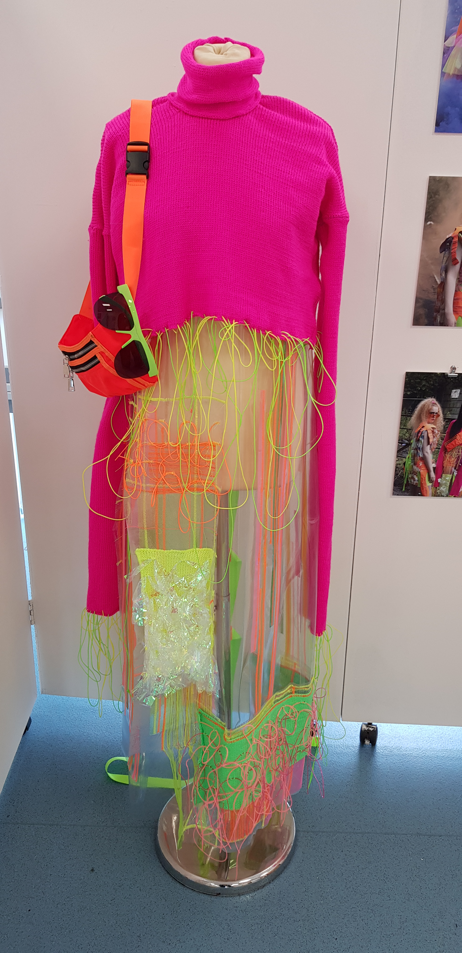

Slide 34
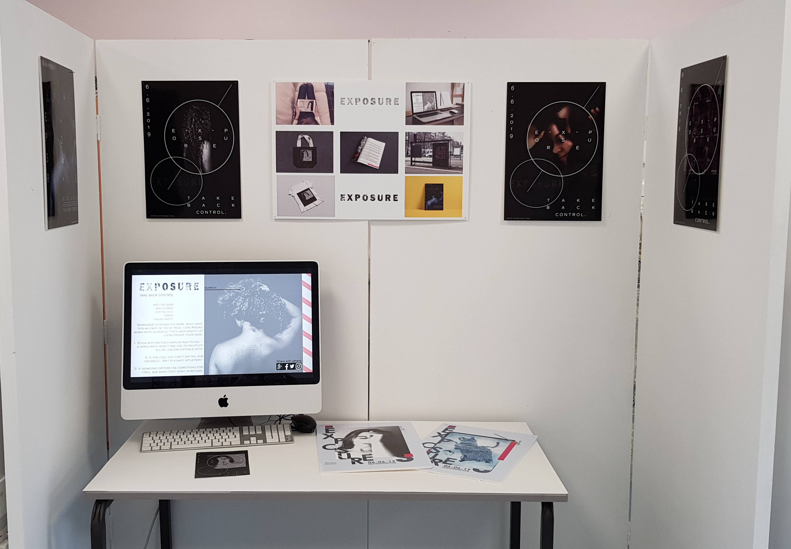

Slide 35
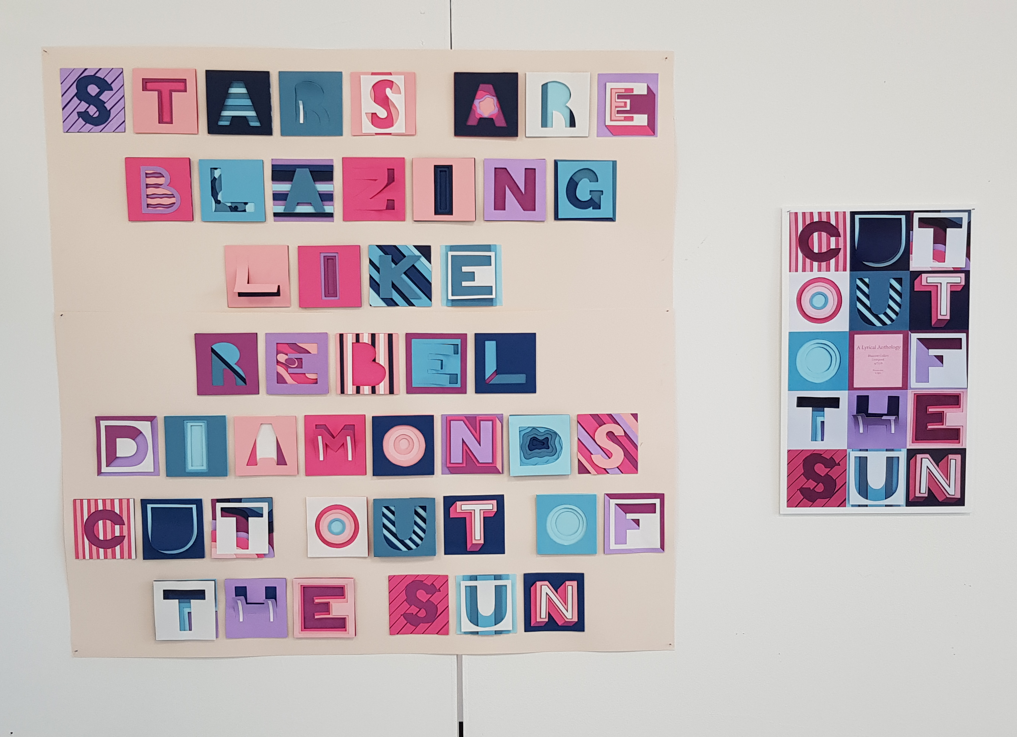

Slide 36
Viewing galleries help sheet
When viewing any online exhibition always have a notepad pen with you to record ideas/ thoughts.
Always read the information on the gallery website. This will discuss the themes/ artists in the exhibition and it can go into your sketchbook.
Information to include:
Name of artist/designer
Name of work/ collection/ series
Year created
Write two sentences for each of the following:
Briefly place the artist/designer in context of art movement/time
Describe the piece of artwork (What is it depicting/containing?)
Make comments on the following:
What medium/ techniques have been used in its creation
Colour or tonal qualities
Details or texture or mark making
Composition (layout, use of space, positive and negative space etc)
Scale (overall structure and sizing, foreground and background)
How is the work displayed? Does it react with its environment?
Does it have a function or use?
What is your personal response to the work?
Additional points to consider:
Do you think there is any symbolism or hidden meaning within the work? Is the artist making a political, social or environment statement? Does the work contain narrative?
Can you compare it to another artist’s work, if so in what way?
Has the work been created in reaction to another artist , perhaps a similar artist in the same exhibition/ gallery?
What influence will you take from viewing this piece of work/ has it given you any ideas for your own work?

