Slide 1

Note making

Slide 2
Some of the study skills you may have used at GCSE will need refining and, for some of you, new skills will need to be learnt.
Two websites with some suggestions you may find useful:
Learning Toolbox website http://coe.jmu.edu/learningtoolbox/studentstart.htm
http://oedb.org/library/college-basics/hacking-knowledge

Slide 3
What is note making?
Note-making, is when you have to actively select, organise and connect data and information that is particularly relevant and important to a deeper understanding of the subject.

Slide 4
Why write notes?
They act as a summary or reinforcement of what you have read
They are an aid to memory
Useful for revision purposes
Encourage you to become an active learner
Note-making has the potential to become a more creative experience, as you can experiment with note making styles to see which work best for you.

Slide 5
Note making tips
Take notes in your own words.
Make sure you can read your notes later. Don't cram too much on the page.
Use different note making methods for different purposes, for example flowcharts for process planning, tables for comparison.
Organise your notes so that you can easily find what you are looking for.
Title your notes and date them.
Avoid cutting and pasting, or copying huge chunks from books or articles

Slide 6
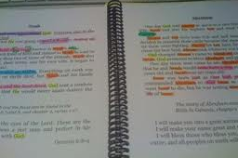

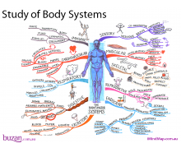
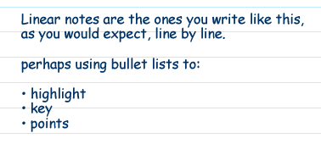

Some examples
Linear
Mind map
Table
Flow chart
Diagrams
Flash cards

Slide 7
How to make good notes
There's no point in making notes if you simply pile them into a heap and never look at them again!
To benefit from note making:
Try to group themes or sections together
Use key words, phrases and short sentences
Do not cram too much information

Slide 8
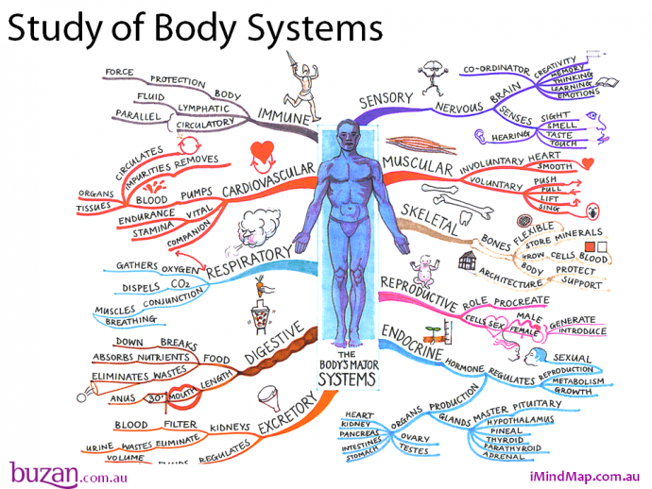

Slide 9
Cornell Notes
Suggestion for revision – A4 piece of paper.
2. Pull out the main ideas and key points.
Write them here.
1. Write notes here.
Use abbreviations.
Review these notes.
3. Write a summary of the main points here.

