Slide 1
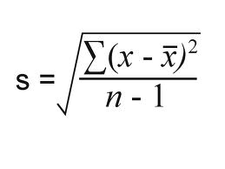
STATISTICS
Spec point: Calculate or compare the mean, median and mode of a set of data. Calculate the standard deviation and understand why standard deviation might be a more useful measure of dispersion for a given set of data
The good news is that you will not be asked to carry out any of these calculations in your exam ☺, but you must know what the calculated number means
Standard Deviation
This is used when we need to know how much a set of data is spread out on either side of a mean.
It takes into account ALL the values, not just the two most extreme ones - which is the range.
E.g. If one of the extreme values is an outlier, then the range will be misleading.
A standard deviation close to 0 indicates that the data points tend to be very close to the mean of the set, while a high standard deviation indicates that the data points are spread out over a wider range of values
Where,
x = values given
x = mean
n = total number of values

Slide 2
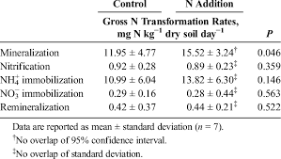
STATISTICS
Standard Deviation
This is used when we need to know how much a set of data is spread out on either side of a mean.
It takes into account ALL the values, not just the two most extreme ones - which is the range.
E.g. If one of the extreme values is an outlier, then the range will be misleading.
A standard deviation close to 0 indicates that the data points tend to be very close to the mean of the set, while a high standard deviation indicates that the data points are spread out over a wider range of values
SD can be found on tables and graphs- the error bars visually represent the SD.
You do not need to understand the experiment to be able to comment on the data
 | Treatment | Mean dry mass / g per plant (± standard deviation)
 |  | Root | Shoot
 | A – heat-treated fungus and nitrate fertiliser | 0.40 (±0.05) | 1.01 (±0.12)
 | B – fungus and nitrate fertiliser | 1.61 (±0.28) | 9.81 (±0.33)
 | C – heat-treated fungus and ammonium fertiliser | 0.34 (±0.03) | 0.96 (±0.26)
 | D – fungus and ammonium fertiliser | 0.96 (±0.18) | 4.01 (±0.47)

Slide 3
Complete the table below working out the means and ranges for 3 hypothetical results.
 | Treatment | Mean dry mass / g per plant (± standard deviation)
 |  | Root | Shoot
 | A – heat-treated fungus and nitrate fertiliser | 0.40 (±0.05) | 1.01 (±0.12)
 | B – fungus and nitrate fertiliser | 1.61 (±0.28) | 9.81 (±0.33)
 | C – heat-treated fungus and ammonium fertiliser | 0.34 (±0.03) | 0.96 (±0.26)
 | D – fungus and ammonium fertiliser | 0.96 (±0.18) | 4.01 (±0.47)
 | No. | Of | reps | /g | /pl | ant
Experimental data | 1 | 2 | 3 | 4 | 5 | 6 | Mean | Range | SD
1 | 0.36 | 0.42 | 0.36 | 0.44 | 0.43 | 0.40
2 | 0.33 | 0.34 | 0.39 | 0.40 | 0.63 | 0.33
3 | 0.29 | 0.63 | 0.33 | 0.24 | 0.53 | 0.36
What do you notice about the mean values?
Which is the most accurate mean? Which is the least accurate mean. Justify your answer (hint: also look at the range)
Copy the SD from the board. What do you notice when you compare the SD of the 3 data sets?

Slide 4
Complete the table below working out the means and ranges for 3 hypothetical results.
 | Treatment | Mean dry mass / g per plant (± standard deviation)
 |  | Root | Shoot
 | A – heat-treated fungus and nitrate fertiliser | 0.40 (±0.05) | 1.01 (±0.12)
 | B – fungus and nitrate fertiliser | 1.61 (±0.28) | 9.81 (±0.33)
 | C – heat-treated fungus and ammonium fertiliser | 0.34 (±0.03) | 0.96 (±0.26)
 | D – fungus and ammonium fertiliser | 0.96 (±0.18) | 4.01 (±0.47)
Experimental data | Mean | Range | SD
1 | 0.40 | 0.08 | 0.03
2 | 0.40 | 0.30 | 0.12
3 | 0.40 | 0.39 | 0.15

Slide 5
You don’t need to understand what experiment to be able to comment on the data.
Identify which control experiments had the most and least accurate means. Justify your answer.
Identify which method had the most and least accurate means after N was added. Justify your answer.
State which method had the greatest gross transformational rate per day after N was added. (Note: UNITS!)
Calculate the gross transformational rate in mg N K⁻¹ dry soil week⁻¹ for nitrification. (Note: UNITS!)
Calculate the percentage difference between gross N transformational rates using remineralization compares to mineralisation.

Slide 6
Control, most accurate mean- largest SD
Control, least accurate mean- largest SD

Slide 7
N addition, most accurate mean- largest SD
N addition, least accurate mean- largest SD

Slide 8
You don’t need to understand what experiment to be able to comment on the data.
State which method had the greatest gross transformational rate per day after N was added. (Note: UNITS!)
Mineralization with a rate of 15.52 mg N kg⁻¹ dry soil per day
Calculate the gross transformational rate in mg N K⁻¹ dry soil week⁻¹ for nitrification. (Note: UNITS!)
Nitrification = 0.89 x 7 = 6.23 mg N K⁻¹ dry soil week⁻¹
Calculate the percentage difference between gross N transformational rates using remineralization compares to mineralisation.
Remineralisation = 0.44, mineralisation = 15.52
0.44- 15.52/0.44 x 100= 3427% slower rate.

Slide 9
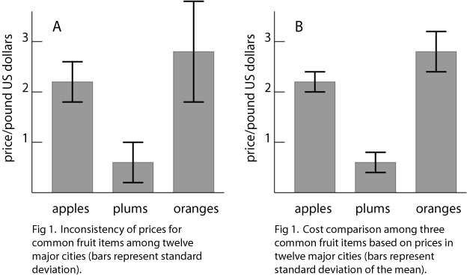
Once the SD has been calculated the SD can be plotted on a graph
SD bars are 1 SD above the mean and 1 SD below the mean.
For example on the graph the means price for apples in 12 cities was $2.20 with a SD of $0.30. $2.20 + $0.30 = $2.50 is the top of the SD bar
$2.20 - $0.30 = $1.90 is the bottom of the SD bar.
Look closely at the SD bar, which values have the most variation around the mean? Justify your answer.

Slide 10
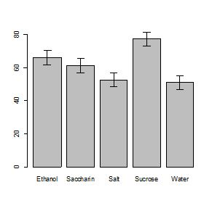
We also use standard deviation to compare between results
Comparing between results allows you to comment on the validity of the data (whether the data can be trusted to support your conclusions.)
If SD overlaps it means values within the data is the same/overlaps or is similar to values in another set of data. This means the results are not unique so you cannot confidently support your conclusion.
If SD don’t overlap there is a significant difference between the experiment results so a valid conclusion can be drawn.

Slide 11
A student concluded that water caused the lowest number of cells to plasmolyse because only 50% of the cells were plasmolysed. Why is this not a valid conclusion, justify your answer.
SD overlap with salt
No significant difference between results
Cannot draw valid conclusions
Another student concluded that sucrose has a greater effect than water on the % of plasmolysed cells. Why is this a valid conclusion, justify your answer.
SD DO NOT overlap
A significant difference between results
Can draw valid conclusion
Can you give another valid conclusions that can be drawn from the graph above.
Sucrose greater effect than salt/saccharin/ethanol because…

Slide 12
Calculate the values the effect on mean root dry mass/g per plant for experiment B and C. Compare your answers for A, B and C drawing 1 valid conclusion, justify your answer
B= 1.33, 1.61, 1.89
C = 0.31, 0.34, 0.37
SD for A and C overlap, no significant difference
SD for A and B/ B and C do not overlap, significant difference.
Calculate the values for the effect on mean shoot dry mass/g per plant for experiment A, B and C. Draw a valid conclusion. (Hint: are there are any SD that overlaps?
A = 0.89, 1.01, 1.13
B= 9.48, 9.81, 10.14
C= 0.70, 0.96, 1.22
 | Treatment | Mean dry mass / g per plant (± standard deviation)
 |  | Root | Shoot
 | A – heat-treated fungus and nitrate fertiliser | 0.40 (±0.05) | 1.01 (±0.12)
 | B – fungus and nitrate fertiliser | 1.61 (±0.28) | 9.81 (±0.33)
 | C – heat-treated fungus and ammonium fertiliser | 0.34 (±0.03) | 0.96 (±0.26)
 | D – fungus and ammonium fertiliser | 0.96 (±0.18) | 4.01 (±0.47)

Slide 13
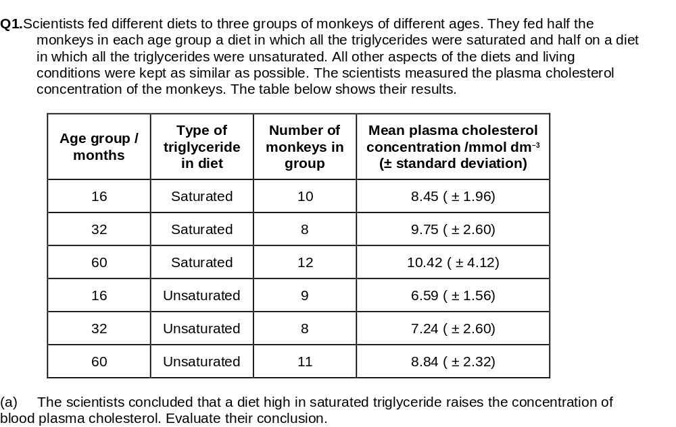
Remember the work we did about data at the end of the exchange booklet!

Slide 14
M1.(a) Diet including saturated fats leads to higher plasma cholesterol concentrations;
Higher in all age groups;
But sample size is very small;
Standard deviations overlap / suggest wide variation;
3 max

