Slide 1
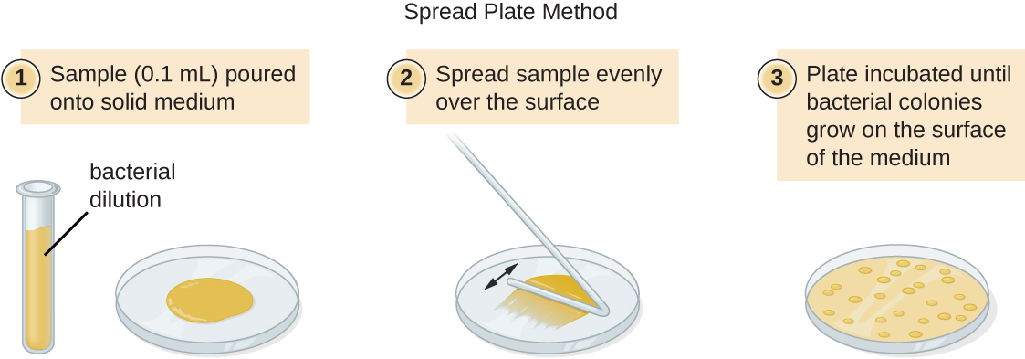
Each colony represents 1 bacteria that was present in the original solution

Slide 2
In reality there would be too many bacteria to count so serial dilutions would have to be carried out before plating onto agar or there would be too many colonies to count

Slide 3
In the simulated data given, samples were taken from the growing bacteria culture over time, diluted, then grown on a plate.
You should average the three plate counts given, then calculate the number of cells that were in the actual sample based on the dilution factor given.
If the dilution factor is 10⁴. That means that for each cell counted on the plate, there were 10⁴ or 10,000 living cells in the culture.

Slide 4
If the dilution factor is 10⁴. That means that for each cell counted on the plate, there were 10⁴ or 10,000 living cells in the culture.
So, there were 206 x 10⁴ cells in the culture at the beginning of the experiment (when time = 0).
BUT, that number is not in scientific notation properly! In order to record this number correctly, it should be 2.06 x 10⁶.
Then convert this number into log₁₀

Slide 5
Then convert this number into log₁₀
Log scales allow us to display a very large number range of the same graph scale – it would be impossible to try to plot 1, 1000, 20million on the same graph axis but converting into logs will allow us to do this
1
2
3
4
5
Log₁₀ scale
10
100
1 000
10 000
100 000
Number scale

Slide 6
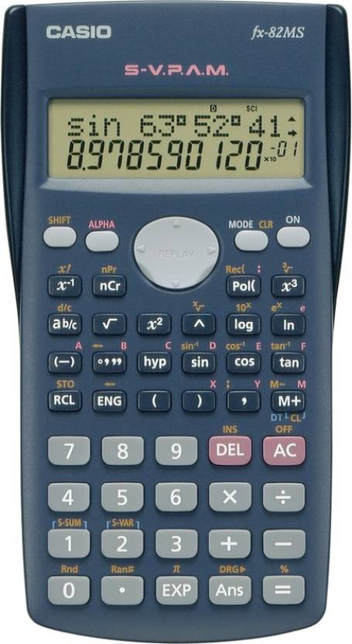
How do we calculate logs using a calculator??
First press the log₁₀ button on your calculator
Then type in the number you want to convert into log10
The press the equals button

Slide 7
Practise calculating logs of the very large numbers of bacteria in the example given in your pack
NOTE 3 repeats were carried out, the commas separate the results from the three experiments
Time (minutes) | Dilution Factor | Plate Colony Counts | Mean Pate Count | Number of cells in undiluted culture | Number of cells (log₁₀)
0 | 10⁴ | 200,205,213
15 | 10⁴ | 195,215,200
30 | 10⁴ | 192,203,214
45 | 10⁴ | 270,255,266
60 | 10⁵ | 42,37,40
90 | 10⁵ | 80,83,78
120 | 10⁵ | 175,168,185
150 | 10⁶ | 42,32,37
210 | 10⁶ | 50,55,53
270 | 10⁶ | 54,49,57
330 | 10⁶ | 51,55,48
390 | 10⁵ | 260,253,249
420 | 10⁵ | 180,176,183

Slide 8
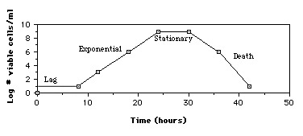
Sometimes you can be given a graph plotted on a log scale and you need to be able to convert the log10 number back into an actual number

Slide 9
First press the shift button on your calculator
Then press the log/10^{x} button
Then type the log₁₀ number on the graph
Finally press the equals button

