Slide 1
What does my additional 4-6 hours look like?
Tick it | Timing & activity | When?
 | 15mins – Go through lesson notes making sure you UNDERSTAND the work, organise file. | Daily
 | 15mins- Write out all specific new terms and definitions | Daily
 | 1hr- Make revision resources for your learning style. | Weekly
 | 1hr- Practicing exam questions using revision materials, Self mark exam questions adding missed marks to your revision resource | Weekly
 | 30mins- Complete and go through homework that has been returned adding corrections to revision/class notes. | Weekly
 | 30mins- Reading around the syllabus. (e.g. BBC website, New scientist, IFLScience website, institute for Biology, Big picture website, TED talks) | Weekly
 | 1hr- Go through revision notes to consolidate your learning. | Monthly

Slide 2
What does my additional 4-6 hours look like?
Other suggestions:
Peer to Peer- Meeting with other members of the group to practice exam questions/revision techniques
Use examiners report- If you are doing past paper also download examiners report to identify most common student mistakes, add these to your revision materials
Researching beyond the syllabus- Your 25 marks essay and universities will expect you to have read beyond the syllabus using books, articles, magazines etc.

Slide 3

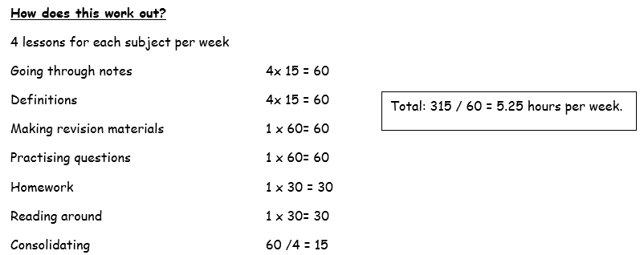

Slide 4
4.40 hours teaching
5.25 hours additional learning
------
10 hours 05 mins per subject per week
10.05 x 3 subjects = 30 hours 15 mins lesson time + additional learning for all subjects
Average working week in a job = 37 hours 30 mins (with doesn’t include lunch breaks)
College timetable = 28 hours potential hours.
So, if you use your college time effectively you will only need to do ~ 2-3 hours at home and still have lunch everyday with friends.

