Slide 1



Health & Social Care
Standards & Expectations
How do these relate to employability skills?

Slide 2
Employability Skills
What are Employability Skills?
Capabilities or competencies: aptitude, attitude and behaviour.

Slide 3

Employability Capabilities or Competencies:
Aptitude, Attitude and Behaviour.
Personal attributes
A positive attitude: a ‘can do’ approach,
Good work ethic and willingness to learn
Good personal presentation
Honesty and integrity
Reliability: Attendance ,Timekeeping, Time management & Personal organisation
Team working, collaboration and co-operation
Flexibility
Skills
Communication – oral and written
Numeracy
Computer literacy/IT skills.

Slide 4
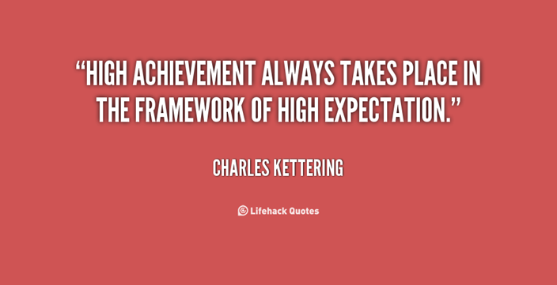

Standards & Expectations?
Standards are an agreed way of doing things. They provide a consistent, clear understanding of what is expected
Expectations are defined as believing that something should be a certain way.
So in the H & Sc department and the wider college it is conduct that is expected from you as a Carmel student or looked for in your behaviour to help you to:
  Achieve your full potential and
  To develop key employability skills

Slide 5
Standards & Expectations in the workplace?
In many organisations, employees must meet standards of professional behaviour and conduct as a condition of employment.
These standards help an organisation create a respectful working environment for everyone.
If you learn the standards that govern your workplace, you can ensure that your behaviour is acceptable and prepare to succeed in your job.
Acceptable behaviour is also required for acceptance into the workplace culture

Slide 6
Codes of Conduct
Organisations provide a code of conduct to explain which behaviours are and are not permitted by employees.
In addition, employees can be required to acknowledge this code by signing an agreement upon employment.
Employees who violate the standards face consequences through a standard policy, such as a progressive discipline system, which has grave consequences for the most serious violations.
Also, employees may get a warning for the first occurrence of a less-serious violation, but they would get a more severe consequence for another occurrence of the same behaviour.
Progressive discipline gives employees a chance to change their behaviour and continue employment.

Slide 7
Activity
In your small group. Discuss the kind of Standards and Expectations that you think your tutors look for as a Health & Social Care student? Look at the points in your learner agreement to get you started.
Record & summarise points on the flip chart paper.
Feedback to the whole group and discuss how the identified H & Sc standards & expectations relate to employability skills.

Slide 8
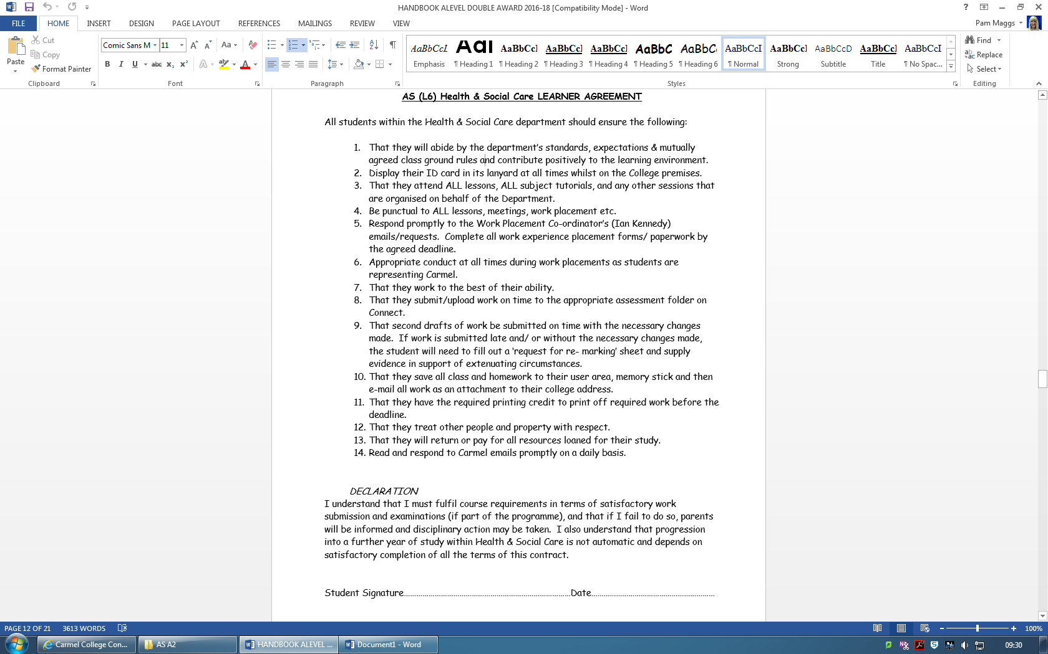

Slide 9
Health & Social Care Standards & Expectations.
How do these relate to employability skills?

Slide 10
Employability skills & the Health & Social Care Learner agreement
The points in your learner agreement relate specifically to developing some of your employability skills.
This is your Departmental work contract – like an employment contract that you would have to sign in the world of work.
If you demonstrating a willingness to adhere to the department’s Learner Agreement, Standards & Expectations and mutually agreed Ground Rules will help ensure that you have a positive reference written about your skills and personal attributes.
These references are provided by the staff to support your applications for Employment, Apprenticeships, Voluntary work Employment etc.

Slide 11
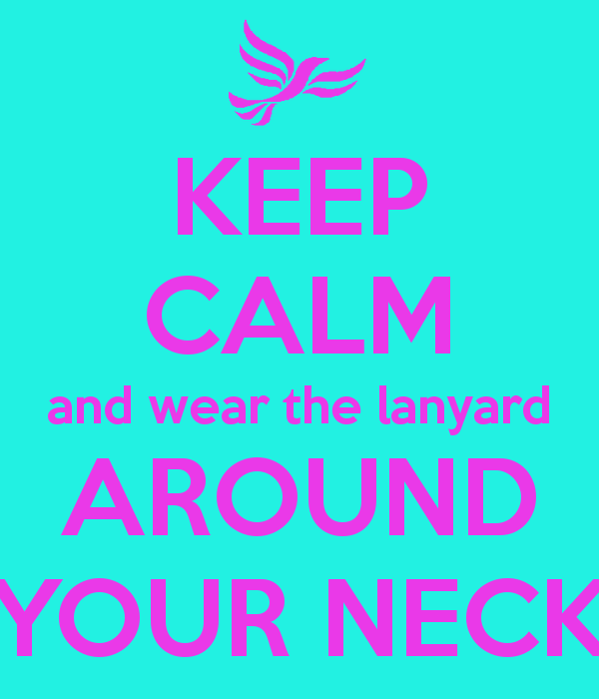
Wear your lanyard

Slide 12
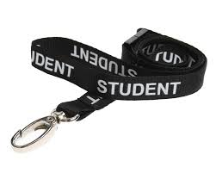
Wearing a lanyard
A lanyard is a cord or strap worn around the neck, to clearly display a person’s identification.
Many organisations/ employers expect their staff or visitors to wear a lanyard. Can you name/identify any organisations?
It is therefore an employability skill.

Slide 13

Why do students, staff & visitors wear lanyards?
Every student, member of staff and visitor to the Carmel College has to wear a lanyard and ID. This is for security reasons.
The College treats it as a priority that Carmel is a safe and secure learning community at all times.
This is for the safety of our students and staff.
Wearing your Student
ID on a Lanyard around
your neck whilst on
the College site is an
expectation.

Slide 14

Excellent Attendance & Punctuality
Attendance and punctuality are key qualities valued by employers and are therefore essential to effective employment.
The Health & Sc department recognises
  that excellent attendance & punctuality is a key factor in maximising the learning experience and in developing your employability skills.
We are, therefore, committed to actively promoting, supporting and encouraging full attendance and punctuality for all our students in preparation for employment.

Slide 15

Excellent Attendance.
You are expected to attend every lesson.
If you miss a lesson it is your responsibility to catch up on any missed work and ensure you are aware of any deadlines for work.
Attendance is monitored and poor attendance will be progressed down the disciplinary procedure as it would in the world of work.

Slide 16
Be Punctual
You are expected to arrive to lessons on time.
If you are late – you are expected to apologise and give a reason for your lateness.
Punctuality is also monitored and poor punctuality will be progressed down the disciplinary procedure as it would in the world of work.

Slide 17


Positive attitude & a willingness to learn…be prepared to learn
- On arrival in the Classroom
Wear your student ID lanyard
Outdoor clothing removed
Mobile phone off
Headphones removed
No food or drink other than water
X
X

Slide 18

At the start of the lesson
You are expected to be ready to learn & start work promptly.
Resources ready – pens & paper.
File of notes out – starter activity or reading over notes whilst the register is done.
Quiet and on task from the start.

Slide 19


During the lesson…
Team working, collaboration and co-cooperation
There is no excuse for rudeness, disrespect or insolence towards others.
You are expected to work sensibly with your classmates - do not distract or annoy them.
Disrupting the learning of others is simply unacceptable.
Respect & do not mistreat the resources available
to support your learning.

Slide 20
The end of the lesson.
You should not begin to pack away until you are told to do so.
Ensure you return resources to their correct place.
Leave the room as you would wish to find it.
Leave the lesson only when instructed to do so.

Slide 21
Time management & Personal organisation
Being prepared for lessons- organised file; pen; paper; handouts; books etc.
Record deadlines, meeting dates & times, tutorials etc in your College diary.
Meet work Submission deadlines.
Work placement paperwork completed by agreed deadlines
Check, read & respond to your Carmel emails on a daily basis.
Turn up to any organised meetings or tutorials with your tutors.
Reliability is a key qualities valued by employers and are therefore essential to effective employment.

Slide 22


Activity three: Team working, collaboration and co-cooperation
Mutually Agreed Ground Rules for your class – ownership!
Typed and displayed

