Slide 1


Skills For Learning

Slide 2
Numeracy
Literacy
Information & Communication Technology
Research skills
Feedback & reflection
Skills for Learning

Slide 3

Why are skills for learning important?
As a H&SC Practitioner
As a student
To develop & maintain knowledge.
To develop interpersonal /communication skills.
To develop practical skills.
To get assignments done.
To develop knowledge.
To develop interpersonal /communication skills.
To develop practical skills.
To develop academic skills.

Slide 4
Skills to support Study / get assignments done.
Skills that you have developed in school.
Health & Social Care induction (study skills pack)
Sessions within the personal tutor programme
Health & Social Care lessons.

Slide 5
Skills to support study / get assignments done.
Planning
Research
Evidencing the research undertaken (referencing & bibliography)
Writing & Presentation Skills
Functional skills – English, ICT
Proof reading

Slide 6
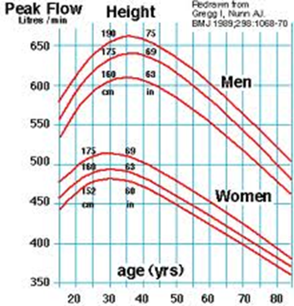
Why are Numeracy Skills important?
As a H&SC Practitioner
As a student
Ability to use numbers in a practical situation is vital for care work.
For example calculating drugs.
To maintain the skills you have developed and apply these to practical situations.

Slide 7
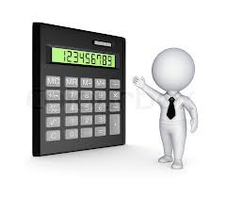
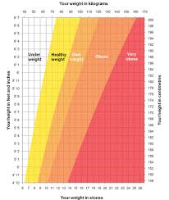
Numeracy Skills
Addition
Subtraction
Multiplication
Mental Arithmetic
Presenting data eg graphs

Slide 8

Why are Literacy Skills important?
As a H&SC Practitioner
As a student
Written communication is an important way of sharing information.
For example writing patient records. ( In a court of law if you didn’t record it you didn’t do it!!)
Prescribing treatments and drugs.
To maintain and improve the skills you have already developed.

Slide 9

Literacy Skills
Composing documents
Writing emails
Planning essays
Spelling & grammar

Slide 10

Why are ICT Skills important?
As a H&SC Practitioner
As a student
Communication
Recordkeeping – most patient records are kept on computer.
Keeping up to date through e journals.- professional are expected to know the latest information.
To maintain and improve the skills you have already developed.
To gather information for your assignments.
To present your work for assessment.

Slide 11

ICT Skills
Word processing documents
Writing emails
Using websites to find information.

Slide 12
Why are Research skills learning important?
As a H&SC Practitioner
As a student
To develop & maintain knowledge.
To develop practical skills.
Evidence based practice - keeping up with new ways of working. E.g. new techniques in surgery.
To get assignments done.
To develop knowledge.
To develop academic skills.

Slide 13
Research Skills
KEY TO SUCCESS in all units
Used in classroom activities and in preparing your assignments.
Library skills
Internet searches – google books google scholar
Remember when you gather information you need to record where you got the information from
( Referencing & Bibliography). Failure to
acknowledge sources of information is
PLAGIARISM.
You should also check the Validity & Reliability of
the sources you are using.

Slide 14
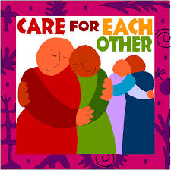
Why is using Reflection & Feedback skills important?
As a H&SC Practitioner
As a student
Reflection on your current practice improves your skills and the care you give.
Feedback from colleagues managers and services users is an important part of improving your skills.
To develop the skills you will need to work in Health & Social Care.

Slide 15
Reflection & Feedback
Some opportunities for Reflection
New experiences.
Completion of a piece of work.
Results & Assessment feedback
Group work in class
Experience & events in work placement.
Feedback from service users eg thank you/ thank you cards.
Feedback from teachers
Feedback from mentors/ supervisor in work placement.
College reviews

