Slide 1
Communication in Health & Social Care.

Slide 2
Why is Communication important?
Good caring is the art of getting to understand people –not acting upon unchecked assumptions.
In order to provide this care health & social care workers need to understand and use a variety of communication skills, interacting with a variety of people not just the client.
Therefore understanding how people communicate is a key part of caring.

Slide 3



Forms of communication
Spoken
Unspoken
Text messaging
Artwork- painting photographs, sculpture
Information technology
Symbols
Music & Drama
Written communication
Braille
Signed languages

Slide 4
What is the meaning of interpersonal interaction?
Interpersonal Interaction DEFINITION
Interpersonal interaction is a communication process that involves the exchange of information, feelings and meaning by means of verbal and non-verbal messages, between two or more persons

Slide 5
Types of Interpersonal Interaction (Communication)
Verbal
Non verbal
Usually means speaking and listening.
It concerns words or substitutes for words
Paralanguage
Facial expression
Gestures
Proximity
Eye contact
Posture
Touch

Slide 6
Think about it.
How might the following affect communication?
First language
Dialect
Jargon
Slang
http://www.youtube.com/watch?v=Pcdg6l7FcqE&feature=related

Slide 7
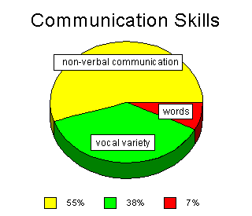
It’s not necessarily what you say but the way that you say it.

Slide 8
Reflective Listening/ Active listening
We can usually read emotions from a persons body language.
To understand someone’s thoughts we need good listening skills.
Hearing the words
Thinking about what the words mean
Thinking about how to reply

Slide 9
The Communication Cycle
Expressing our thoughts
Watching the others non verbal response
Interpreting the person’s body language
Listening to their response to what we said
Making sense of their response
When we communicate with others we become involved in expressing our thought’s and interpreting others understanding of what we are communicating, therefore it is a two way process.

