Slide 1
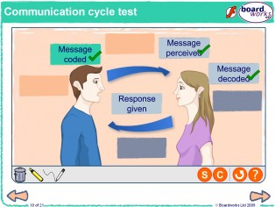
The Communication Cycle
&
Theories of Communication

Slide 2
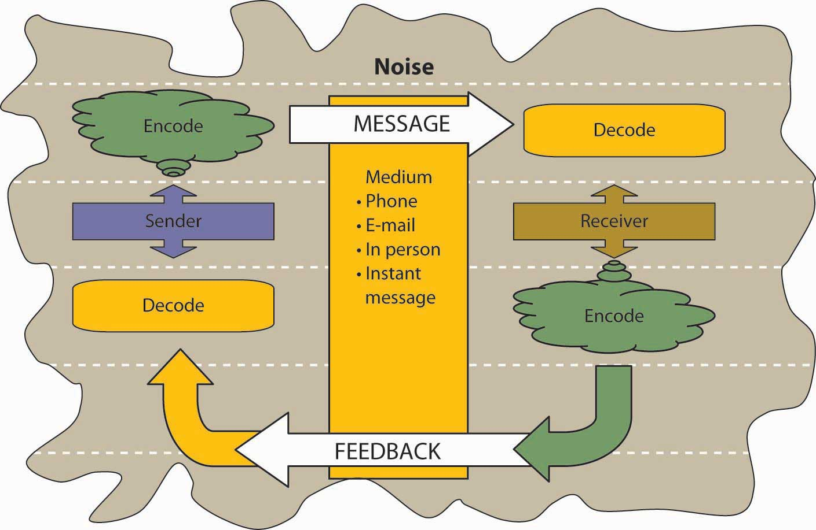
The Communication Cycle
Communication is an essential part of all of our lives.
There are many different methods of communication. This ranges from a note stuck on a notice board, to video conferencing and phoning.
The ‘communication cycle’ is a structure that was thought up about how we communicate.
It refers to the process of sending and receiving messages.

Slide 3
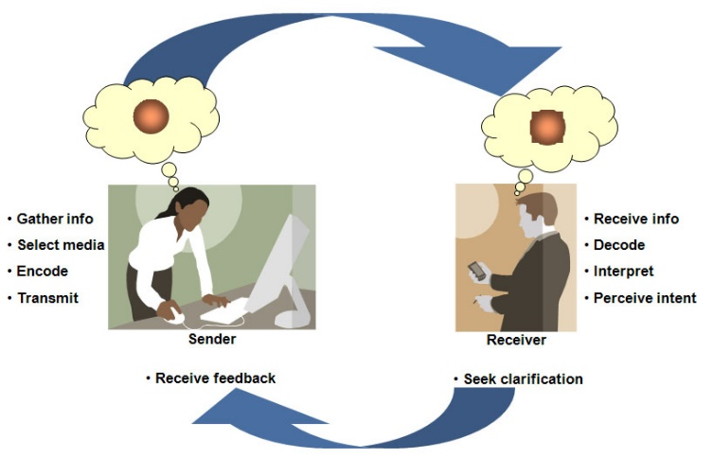
The Communication Cycle
Communication is based upon being able to engage with others and make contact with them at the same time ensuring that messages are being understood.
It is a continuous process that all people use regardless of the type of communication being used.
This is why it is known as the communication cycle.

Slide 4
The Communication Cycle
Most important communication in care work involves a cycle of building understanding using an active process of reflecting on, and checking out, what the other person is trying to communicate.
Good communication involves the process of ‘checking’, ‘understanding’, using ‘reflective’ or ‘active listening’.
To be effective it involves:
Hearing what the other person says
Watching the other persons non verbal communication
Having emotional feeling
Beginning to understand the other person
Sending a message back to the other person

Slide 5
The Communication Cycle
The communication cycle is the way in which a person communicates with another person.
There are 6 stages to it which ensures a message is clearly given across to someone:
1) Ideas occur
2) Message coded
3) Message sent
4) Message received
5) Message Decoded
6) Message understood

Slide 6

Theories of Communication
A theory is a set of ideas that can be used to understand, explain and make predictions about something. (oxford dictionary)
Theories of communication provide ways of analysing communication between people and give care practitioners an insight into what works and why.
2 main theories Argyle & Tuckman however there are others that help to explain peoples behaviour in H&SC settings.
Reading & Note Taking:
Stretch & Whitehouse pages 18-19
Rasheed pages 3-4, 13-14
Walsh pages 26-35

Slide 7
Theories of Communication: Argyle
Michael Argyle (1925–2002) was a social psychologist who researched and developed theories about human communication and interpersonal interaction.
He focused on both verbal and non-verbal communication, carrying out experimental research to test and develop his theoretical ideas (see Argyle, 1967, 1969 and 1975).
Social psychologist = a psychologist who studies the relations between people and groups
Experimental research = research that investigates cause and effect relationships

Slide 8
Theories of Communication: Argyle
Argyle’s ‘communication cycle’ theory sets out to understand, explain and predict how communication occurs between people in one-to-one situations.
Human communication is essentially a two-way process that involves people sending, receiving and responding to each other’s verbal and non-verbal messages. Argyle’s (1967)
Argyle (1967), said that interpersonal communication was a skill that had to be learned.
He suggested that you have to learn to decode the messages sent and constantly adapt your behaviour to be effective in communicating with someone.
Ref: Argyle (1967) The Psychology of Interpersonal Behaviour.

Slide 9
Is the communication cycle working?
GP: How can I help you today?
Patient: I’ve got this pain that goes down my leg.
GP: What sort of pain is it ?
Patient: A shooting pain that goes right down my leg.
Doctor: So the pain is in your leg?
Patient: No, it is in my back but sometimes goes right down my leg.
GP: It starts in your back and shoots down your leg?
Patient: That’s right.
GP: I think you have sciatica. Let me examine you......

Slide 10
Tuckman’s group formation theory
Bruce Tuckman (1965) outlined a model of group development based around a number of stages, or a sequence, of group activity.
Tuckman’s (1965) theory suggests that groups must go through these stages to be effective and that the pattern of communication in each of the four stages is different:
                1) Forming
                2) Storming
                3) Norming
                4) Performing

Slide 11
Tuckman’s group formation theory
1) Forming :
  Involves group members coming together and asking basic questions about the purpose and aims of the group.
  Each member’s role within it and commitment to it.
  In this first stage of group development, members tend to feel quite anxious, often prioritise their own interests and may feel ‘disorientated’ in their interactions with others.
  A leader usually emerges in this early stage.

Slide 12
Tuckman’s group formation theory
2) Storming,
The second stage, is a period of conflict within the group.
Members may argue over the purpose of the group, may contest its aims and sometimes resist the authority and role of the leader.
In this stage, power and control are the main issues.
Eventually, the purpose of the group and the roles within it become clearer as power and control battles are won and lost.
Without tolerance and patience at this stage, the team will fail.
Co-operation between members should begin to develop towards the end of this phase.

Slide 13
Tuckman’s group formation theory
3) Norming
Is the stage when the group’s identity develops.
A strong set of shared values, norms of behaviour and a group ‘culture’ emerge.
The group arrives at one goal and agrees a shared plan to achieve it.
The group becomes more cohesive and group members tend to work together to resolve conflicts.

Slide 14
Tuckman’s group formation theory
4) Performing
Is the stage when the group finally matures and gets down to working effectively.
Members tend to focus more on the overall goal rather than on relationships between themselves.
Relationships have, by this stage, become more comfortable and are based on trust and mutual support.

Slide 15
Useful article
http://www.buzzle.com/articles/communication-cycle.html

Slide 16
P2: Grading tips
How does communication theory help to explain effective communication in health and social care contexts?
Consider
One to one and group interactions
Formal and informal communication
Different types of communication
Different forms of interpersonal interaction
Read pages p13-14 in the Rasheed textbook for other theories which also link to communication in Health & Social Care. Including some of these will show the reader you have read around the subject.

