Slide 1
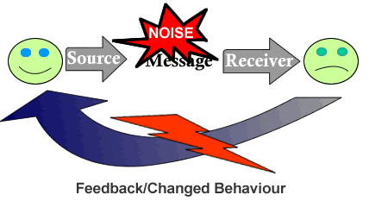
Factors that may influence communication and interpersonal interaction in Health & Social Care settings.

Slide 2
At the end of this session you should be able to:
Identify the environmental factors that may affect communication.
Identify the barriers to interpersonal communication
Explain a range of factors that can affect people’s ability to communicate effectively
To begin to identify strategies to overcame the factors and barriers that inhibit communication.

Slide 3
Please read and complete the following instruction.
Please write your name.
Can you tell me how easy you find it to read this instruction?
What is making it difficult?
Is it the font? Is it the lighting?

Slide 4
Answer the question below….
صبح لڑکوں اور لڑکیوں کو ہے. براہ کرم اور کڑیو خاموش ہے. اج ہم کام شروع یونٹ 1 3 ہے. مجھے بتا سکتے ہیں کہ کیا یہ کسی ہے؟
What is preventing you from reading the instructions on the board?

Slide 5
Communication can be blocked if
A person cannot see, hear or receive the message
A person cannot make sense of the message
A person misunderstands the message
Effective communication depends on us identifying any factors that may create potential barriers that may block understanding.

Slide 6
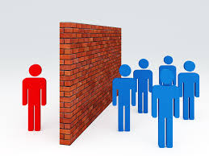
What is a barrier?
A barrier is something that blocks things and stops them getting through.

Slide 7

Activity 1
On a sheet of paper please make a list of the things that you think may affect the effectiveness of interpersonal communication when you are having a conversation with another person…
2 minutes!

Slide 8
Factors that affect communication
Jargon, slang and acronyms
Disability
Setting
Cultural differences
Seating Arrangements
Dialect
Emotional distress
Health Problems
Language Differences
Time available
Poor Lighting
Sensory deprivation
Noise

Slide 9
We can divide these into two groups.
Environmental Factors
Other Factors
Jargon, slang and acronyms
Disability
Noise
Setting
Cultural differences
Sensory deprivation
Poor Lighting
Health Problems
Language Differences
Time available
Seating Arrangements
Dialect
Emotional distress / anxiety

Slide 10
Environmental Factors
The environment refers to the physical place in which communication takes place.
Aspects of the physical environment can affect the quality of communication between people and may even deter individuals from making an effort to communicate with one another in the first place.

Slide 11
Some Environmental Factors/Problems
Factor | Possible Effect
Time | Limited time or perceived limited time may prevent a person effectively communicating their needs.
Noise | Affects our ability to listen and concentrate.
Comfort | Environments that are too hot or cold cause discomfort and affect our concentration.
Lighting | Poor lighting can affect our ability to notice nonverbal communication and could reduce a hearing-impaired person’s ability to lip read.
Space / lack of privacy | Discourages people from expressing their feelings and problems.
Seating arrangements | May be difficult to communicate if you can’t see the other person clearly or furniture may create a barrier.

Slide 12

Activity 2 – 20 minutes
Read & make a set of notes on the environmental factors using
Walsh M (2011) BTEC National Health & Social Care level 3. Harper Collins. London pages36 -39.
These notes will assist you when completing the environmental part of Assignment 3 – you will still need to do some extra reading to find other sources of information

Slide 13
Extension Activity – check your learning.
Identify five different environmental factors that can influence the effectiveness of communication.
Describe the possible impact of poor lighting on communication and interaction in a residential care setting.
Identify three sources of noise that could impact on communication within a setting.
What is communal space and why is it important to have this in a residential care setting?
How can seating in a communal room be used to promote more effective group interaction?

Slide 14


Activity 3 - Group work
Dr Baldwin
Read the case study.
Identify the potential environmental barriers to effective communication.
Produce some recommendations for Dr Baldwin that would enable him to improve the interpersonal interactions with his patients.
This will assist you when completing Assignment 3 – you will still need to do some extra reading to find other sources of information

Slide 15

Activity 4 – Paired Research
Task
Research & discuss the factor you have
been given. - Type of setting, Space available, Noise levels, Quality of lighting, Seating Arrangements, Time available.
2. Complete the table on the document
Student paired work on Connect – email
to Ann.
3. Be ready to display your table to the
class and present back your finding.

Slide 16
Barriers to communication
Barriers prevent the message being passed effectively.
Prevent or interfere with the person’s ability to send a ‘message’
Prevent or interfere with the person’s ability to receive a ‘message’.
Prevent or interfere with the person’s ability to understand a ‘message’.

Slide 17

What factors other than environmental factors may affect a persons ability to send a message?
Language - English may be a second or even third language for some people and may not be spoken or understood at all by others.
Sensory Impairment -Visual and hearing impairment can act as a barrier to effective communication. Conditions such as cerebral palsy, Down’s syndrome and autism also tend to limit an individual’s ability to communicate verbally and to interpret other people’s non-verbal communication.

Slide 18

What factors may affect a persons ability to understand message that is received?
Language difficulties – if the message is in their second language translation of the meaning may be difficult
Dialect
Jargon, Slang or the use of acronyms
The type of communication – difficult, sensitive.
Emotional distress - When a person is anxious, angry, or upset, they may find it difficult to communicate and their own communication may be misunderstood by others for example as aggression.

Slide 19
What factors may cause the understanding of the message to be distorted?
State of Health – pain, medication, anxiety may also affect an individual’s ability to speak, concentrate or use non-verbal methods of communicating.
Emotional Distress
Drugs & Alcohol
Cultural Variations

Slide 20
Communication Barriers
Type of barrier | Factors that may result in this
Communication is not sent or received | Environmental Sensory Impairments and Disability Language Difficulties
Communication is received but not understood | Dialect Jargon, slang and acronyms Language difficulties
Understanding is distorted | Aggression Cultural variations / differences Dialect Environmental - noise Jargon, slang & acronyms Emotional & health problems Drugs & alcohol use

Slide 21

Individual activity 5 -
Using Walsh M (2011) BTEC National Health & Social Care level 3. Harper Collins. London
Read pages 40 -48 & make a set of notes on
the barriers to effective communication.
2. Undertake the case study on page 43 and be
ready to feed back your ideas to the class
These notes will assist you when completing the barriers part of Assignment 3 – you will still need to do some extra reading to find other sources of information

Slide 22
Extension Activity- check your understanding.
Describe using a practical example how acare professionals values, beliefs or assumptions could become a barrier to effective communication.
Explain how communication barriers associated with cultural differences could be overcome by a care worker.
How can personality & self esteem problems prevent effective communication?
Explain how aggression can act as a barrier to effective communication in a care setting.

Slide 23
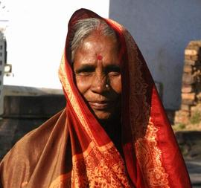
Activity 6 - Group work
Read the case study – Mrs Singh.
Identify the potential barriers to effective communication.
Be ready to discuss the ideas of the group with the rest of the class.

Slide 24

Activity 6 - Individual
Complete the table on the back of the case study.
This will be useful when completing your P3 & P4 assignment.
These notes will assist you when completing the environmental part of Assignment 3 – you will still need to do some extra reading to find other sources of information

Slide 25
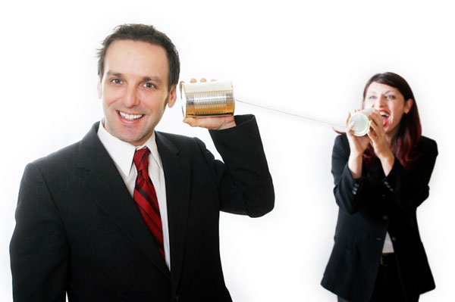
Communications Skills - The Importance of Removing Barriers
Communication barriers can pop-up at every stage of the communication process and have the potential to create misunderstanding and confusion.
To be an effective communicator and to get your point across without misunderstanding and confusion.
Your goal should be to lessen the frequency of these barriers at each stage of this process with clear, concise, accurate, well-planned communications.

Slide 26
Factors which inhibit Communication
Inappropriate non verbal communication (looking bored)
Emotional barriers
Inappropriate setting
Inappropriate questioning
( closed Questions)
Lack of a communication cycle
Hearing but not actively listening
Aggressive or withdrawn behaviour
Inappropriate verbal behavior (not knowing what to say)
Making assumptions
Lack of cultural understanding
Language barriers
Lack of confidentiality

Slide 27

Communications Skills - The Importance of Removing Barriers
Communication can become blocked if individual differences are not understood.
In order to minimise communication barriers it is important to learn as much as possible about others.

