Slide 1

Strategies to overcome the factors that inhibit effective communication

Slide 2
Focus of the power point & the activities.
To identify strategies to overcame the factors and barriers that inhibit communication.
To explain the strategies to overcome the factors and barriers that inhibit effective communication.

Slide 3
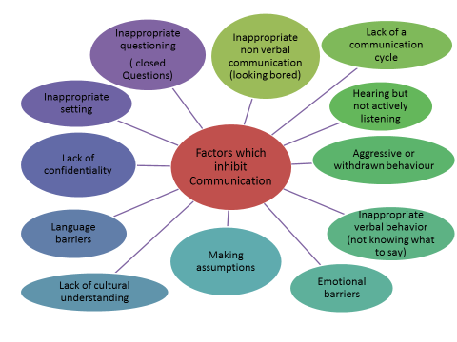
The most important strategy is staff training
Health & social care users are often in an unfamiliar and stressful situation and may not behave as they usually would – anxiety, fear, aggression, depression. Also illness may make them unable to interact effectively.
Practitioners need to make sure that effective communication takes place.
Practitioners need to learn about all aspects of effective communication & the barriers, practice and reflect upon these skills.
They will also need to learn to the skills associated with assertion and to defuse aggression
Tip: I would discuss the above when writing my introduction to the barriers to interpersonal interaction

Slide 4

Individual Activity
Make a set of notes using pages 30 -334 in the Stretch and Whitehouse book & pages 15-16 in the Rasheed textbook about
Assertiveness
Defusing aggression
Tip: Again, I would include some explanation of these when writing my introduction to the barriers to interpersonal interaction

Slide 5
In order to care for and communicate with people effectively practitioners need to:
Build an understanding of the needs of the people they are caring for, including their communication needs & preferences and using aids to communication if they are needed.
Being aware of the persons cultural variation.
Avoid making assumptions
Being aware of service users rights, -dignity, confidentiality, privacy etc.

Slide 6
Individual activity - Strategies to overcome barriers to communication
Complete the table using the following:
Your previous notes from the Walsh textbook on barriers to effective communication.
Tables 1.7 & 1.8 in the Stretch & Whitehouse book pages 38&39 will also assist you
These notes will assist you when completing the strategies part of Assignment 3 – you will still need to do some extra reading to find other sources of information

