Slide 1
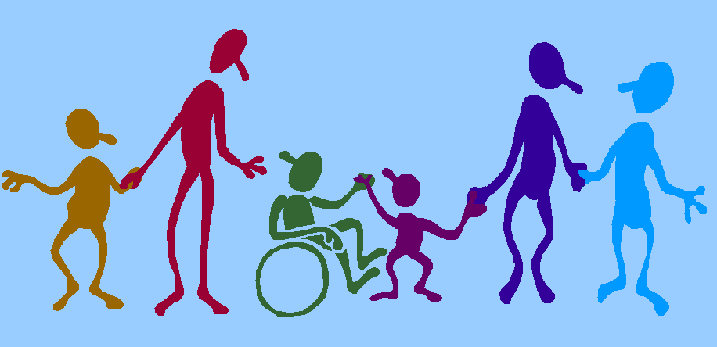
Individual Rights & the Role of Health & Social Care Practitioners

Slide 2


Individual Rights
Everyone has rights as a human being as set out in the Human Rights Act which should be protected and respected in Health & Social Care settings.

Slide 3

Individual rights
To be respected and treated as an individual.
To be treated equally & not be discriminated against.
To be treated in a dignified way.
To be cared for in a way that meets their needs.
To exercise personal choice
A right to privacy.
To be safe and protected from danger and harm.
To be able to communicate in their preferred method.
To be allowed access to information about themselves.

Slide 4

The Role of Health & Social Care Workers
All health and social care practitioners must work within the law of the land and all relevant professional guidance and standards.
Practitioners are expected to promote equality and individuals rights within their work.
Treating people well has a beneficial effect on both their physical & psychological health

Slide 5

Care workers should ‘act in the best interest of the service user’ and put the service user at the heart of service provision.

Slide 6
H&SC workers must
Value service users as individuals
Treat people in a way we would like to be treated ourselves
Show they ‘value’ each individual by following three key principles
Maintain confidentiality
Fostering Equality & Diversity
Promoting rights and responsibilities

Slide 7
What forms the basis of good care?

Slide 8

Dignity in Care Videos
Watch the following series of several short videos. What values are being discussed. How are rights promoted?
http://www.cetl.org.uk/learning/dignity_in_care_videos.html

Slide 9

Case Study
Read the case study and identify which care values are not being observed.
What should be done differently?
What would you do to challenge the situation if you were the manager?
How would this treatment affect Mr Newman if it didn’t change?
How would you change the behaviour of the staff to empower the people they are looking after?

Slide 10

Case Study
Shelia works in a care home for older people with dementia. She sees Carla , another assistant, dress Mr Newman. Carla chooses that clothes he should wear without consulting Mr Newman.
After he is dressed, Mr Newman comes down for his breakfast. He is a strict orthodox Jew. The new care assistant, Tim is giving Mr Newman his breakfast of bacon and eggs and has not been told of Mr Newman's dietary requirements.
Mr Newman later requests to visit the synagogue and this is denied.
Later Carla, Tim and Shelia write up their notes from the shift. Shelia completes her notes and puts them away in the filing cabinet before leaving. Carla and Tim forget to put their notes away and are still talking about the shift and the demands of Mr Newman when they go for a drink after work.

