Slide 1
Equality, Diversity & Rights in Health & Social Care
Introducing Equality, Diversity & Rights

Slide 2
Introducing Unit 2
The unit introduction and highlight/ underline any words you are unsure of.
Note down your answers to the following:
1. What are you expected to know when you have completed this work?
2. Why are we interested in diversity and the promotion of equality and rights in Health & Social Care?

Slide 3
How will you be assessed?
You will complete a number of assignments designed to cover all the criteria on the assessment grid.
If you achieve all the criteria on the grid you will achieve a DISTINCTION.
For each assignment you have one resubmission opportunity

Slide 4
Starter Activity
Using the whiteboard – make a list of the following:
Your favourite foods.
Your favourite films.
The music you like.
The languages you speak.
The nationalities of your family and close friends.

Slide 5
What have we learned from the starter activity and our discussion?
We are all different - Diverse
What is Diversity?
Basically diversity means differences and people’s differences can be many and varied

Slide 6
Why are we interested in Diversity in Health & Social Care?
Diversity is a broad concept, embracing culture, belief, disability, gender, race and ethnicity as well as including overlooked and marginalised populations in society
As Health & Social Care professionals we must respect the differences between people........
We will be dealing with a very diverse Client base so must be very understanding

Slide 7
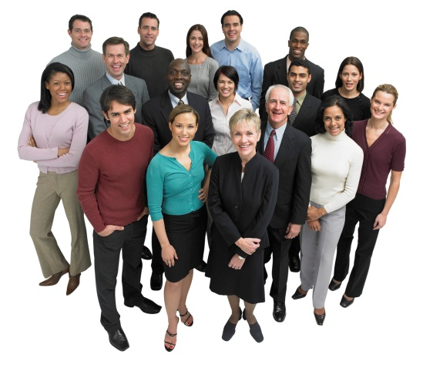

Before we look at what makes us different – What makes us similar?
Food & water
Breath
Human Needs
Same blood groups
Happiness
Human Characteristics
Sleep
Growth
& development
Shelter
Love

Slide 8

Different factors that help make us diverse or different.
Age
Disability
Lifestyle choices
Ethnicity
Hobbies
Culture
Politics
Race
Marital status
Nationality
Family structure
Gender
Values
& Beliefs
Religion
Sexual orientation

Slide 9
Our attitudes to the things that make us different varies not all of us will think the same.
Attitudes = assumptions we use to make sense of our social experience

Slide 10
Where do we get our attitudes from?
Watch this clip that shows how attitudes have changed over time.
https://www.youtube.com/watch?v=_jEM6PS_Q10
What we learn from others creates our attitudes.
Primary Socialisation – Family & Carers
Secondary Socialisation – Peer groups

Slide 11

Bandura’s Social Learning Theory
Perhaps the most influential theory of learning and development.
He suggested that people can learn behaviours by watching other people and will model their behaviour.
Bobo doll – 1961
http://www.youtube.com/watch?v=zerCK0lRjp8

Slide 12
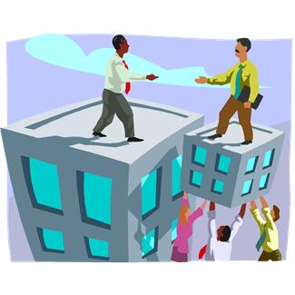
What is Equality?
Equality is being equal in terms of rights, status and opportunity.
It means that people are given equal opportunities in relation to education, employment and different services.
Equality is not about treating everyone in the same way, but recognises their needs are met in different ways.

Slide 13

What are rights?
By rights we mean human rights
These are the basic rights and freedoms to which all humans are entitled.
First defined by the Scottish philosopher John Locke (1632-1704) and by other conventions since such as the United Nation’s Declaration of Human Rights in 1948.
The Human Rights Act 1998 came into force in Britain in October 2000.

Slide 14
individual rights.
you can find information on each of these rights in Stretch & Whitehouse pages 62 -64 and Rasheed pages 28-29
The right to be respected
The right to be treated equally and not discriminated against
The right to be treated as an individual
The right to be treated in a dignified way
The right to be allowed privacy
The right to be protected from danger and harm
The right to be allowed access to information about themselves
The right to be able to communicate using their preferred methods of communication and language.
The right to be cared for in a way that meets their needs

Slide 15
Independent Activity
Using the information overview on the Human Rights Act 1998
List a person’s Human Rights as set out in law by this act.

Slide 16

Investigating the terminology used in Equality & Diversity.
Equality
Equity
Diversity
Tolerance
Rights
Opportunity
Difference
Direct discrimination
Indirect discrimination
Stereotyping
Labelling
Prejudice
Disadvantage
Beliefs & Values
Vulnerability
Abuse
Empowerment
Independence
Interdependence
Hate crime
Racism
Sexism
Ageism

Slide 17
Recap
Explain diversity
Explain what is meant by equality
What are rights?
What is a key piece of legislation as regards a persons rights?

