Slide 1

The Benefits of Diversity

Slide 2
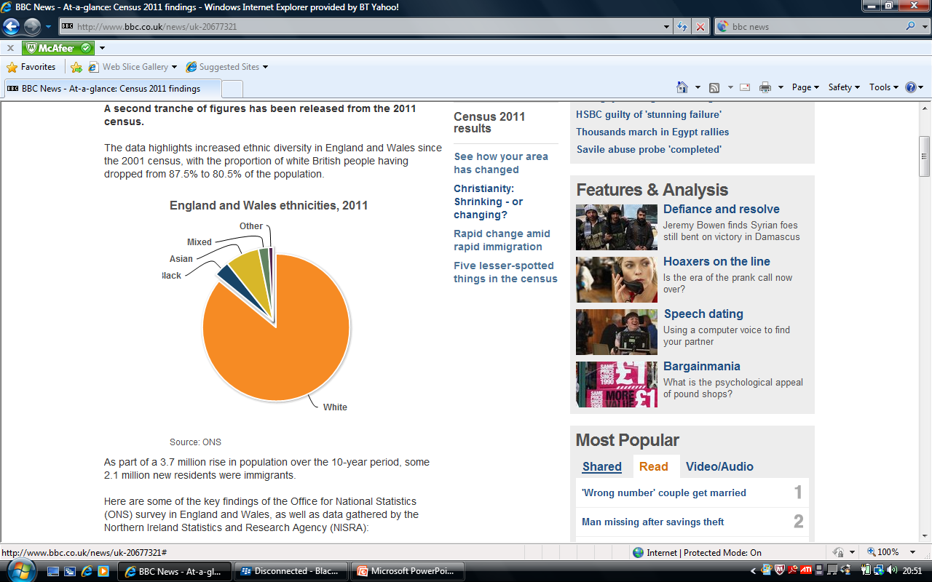
Before we consider the benefits of diversity lets look at how diverse Britain is.
“A second tranche of figures has been released from the 2011 census.
The data highlights increased ethnic diversity in England and Wales since the 2001 census, with the proportion of white British people having dropped from 87.5% to 80.5% of the population.”
BBC News 1/12/12

Slide 3
Ethnicity in Britain.
https://www.youtube.com/watch?v=GBNxUKGxV0Y
(This link includes information that may be useful and a short video clip)

Slide 4
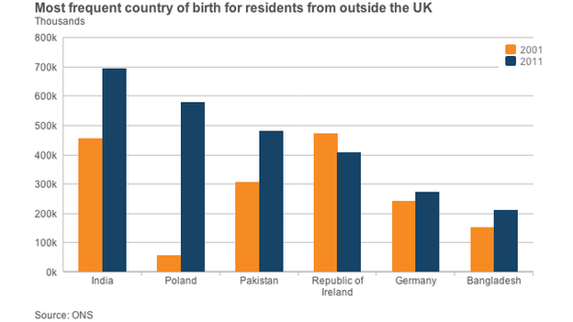

Slide 5
Diversity should benefit everyone, with people
valuing each other and experiencing a strong
bond with others from different backgrounds.
Unfortunately this is not always the case.
Spend 2 minutes discussing why this is not always the case and be ready to feed back to the rest of the class
WHY?

Slide 6
Reasons why people may not value people from other backgrounds.
Personal Attitudes & Prejudices
Lack of Knowledge/ignorance
Fear
Vulnerability
Define Vulnerability
Define Attitude
Define Prejudice

Slide 7

Individual Activity
Read Stretch & Whitehouse pages 49- 52 and Rasheed pages 22-23 making your own set of notes.

Slide 8

The Benefits of Diversity
Social & Cultural
Economic
In groups you have five minutes to come up with as many benefits of diversity as you can ... under the above headings.

Slide 9









A mix of food

Slide 10













A mix of music and dance

Slide 11











Our cultural life
British young people set the fashion trends worldwide by combining a unique mix of ethnic styles.

Slide 12


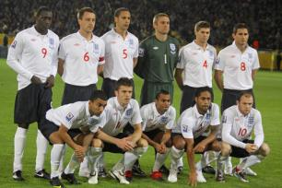
Sporting Success
Sportsmen and women from ethnic minority groups have made huge contributions to our sporting success and achieved world class status.

Slide 13

Social, Cultural & Economic Benefits
Social / Community Cohesion
Everyone value’s & circumstances are respected and the community work together
Cultural enrichment
The arts – museums,
theatres, music
Education
Language
Diet - foods
Tolerance
Economic
Sport
New Businesses
Improved performance
Employment
Knowledge & skills

Slide 14
Economic Benefits of Diversity & Immigration.
People have throughout the centuries come to Britain to work, providing both manpower and skills.
What would be the effect on the NHS if we didn’t have overseas workers?

Slide 15
The links below link to the NHS
http://www.telegraph.co.uk/health/healthnews/10376026/Number-of-foreign-nurses-coming-to-UK-doubled-in-three-years-as-NHS-poaches-workers-from-abroad.html (article)

Slide 16



Individual Activity
Using the word document available on connect – The Benefits of Diversity
Read the two articles and answer the questions
Your work should be uploaded to Connect

Slide 17

Individual Activity
Produce an A3 poster on the computer showing the benefits on diversity which could be displayed in a Health & Social Care setting. (you must include references)

