Slide 1
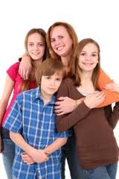
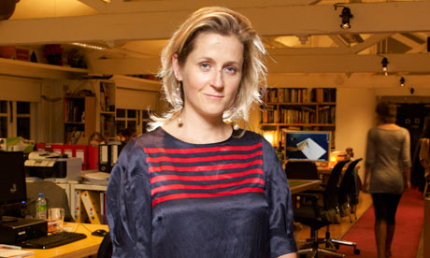
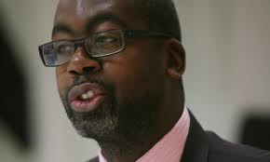
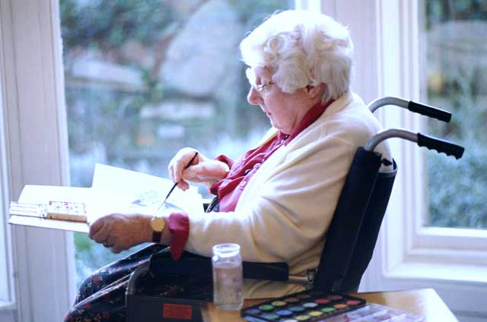
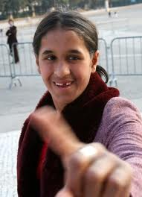
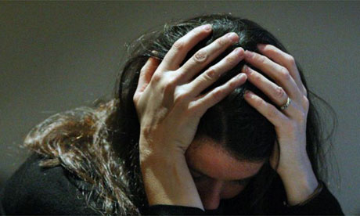
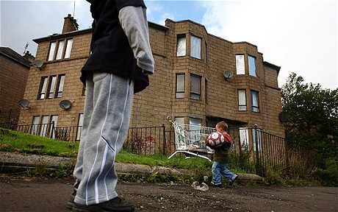
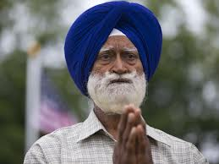
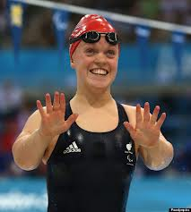
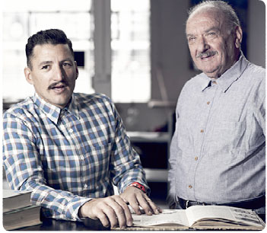
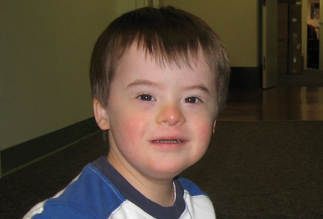

What do these people have in common?

Slide 2
Discrimination

Slide 3
They can all be discriminated against
Gender
Culture
Race
Religion
Age
Social Class
Sexuality
Family status
Health Status
Cognitive ability
Extension Activity- read/watch the following. Can you find other Articles or video’s examples?
LBGT
https://www.bbc.co.uk/news/technology-49343823
Race
https://www.bbc.co.uk/news/uk-wales-49410986
Disability
https://www.bbc.co.uk/news/uk-northern-ireland-49157916
Age
https://www.bbc.co.uk/news/uk-northern-ireland-48191158
Gender
https://www.bbc.co.uk/news/technology-45569227

Slide 4
Discrimination
The definition of discrimination is the treat someone less well person than others because they have a certain set of characteristics. (Moonie 2005)
An individual need not be actually harmed in order to be discriminated against. He or she just needs to be treated worse than others for some reason.

Slide 5
Discrimination in what ever form has an affect on a persons health & wellbeing.
Read the case study on what grounds is the person being discriminated against?
Is this direct or indirect discrimination?
When passing reception you hear a receptionist talking on the phone “Tell your mother that she needs to clearly understand English, otherwise she won’t understand what she is being told ………..”

Slide 6
Discrimination can come in one of the following forms:
http://www.youtube.com/watch?v=_TbvuqRMUO4
Direct discrimination - treating someone with a protected characteristic less favourably than others. This is very open and obvious.
Indirect discrimination - putting rules or arrangements in place that apply to everyone, but that put someone with a protected characteristic at an unfair disadvantage. This is a more subtle and less obvious way of discriminating.
Harassment - unwanted behaviour linked to a protected characteristic that violates someone’s dignity or creates an offensive environment for them.
Victimisation - treating someone unfairly because they’ve complained about discrimination or harassment.

Slide 7
Behaviours that can lead to Discriminatory Practice
Attitudes & Prejudice
Stereotyping
Labelling
Infringement of rights
Covert abuse of power & Overt abuse of power
Bullying
Abuse

Slide 8
Attitudes and Prejudices.
Attitudes:
An attitude is a long-lasting set of beliefs, feelings and behaviour tendencies towards an individual, group or object.
An attitude can act as a barrier to treating people well eg by shaping the way a care worker thinks about clients.
This can prevent a care worker thinking about a client as an individual.
Prejudices:
These are attitudes or prejudgements that are generally negative and lead to discrimination.
Attitudes are called prejudices when they are generally disapproved of or are seen to be socially unacceptable.
Prejudice is often based on ignorance and stereotyped views of an individual or group.

Slide 9

Stereotyping
Is an oversimplified belief that all members of a particular social group share some particular characteristic.
Stereotypes are culturally transmitted.- beliefs learned from other people, often parents or peers but also from the media.
Stereotyping means noticing or assuming that a person belongs to a particular social group and applying a stereotype to them i.e. assuming that the person has a characteristic believed to be shared by members of that group.
It acts as a barrier because it leads care workers to make assumptions about clients instead of really getting to know them.

Slide 10
Labelling
Giving people labels – applying stereotypes to a particular person.
When one individual labels another they are unlikely to accept evidence which contradicts this label.
Labels often become self fulfilling prophecies.
Labels result in individual discrimination.

Slide 11
Infringement of rights
Not respecting an individuals rights and not letting them practice their culture.
Devaluing people – Treating their needs and interests as of less value than others.
This often occurs due to people’s attitudes, prejudices and labelling.

Slide 12
Covert and Overt abuse of power
Covert
Hidden use of power to discriminate.
This indirect discrimination involves treating someone less favourably.
For example an older person not getting the same level of treatment as a younger person.
Overt
Openly using power to discriminate.
Similar outcome to Covert but if the individual it is likely to have a greater impact on their life.

Slide 13
Bullying
Bullying is defined as deliberately hurtful behaviour repeated over a period of time.
This can take various forms - physical, written (including cyber) and verbal. All are forms of harassment and can lead to mental distress.

Slide 14
Abuse
Abuse can take different forms
Neglect – this means to leave someone uncared for, this can be not meeting physical needs or not meeting psychological needs such as communication, safety or security.
Hostility – may be due to a lack of understanding about the person or a fundamental disagreement about their beliefs & values.
Verbal abuse
Psychological abuse
Physical abuse

Slide 15
Paired Activity
Undertake the discriminatory practices activities
Discriminatory Practice Activity
Activity 14

Slide 16

The effects of discrimination
Marginalisation – people feel they are not part of the main group in society.
Disempowerment – makes a person or group less powerful or confident.
Low self esteem & self identity.
Restricted opportunities
Negative behaviours - aggression

Slide 17
Effects of Discrimination
Effects of discrimination
Expecting to be rejected
Being no good at things
Depression
Loss of motivation
Low self esteem
Self –fulfilling prophecies, not achieving
Low self worth
Withdrawal
Disengagement from Society

Slide 18

Why might Health & social Care practitioners discriminate against people?
Attitudes and prejudices
Stereotyping
Lack of motivation
Conformity with inappropriate workplace norms
Preoccupation with their own needs
Lack of skill

Slide 19
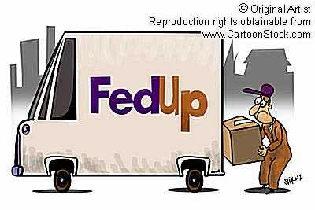
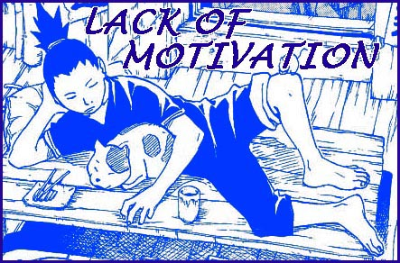
Lack of Motivation
A person who lacks motivation might have few reasons for treating people well.
Lack of motivation can occur when a person has a job that they do not enjoy or for which they have little aptitude.
It can also occur when people perceive that they are not valued or well treated at work. Eg if they are low paid, frequently criticised and never praised.

Slide 20
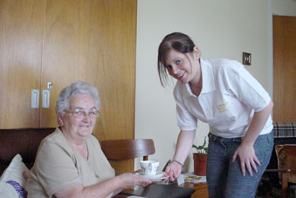
Conformity with Workplace Norms
A norm is a behaviour or belief shared by most members of a group.
People who work together develop norms in the way that they treat each other or do their job.
Eg it might be the norm for workers to ‘cover up’ for each other if something goes wrong.

Slide 21
Conformity with Workplace Norms
When a new member of staff starts work in an organisation a process of socialisation begins by which that member of staff learns (usually by observation) what the workplace norms are.
In some cases, workplace norms may be inappropriate eg they could have potentially dangerous consequences.
In care settings this could lead to poor treatment of clients

Slide 22
Preoccupation with own needs and lack of skills
This is a barrier that mainly affects inexperienced care workers.
If care workers find themselves in a new situation eg treating a client that they have not previously treated/encountered; there is a tendency for them to focus on their own feelings rather than on the needs of the client.

Slide 23


Activity
Using Moonie (2005) AS Health & Social Care. Heinemann. Oxford
Read consider this pg 22 jot dot down your ideas in response to the questions and be ready to discuss them with the rest of the group.

Slide 24
When can an individuals rights be overridden?
The right to life and the freedom from degrading and inhumane treatment are absolute.
Other rights are qualified rights and can be set
aside in some circumstances
The right to liberty
If a crime is committed
Under the Mental Health Act (2007) if a
person is considered a risk to themselves or
others.
The right to privacy/confidentiality
May be limited by the need to prevent a crime,
to safeguard an individual or to protect others

Slide 25
Stretch & Challenge
You may want to find out more about
The Mental Health Act 2007
The Mental Capacity Act 2005
The Equality Act 2010
Find out more about the:
Equality & Human Rights Commission

