Slide 1

How national initiatives promote anti-discriminatory practice and how this is put into practice.

Slide 2
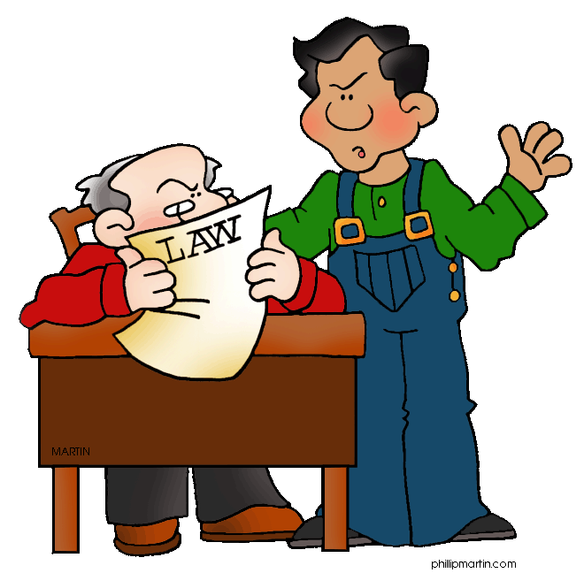
Learning outcomes
You will be able to:
Explain how national initiatives promote anti-discriminatory practice (P4)

Slide 3

Health & Social Care Practitioners are expected to work within a legal and ethical frame work.
This means that practitioners must follow and put into practice a range of laws , policies, codes of practice and charters in their work with service users.

Slide 4
Overview of the Framework
Sources of Equality law
British Parliament
European Courts
British Courts
European Union
Acts of Parliament
Case law
Case Law
Directives
Regulations
EQUALITY LAW
Put into Practice
Charters
Codes of Practice
Organisational Policies & Procedures

Slide 5

Legislation
Legislation refers to Acts of Parliament developed by the British Government.
UK equality laws have been developed as a result of directives and regulations passed by the European Union and decisions made in the European Court of Justice.
European Union law now takes precedence over UK legislation & case law (decisions made in UK courts). When a decision or directive on an equality issue is made in the EU then Uk law has to be changed to accommodate it.
(Stretch & challenge - Read : Walsh et al (2000) Health & Social
Care. Collins London page 28-29.)
The foundation for Equality legislation is The European Convention on Human Rights and Fundamental Freedoms 1950.

Slide 6

Landmarks in employment related equality law
-The Sex Discrimination Act 1975
- Race Relations Act 1976 (amended 2000)
Since then there have been numerous other acts that have outlawed unfair discrimination in other areas of life and have introduced rights to protect service users
(See page 72 of the course textbook.)

Slide 7
Some Key Legislation
Human Rights Act 1998
Data Protection Act 1998
Nursing & Residential Care1984 (amended 2002)
Care standards Act 2000
Children's Act 2004
Disability Discrimination Act 2005
Mental Capacity Act 2005
Age Discrimination Act 2006
Mental Health Act 2007

Slide 8

The Equality Act 2010.
The Most Recent and significant legislative development.
Consolidates the previous acts & the protection against discrimination on the grounds of age, disability, gender reassignment, pregnancy and maternity, race, religion or belief, sex and sexual orientation.
It also put in place a new public sector equality duty, which gives public authorities a legal responsibility to provide this protection and make decisions which are fair and transparent, including the allocation of public money.

Slide 9

The Equality and Human Rights Commission.
A statutory body established under the Equality Act
Took over the responsibilities of Commission for Racial Equality, Disability Rights Commission and Equal Opportunities Commission.
The Commission enforces equality legislation on age, disability, gender, race, religion or belief, sexual orientation or transgender status, and encourages compliance with the Human Rights Act.
It also gives advice and guidance to businesses, the voluntary and public sectors, and to individuals to assist in reducing inequality & discrimination, to strengthen good relations between people and promote and protect human rights.
Stretch & Challenge – Find out more
http://www.equalityhumanrights.com/about-us/

Slide 10

Putting Equality Law into Practice
Laws that promote equality are incorporated in a number of
different types of document that can be found in care settings
and are widely used by health and social care practitioners in their
work.
These include
Charters – define national standards of care that
service users can expect
Codes of Practice
Codes of Conduct
Organisational policies and procedures
These documents impose responsibilities on care practitioners and
the managers of care organisations.
Failure to comply with these can lead to sanctions or punishment.

Slide 11
Charters
Give assurances to service users that certain services will be provided by care organisations within given timescales and to specified standards.
However they do not have legal force in the way that legislation and case law do.

Slide 12
Care Quality Commission
Independent regulator of all health and social care services in England on behalf of the government.
Funded through a combination of registration fee income and government grant-in-aid.
Began operating on 1 April 2009 as the independent regulator of health and adult social care in England replacing three earlier commissions: the Healthcare Commission, the Commission for Social Care Inspection and the Mental Health Act Commission.

Slide 13
Fundamental Care Standards
Part of the changes recommended by Sir Robert Francis following his inquiry into care at Mid Staffordshire NHS Foundation Trust.
Find out more http://www.bbc.co.uk/news/uk-england-stoke-staffordshire-20965469
The fundamental standards are the standards below which care must never fall.
Come into force for all health and adult social care services from 1 April 2015.

Slide 14

CQC Fundamental Care Standards
All health & social care agencies must provide the public with services of a specified standard.
10 minute activity
Find out about the Fundamental Standards and make a set of notes about these using the link below
http://www.cqc.org.uk/content/fundamental-standards

Slide 15

Links to further information
Care home standards
http://www.cqc.org.uk/content/standards-care-homes
Standards for hospitals
http://www.cqc.org.uk/content/standards-hospitals

Slide 16

Codes of Practice
These are documents that set out the key principles or guidelines to help care workers implement specific features of legislation and good practice.
Codes of practice themselves do not have legal force.
In breaching the code of practice a person is likely to be breaking the law and failing to meet expected standards for their profession. This could lead to prosecution and disciplinary proceedings.

Slide 17
Equality & Human Rights Commission Codes of Practice
In line with their statutory powers they have produced Codes of Practice on Employment, Services and Equal Pay.
The main purpose of the Codes of Practice is to provide detailed explanations of the provisions in the Act and to apply legal concepts in the Act .
Key code of Practice
- Services, public functions and associations Statutory Code of Practice

Slide 18

Codes of Conduct
Guidelines for professional and ethical practice produced by the regulatory bodies of various care professions.
Aim to define best practice, to protect service users rights and ensure they received the highest possible care.
Professionals who fail to follow or breach the code can be report to the professional body and brought before a disciplinary hearing – this could lead to a practitioner being struck off and prevented from practicing

Slide 19

Nursing And Midwifery Council(NMC)
Professional regulatory body for Nurse, Midwives & Health Visitors.
Link to the Code of Conduct
http://www.nmc-uk.org/Publications/Standards/The-code/Introduction/

Slide 20


Health & Care Professions Council (HPC)
Regulate many of the professions involved in care in addition to Social Workers in England- arts therapists, biomedical scientists, chiropodists / podiatrists, clinical scientists, dieticians, hearing aid dispensers, occupational therapists, operating department practitioners, orthoptists, paramedics, physiotherapists, practitioner psychologists, radiographers and speech and language therapists.
Link to Code of Conduct
http://www.hpc-uk.org/assets/documents/10003B6EStandardsofconduct,performanceandethics.pdf

Slide 21
Regulation of Adult Social Care workers
Includes staff who work with adults in residential care homes, in day centres and who provide care in someone’s home.
No regulation
In February 2011, the Government published ‘Enabling Excellence – Autonomy and Accountability for Healthcare Workers and Social Care Workers’.
Proposed that the Department of Health would by the end of 2013 explore the HCPC establishing a voluntary register of adult social care workers in England.
Voluntary register = not compulsory to become registered

Slide 22
Current situation regarding the regulation of Adult Social Care Workers 2016
Wales, Scotland and Northern Ireland have regulators that register social workers and social care workers working with adults and children.
http://www.niscc.info/index.php/registrants/social-workers-2
Still no regulation and register in England but skills for Care have published a Code of Conduct that can be used by employers.
http://www.skillsforcare.org.uk/Standards-legislation/Code-of-Conduct/Code-of-Conduct.aspx

Slide 23
Organisational Policies & Procedures.
Policies
Detailed statements of the approach that an organisation will adopt to a particular issue. (rules & guidelines)
They set out how an employee is expected to deal with specific issues such as equal opportunities or access to clients records.
It ensures services users legal rights are observed and that a high standard of care is provided to service users.
Procedures
Written instructions about what must happen in a certain situation. (how to carry out the rules/guidelines)

Slide 24
Policies and procedures are usually written in a way that incorporates the key points of law that they cover.
Breaching or failing to follow an organisational policy can result in dismissal from employment and even prosecution.

Slide 25

Types of Policies
Confidentiality
Complaints Procedures
Harassment & Bullying
Staff development & Training
Work Practices – manual handling, infection control etc.

