Slide 1


Promoting Anti discriminatory Practice in Health & Social Care Settings.

Slide 2

Learning Outcomes
You will be able to:
Describe how anti-discriminatory practice is promoted in health and social care settings.(P5)

Slide 3
Anti-discriminatory practice
What do you think this term means?
Spend a few moments discussing this with the people around you. Jot down your thoughts and be ready to feedback to the class

Slide 4
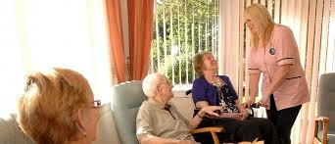
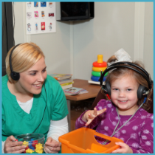
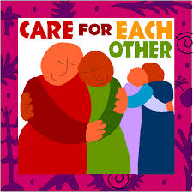
Anti-discriminatory practice means -
The actions taken to prevent discrimination on the grounds of race, class, gender, disability etc.
It takes into account how we behave towards other individuals.

Slide 5

How can the individual care worker promote equality diversity & rights in their practice?
By understanding the bases of discrimination within society
Challenging oppressive & discriminatory behaviour
eg inappropriate language by other staff, clients or relatives
Identifying their own beliefs & Prejudices as much discrimination is unintentional – result of learned attitudes & a lack of knowledge.
Using appropriate language
Role modelling
Treating people well – providing support with the individuals beliefs, culture, values & preferences.
Promoting their rights & choices.,
Changing their own beliefs & Prejudices – gaining knowledge & awareness through training.

Slide 6

Group work (4 groups)
In your groups you have 10 minutes
Read the Case study: Carol in the Stretch & Whitehouse book page 78
Discuss the case study and jot down your responses to the four questions.
Be ready to discuss your ideas to each question.

Slide 7
Anti-discriminatory practice
All employees in a care setting should promote this practice in the workplace as it is key to combating prejudice, in doing so they are trying to eradicate discrimination and promote equality for service users and for staff.
This means treating people well.

Slide 8

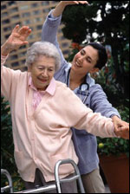
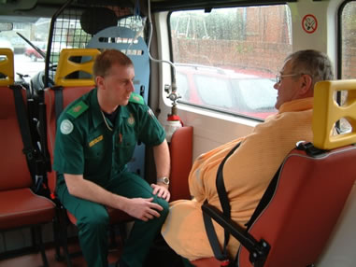
Treating People well.
Providing care that matches the needs and personality of the individual avoiding stereotyping and empowering people.
Every individual is different and should be treated with equality.
This does not, however, mean treating everyone the same.

Slide 9

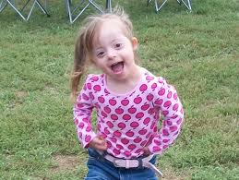
Think about
Why is it important we get to know our clients?
Empower individuals
Provide support consistent with their beliefs culture and individual preferences.
Support individuals in expressing their needs and preferences
Promote individual rights, choices and well being

Slide 10

Ethical & Practical Reasons for Treating People Well
Care workers have an ethical duty to ensure that the care that they provide safeguards the interests of the individuals and maintains as good a quality of life as possible.
Treating people well in practical terms, leads to a good working relationship which is based on trust.
If service users are treated well they trust those providing care and behave cooperatively.
If carers are treated with respect by those for whom they are providing care, they will make sure that they do the same in return.

Slide 11

Care workers should ‘act in the best interest of the service user’
They must value them as individuals
Treat them in a way we would like to be
treated ourselves
Care workers show they ‘value’ each individual
by applying the Fundamental Care Standards.
Knowledge Check
1.Who sets out the Fundamental Care Standards?
2. Give me one of the care standards?
3. Which settings do these standards apply to?
4. What are the standards for Early Years settings?

Slide 12

Links to standards for care in different settings
Care home standards
http://www.cqc.org.uk/content/standards-care-homes
Early Years standards – nurseries & primary schools
https://www.gov.uk/government/publications/early-years-foundation-stage-framework--2
Spend some time refreshing your memory about these- read the information on the links & make some notes.

Slide 13
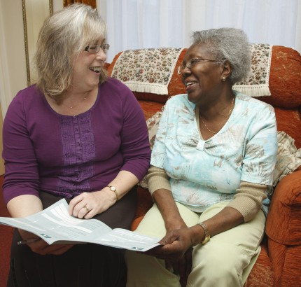
Key to promoting anti-discriminatory practice.
Putting the individual at the centre of service provision.
Watch the following clip
http://www.scie.org.uk/socialcaretv/video-player.asp?v=better-life-in-residential-care
This can be achieved by
Providing active support consistent with their beliefs, culture and preferences.
Supporting them to express their needs and preferences
Empowering individuals
Promoting individuals rights, choices and well being

Slide 14
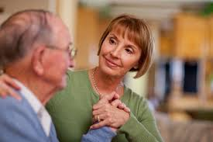
How do Settings promote anti - discriminatory practice for clients?
Empowering individuals
Staff training
OrganisationalPolicies & Procedures
Complaints procedures
Advocacy
Encouraging & supporting clients to express their needs & preferences
Avoiding stereotyping
Challenging Stereotyping & Prejudice not only from staff but also clients
Provide active support consistent with the beliefs, culture & preferences of individual clients
Following care standards
Can you give examples of any of these from work placement?

Slide 15

Paired Activity
Discuss and jot down some ideas about how staff in a care home can do the following.
Encouraging & supporting clients to express their needs & preferences
Provide active support consistent with the beliefs, culture & preferences of individual clients
Be ready to feedback your ideas to the class in 5 minutes

Slide 16
Advocacy
What is advocacy?
Advocacy is a process of supporting and enabling people to: Express their views and concerns. Access information and services. Defend and promote their rights and responsibilities
In order to have choice individuals must be able to understand what is available and express an opinion. – some people cannot.
Advocacy helps them to do so.
Sometimes an advocate may make decisions in their interests and on their behalf

Slide 17

Complaints procedures
All organisations must have a complaints procedure.
An accessible complaints procedure is a basic part of any organisations equality policy.
If someone complains they should:
Have the complaint dealt with efficiently
Have the complaint properly investigated
Know the outcome of the complaint
If they are not satisfied be able to take their complaint to an ombudsman

Slide 18
Steps to making and dealing with a complaint
Speak to member of staff concerned of their manager to see if the issue can be resolved informally.
If not resolved complaint to senior manager.
If not satisfied with the response there is the right to refer to the ombudsman.

Slide 19


If you are unhappy about the care you or a relative are receiving what can you do?
Make a set of notes using the link below.
10minutes allowed
This is for the NHS but the principles apply to any setting
http://www.nhs.uk/choiceinthenhs/rightsandpledges/complaints/pages/nhscomplaints.aspx

Slide 20
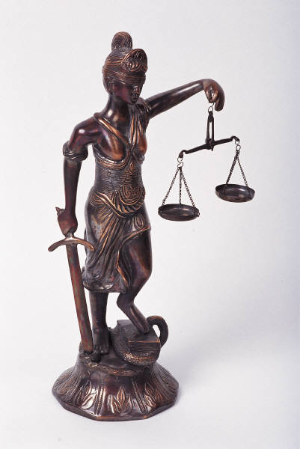
Organisational Policies, Procedures & working practices.
Key basis for promoting anti-discriminatory practice if used effectively.
Ensure the setting is complying with national initiatives such as the Equality Act.
Available for both staff & service users.

Slide 21

‘Promoting Equality’
Actions not just ideas and beliefs.
It is about actively working to ensure everyone is fairly treated this includes not only clients but also those working in the organisation.

Slide 22

How do Settings promote anti - discriminatory practice for staff?
Equal opportunity policies for employment and training opportunities.
Providing equal opportunities for staff
Staff training sessions on anti-discriminatory practice
Avoidance of stereotyping
Challenging discrimination.
Fostering positive attitudes
Can you give examples of any of these from work placement?

Slide 23
Fostering positive attitudes in staff
Organisations have a responsibility to ensure that unfair discrimination does not limit the opportunity of different groups of staff and that prejudice does not affect working relationships.
Staff who feel valued are more likely to treat clients well. – If staff do not feel valued they are less likely to take on board the training.

Slide 24

How do work places try to ensure that staff are aware of and observe equality, diversity and rights?
Induction
Staff handbook
Frequent on going training/ updating
Policies & Procedures – readily available for staff & service users
Notice boards – key information.
Applying the care value base to care. Examples of good practice.
Monitoring the quality of the care provided.
Complaints management.
Advocacy.

Slide 25
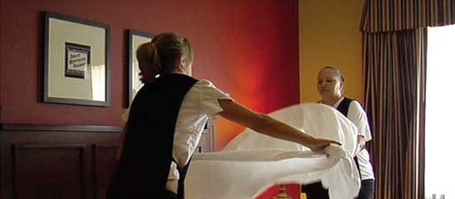
Why might people not comply with policies, procedures and work practices?
Reason
Overcome by
Lack of awareness
Clearly displaying these in notices.
Staff training.
Staff handbook.
Role modelling – observing anti-discriminatory practice and challenging discriminatory attitudes

Slide 26

Why might people not comply with policies, procedures and work practices?
Reason
Overcome by
Lack of knowledge – may not understand the reason behind the policy or procedure
Lack time/ pressure – if staff are under pressure for example short staffed or do not have enough time to do a task they are more likely to cut corners leading to inappropriate care.
Staff training
Being aware of the standard/ quality of care within the setting.
Clear complaints procedure so users can challenge inappropriate care and stand up for their rights

Slide 27


Why might people not comply with policies, procedures and work practices
Reason
Overcome by
Staff do not feel valued
Acknowledgement of the staff’s work.
Providing equal opportunities for staff

Slide 28
Staff Training & raising staff awareness.
Training ensures that policies and procedures are followed and that
the reason behind them is apparent.
Care workers should understand and adopt anti-discriminatory strategies in their work, ensuring that there is a high standard of care, the key to this is training.
It is important that staff not only have the opportunity for induction but continued professional development.

Slide 29
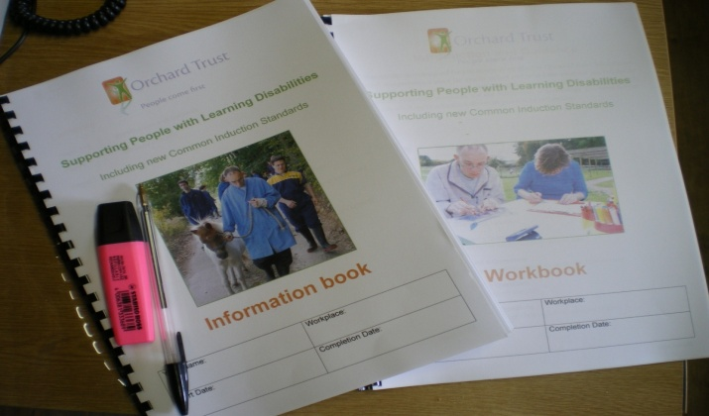
Induction Training
Introduces staff to the organisation and its policies and procedures.
The Care Quality Commission (CQC) state that all staff should receive a comprehensive induction that takes account of recognised standards and is relevant to their workplace and their role.
Do you think this is important? Why? Jot down your ideas & Lets discuss

Slide 30
Care Certificate
Aims to provide a consistent standard of induction for care staff
Find out more at
http://www.skillsforcare.org.uk/Learning-development/Care-Certificate/Care-Certificate.aspx
When you have read this page
Click on Download the Care certificate standards. Read the booklet.
Do you think everyone will get this training?

Slide 31
Why is on going training /development important?
To maintain up to date knowledge of good practice.
To ensure staff are reminded of the standards that need to be maintained – avoids conformity to inappropriate norms.
Some skills eg first aid & resuscitation require regular updating.

Slide 32
Why is on going training /development important?
4. Changes that come into force.
Legislation – regular updating due to changes, as the responsibilities of the care worker and service user rights may be affected.
New guidelines for practice – ensures these are enforced and that each worker has the opportunity to develop their understanding of the changes.
New regulations may become a training requirement – manual handling.

Slide 33

Benefits of effective training on client care.
Staff are more likely to be more positive in their approach to clients needs and put the client at the heart of the service they are providing.
Ensures the client is supported in their beliefs and preferences, encouraged and empowered to express their needs and their individual rights are promoted.
By being aware of the client and their individual needs they can act as an advocate for the client if necessary

Slide 34

Benefit of effective training for staff
Encourages people to challenge their personal beliefs and values.
-culture
-beliefs
- past experiences & events
- Socialisation
- use of language
-Health and well being
By developing greater awareness of themselves and their attitudes people become more aware of how they treat others and the reason behind this behaviour. They are then more likely to commit to the care value base and therefore treat others well.

Slide 35
Benefit of effective training for staff
Staff are more likely to feel supported in the care they provide.
Able to meet the demands and challenges and are less likely to suffer ill health and stress.
Staff will be able to deal with conflict effectively, preventing escalation of the situation.
Less likely to conform to inappropriate norms in care ( think back to the DVD’s you watched)
Staff will be more likely to identify and challenge discrimination if they are aware of the underpinning legislation which can support them.

Slide 36
What are the difficulties of providing staff training?
Not everyone will be motivated to participate in training.
Ensuring all staff have the training.
Why might this be difficult in a care home?
Shifts – may need several sessions to ensure all staff receive the training

