Slide 1

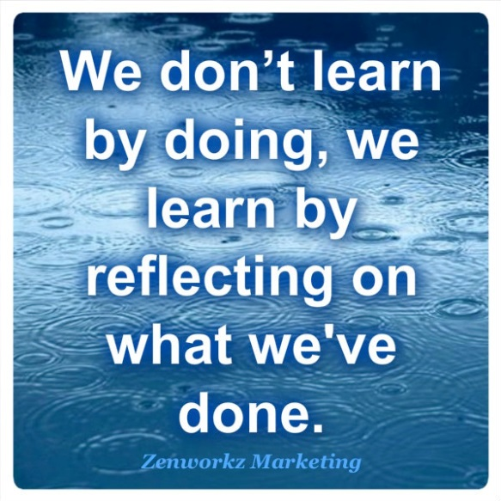
Introducing Reflection

Slide 2

What is Reflection?
‘Reflective practice is a way of studying your own experiences to improve the way you work.’ (brightknowledge.org 2012)
http://www.youtube.com/watch?v=T_4PhA3XC8o&feature=related
http://www.youtube.com/watch?v=84Egv2GEC1I&feature=related

Slide 3

How do you think reflection has benefitted the practitioners in the clips?

Slide 4

The benefits of reflection for health & social care practitioners
Increases confidence and helps them to become a more proactive and qualified professional.
Improves the quality of care they give and closes the gap between theory and practice.
It enables practitioners to continually update their skills and knowledge and consider ways to interact with their colleagues

Slide 5

How might practitioners undertake reflection?
Keeping a journal – writing about it
Seeking feedback – talking to other practitioners or a mentor.
Taking time at the end of each day, meeting, experience etc. to reflect-on-actions.

Slide 6

Purpose of reflection in the BTEC course
To demonstrate that you can reflect and that you have learned from this reflection.
Reflection should help you to achieve your potential on each unit.
To help you understand yourself better and prepare yourself for employment.
To assist you in making informed career choices and progression after your BTEC course.

Slide 7

Keeping a reflective journal
Get used to reflecting on your experiences as part of your everyday learning. In this way, each experience - whether positive or negative - will contribute to your development and personal growth. Record your experiences in your reflective diary.
See reflection as complementary to your study
Use it to clarify your thoughts and focus on your development
Record your thoughts on any difficulties or challenges you are facing
Think about any strategies that might help you deal with difficult tasks or assignments
Use it to help you think about how the topics relate to other areas of your experience

Slide 8
Models of Reflection

Slide 9
1. Gibbs Reflective Cycle (1988)
Description - What happened?
Feelings - What did you think and feel about it?
Evaluation - What were the positives and negatives?
Analysis - What sense can you make of it?
Conclusion - What else could you have done?
Action Plan - What will you do next time?

Slide 10
2. Johns Reflective Model (1994)
This model recommends that the student use a structured diary.
It is suggested the student should ‘look in on the situation’, which would include focusing on yourself and paying attention to your thoughts and emotions.
He then advises to ‘look out of the situation’ and write a description of the situation around your thoughts and feelings, what you are trying to achieve, why you responded in the way you did, how others were feeling, did you act in the best way.
This uses a set of questions to help you think through what has happened. and can be used for general reflection on experiences.

Slide 11

John’s questions
Description of the experience -Describe the experience and what were the significant factors?
Reflection -What was I trying to achieve and what are the consequences (for me, other people)?
Influencing factors -What things (internal factors/external factors / knowledge) affected my decision making?
      Could I have dealt with it better ?
      What other choices did I have?
      What would be the consequence of these other choices?
Learning - What will change because of this experience?
- How do I NOW feel about the experience ?
5. How has this experience changed my knowledge?

Slide 12
Atkins & Murphy’s model (1994)
1. Awareness of uncomfortable feelings & Thoughts.
or
Action / new experience
2. Describe the situation including thoughts & feelings
Key features
3. Analyse feelings & knowledge relevant to the situation.
Identify knowledge.
Challenge assumptions.
Imagine & explore alternatives.
4. Evaluate the relevance of knowledge
Does it help to explain/solve problems?
How complete was your use of knowledge
5. Identify any learning that has occurred.

Slide 13


Reflection in Practice
Any of these models can be used to reflect on your experiences and learning.
You only need to use one model
Don’t worry if your first attempts are not very good, you will get better with practice.

Slide 14
Some practical tips
Get a note book and start making notes and jottings about your experiences.
Use one of the models to help you structure your writing.
Get something on paper as early as possible.
Write down what happened, why what you learned and what you would do next time.
REMEMBER – you cannot write anything wrong – whatever you write will be right for you.

Slide 15
Try it out!
Write a reflection.

Slide 16
Gibbs –Description
Johns 1.
Atkins & Murphy 1
What GCSE results did you get?
Did this mean you had the qualifications to study BTEC H&SC.
How did you feel about your GCSE results?
What were the positives and negatives that affected your learning at school?
What effects did these have on your success at GCSE?
What actions do you need to take to ensure success in your current studies?
Gibbs –Feelings
Johns 2
Atkins & Murphy 2
Gibbs – Evaluation
Johns 3
Atkins & Murphy 3
Gibbs Analysis -
Gibbs – Conclusion
Johns 4
Atkins & Murphy 4
Gibbs - Action Plan
Johns - 5
Atkins & Murphy - 5

Slide 17
What were the comments from your subject tutors at review? What were the comments of your parents if they attended review 3?
Gibbs –Description
Johns 1.
Atkins & Murphy 1
Gibbs –Feelings
Johns 2
Atkins & Murphy 2
How did you feel about the feedback you received at review 3 and the targets you were set in each subject?
Gibbs – Evaluation
Johns 3
Atkins & Murphy 3
What were the positives and negatives from review 3?
Gibbs Analysis -
Gibbs – Conclusion
Johns 4
Atkins & Murphy 4
What conclusions can you draw from review 3?
Gibbs - Action Plan
Johns - 5
Atkins & Murphy - 5
What actions do you need to take to ensure success following on from review 3.
What targets do you need to set yourself? You can put these on your action plan

