Slide 1
How does Personal Learning benefit others?

Slide 2
Personal Learning
Kolb (1984) would suggest that much of our learning is experiential learning – through experience not just learning from a book
This is this acquiring of information and the gaining of new skills that change your behaviour (Rasheed 2010)
Reference: Kolb DA (1984) Experiential Learning: experience as the source of learning and development.
Englewood Cliffs, Prentice Hall.
Formal
Learning
Informal
Learning
Personal
Learning

Slide 3
Benefits of Personal Learning and Development
It helps you to know yourself. As you reflect on your progress you become more aware about yourself. You become aware of your shortcomings and weaknesses as well as your strengths and capabilities. An individual may assume he is performing excellently in his career but in reality, he is causing problems, this might be as result of an inability to pass information clearly to others which will affect how the team functions.
It improves your attitude- Attitude matters and this is an area you must try to address in your personal development journey because it attracts or pushes people away from you. You are responsible for the attitude you exhibit and it is in power to decide to carry a positive or negative attitude in your personal or work environment. Without a positive attitude, you will fail in your personal learning and development. Attitude is infectious and people love to be in the company of those who have a positive attitude.
Knowledge As you pursue your personal learning and development goals, you acquire knowledge in the process. This can come through learning and reading. Knowledge helps to move you forward and improves your ability in your role. You can also pass your learning to others in any environment in which you operate.
Skills -You can develop skills not just by reading but by applying what you read in a productive manner. You can acquire skills through instruction and regular practice. Skills can be taught or reinforced through hands-on training for their workers.
Purpose. To pursue effective personal development, you must know your purpose. What are you trying to achieve? Purpose motivates you into action.
Behaviour This is developed over time. It is formed by the thoughts, exposures and the good or bad experiences you have had over the years. As you pursue your personal learning and development, your behaviour will be affected in a positive way.

Slide 4
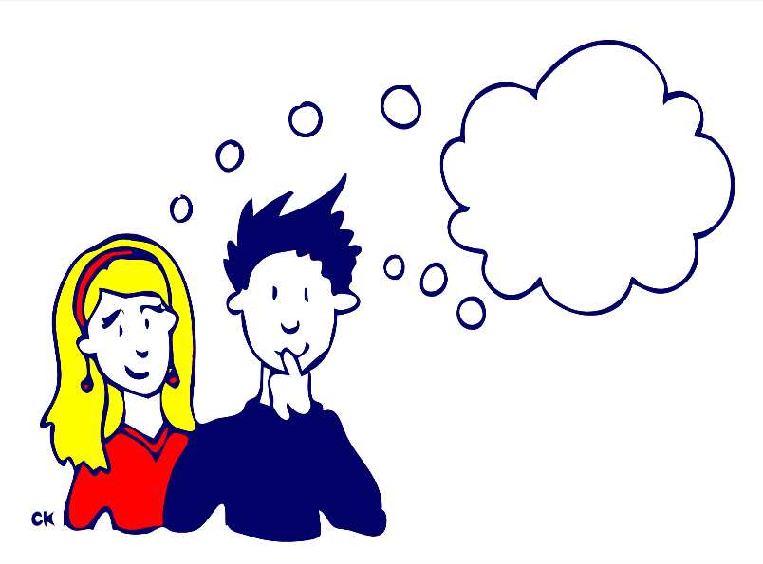
Consider what you have learned so far in the course.
What have you learned formally?
What have you learned informally?
Where has your informal learning taken place?

Slide 5
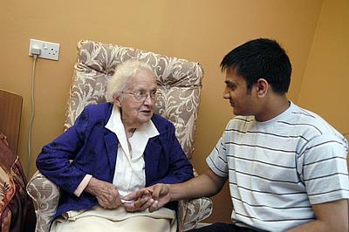
How our own learning may benefit others
Our own learning can affect others thorough our contributions.
We can leave an impact on
Family
Friends
Service Users
Staff
The above persons can also benefit our own learning through our experiences

Slide 6

Try to think of examples
An example of how the communication skills you have learned about in class and seen in practice during placement have helped you communicate with a service user.
An example of how you have shared something you have learned during the course with a family member.
An example of how what you learned in the Equality & Diversity unit helped you to challenge someone's attitude
An example in which your placement experience help you to anticipate what needed to be done and therefore assisted the staff you are working with

Slide 7
How others can benefit - examples
Teaching others a new skill or talking about new knowledge that you learned.
Being able to organise activities which are more appropriate for the needs of service users.
Being able to understand situations and being able to respond appropriately.
Better communication resulting from understanding situations.
Less need for instruction – anticipating what needs to be done.
Ability to communicate effectively with professionals & service users.
Having previous experience on how to deal with certain issues.
Being aware of own process leading to a better service provision.

