Slide 1
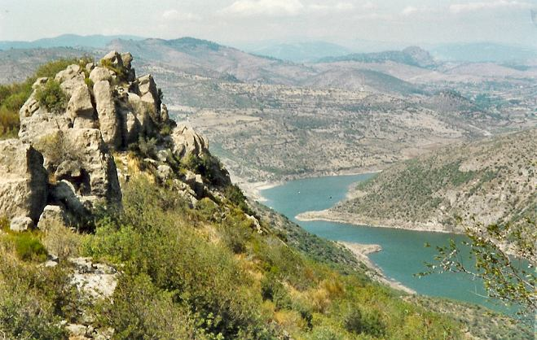
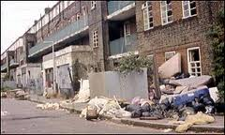

Environmental factors on the development of individuals

Slide 2
Learning Outcomes
To be able to explain how social classification may affect the environmental influences on development.
To be able to explain the environmental effects on the development of the individual.
To be able to explain the socio-economical effects on the development of the individual.
To be able to explain the life style factors and their effects on the development of the individual.

Slide 3
The interrelationship of these Environmental Factors influence our development both positively & negatively.
Environmental
Societal factors
Socioeconomic Factors
Lifestyle

Slide 4
Factors that affect our development are often linked to Social Classification
The UK Office for National Statistics (ONS) produced a new socio-economic classification in 2001.
The reason was to provide a more comprehensive and detailed classification to take newer employment patterns into account.
Group | Description | NRS equivalent
1 | Higher professional and managerial workers | A
2 | Lower managerial and professional workers | B
3 | Intermediate occupations | C1 and C2
4 | Small Employers and non professional self-employed | C1 and C2
5 | Lower Supervisory and technical | C1 and C2
6 | Semi-Routine Occupations | D
7 | Routine Occupations | D
8 | Long-term unemployed | E

Slide 5
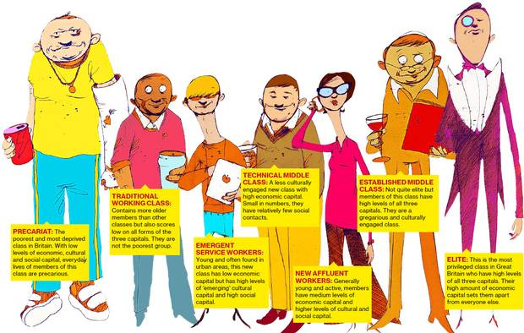

Activity:
Read this
http://www.bbc.co.uk/news/uk-22007058

Slide 6
Social Class and its effects on health
1980 – Black Report demonstrated the links with social class and health.
The lower your social class the more likely you and your family are to have poor health.
1998 - Acheson Report – showed health is still affected by income and ill health is still more prevalent in lower socio economic groups.
http://www.bbc.co.uk/learningzone/clips/summary-of-health-inequalities-in-the-uk/5080.html

Slide 7
Environmental Factors.
Pollution
Housing Conditions
Access to Health & Social Care Services
Access to Recreational Facilities

Slide 8
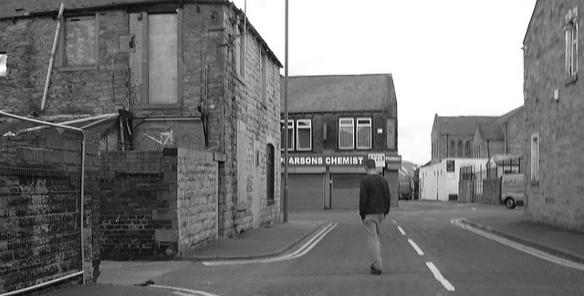
Why does living here affect a persons health?
Lower
Socio-economic class
Lower income
Less money for food
Poorer quality housing
Poorer education
Poorer access to health care
Less access to recreational activities
Local area likely to have more pollution
Discrimination
http://www.bbc.co.uk/learningzone/clips/social-issues-young-people-from-deprived-areas/3842.html

Slide 9
Further reading
http://www.dailymail.co.uk/news/article-2258375/Estate-Rochdale-people-benefits-named-deprived-area-England-fifth-year-row.html#ixzz2gyIkFDaE
 | 10 most deprived areas in Britain 2013
1 | Falinge - Rochdale
2 | Langworthy - Salford
3 | Everton (Liverpool)
4 | Grangetown (Redcar/Cleveland)
5 | Sparkbrook (Birmingham)
6 | Birkenhead North (Wirral)
7 | East Jaywick (Tendring Essex)
8 | Granby (Liverpool)
9 | North Huyton (Knowsley)
10 | Hupurhey (Manchester)

Slide 10
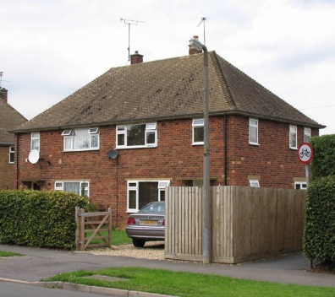
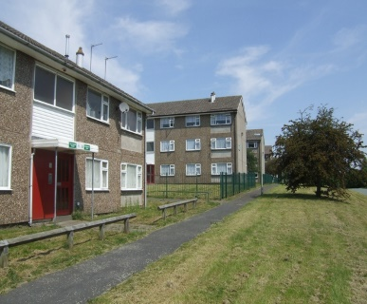
Housing
Poor quality housing is associated with poor health
Dampness – may increase the risk of allergies eg asthma
Poor lighting, poor maintenance – accidents
Overcrowding – stress, poor sleep
People on low incomes more likely to live in poorer quality housing.
Implications of housing for the elderly
vary
Home owners - maintenance costs on a lower income
Health disorders and increasing age – may need adaptations to enable them to continue to live independently.

Slide 11
Environmental Factors & their effects on ageing.
Where you live and how advantaged is your local community is important affects not only your quality of life but also your life expectancy.
WHY?
exposure to toxins and infections,
psychological issues, such as depression (with resultant lack of motivation to live a healthy lifestyle).

Slide 12

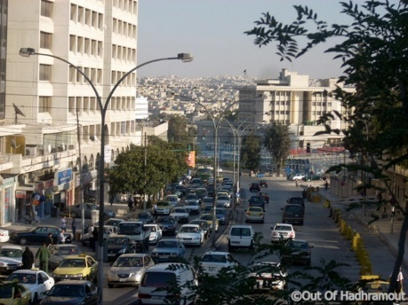
Pollution
“Exposure to toxic chemicals and other environmental pollutants, and socioeconomic stress can alter biochemical pathways influencing the risk of Alzheimer's, Parkinson's and other chronic illnesses such as diabetes, obesity, cardiovascular disease” (ncoa 2013)
Ref: http://www.ncoa.org/improve-health/chronic-conditions/a-look-at-how-the-environment.html#sthash.vFxljPzG.dpuf

Slide 13
Reduction in harmful working practices & their effects on ageing.
Legislation -Health & Safety, Clean Air Act etc
Development of unions- protection for workers
Positive effects – safer working practices, reduction in heavy industry – decrease in serious injuries.
A negative effect – the closure of heavy industry has led to increases in redundancy the can affect a persons mental and physical health due to early retirement and disengagement from society.

Slide 14
Improvements in Health Care & their effects on ageing.
How have improvements in Health Care influenced ageing?
Are improvements in Health Care always positive?
Read the articles below the help you examine some of the issues.
http://www.bbc.co.uk/news/uk-northern-ireland-15842510
http://news.bbc.co.uk/1/hi/health/4706604.stm
http://www.bbc.co.uk/news/health-22198464

Slide 15
Socioeconomic Factors
Economic
Income & Expenditure
(including the impact of low income)
Education
Employment
Access to recreational facilities

Slide 16
Socioeconomic factors
These determine whether people can afford to take part in society
There is a strong link between education, academic achievement, future employment and earning potential.
Those on a higher income are likely to have more disposable income for holidays, going out, leisure activities.

Slide 17
Socioeconomic factors and their effects on ageing
Income during working life can affect the ability to maintain an active lifestyle in retirement. (pension & savings)
The top fifth of pensioners has income 3.8 times greater than the lowest fifth (Rasheed et al 2012)
In later life, people are particularly vulnerable to changes of their income situation.

Slide 18
This report is available on Connect
In Britain, there is a long-standing correlation between old age and poverty. Older age pensioners are more likely to be affected by poverty than paid workers with widowed women at greatest risk as shown in the ‘Wealth of the Nation 2005’ report that both poverty and wealth correlate with population structure. In wealthy areas there are higher proportions of middle-aged whereas, poor neighbourhoods have a high proportion of children and older persons. The Department of Work and Pensions states there has been a reduction in pensioner poverty over the past decade. However nearly a quarter of all British pensioners continue to live in poverty, meaning that a significant proportion of British older people are excluded from full participation in social life.
REF: Hoff A (2008) Tackling Poverty and Social Exclusion of Older People – Lessons from
Europe.Working paper 308
Oxford Institute of Ageing

Slide 19


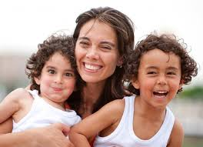
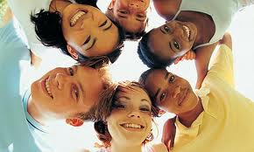
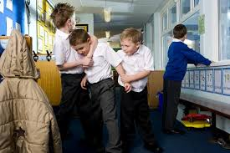
Societal factors
Society & Family
Culture
Value & attitudes
Bullying
Discrimination
Family
Support
Family Dysfunction
Peer groups

Slide 20
Values and attitudes – affect life style choices, health behaviours and the way we form and maintain relationships
Child
Primary Socialisation – family, carers
Secondary Socialisation- School, Peers

Slide 21
Relationships & Social Activity and their effects on ageing.
Positive - A network of family , friends and a partner provide emotional support
Negative - Few friends, no social support.
Sense of purpose
Control of life
No social protection from stress
Isolation
No sense of purpose.
May become withdrawn and depressed

Slide 22
Why are relationships and social interaction important?
Stress reduction. Reduction of stress and anxiety helps to strengthen the immune system and decreases susceptibility to disease.
Cultivating satisfying relationships. Social interaction and support have been found to reduce stress, help cognitive functioning, and prevent depression.
Challenging the mind. Learning new skills and regular mental activity promote healthy mental functioning.
(schools for champions.com)
Ref: http://www.school-for-champions.com/health/lifestyle_elderly.htm

Slide 23
Additional Reading
http://www.sciencedaily.com/releases/2011/02/110217110947.htm
http://www.ncbi.nlm.nih.gov/pubmed/17564515
http://www.csef.it/WP/wp320.pdf

Slide 24


Lifestyle
Nutrition
Use & misuse of Drugs

Slide 25

Activity:
Identify the different lifestyle factors that may have positive and negative effects on health. Be ready to feedback in 2 minutes.
Each group should now think of the positive and negative effects of the lifestyle choice they have been given and feed them back to the class
Nutrition & dietary choices
Alcohol intake
Smoking
Drugs (legal & illegal)

Slide 26
Life style effects on ageing
Lifestyle factors have a greater impact than genetics
Healthy ageing is a lifelong process.
Patterns of harmful behaviour, often established early in life, can reduce the quality of life and even result in premature death.
Poor nutrition, physical inactivity, tobacco use and harmful use of alcohol contribute to the development of chronic health conditions.
What are the 5 most common health Conditions?

Slide 27
The most common health conditions
86% of the deaths in the European Region are from these conditions:
Diabetes – Which type?
Cardiovascular diseases, - Examples?
Cancer, - Which types?
Chronic respiratory diseases - Which types?
Mental disorders -Which types?
The most disadvantaged groups carry the greatest part of this burden. Why?
Further reading:
http://www.euro.who.int/en/health-topics/Life-stages/healthy-ageing/data-and-statistics/risk-factors-of-ill-health-among-older-people

Slide 28

Although smoking or lack of exercise, for example, can have long-term effects, changing course is beneficial at any age.
The risk of premature death actually decreases by 50% when people stop smoking at age 60–75 years.
Altering our lifestyle can reduce the incidence and the effects of age related diseases.
http://www.nhs.uk/video/Pages/Stayingactiveover60.aspx?searchtype=Tag&searchterm=Older+people&offset=33&
http://www.nhs.uk/video/Pages/Alcoholrisksinover60s.aspx?searchtype=Tag&searchterm=Older+people&offset=33&

Slide 29
Age Related Disease – additional information for you
Cardiovascular disease
http://www.nhs.uk/video/Pages/CHD.aspx?searchtype=Tag&searchterm=Heart_vascular&offset=33&
Arthritis, http://www.nhs.uk/video/Pages/Osteoarthritisrealstory.aspx?searchtype=Tag&searchterm=Older+people&offset=33&
Dementia & Alzheimers.
http://www.nhs.uk/video/Pages/Livingwithdementia.aspx?searchtype=Tag&searchterm=Older+people&offset=1&
http://www.nhs.uk/video/Pages/Alzheimerrealstory.aspx?searchtype=Tag&searchterm=Older+people&offset=1&
Cataracts
http://www.nhs.uk/video/Pages/Cataractanimation.aspx?searchtype=Tag&searchterm=Eyes+and+sight&
Osteoporosis http://www.nhs.uk/video/Pages/Osteoporosisrealstory.aspx?searchtype=Tag&searchterm=Older+people&offset=1&-

Slide 30
Working Together Task:
Using your hand outs and the internet work together to produce a poster about how the factors you have been given can affect a persons growth and development.

