Slide 1
STARTER
Jot down the factors (things) that you think affect how we develop and age.
Everyone should have at least 3.

Slide 2
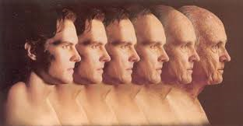
Factors and Events influencing our development, ageing and a persons health & wellbeing.
Learning outcome :
To be able to explain the factors that influence our development & ageing.
To be able to discuss the nature nurture debate.

Slide 3
Key point:
It is important to remember that factors can have both positive and negative effects on our development and ageing.

Slide 4


Feedback/Discussion:
What ideas did you come up with?

Slide 5
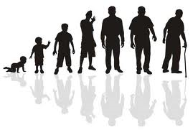
Smoking
Alcohol
Diet
Drugs
Normal Physical & Cognitive changes in later life
Financial (Income)
Occupation (employment
and access to recreation)
Lifestyle
Socio Economic
Age related
Diseases
FACTORS THAT AFFECT AGEING
Relationships
&
Social activity
Environmental
Factors
Genetics
Reduction in harmful working practice
Improvements in health care
Housing & Living conditions
Friends, Family
Social isolation
Bereavement

Slide 6
The Factors Can be Divided into
Biological
(nature)
Environmental
( nurture)
Environmental Factors
Lifestyle factors
Socio Economic factors
Relationships & Social activity
Genetics
Normal Physical & Cognitive changes in later life.
Age related Diseases.

Slide 7

Activity:
Watch the clip-try to identify the factors that may affect the ageing process.
Write down as many as you can
and be ready to discuss them.
https://www.youtube.com/watch?v=r0cJ7CX1lCA

Slide 8
We will examine both the biological factors and the environmental factors in detail shortly but first we discuss the nature nurture debate.

Slide 9
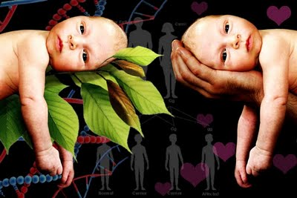
Nature - nurture

Slide 10
The nature nurture debate
What is the debate about?
Are human beings a product of their hereditary and biological predispositions or are they shaped by their environment ?
Often presented as an argument between two extreme viewpoints
Third approach takes into account the influence of both in our development.

Slide 11
Nature
Suggests that people are born with qualities, abilities & characteristics that determine the type of person they will become.
Supporters argue that people are pre- programmed by their genes and biological processes to develop and behave in certain ways.
Nurture
It is the way a person is brought up & their circumstances that influence the kind of person they become.
Supporters argue that humans are not programmed to develop in a specific way because we have free will, can make lifestyle choices and are influenced by a complex range of psychological, social, geographic and economic factors.

Slide 12
Evidence to support Nature
Key study used to support this theory – Minnesota twin study.
Identical twin boys who were separated at birth and adopted by different families.
Met at the age of 39 - (both named Jim by their adoptive families)
Both suffered headaches, bit their nails, smoked, took up woodworking and holidayed in the same area of Florida.
Want to know more? Additional reading – pdf file 05 twin studies context.

Slide 13

Maturation Theory
Developed by Gesell
He explained that child development was a result of body changes due to the ageing process.
http://www.youtube.com/watch?v=ByBRqMNTcNQ
This means the genetic make up is responsible for our development from conception onwards.
Each individual will develop at their own rate regardless of the environment.

Slide 14
Evidence to support Nurture
Key studies – feral children
Genie the wild child – unstimulated - did not develop speech
https://www.youtube.com/watch?v=zb_W1IePnIY

Slide 15
Conclusion
The nature vs nurture debate continues
However it is a fact that we have traits that are predetermined by our genes, but we can still choose who we want to be as we travel through our lifetime due to environmental influences.

