Slide 1
Starter Activity:
Write a quick definition of the term ‘Life Events’ .
Be ready to feed back to the class after the register is done.

Slide 2

The effect of life events on development

Slide 3
What are life events?
Events that causes a change in a persons development or has a special significance to them.
It is important to develop a knowledge of the various life events that people may experience.
Often these events impact on a person’s development, health & well being. These may be positive or negative effects.

Slide 4

TASK:
Working in pairs, identify as many life events as you can in 3 minutes.
Be ready to feedback at least one
each

Slide 5
Are the events identified Predictable or Unpredictable?

Slide 6
Predictable Or Unpredictable Life Events
Predictable events – expected or planned changes.
Expected life events are events or milestones in social and personal development that occur at predictable points in the life cycle. Very often act as milestones in our personal; development.
Unpredictable events – a sudden or unexpected change
This life events occur unexpectedly and may impact more on a persons life; this can have a negative or a positive effect.

Slide 7
TASK: Individual activity
Complete task 1 & task 2 on your activity sheet.
Stretch & Challenge
Can you identify any other unpredictable life events?

Slide 8
To what extent are all life events predictable?
Life events are all predictable
Life events are not predictable
All life events are predictable – peoples many different experiences are shown in the media, so there is no longer one traditional pattern of life events anymore.
It is possible to identify different life events that people may experience, making life events predictable.
Most people still aspire to the ‘traditional’ pattern of life events (eg education, marriage, children, etc) due to conformity promoted via media sources.
There are many agencies to support people during life events so how can life events be unpredictable?
Life events are not predictable because of the breakdown in ‘traditional’ expectations and cultural and religious rules.
Life events are not predictable due to society being exposed to different cultural values due to globalisation, migration and immigration patterns.
Life events are not predictable as, society is constantly changing and people are now living longer, so it is becoming more difficult to identify generic life events.
‘Traditional’ patterns of life are outdated, as society becomes more secularised, and fragmented.

Slide 9
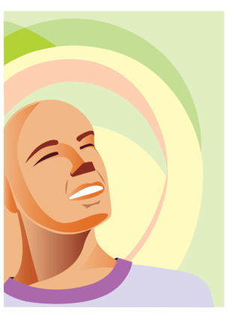
Effects of life events
Positive.
Provide a challenge.
Support people to diversify their approaches to work.
Can develop character and make you emotional
Negative
Cause illness.
Cause depression.
Cause family breakdown.
Cause criminality.

Slide 10
Case study:
Farah Hussein, a 72-year-old woman lives with her son, his wife and two grandchildren in an extended family unit. Farah was the youngest of 4 children, she developed normally as a child achieving all her developmental milestones. She contracted tuberculosis of the spine as a young girl of six in Pakistan which required long stays in hospital.
When Farah was 12 years old her family emigrated from Pakistan to Northern England when her father who was a doctor got a job as a GP. She attended a local secondary school and despite English being her second language she achieved excellent results gaining 3 A grades at A level before going to university to study chemistry with the aim of becoming a teacher.
At the age of 22 Farah married her husband, an accountant and gave up work to bring up her family, having 3 children; Farah never returned to work. Farah has lived a full and happy life so far; she has a supportive family, and before her husband died two years ago, a happy marriage. Farah has always required the use of crutches due to having had tuberculosis of the spine, but is now confined to a wheelchair due to the onset of osteoarthritis.

Slide 11

Group activity:
Using the case study identify the life events that have occurred in Farah’s life for the life stage you have been given.
How may these factors have affected Farah’s PIES? Consider before the positive and negative effects.
Be ready to feedback back to the class

