Slide 1
Introducing BTEC unit 3
Health, Safety & Security
in Health & Social Care

Slide 2
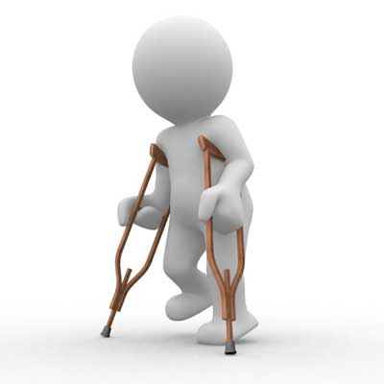

Aim of the unit
To gain an understanding of the Health, Safety & Security of individuals in a Health &Social Care context.
Gain a knowledge of legislation, policies and procedures surrounding Health & Safety.
Gain an understanding of risk assessment.
Gain an understanding of how to deal with incidents and emergencies

Slide 3
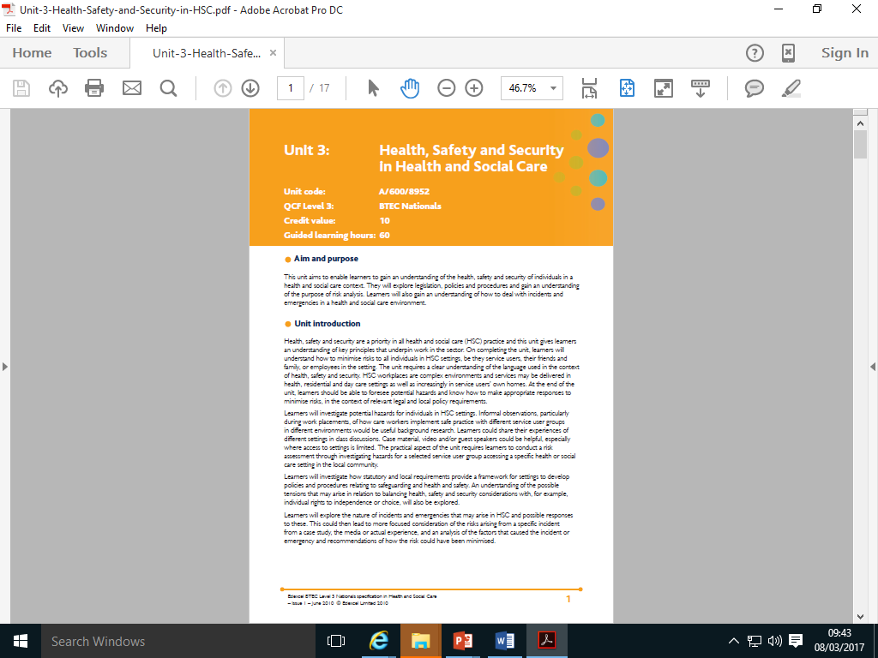
Specification
Learning Outcomes
Understand potential hazards in H&SC
Know how legislation, policies & procedures promote health, safety & security in H&SC settings.
Be able to implement a risk assessment
Understand priorities & responses in dealing with incidents & emergencies

Slide 4
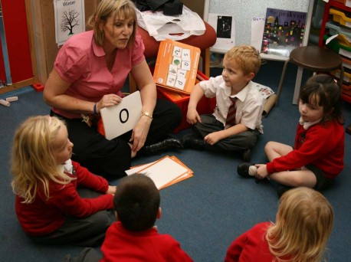

How will you be assessed?
Some of your assessment will be gathering information from your work placements. (Present/past)
Undertaking a risk assessment and writing this up
Some of your work will centre around Pippins a fictitious Children’s Day Care Nursery to assist you in putting your information into context.

Slide 5

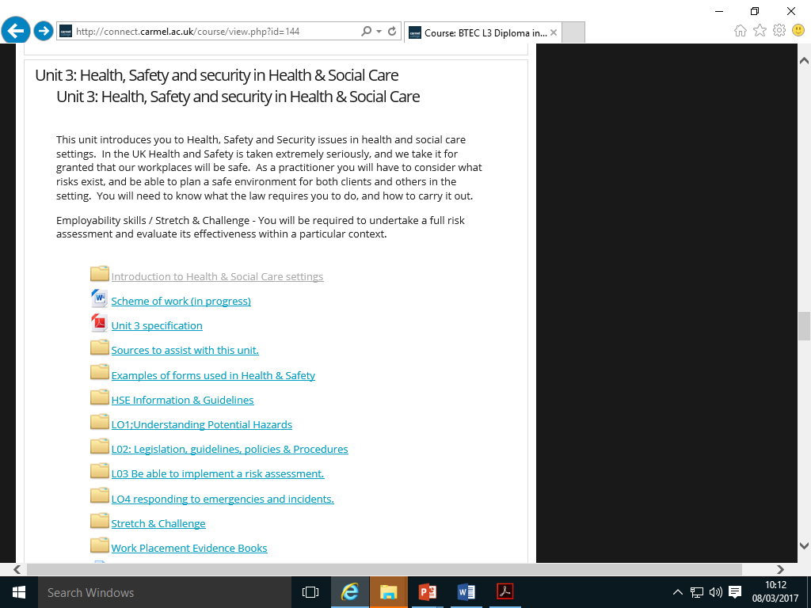
Your Mission
Prepare yourself for this unit by:
Reading the relevant chapters in the three textbooks.
Reading the materials in the following folders
Sources to assist
Examples of forms used in Health & Safety.

