Slide 1
Starter : What is risk assessment?
Write a definition of risk assessment.

Slide 2
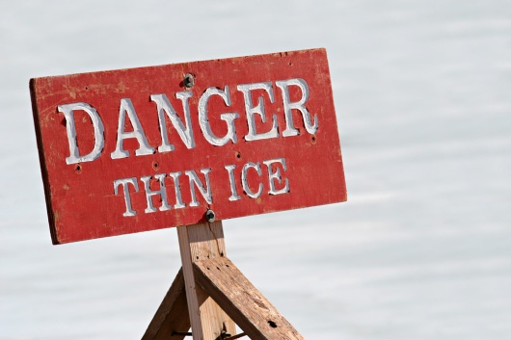
Risk Assessment
L03 Be able to implement a risk assessment

Slide 3
Definition of Risk assessment
A process that aims to identify potential risks to the health safety and security of all people at a specified location.
https://www.youtube.com/watch?v=fY6KGN72d7Q

Slide 4
Why should we carry out risk assessment?
1. Legal requirement
Management of Health & Safety at Work Regulations (1999)
Health and Safety inspectors visiting workplaces will want to know how employers are managing safety and health. If they investigate an accident, they will scrutinise the risk assessment and safety statement, and the procedures and work practices in use.
2. Financial reasons
Accidents and ill-health inflict significant costs, often hidden and underestimated.
3. Moral and ethical reasons
The process of carrying out a risk assessment, will help prevent injuries and ill health at work. Employers are ethically bound to do all they can to ensure employees and those using the facility do not suffer illness, a serious accident or death.

Slide 5
Research Tasks
Use the following website
http://www.hse.gov.uk/risk/index.htm
Find out more about risk assessment by reading the different sections.
Click on Controlling Risks from this page
Identify the 5 stages of risk assessment, the key questions that
should be asked and the purpose of that stage.
Make a set of notes to help your understanding
Find the frequently asked questions about risk assessment and read
the responses.
Make your own set of notes from these

Slide 6
Key terms used in Risk assessment
Hazard - anything that has the potential to harm someone in some way.
Risk - a chance or possibility of danger, loss, injury or some other serious consequence. Hence risk is a measure of how likely a hazard is to cause harm.
Control - a recommended or prescribed way of carrying out the work that, if followed, should reduce the risk.

Slide 7
Stages of Risk Assessment
Stage | Key Questions | Purpose
1. Look for hazards | What are the hazards? | To identify all the hazards
2. Assess who may be harmed | Who is at risk? | To evaluate the risk of hazards causing harm.
3. Consider the risk – whether existing precautions are adequate | What needs to be done? Who needs to do it? | To consider risk control measures To identify risk control responsibilities
4. Document the findings | Can you give a summary of the hazards and risks | To record all findings and the risk control plan
5. Review the assessment and revise if necessary. | Is the risk controlled? Are further controls needed? | To monitor and maintain an accurate and up to date risk control system.

Slide 8
Risk Assessment Step 1
Spotting Hazards - Task
A member of your Health & Social Care group has broken their ankle and will be using crutches for the next 8 weeks. They also study Sociology based on the first floor. They will be allowed in college after a thorough risk assessment is undertaken.
Your task today is to carry out stage one of a risk assessment and identify potential hazards in college starting at the gates to college and considering all areas.

Slide 9
What hazards did you find?

Slide 10
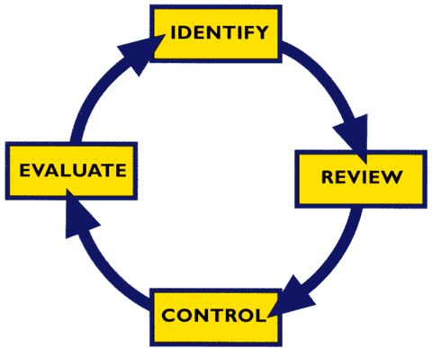
Risk Assessment is an on going process.

Slide 11

Risk Assessment Step 2
Identifying who is at risk?
In this case you already know who is at BUT could anyone else be at risk ?

Slide 12
Risk Assessment Step 3
How could the potential hazards cause harm? - Task
Considering the how the potential hazards you identified could cause harm to the person using crutches.
For each hazard you identified in the spotting hazards
task write an explanation of how this could cause harm.

Slide 13
Risk Assessment step 3
Calculating the degree of risk
This means working out the likelihood, great or small, that someone will be harmed by a hazard, together with the severity of the harm suffered.
Risk also depends on the number of people who might be exposed to the hazard.
In assessing the risk, it you should estimate:
- how likely it is that a hazard will cause harm
- how serious that harm is likely to be
- how often and how many people are exposed
It can then be decided whether enough precautions have been taken or should more be done to prevent harm.

Slide 14
Degree of risk
Chances of the hazard occurring
= likelihood x severity.
The higher the score the greater the risk.

Slide 15
Calculating the risk
Likelihood | Severity
1 Not very likely to occur | 1 If it did happen the harm would be minimal and could be dealt with by an untrained person
2 may occur 25% | 2. Might need professional advice or treatment eg cut that needs sutures
3 possibility 50% | 3 Would take time to heal but not a serious injury eg broken arm
4 quite likely 75% | 4 Could cause serious injury but would be eventually resolved eg broken leg
5 Very likely to happen | 5 The result could cause permanent disability or death

Slide 16
Calculate the degree of risk
Work out the degree of risk for the hazards you identified.
Eg Using stairs with crutches 2x4 = 8

Slide 17
Risk Assessment Step 4:
Reducing /Controlling Risk.
You’ve identified the risk
Spotting the chance of someone tripping over wires from a machine to the electricity socket
You’ve identified who might be at risk
Anyone walking near the machine
You’ve calculated the risk
This means estimating the extent of the risk (low, moderate or high) and the likelihood of it happening.
It might be of a high risk that someone might trip over the wires
You now need to control the risk
This means deciding what can be done to reduce the risk.
Taping the wires down to the floor might reduce both the risk and the
likelihood of an accident happening to low which is considered more
acceptable.

Slide 18
What controls can we put in to reduce the risk?
Identify the controls for each of the risks you identified
Eg risk of fall down stairs when using crutches – student to use the lift when accessing first floor.

Slide 19

The produced risk assessment should:
Clearly identify the potential hazards and risks to the health & safety of all people in the setting.
Clearly identify any preventive and protective measures that are needed to minimise risk and improve health & safety.

Slide 20
Task: Fill in your risk assessment form

Slide 21


Well done your student should be able to return to college
BUT One final thing!

Slide 22

Risk Assessment Step 5:
Assessing and Reviewing
When are you going to review the effectiveness of your risk assessment?

