Slide 1
LO4: Understand priorities and responses in dealing with incidents and emergencies.

Slide 2
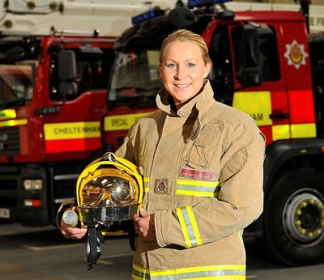
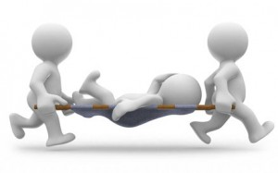

Every one would like to think that untoward incidents & emergencies will not happen.
Unfortunately they do but infrequently as a result of careful health & safety checks.

Slide 3
Key terms
Priorities - steps that need to be taken in the case of an emergency or incident that are considered more important over other plan of actions.
Response - action taken after the emergency or incident in order to prevent it from recurring or minimising the risk and likelihood of it happening again
( often the two terms are interchanged)

Slide 4
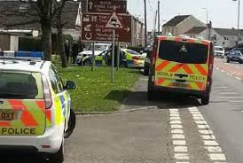
Incident
Accident
An occurrence or event that interrupts normal procedure or precipitates a crisis (Free dictionary 2013)
An event that happens suddenly and unexpectedly or by chance (Walsh 2011)

Slide 5

Incident or accident?
Incident does not mean the same as accident.
An incident can be caused deliberately.
All accidents are incidents but not all incidents are accidents.

Slide 6



What Incidents can you think of?
Be ready to feedback in 60 seconds

Slide 7
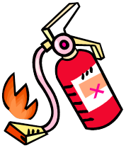

Possible Incidents
  Aggressive Behaviour from clients or visitors.
  Break in, burglary, theft of personal or the setting's property;
  Intruders gaining unauthorised access to the premises;
  Fire,
  Flood,
  Gas leak or electrical failure;
  Attack on a member of staff or parent on the premises or nearby.
  A terrorist attack or threat of one

Slide 8

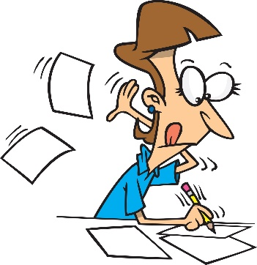

Individual Task
You have 40 minutes to:
Read Stretch & Whitehouse-pages 119-127.
Make a set of notes on the incidents identified in section 4.1.
Read Rasheed -pages 66-72.
Looking at the range of incidents identified with the appropriate responses. Consider how the responses may be changed to meet the needs of a nursery setting and the service user group.

Slide 9
How do settings manage incidents ?
As we saw earlier in the unit settings have policies and procedures for accidents and incidents.
Staff training
Accident book
Incident book
Reporting the incident if necessary to other agencies eg HSE, OFSTED, Police
Review and amending/updating policies

Slide 10
Put the priorities in the correct sequence
Change, adapt policies.
Inform required services and move to emergency setting or place of safety.
Ensure safety of vulnerable people and others.
Review policies and procedures.
Check the environment for immediate danger. Evacuate if necessary.
Incident, accident or emergency occurs
Ensure safety of buildings and property

Slide 11
Dealing with incidents in the setting.
Follow the policies and procedures to deal with the incident
Afterwards
Incident recorded in the incident book - the date and time of the incident, nature of the event, who was affected, what was done about it - or if it was reported to the police, and if so a crime number. Any follow up, or insurance claim made, should also be recorded.
Response reviewed
– Were the our responses appropriate?
- Could we have done anything better?
- Do we need to change any policies and procedures?

Slide 12

Paired activity
Read the following case study
Harriet aged 2 is trying to climb a wrought iron gate in the garden. She is trying to reach the bolt at the top. She has learned to open the doors at home and has been praised for being a clever girl. Yasmin the childcare worker calmly walks to the gate, distracts Harriet and takes her to the play house were she can practice her newfound skills in safety. Lucy who is on placement cannot understand why Harriet was not told off as the situation was a potential safety hazard and Harriet was being ‘naughty’ trying to get out of the garden.
Develop your responses to the questions below.
What might have been Yasmin’s reasons for responding in this way?
Should Yasmin talk to Harriet about the need to keep the gate closed?
Why was it important that Yasmin did not over react to Harriet’s actions?

Slide 13
Dealing with accidents in the setting.
Assess
– Decide how serious it is and what action is needed.
Assess for dangers to self or others.
Remove dangers – eg electrocution - Is electricity turned off?
- Decide what the immediate priorities are.
- Reassure injured person /persons
Get help
– Give clear instructions - if asking someone to get
help eg a child - Please fetch….. Tell her there has
been an accident and bring her straight away.
Interrupt her if necessary.
If you are calling emergency services – give clear information, stay calm.

Slide 14
Dealing with accidents in the setting.
First Aid
If no qualifications do as little as possible
Aim of First aid - keep alive, prevent condition worsening, help recovery
Treat most seriously injured first
Assess for response – Are they moving? Have they opened their eyes? Are they making any sound?
If no response likely that they are unconscious.
Start ABC
– if breathing – maintain airway – Recovery position
- if not breathing start resuscitation
Other appropriate treatment – until qualified help arrives or
until the treatment is complete
Record Information regarding the Accident
Inform relatives eg next of kin, partner or parent if appropriate.

Slide 15
Other considerations in a nursery setting.
Ensure all non injured children are being cared for and reassured appropriately about what is happening.
If you feel medical assistance is required call 999 and ask for an ambulance. If they need assistance but not as an emergency inform the parents and advise them to visit their local A&E.
If ever in doubt always phone for an ambulance, especially in the case of children.

Slide 16

Lets try it out
Daisy is a care worker at The Elms Care Home. She is at the tea trolley in the dayroom pouring freshly made tea into the cups; Mr Jones who is blind bumps into to her causing her to spill the freshly made tea onto her left hand.
In pairs
What will be your priorities?

Slide 17
What actually happened
Sally witnessed the accident.
She asked Daisy was it painful and reassured her. She called another member of staff to look after Mr Jones who was upset about the incident and the other residents who were present.
Sally took Daisy to the kitchen sink and ran the cold water over her hand whilst reassuring Daisy.
After ten minutes of this, she wrapped Daisy hand in a clean new laundered tea towel and arranged for her to be taken to hospital.
At the hospital Daisy was seen and her hand was which was blistering was assessed and the burn dressed. She was asked to return the following for further dressing.
Sally completed the accident form

Slide 18
Accident Forms
See examples on Connect.
When writing an accident form it is important that the correct information is gathered.
The accident form should provide correct documentation of an accident.
With a clear description of the event it may be possible to ensure that measures are taken to reduce the risk of a similar incident reoccurring.

Slide 19

Lets complete the accident form for Daisy’s accident.

Slide 20
Reporting of incidents/ accidents in a nursery setting.
Ofsted
Notified of any injury requiring treatment by a general practitioner or hospital doctor, or the death of a child or adult.
Must be informed within 14 days of the incident occurring.
Reporting of Injuries, Diseases and Dangerous Occurrences.
Injuries to a child, parent, volunteer, visitor, member of staff or where there is a death.
Any dangerous occurrences. This may be an event that causes injury or fatalities or an event that does not cause an accident but could have done, such as a gas leak.
See Health and Safety Executive - Dealing with incidents

Slide 21
Response to an Emergency or Incident.
Action taken after the emergency or incident in order to prevent or minimise the risk and likelihood of it happening again
Review accident/ incident book for similar incidents to identify any potential or actual hazards.
Review the care given.
Risk assessment of the activity if appropriate.
Review staff training.
Review policies and procedures – amend if necessary.

Slide 22

If you were Sally and Daisy’s manager what action would you take on receiving the accident form?

Slide 23
Summary of Managing Accidents & Incidents.
Staff training so they are aware how to respond
Recording & Reporting of incidents & accidents
Review the response to & outcome of the incident or accident
Policies & Procedures for incidents & accidents

