Slide 1
Learning outcomes
P4 – Explain the two theories of ageing
M2 – Discuss two major theories of ageing in relation to the development of an individual

Slide 2
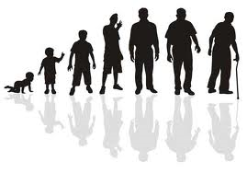
The Theories Of Ageing

Slide 3
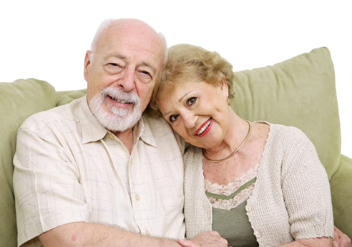
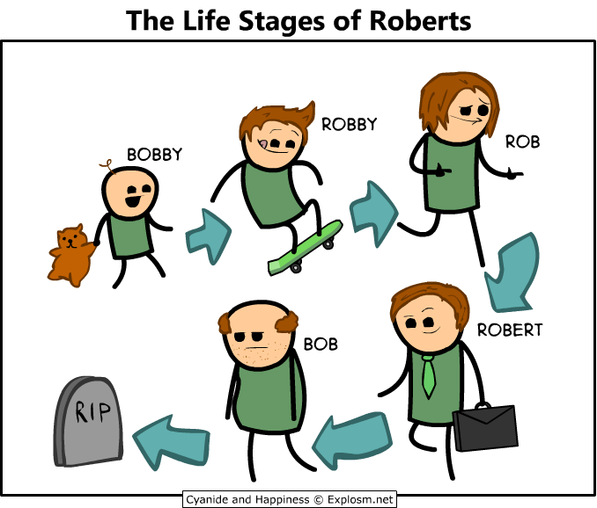
Ageing
Ageing is an inevitable part of human growth and development.
Factors affecting the rate of ageing
Lifestyle
Genetics
Socio-economic factors
Environmental Factors

Slide 4
Health & Social Care Practitioners often work with older people and need to understand how individuals adapt to life during old age.

Slide 5
There have been various attempts to explain the process of ageing, these have led to Theories of Ageing.
A theory is a set of ideas that can be used to understand, explain and make predictions about something.

Slide 6
What have we already discovered?
Erikson’s Theory (P1 unit 4)
One of the first psychological theorists to develop a theory of emotional development that extends to old age.
Argues that older people need to develop a secure sense of self that enables them to cope with the physical changes associated with ageing and the end of life.
People who fail to make sense of their life might experience emotional despair.

Slide 7
Those who succeed in maintaining ego integrity (holding on to one's sense of wholeness), while avoiding despair (fearing there is too little time to begin a new life course) also develop wisdom.
The person is able to accept without major regrets the life that they have lived, as well as the inescapability of death.
Even people who achieve a high degree of integrity may feel some despair at this stage as they contemplate their past.
No one makes it through life without wondering if another path may have been happier and more productive.
(Cliffs notes 2013)

Slide 8
ACTIVITY
In pairs Research the following theories of ageing:
Disengagement theory
Activity theory
Continuity theory
BE READY TO FEEDBACK NEXT LESSON

Slide 9
Key Psychosocial Theories of Ageing
Psycho-Social Theories - explain the thought processes and behaviors of ageing.
Disengagement theory
Activity theory
Continuity theory

Slide 10
Two Major Theories
Disengagement theory
Views ageing as a process of mutual withdrawal.
Older adults voluntarily slow down by retiring, as expected by society.
Activity theory
Sees a positive correlation between keeping active and aging well.
In other words, growing old means different things for different people. Individuals who led active lives as young and middle adults will probably remain active as older adults, while those who were less active may become more disengaged as they age.

Slide 11
Activity:
Watch the clip- Can you see examples of disengagement and activity theory?
http://www.bbc.co.uk/learningzone/clips/ageing-adapting-to-retirement/6596.html

Slide 12
Disengagement Theory
One of the earliest theories of aging – Cumming & Henry (1961)
Views ageing as a process of gradual withdrawal between society and the older adult.
According to this theory, disengagement benefits both the older population and the social system.
Gradual withdrawal from society and relationships preserves social equilibrium and promotes self-reflection for elders who are freed from societal roles.
Enables an orderly means for the transfer of knowledge, capital, and power from the older generation to the young. It makes it possible for society to continue functioning after valuable older members die.

Slide 13
Activity Theory
Developed by Robert Havinghurst in 1961, as a response to disengagement theory.
The theory suggests that older adults are happiest when they stay active and maintain social interactions.
Activity engages older adults (both physically and mentally) and allows them to socialize with others. This increases feelings of self-worth and pleasure, which are important for happiness and longevity.
These activities, help to replace lost life roles after retirement and resist the social pressures that limit an older person's world.

Slide 14
The theory assumes a positive relationship between activity and life satisfaction.
This theory proposes that an older person should continue a middle-aged lifestyle, denying the limitations of old age as long as possible. Likewise, society should avoid the injustice of ageism by applying the same norms to old age as it does to middle age. Society should not demand declining involvement of its aging members.

Slide 15
Weaknesses of activity theory
Critics of activity theory argue that it overlooks inequalities in health and socioeconomic status that could prevent some older adults from maintaining an active lifestyle.
Some older people cannot maintain a middle-aged lifestyle, due to functional limitations, lack of income, or lack of a desire to do so.
Therefore many older adults lack the resources to maintain active roles in society.
On the flip side, some elders may insist on continuing activities in late life that pose a danger to themselves and others, such as driving at night with low visual acuity or doing maintenance work to the house while climbing with severely arthritic knees. In doing so, they are denying their limitations and engaging in unsafe behaviours.
However, it is suggested that the activity model is more accurate than the disengagement model.

Slide 16
Bromley (1966) argued that older people needed to disengage but they did need to stay mentally and socially active to prevent this disengagement process from going too far.

Slide 17
Continuity Theory - Atchley 1989
Builds upon and modifies the Activity Theory.
Later life is simply a continuation of the earlier part of life, a component of the entire life cycle.
This theory suggests people have different needs when it comes to activity and will usually maintain the same activities, behaviours, personality traits, and relationships as they did in their earlier years of life.
Personality traits often become more entrenched with age.
Patterns developed over a lifetime determine our behaviours, traditions, and beliefs in old age. Past coping strategies recur as older adults adjust to the challenges of aging and facing death. Successful methods used throughout life for adjusting to situational and maturational stressors are repeated.

Slide 18
It encourages young people to consider that their current behaviours are laying the foundation for their own future old age. What one becomes in late life is a product of a lifetime of personal choices.
The theory considers the internal structures and external structures of continuity to describe how people adapt to their circumstances and set their goals.
Internal structure - includes elements such as personality traits, ideas, and beliefs. Facilitates future decision-making by providing the individual with a strong internal foundation of the past.
External structure - consists of relationships and social roles. It supports the maintenance of a stable self-concept and lifestyle.

Slide 19
Weaknesses of Continuity Theory
The theory is criticized primarily for its definition of normal aging.
The theory distinguishes between normal aging and pathological aging, so it neglects older adults who suffer from chronic illness.
Fails to explain how social institutions impact individuals and the way they age.

Slide 20
Useful websites about these theories
http://cnx.org/content/m42973/latest/?collection=col11407/latest
https://www.boundless.com/sociology/understanding-aging/the-functionalist-perspective--3/activity-theory/
https://www.boundless.com/sociology/understanding-aging/the-functionalist-perspective--3/disengagement-theory/
https://www.boundless.com/sociology/understanding-aging/the-functionalist-perspective--3/continuity-theory/
http://www.cliffsnotes.com/sciences/psychology/development-psychology/psychosocial-development-age-65/theories-of-aging
http://allnurses-breakroom.com/geriatrics-aging-elderly/theories-aging-part-412760.html

Slide 21
Biological Theories of Ageing

Slide 22
Why Do People Age?
Many theories to include:
Hereditary Factors
Loss of cellular mass and ability of cells to divide and replicate
Changes in structure of connective tissue
No single theory adequately describes the aging process

Slide 23
Why do People Age?- Biological Theories of Ageing
The process of ageing is still not fully understood, but it is felt that there are many mechanisms involved.
Two main theories
The programmed theory
Damage or error theory
Other theories are also evolving
–Look at the link on the answer plan and the one below.
http://www.ncbi.nlm.nih.gov/pmc/articles/PMC2995895/

