Slide 1
GCSE English Language
Eduqas

Slide 2
Before we begin…
English is a subject which is extremely important in almost every field you are likely to be pursuing. Currently, the grade you have attained in GCSE English will probably prove disadvantageous to you at some stage, so it is in your best interests to attempt to get a better result.
I realise that many of you will probably lack enthusiasm about this class when compared to the other subjects that you have CHOSEN to do. However, there are a couple of things that I want you all to bear in mind….

Slide 3
Before we begin…
1. We have extremely impressive success rates teaching GCSE resit at Carmel College. In the last two years, almost three quarters of our students have gained a C or above by resitting with us. This includes a number of students whose primary language is NOT English. We realise some of you might see this as an inconvenience, but we are committed to making the subject enjoyable and productive.
2. You are not at your school anymore. It may well be that you have come from a school environment which was not suited to you, and you may have found it difficult to engage with the subject. You may even think you ‘hate’ English. You will get far more out of this subject if you approach it with a clean slate and an open mind.
3. Just because this is a GCSE, it does not mean that the college rules of attendance, punctuality and meeting deadlines do not apply. Please ensure that you give this subject the same respect as your other A-Levels/BTEC’s.

Slide 4
Folders
In order to keep on top of your work, and to ensure smooth progression, you will be required to keep a tidy and organised folder or file.
This folder will keep a record of all of the assessments you complete, tutor feedback, resources and class notes. I will be checking your folders to ensure that you are keeping them organised and up to date.
Please ensure that, by Friday 8th, you have a folder (preferably a ring binder) to have with you in all lessons. If purchasing a folder presents a difficulty to you, then please speak to me privately over the next couple of lessons.
Unless otherwise instructed, I will ask you to keep your folders in college to ensure that they do not go missing.

Slide 5
Conduct in class
As I have already stated, this subject should be treated like any other. You should arrive to lessons on time, ready to learn.
I expect people to take an active part in discussions as this is one of the primary ways that I will be able to assess your progress and needs.

Slide 6
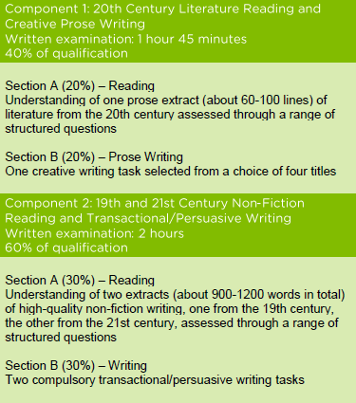
Course structure - Eduqas

Slide 7
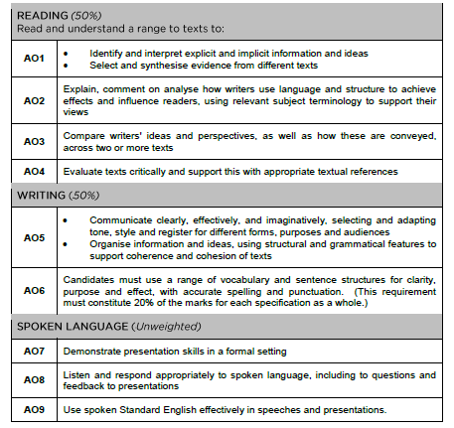
Assessment objectives – get to know these!
If you can do all of the following things well, then you will pass this course…

Slide 8
What you will learn
In each half term, there will be a separate them which will influence the content of the resources we study.
Gothic, Horror and Paranormal
Celebrations
Love and Relationships
New Beginnings

Slide 9
Within each half term…
You will learn all of the vital skills needed to pass this qualification and apply them to a wide variety of resources and materials.
You will also be tested on spelling each week.
Additionally, there will be a key grammar focus in each half term which you will be expected to focus on heavily.

Slide 10
Introduce yourself
I just want you all to introduce yourselves and tell the class one fact about yourself.

Slide 11
Fill in the ‘About me’ sheet

Slide 12
Diagnostic
In the following lesson, you will be given time to prepare for your diagnostic test. This is something which every student will do in every subject when they first start at Carmel College.
This test will give me an idea about your strengths and weaknesses in English so that I know how to tailor your learning. You should try your absolute best on it, but don’t be worried or scared about it.

