Slide 1
frankenstein
Looking at Component 1 in more detail
AO2

Slide 2
Today you will…
Read an extract from a famous gothic horror novel.
Draw conclusions about what the author wanted the reader to think.
Analyse some of the author’s language use.
Talk about the effects of language on the reader.
Examine Component 1 Section A in more detail.

Slide 3
Component 1 – Section A
Component 1 is called ‘20th Century Literature Reading and Creative Prose Writing’
This means that, in section A, you will be presented with an extract from a fictional novel, and will then be asked a series of questions about it.
The section will start off by asking some lower marked questions which require you to identify the author’s intentions and comment on how language is used.
The questions will then become slightly more complex and will ask you to comment on your own reactions to the text, and how the text is likely to affect an audience.

Slide 4
Language Features
To answer many of these questions, you will need to be aware of a number of different language features which you can spot and pick out whenever you are presented with an unseen text. To access the higher marks, it is not ok just to say ‘the word – is important because…’
You must learn how to identify more specific language features and incorporate these terms into your PEE paragraphs.
Things such as…

Slide 5
Language features
Similes
Metaphors
Personifications
Onomatopoeia
Dehumanisation
Direct Address
Rhetorical Questions
Emotive Language
Repetition
Rule of three
Humour
Adverbs
Adjectives
Verbs
Low-frequency-lexis
Imagery
Statistics
Exclamations

Slide 6
Plus many more
There are all kinds of language features that you will be able to spot. Nobody is expecting you to remember every type of language feature. But you will need to know some, so that you can look out for them when you are presented with an unseen text.
Here is a good way to remember some…

Slide 7
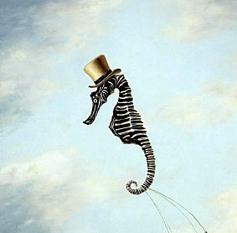
Mr seahorse

Slide 8

M – Metaphors and Personifications
R – Rhetorical Questions
S – Similes
E – Emotive Language
A – Adjectives and Adverbs
H – Humour and Tension
O – Onomatopoeia
R – Repetition and Rule of Three
S – Sentence Types and Lengths
E – Evidence (Statistics/Quotes/Surveys)

Slide 9
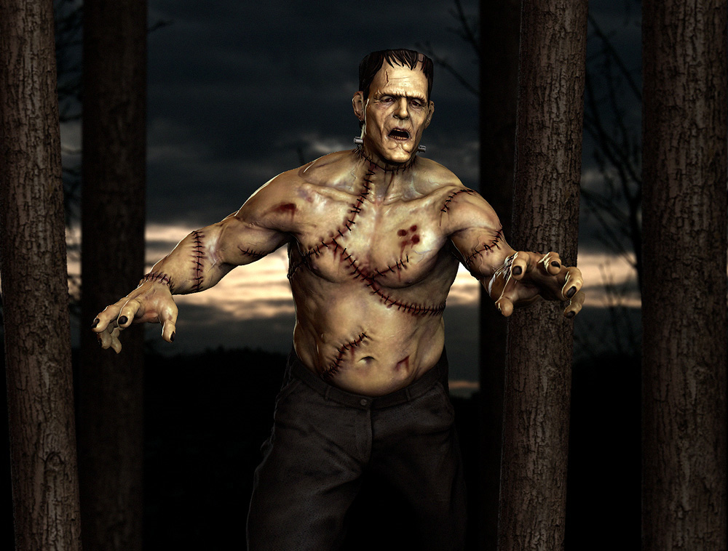

Slide 10
What do you know about the story of ‘Frankenstein’?
Discussion – to ensure you don’t have any misconceptions!

Slide 11
Lets try to apply this to a fiction text…
1. How does the author make Frankenstein sound panicked and anxious? (5 marks)
2. How does the author make the reader feel scared? (10 marks)
These are the sort of questions you will be expected to answer on any given fiction text.
Try answering them now. 3 paragraphs for Q1, 5-6 for Q2.

Slide 12
Verbal feedback
Please ensure that you have the work out in front of you. I will come around the class to verbally mark your work. Please ensure that you make a clear record of the feedback you are given.

Slide 13
Stretch and challenge
Think how the audience reading this when it was first published in the 19th Century would have reacted compared to an audience now.
How would their reactions differ? Give reasons for why you think this.

Slide 14
To finish
Identify what you believe to be the most effective sentence or phrase from the Frankenstein extract, and explain why you think this.

