Slide 1
Ghost walks
Reading – AO1, AO2

Slide 2
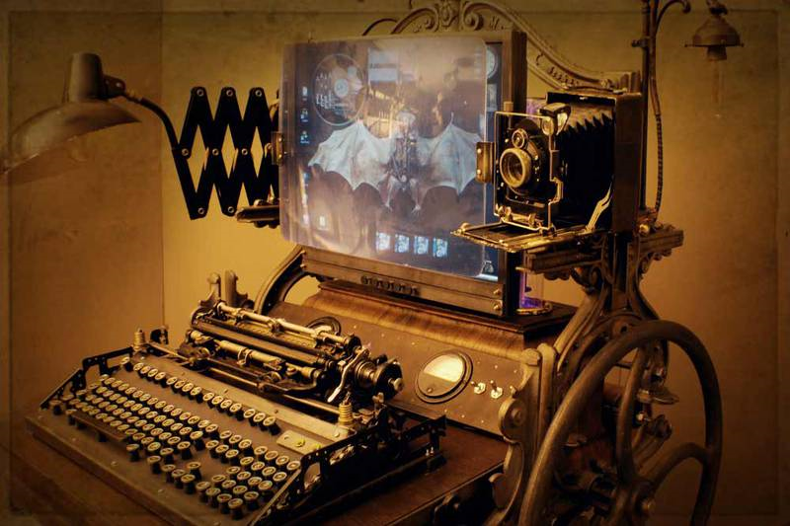
Computer lesson…

Slide 3
Today you will…
Analyse a tabloid news article in order to determine how different language features have been used to create a specific effect on the reader.
Practice MR SEAHORSE in order to identify as many of these effects as you can.
Create a table to show your findings.

Slide 4
To prepare…
Do you believe in ghosts?
What reasons do you have for your beliefs?
Do you think the majority of people believe in ghosts?
Why do you think the tabloid newspaper would print an article such as this?
What effect will this article have on the readers of tabloid newspapers?
Do you think that articles such as this belong in national newspapers?

Slide 5
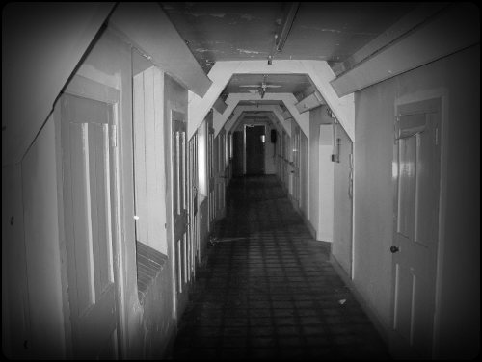

Slide 6
Read the article…

Slide 7
Find the ten most effective language features in the article
Word or phrase that you think is important? | This is an example of… MR SEAHORSE | These key words are very important… | EFFECT - Overall, this language feature will make the audience feel/think/do this…

Slide 8
Why are we doing this?
This is a particularly important skill to be able to master. When a question asks you to pick out language features, they do not want you to just use a ‘scattergun’ approach, and pick out every single word you see. AO2 requires you to be able to pick the BEST examples and present them in the best way.
This means that you don’t just pick out lots of examples of the same type, and you shouldn’t end up with ten examples which all have exactly the same effect on the reader.
You should be able to demonstrate a RANGE of features and a RANGE of different effects to get the top marks.

Slide 9
Spend ten minutes…
Highlight any language feature which you think has a specific effect or meaning.

Slide 10
Create the table…
20 minutes

Slide 11
To finish
Let’s get an idea from each person and put them up on the board.

