Slide 1
Halloween attractions
Writing Task AO5, AO6
Key Assessment

Slide 2
Today you will…
Study the many types of attractions which are often established around Halloween season, and begin to plan your own.
This will be done in preparation for a persuasive/transactional writing task like the ones you are likely to be set in component 2, section B

Slide 3
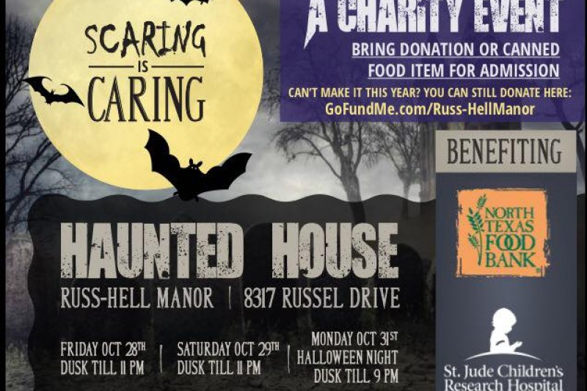
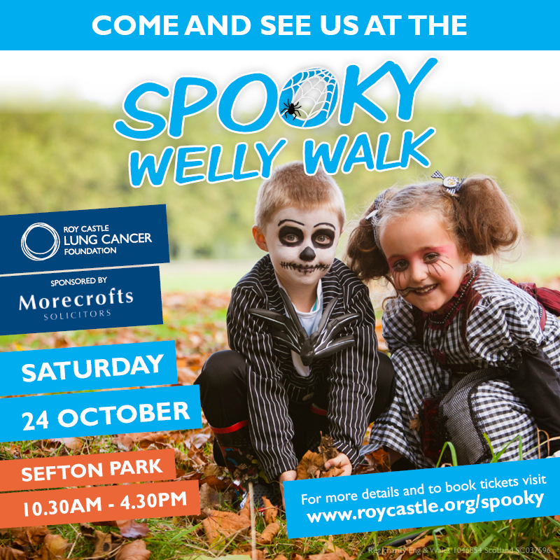
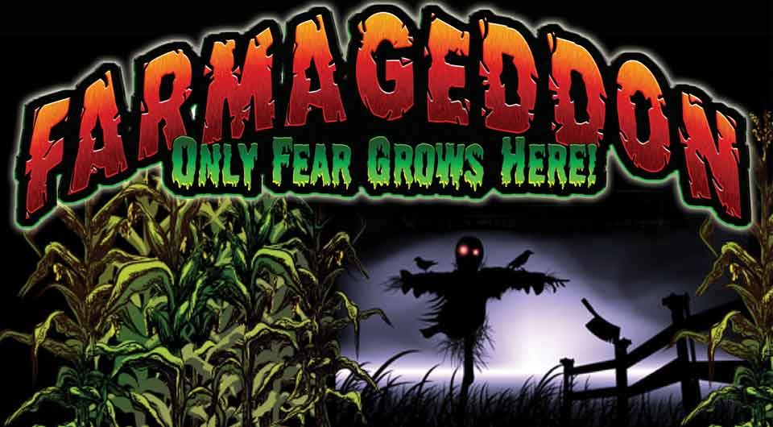
Examples…

Slide 4
What is farmageddon?
Farmageddon

Slide 5
Halloween in uk
Over the last 20 years, the holiday of Halloween has grown hugely in popularity. Before this surge in interest, people used to mark the festival in a much more subdued manner.
Now, people go to great efforts planning parties, decorating their houses, and even planning themed events or fund-raising activities.

Slide 6
First task
I want you to plan a Halloween themed attraction to pitch towards a particular age group.
Ideas
Something for small children – a bat walk or a park trek.
Something for teenagers – a horror show/ haunted house.
Something for adults – An immersive film/theatre experience.
Once you have decided on your particular target audience and type of attraction, I want you to mind-map your event on a piece of A3 paper, using words and images to include as much information about the event as possible.
I will model this on the board to demonstrate what I mean.

Slide 7
Checking
I will come around to ensure that your planning is going well…

Slide 8
Relating this to the exam…
In component 2 section B, you will be asked to complete a piece of Transactional Writing to a brief. This usually means that you will be asked to create a piece which serves a specific purpose such as to inform or persuade.
The task I want you to complete is as follows:
Create a general letter to be dropped through the letter boxes of local residents persuading them to attend your Halloween event.

Slide 9
But how should this be done?
Have a look at the separate PPT for some good tips on hitting the top band of the mark scheme.

