Slide 1
Writing a persuasive letter
Treating an imaginary person like a real person.
AO5, AO6

Slide 2
Introduction to the unit
Through your GCSE studies, your teachers will have been limited in some ways regarding how to teach writing. Often they are teaching to a broad range of abilities, and it is essential that the teacher gives information which will allow students to be able to complete the tasks which are put in front of them to a COMPETENT level.
However, often this limits students from being a little bit more adventurous with their writing, and stops them hitting high grades.

Slide 3
Introduction to the unit
What I am aiming to do is to show you some of the skills which I would normally use for Level 8/9 GCSE students or A-Level students to give you greater scope of writing at the higher end of the mark scheme.

Slide 4
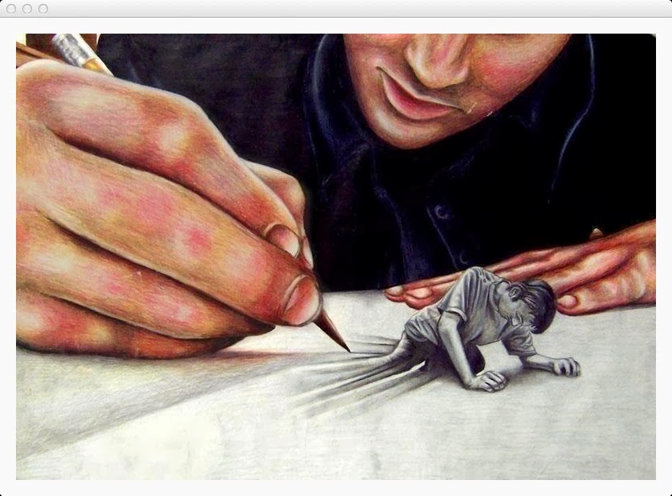
Essential rules…
At the centre of most of this work are three basic principles.
1. If you are willing to be BRAVE, it will help you.
2. If you write with genuine FEELING, it will help you.
3. If you treat your TARGET AUDIENCE like a real, living, breathing person, it will help you.

Slide 5
Bravery
For a lot of people, writing is an embarrassing subject. I have had enough experience of watching students being too shy or scared to read out what they have written, even if it is really good.
I have also taught many classes where students have thrown away their chance of achieving a ‘C’ because they have never been able to get over the fact that their ‘mates’ might skit them if they try hard in their writing, or take pride in what they have written.
This is something which you need to get over for the sake of your own achievement.
Nobody who would ever laugh at your work will be reading it – so be brave and show off.

Slide 6
FEELING
Is it really that difficult to pretend that you care about something?
I’m pretty sure that we do this all the time in our lives. So why is it that when it comes to our qualifications, we often write boring and drab responses which make it sound like this subject is the last thing we can about?
If you can JUST PRETEND TO CARE for a short time, then it will pay off.

Slide 7
Treating you T.A. like a person
This is simple.
The second you start to think that your piece of writing is pointless, it will suffer.
As far as you are concerned, the person you are writing to is real, and they will really receive your letter/read your article etc and respond to it.

Slide 8
For today, here is your task…
Write a letter to be dropped through peoples’ letter boxes to persuade them to attend your Halloween event.

Slide 9
The way we would normally approach this…
Get the formalities out of the way (address etc)
Introduce yourself
Say why you are writing
Write about five paragraphs, each with a different reason why the park should not be shut (kids will have nowhere to go, animals will suffer etc)
Try to weave in some language techniques.

Slide 10
What is the problem with this?

Slide 11
Have a look at this example…
Used syringes discarded on the floor, near to where children play; undesirable youths congregating on street corners, threatening the safety of our citizens; a massive down-turn in property prices. Does this sound like a world that anybody would like to live in? This, I believe is the future which awaits all of us if you allow the opening of the proposed new Drug-use Drop-in centre on Penketh street. I am Felicity Adams, a local resident, and I am writing to you today to convince you that opening this centre could be the worst decision you ever make.

Slide 12
Our rules…
Is it writing with feeling?
Is it treating the TA like a real person?
Is it being brave?

Slide 13
Feedback?

Slide 14
What can we use in our task?

Slide 15
So, instead of…
This…
Try this…
Introduction
Reason one
Reason two
Reason three
Reason four
Conclusion
Challenge them
Focus on you
Focus on everyone
Focus on someone specific
Focus on them
Conclusion

Slide 16
So…
Now, you are going to work on a challenging introduction like the one you have seen

