Slide 1
Jack the ripper
AO1 – Interpret implicit ideas

Slide 2
Today you will
Begin to interpret implicit information from some texts about Jack The Ripper.
This skill is known as ‘INFERENCE – TO INFER’ and is one of the key skills you will need to pass this qualification.
Make deductions based on the information you have been given.

Slide 3
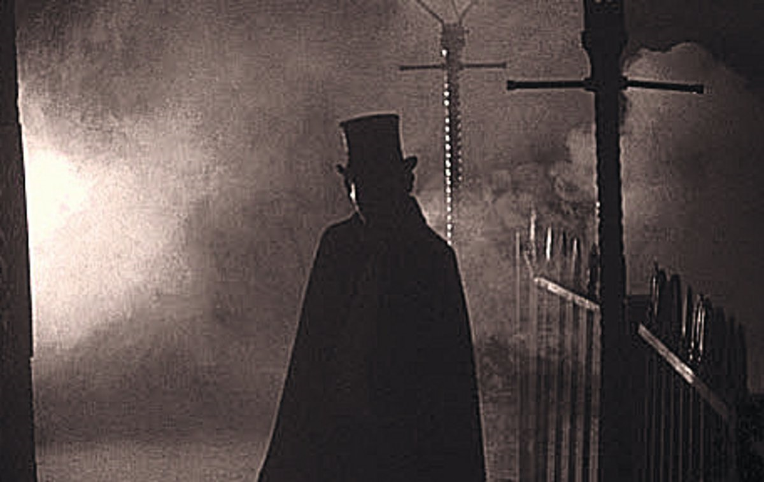
Who was jack?
Jack the Ripper is the best-known name given to an unidentified serial killer generally believed to have been active in the largely impoverished areas in and around the Whitechapel district of London in 1888. The name "Jack the Ripper" originated in a letter written by someone claiming to be the murderer that was published in the media. Attacks ascribed to Jack the Ripper typically involved female prostitutes who lived and worked in the slums of the East End of London whose throats were cut prior to abdominal mutilations. The true identity of the murderer was never discovered.

Slide 4
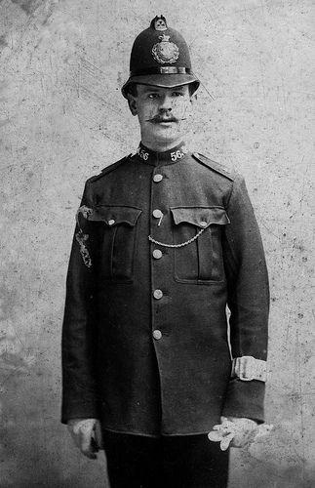
Inference – What do we know about jack the ripper?
Many letters were sent to the police and media of the time, claiming to be the murderer. Many of these were denounced as hoaxes from people trying to gain fame or cause further trouble.
However, a small number of letters were kept aside by the police as they were believed to be genuine.
These letter shared certain characteristics and traits which the police believed could only have been written by the person who had carried out the murders. These include references to some of the more gruesome details of the crimes that the public would have known nothing about.

Slide 5
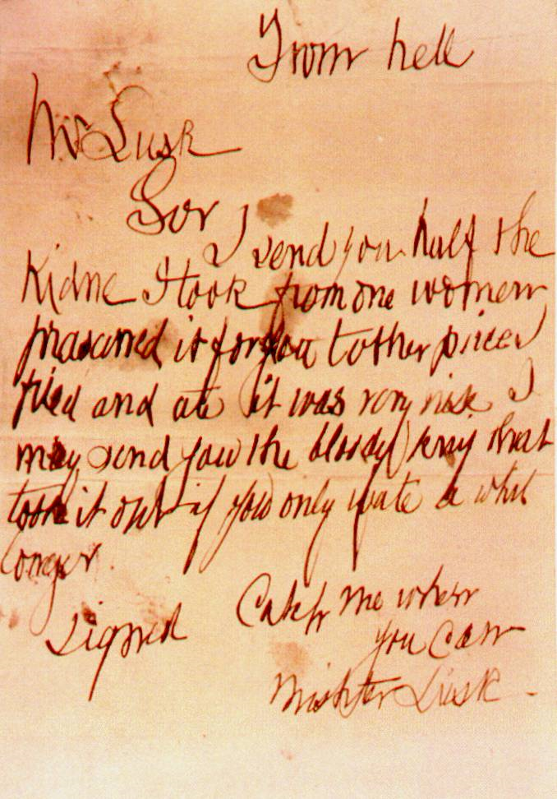
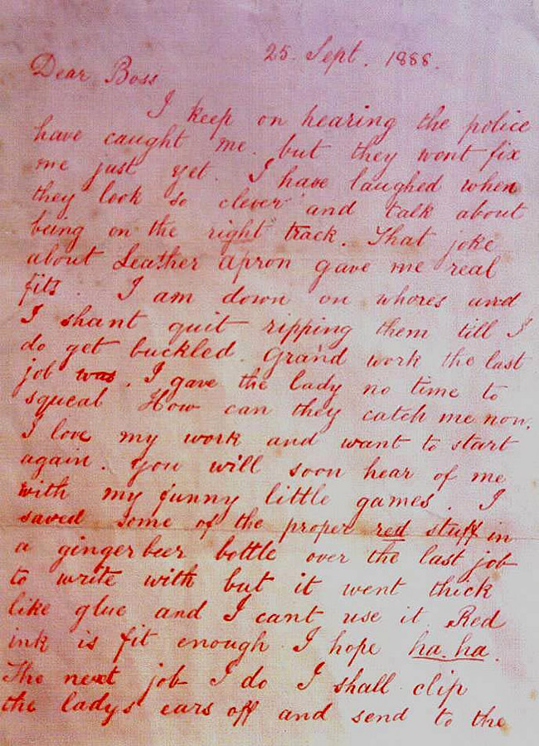

Slide 6
Task one
AO1
In front of you is a pair of genuine letters believed to have been written by Jack the Ripper.
These letters were one of the only real pieces of evidence that police had at the time which could have pointed them towards the identity of the murderer.
Using the murderer analysis sheet, I want you to identify five characteristics of the man who wrote these letters, using quotes from the letters to support your points.

Slide 7
Example
The first characteristic I identified is that the writer is KIND (unlikely I know). I came to this conclusion because of the quote which says ‘I just like to help old ladies across the street’. The word ‘help’ is important because it shows he cares about others and the word ‘like’ is important because it shows that it makes him feel good to be kind.
I want you to do this FIVE times based on the evidence that you have been given.

Slide 8
feedback
Please be prepared to give your opinions on what you have written.

Slide 9
Task two
AO1
The police have managed to narrow their investigation down to three employees who work at a high street shop near where the murders took place.
Before they make any arrests, they want you to analyse the diaries of the three suspects to see if you can INFER any information about the sort of people they are, and DEDUCE which one of them is more likely to be the murderer.
I want you to spend TEN minutes filling in a suspect analysis sheet for each suspect. When you have done that, I want you to come to a conclusion which one of the employees is most likely to be the murderer based on how closely their personality characteristics match with those of the murderer.
When you have made that decision, I want you to spend TEN minutes writing three paragraphs in your own words explaining which you believe suspect A, B or C is the murderer.

Slide 10
Feedback

Slide 11
Conclusion
The skill that you have practiced today, inference, is a key skill and you will need to do this A LOT during your English GCSE.
Please raise your hand and tell me one thing that you successfully INFERRED today.

