Slide 1
Jack the ripper
Writing task – 2 lessons

Slide 2
Today you will
Imagine the setting and context in which Jack the Ripper killed his victims by using stimulus material.
Write a short descriptive statement.
Use some specific writing techniques to improve the quality of your writing.
Peer assess each others’ work in order to ensure that these techniques have been used.

Slide 3
Introduction
As there were no cameras or microphones during the 1800s, we have no film footage to show us exactly what it would have been like to be a key witness to the crimes of Jack the Ripper.
But this is what I would like you to imagine today, using some stimulus material.

Slide 4
Today’s task
A policeman has been informed that you were walking through the streets of London shortly before one of Jack’s victims was killed.
The officer wants you to write a statement of THREE paragraphs where you describe your walk home in as much detail as possible.

Slide 5
Writing Task
Paragraph 1 – Describe the overall scene in as much detail as possible.
Paragraph 2 – Choose a significant other character (person or animal) and describe their appearance and actions in detail, no matter how insignificant they may seem.
Paragraph 3 – Describe your feelings upon walking through one of the more isolated streets. How did the setting change?
Stimulus - Stroll through Victorian London
25 minutes

Slide 6
Specific features
In your writing, you should include the following techniques:
AO5 – Communicate imaginatively – Use MULTI SENSORY descriptions to enhance your writing. Refer to your FEELINGS and EMOTIONS. Not just what you can see.
AO6 – Use a range of sentence types and structures – Use a mixture of compound, complex and simple sentences for effect.

Slide 7
Longer sentences…
…can be used to add increased descriptive detail….
“The long, spindly, dark road stretched further and further into the distance, disappearing into a thin speck of light and hiding what was to come from the view of the weary travellers.”
…or to create tension…
“As they crept on further and further, not knowing what was to come, the creaking noise got louder and turned into a loud repetitive thud as they fought their instinct to run away.”

Slide 8
Shorter sentences…
…can be used to release tension…
“That’s when the rope snapped.”
…or to create horror and panic…
“In front of me, it appeared.”

Slide 9
Types of sentences
Simple
Complex
Compound

Slide 10

The cat sat on the mat

Slide 11
The cat sat on the mat
This is probably the most OVERUSED simple sentence in history. Millions of English teachers around the world use this simple sentence to explain how they work.
TASK – Identify the subject and verb.
It is boring, so can you suggest something a bit more interesting please?

Slide 12
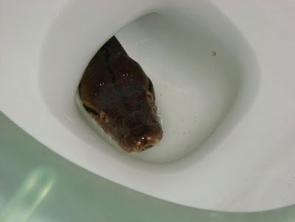
My Version
The snake hid in the toilet.
TASK - Identify the subject and verb.

Slide 13
Clauses
In order to understand how different types of sentences work, we need to talk about clauses.
Effectively, clauses are the individual units WITHIN a sentence which provide us with additional pieces of information.
‘The snake hid in the toilet’ is one single piece of information.
Therefore, we know that SIMPLE SENTENCES are made up of one stand-alone CLAUSE – known as a PRIMARY CLAUSE because it makes sense all on its own.

Slide 14
Task – Five minutes
Write out FIVE simple sentences based on what you have learned so far.

Slide 15
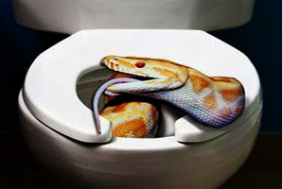
Adding a clause
The snake hid in the toilet = primary clause. It makes sense on its own.
However, look at this next sentence…
The snake hid in the toilet, whilst licking the seat.

Slide 16
The problem…
We now have TWO pieces of information/clauses
The snake hid in the toilet
AND
Whilst licking the seat

Slide 17
We now have TWO pieces of information
The snake hid in the toilet = makes sense on its own
AND
Whilst licking the seat = does not make sense on its own

Slide 18
Whilst licking the seat
We call this clause the ‘subordinate’ clause. This means that, whilst it gives us more information, it only makes sense if it is attached to a primary clause.
Sentences which contain more than one clause, such as this, are known as COMPLEX sentences.

Slide 19
Task 2 – Five minutes
Turn your FIVE simple sentences into COMPLEX sentences based on what you have learned so far. I will come around and check that you are doing things correctly.

Slide 20
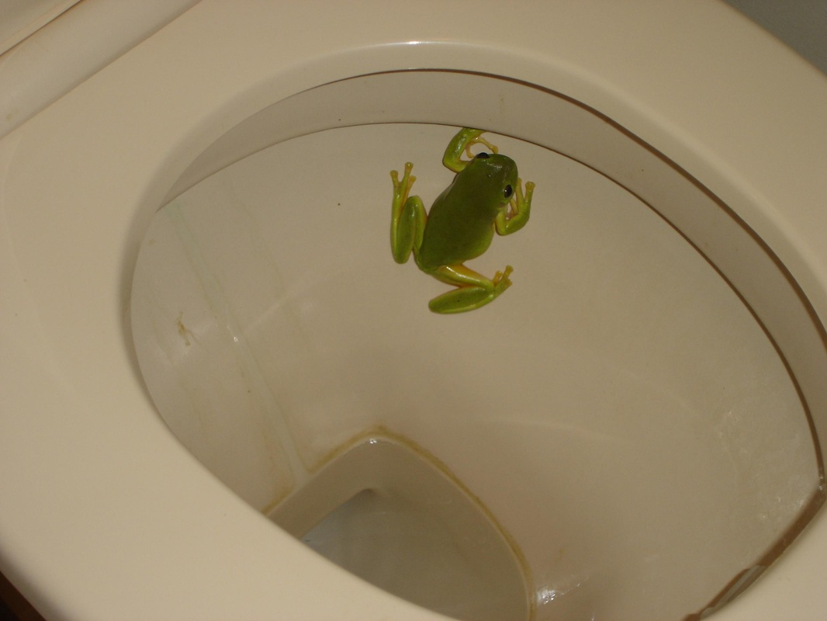
Another type of sentence?
The snake hid in the toilet and the frog had no idea.

Slide 21
In this instance…
…we still have two clauses. However, you will notice that they both make sense on their own. They are simply joined together by the connective ‘and’.
Sentences such as this, where ‘primary’ clauses are joined by a connective, are known as COMPOUND sentences.

Slide 22
Summing up
In order to hit the TOP bullet point for AO6 on the mark scheme, you must include a variation of all of these types of sentences.
(as well as varying the lengths for effect)

Slide 23
Writing Task
Paragraph 1 – Describe the overall scene in as much detail as possible.
Paragraph 2 – Choose a significant other character (person or animal) and describe their appearance and actions in detail, no matter how insignificant they may seem.
Paragraph 3 – Describe your feelings upon walking through one of the more isolated streets. How did the setting change?
Complete the task
25 minutes

Slide 24
Peer assessment
Has your partner done all of the things we discussed during the lesson?
Give them some feedback, informing them what they have done that is:
A. Effective
B. In need of a little improvement – tell them if they have failed to neglect any of the key techniques we have discussed and suggest how they could have used them.

Slide 25
To finish
Choose an area of your writing that you feel particularly happy about, and read it out when I point to you. Explain what it is about this section that you are most happy about.

