Slide 1

Freakshows & Circuses

Slide 2
Today you will
Become familiar with a 19th century (1800s) non-fiction text, as you will need to be able to analyse texts from this era in the exam. (Component 2 exam)
Begin to analyse the attitudes and purposes of the author, and begin to compare them with what we might expect today.
Identify the key words and phrases which demonstrate the views and opinions of the writer.

Slide 3
What is a freakshow?
A freak show is an exhibition of biological rarities, referred to as "freaks of nature". Typical features would be physically unusual humans, such as those uncommonly large or small, those with both male and female secondary sexual characteristics, people with other extraordinary diseases and conditions, and performances that are expected to be shocking to the viewers. Heavily tattooed or pierced people have sometimes been seen in freak shows, as have attention-getting physical performers such as fire-eating and sword-swallowing acts. Such shows are now extremely rare due to the offensive and un-politically-correct nature of the attitudes which they embody.

Slide 4
Task one
The text in front of you is an advert for a real Freakshow act in the year 1844.
Before reading the text, try to identify how you think peoples’ attitudes back then would be different to attitudes today.
Explain why you believe this.

Slide 5
feedback

Slide 6
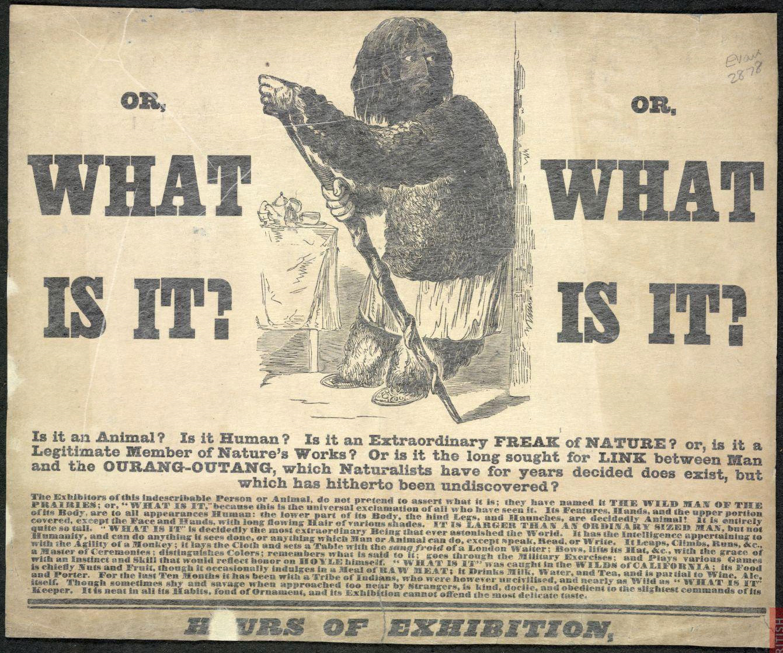

Slide 7
AO1 – Identify implicit ideas task 2
1. Read the text in front of you and highlight any words which you are unsure of in terms of their meaning.
2. Discuss these words with your partner and try to determine what you think they mean based on the context they are used in.
3. See next slide…

Slide 8
Make this table
Identify and attitude displayed by the author AO3 | Write one or two quotes which prove this attitude | Which words are most important in showing this attitude? AO2

Slide 9
feedback

Slide 10
In your exam…
You will need to be able to identify attitudes and purposes in this way, and write your findings up into a neat and tidy paragraph.
Choose two of the attitudes you have identified and turn them into PEE paragraphs like this….
One attitude which I identified from the text was….We can see this attitude presenting itself through the quote….Within this quote, the word --- is important because it shows that…..
I will come round and check these paragraphs once you have done them.

Slide 11
To finish
What are the main ways in which attitudes differ between the 19th and 21st centuries?
I will choose around four people to answer, so ensure you have something to offer.

