Slide 1
Freak shows & circuses - writing
AO5, AO6
KEY ASSESSMENT PIECE

Slide 2
Today you will…
Recap the key skills that you have learned with regards to your writing.
Use these learned skills to aid the planning of your first key piece.
Incorporate the spellings you have learned so far in order to enhance the quality of your writing.
Complete a short response to an exam style question as a key assessment.

Slide 3
Recap
What are the three main types of sentence?
What are the benefits of varying your sentence lengths?

Slide 4

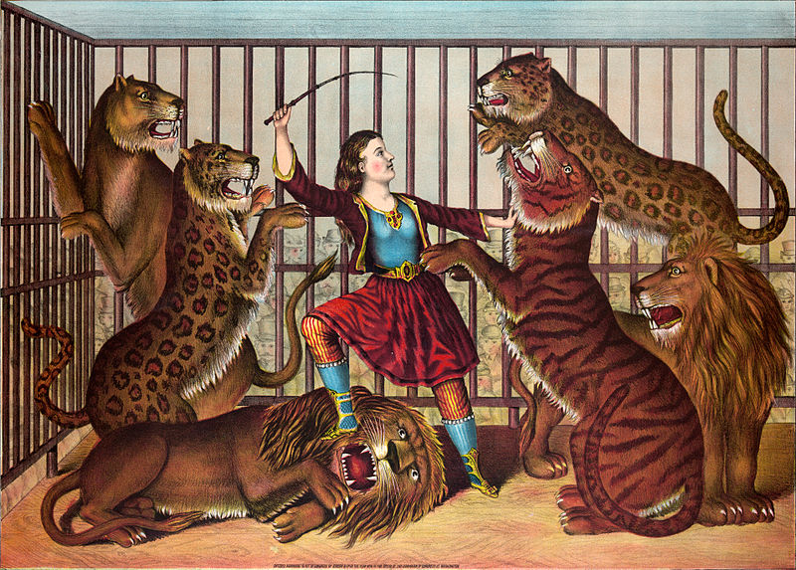
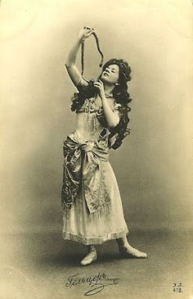
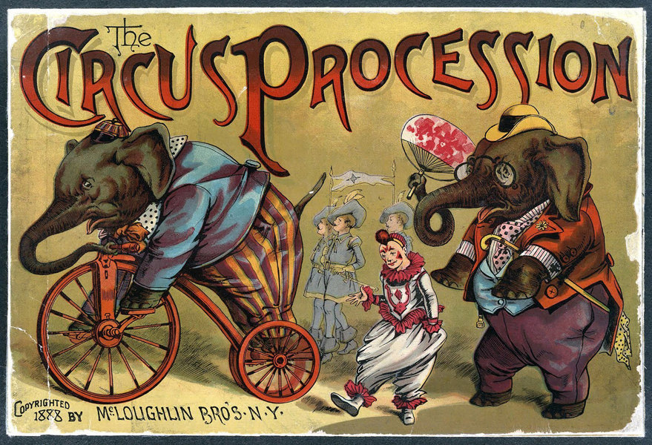
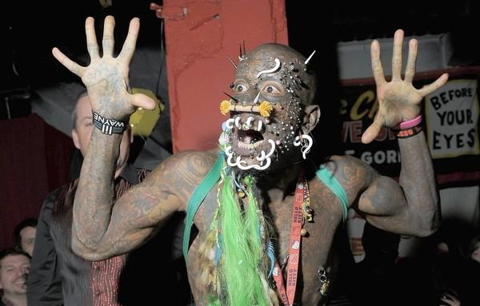

Slide 5
Task
Write a short, descriptive piece of writing where you describe your surroundings whilst visiting a Freak Show or Circus.
1. Describe the overall scene. Mention feelings. Use Multisensory descriptions.
2. Focus on an individual character, animal or event and describe in great detail.
3. Describe the climactic end to the experience. Use detailed description and emotions.
STRETCH AND CHALLENGE –
Add a paragraph of your own choosing, including as much detail as you can.

Slide 6
Adverbial sentence starters – AO6
Another way to vary your sentences, and to make your writing more interesting, is to begin some of your sentences with an ADVERB or ADVERBIAL PHRASE.
Adverbs and adverbial phrases describe the noun in a clause. For example:
He ran QUICKLY.
She caught the ball ASSUREDLY.
They fought VIOLENTLY.
All of the words in capitals are adverbs, and describe the way in which the verb occurred.

Slide 7
Identify the adverbs
Interestedly, she read on.
The dog napped restlessly.
The penguin fell over again.
Gradually, the bear crept up on the campers.
He slammed on the breaks and stopped dead.
The clown stood still so that nobody would notice it.

Slide 8
Adverbial phrases
These are short phrases which play the part of an adverb, but are more than a single word.
AS HE CRIED, he had no idea that he was being hunted.
She went for a walk IN THE MIDDLE OF THE DAY.
He grabbed the phone as dialled AS FAST AS HE COULD.

Slide 9
Time adverbials
We can also use adverbs of time which describe WHEN an action takes place.
For example:
AT THREE O’CLOCK, a strange knocking appeared at the door.
AS SOON AS THEY FINISHED TALKING, the lights went out.
AFTER THREE WHOLE DAYS, they gave up the search.
LAST FRIDAY, the thing was seen entering a sewage outlet.

Slide 10
Add time adverbials to these sentences.
The fog grew thicker.
A voice could be heard in the distance.
She visited the house late at night and seemed flustered.
He was exhausted and unable to speak.
They crawled into the town centre, causing panic all around.

Slide 11
Planning time
Create a mind map for each paragraph of your writing in order to plan details, key words and ideas that you will use in your writing.

Slide 12
Completion of task
25 minutes.

Slide 13
To finish
Create a sentence that you have not used today which contains an adverbial phrase and be prepared to share it with the class.

