Slide 1
The elephant man
Reading Task – AO1, AO2, AO4

Slide 2
Today you will…
Consider how British Values have changed since the 19th Century.
Attempt to consider the viewpoint of an author with totally different circumstances to our own.
Make judgements about the life of a 19th Century author.

Slide 3
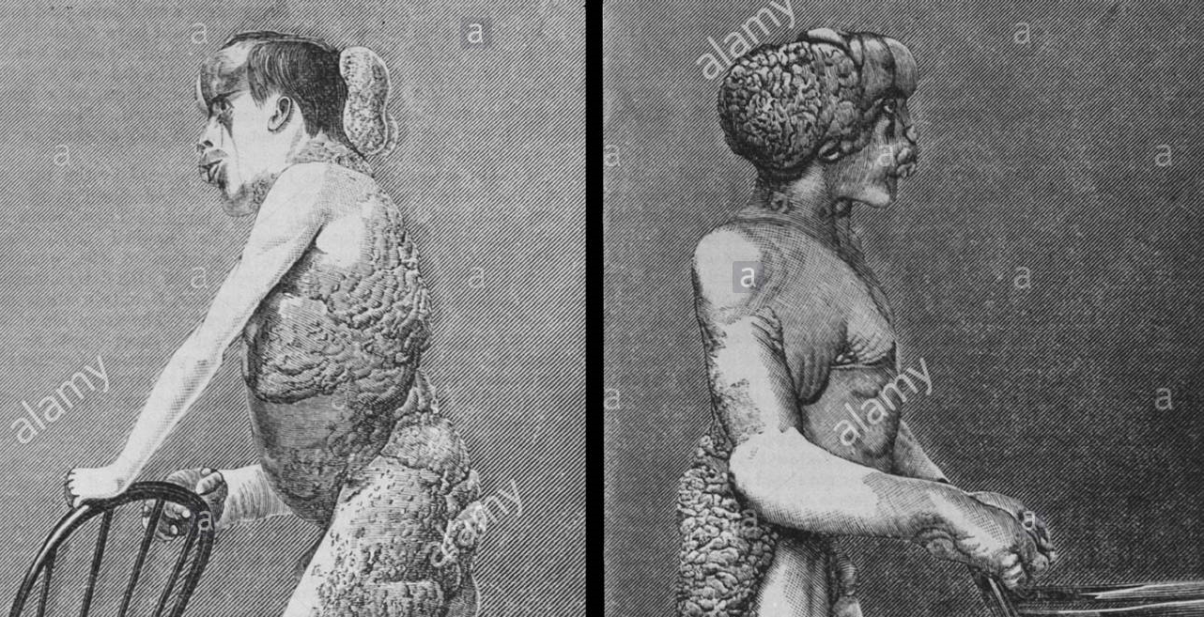
Who was Joseph Merrick?

Slide 4
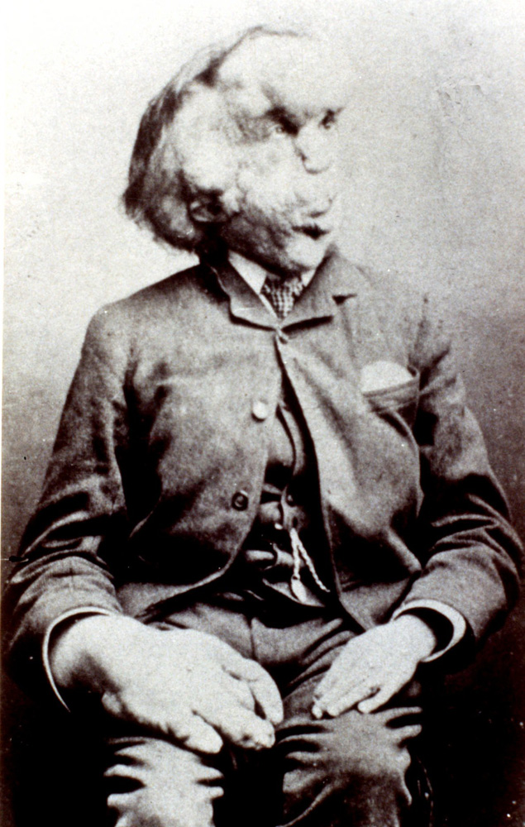
Biography
Joseph Carey Merrick (5 August 1862 – 11 April 1890) was an English man with very severe deformities who was first exhibited at a freak show as the "Elephant Man", and then went to live at the London Hospital after he met Frederick Treves, so becoming well known in London society.

Slide 5
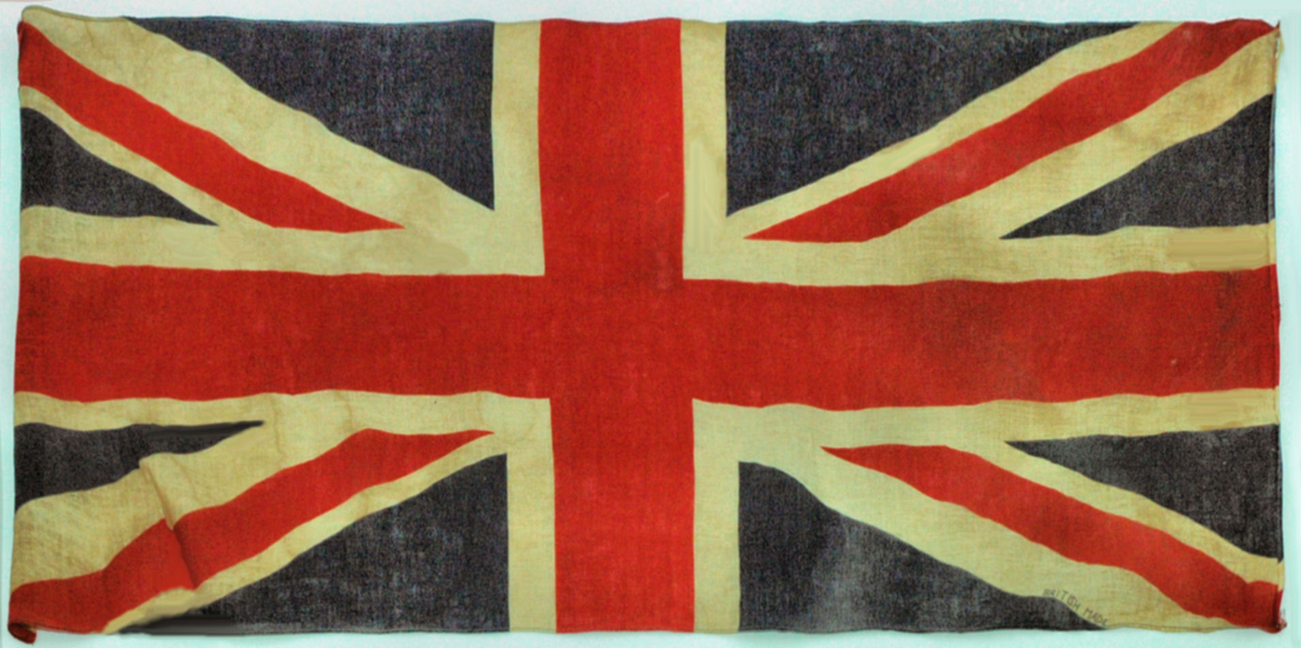
Task
Read the diary and discuss.
What can we learn about how British Society has changed since the 19th century?
Why do you think that these values have changed?
How do you think Merrick himself must have felt?

Slide 6
Main Task
Read the Joseph Merrick handout and complete the task.
Prepare to feedback at the end of the lesson.

Slide 7
To finish
I will choose some people to read out their paragraphs.

