Slide 1
Paranormal activity
Review writing – AO5, AO6

Slide 2
Today you will…
Analyse a review of a popular horror film and use this as a guide for your own work.
Identify the purposes of the different paragraphs of the review.
Identify different techniques used in each paragraph and prepare to use these in your own work.

Slide 3
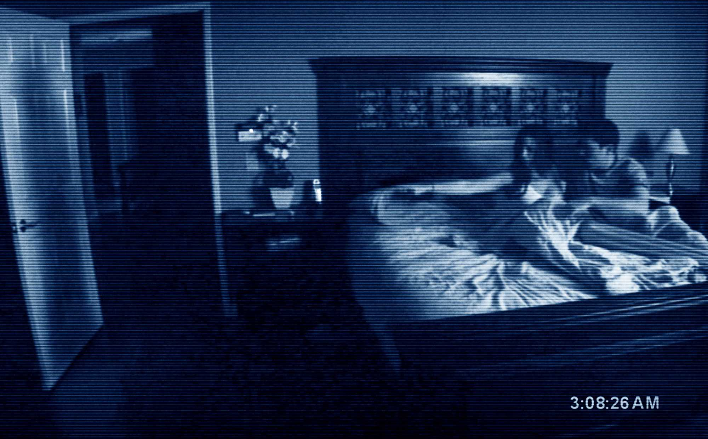
Movie trailer

Slide 4
Task one
Read the review for the movie ‘Paranormal Activity’.
This is fairly standard example of a film review, and shares many of the features that we would expect it to in terms of the voices used, its structure and its use of language.
Identify how the voices, emotions and formality of the review change and how this is demonstrated.
Spend 5 minutes annotating the different tones and voices, and prepare to feed back to the class.

Slide 5
Feedback
Tell me what you came up with.
What effect does this have when the author changes tone and formality?
This is often done in reviews to add a sense of liveliness and enjoyment to the writing, giving the impression that the person who is writing is relatable and on your level. They are formal when they need to be, but informal when they want to reveal their true feelings.

Slide 6
Task two – cut and paste
There are SIX paragraphs in this review.
Cut them out and stick them onto a piece of A3 paper, leaving room around every edge.
Once you have done this, I want you to complete the following two minor tasks for each paragraph.
1. Label what you think the main purpose(s) of the paragraph are.
2. Identify two techniques or ideas from each paragraph that you could use in your own corresponding paragraph. (eg, a simile, exaggeration, a particular word…)

Slide 7
Feedback

Slide 8
homework
Choose a movie that you know extremely well and prepare to write a review of it. Look at the annotated sheet that you have created for the movie ‘Paranormal Activity’ and think about how you could mimic that structure to talk about your own movie.
If there is any particular information that you think you will need (eg, names of actors, year of release, name of filming locations) then make a note of these and bring them with you to the next lesson.

