Slide 1
Characterisation and narrative voice

Slide 2
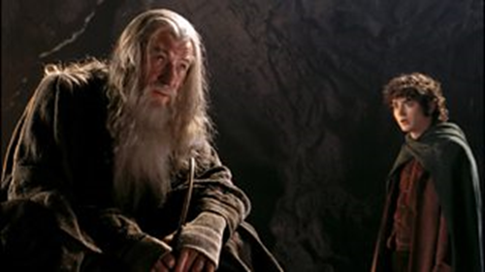
What is characterisation?
Characterisation is the way writers create characters and make them believable. When writing about texts, it is easy to treat characters as real people. Try to remember that the author is creating characters using language.
Think about the set of characters in a text:
What are the characters like? How do you know this?
What do the characters say (dialogue)?
What do the characters do?
How are they described?
How are they seen by other characters?

Slide 3
Characterisation example
The following extracts describe two farmers from Bruce Chatwin’s On the Black Hill. What do we learn about these characters from the writer’s choice of language?
Write down in your notes your analysis of the two boys.

Slide 4
Analysis
The writer uses language to contrast the two characters; although they are twins, they are very different.
The first twin, Lewis, is presented as physically active with "a steady long-limbed stride...” The choice of words here suggests confidence - the word "stride" has connotations of energy and vigour.
In contrast to this - "His head would wobble as he spoke…" - the word "wobble" suggests an uncertainty in Lewis. This is reinforced by the choice of the verb "fumbling" in the same sentence.
The examples of his limited dialogue "Thank you!...Very kind of you!" also reveal he is not quite comfortable with talking at social occasions, with the exclamation marks adding a comical feel to his speech.
In contrast Benjamin is presented as a character who "…would go on, arguing for hours…”
The repetition of the ‘er’ after the sharp consonants in “shorter, pinker, neater…” mirror the idea of Benjamin as more "sharp-tongued”.
The image of the character using his nose "…as a weapon" is also effective in establishing his sharper personality.
The formal, deliberate tone of his dialogue "What can you mean by that?" shows that he is more in control than his brother during social conversation.

Slide 5
Characters and contrasts
It’s important to think about how characters’ change and interact with each other, as this could suggest some important themes or ideas in the text. The writer may use language to encourage the reader to respond to a character in a certain way.
Look for contrasts or contradictions - not just between characters, but within each character. In real life, no one is simply good or bad. All effective characters have more than one side.

Slide 6
Typical contrasts between characters
Characters who think versus characters who feel.
Characters who talk versus characters who act.
Sociable characters versus solitary characters.
Predators who take advantage of people versus characters who are victims.
Characters who want one thing versus those who want another.

Slide 7
Typical contrasts within a character
A person who says one thing, and does another.
A character who sacrifices something important to pursue a goal of their own.
A character who wants two opposing things.

Slide 8
Example – Bring Up the Bodies
Read the extract

Slide 9
Analysis
Write down any features that Hilary Mantel uses here to define the character of Thomas Cromwell

Slide 10
Analysis
There’s a contrast between Cromwell’s background, as the son of a blacksmith, and his current job and position.
The use of different tenses stresses this, by placing the word "now" in the middle of the first sentence, then the rest of the extract focuses mainly on his past.
The writer focuses on Cromwell’s varied background, by listing his various professions or occupations.
First his father’s various trades are listed - “a brewer and a blacksmith…a shearsman too…” Later in the extract Cromwell’s occupations are listed - “…a hired soldier, a wool trader, a banker.”
The effect of this listing, seems to be to link the two men, one who was "a brawler, a drunk and a bully…” and one who is surrounded by mystery.
The opening phrases from some of the sentences are repeated - “Some say...Some say…Others say…” The effect of this repetition is to suggest there’s a mystery about how Cromwell got to where he is – that people gossip about him.
People don’t seem to like him - either he "came up" with the family of the queen, or maybe he owes his rise to "sorcerers."
“…made money for him and knew his secrets.” The choice of language here implies that the character may owe his success to dishonest dealings.
The reader could feel sympathy for Cromwell. He’s a self-made man, who is sometimes looked down on by those around him.
There is also a suggestion that this character doesn’t need the reader’s sympathy.
His physical appearance also suggests a certain toughness, he is "stocky" and his skin is described as "impermeable." The use of this last adjective could also represent his character: he is closed and gives nothing away.

Slide 11
TIP
When you are writing about characterisation, don't just describe what characters are like. Examine the language techniques used by the writer to create the character.

Slide 12
What is narrative voice?
Narrative voice is the perspective the story is told from. The writer chooses a narrative voice carefully, as it can have an important effect on the story and the reader’s response.
 | Different types of narrative voice | Example
First person | A character within the story is telling the story. Some of the main personal pronouns used are I, my, me, we. | I watched as the boat sank. I felt a mixture of relief and guilt. I turned to take the rudder, pushing away the thoughts that crawled like ants into my mind.
Second person | Not commonly used by writers. The personal pronouns you and your are used throughout. | You watch as the boat slowly sinks. You feel relief mixed with guilt. You turn and take the rudder, pushing away the thoughts that crawl like ants into your mind.
Third person | The story is being told by the voice of someone who is not a character in the story. The main personal pronouns used are she, he and they. | George watched as the boat slowly sank. He felt relief mixed with guilt. He turned to take the rudder, pushing away the thoughts that crawled like ants into his mind.
Third person omniscient | The story is being told by a voice who shows they know more than the characters in the story – the narrator is all knowing. The main personal pronouns used are she, he and they. | George watched as the boat sank. He felt relief mixed with guilt. Six miles away a group of fishermen watched the horizon, looking for signs of the storm they could feel in the air.

Slide 13
When thinking about narrative voice, think about the following:
How does the reader feel about the narrator?
Does the reader trust the narrator? Do they seem reliable?
Is the voice of the narrator the author or someone else?
How does the narrator choose to show us this fictional world?

Slide 14
Examples of narrative voice
Catcher in the Rye by J D Salinger is a first person narrative. The story is told from the perspective of a character called Holden, as if he were confiding in the reader. We get a sense of his character from the language he uses.
Read the extract in your notes.

Slide 15
Third person Narrator
In this next extract the writer uses a third person narrator. This narrator is not a character, but a voice that knows the thoughts and feelings of the characters in the story. In this extract we are presented with Harriet’s feelings.
Read the extract in your notes.

Slide 16
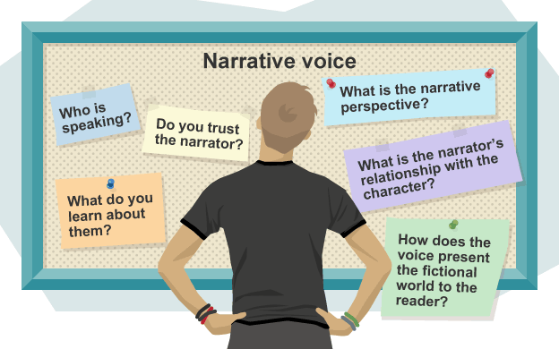
Analysing narrative voice in an extract
Example
This extract is the opening of D.H Lawrence’s Lady Chatterley’s Lover. Read the extract and make notes on what is the effect of the narrative voice in this extract?

Slide 17
Analysis – Lady Chatterley’s Lover
This extract is written in the third person.
The use of the third person voice allows the writer to share direct information about the setting and characters.
The narrative voice has an educated, formal tone. The reference to a "tragic age" also gives the opening a wide reaching, philosophical tone.
The narrator uses the present tense to establish the historical setting of the novel: the time of World War One.
The reader is acknowledged and included by the narrator - “Ours is", "we are", "we start", "we’ve got to”. These references also establish a link between the voice telling the story and the characters in the story – they both share the same context.
A modern reader may find the formality of the personal pronoun– “one must live" makes them feel less connected to the narrative voice.
The narrative voice uses detached, matter of fact language – for example the use of the word "habitats" when referring to people, makes the narrator appear as a detached observer.
The use of numbers also makes the narrative more objective - “1917", "a month", "six months later", "twenty-three", "twenty-nine".
This matter of fact tone contrasts with the informality of the phrases "shipped over…more or less in bits” The use of complex nouns like "cataclysm" contrast with informal verbs like "scramble".
The second paragraph seems to offer an insight into the character of Constance – her feelings and perspective - “..she had realized that one must live and learn.”
In places the third person narrative seems to be coloured by her perspective - “His hold on life was marvellous.”
The emotive subject matter is undercut by the detached narrative voice, so that the tone is not sentimental or tragic. This reflects the overall tone of the opening paragraph - “…we refuse to take it tragically.”
The narrator layers several linked metaphors - “among the ruins", "build up new little habitats", "no smooth road into the future", "skies have fallen". These geographical images give the narrator’s philosophical musings a more direct, physical impact.

