Slide 1
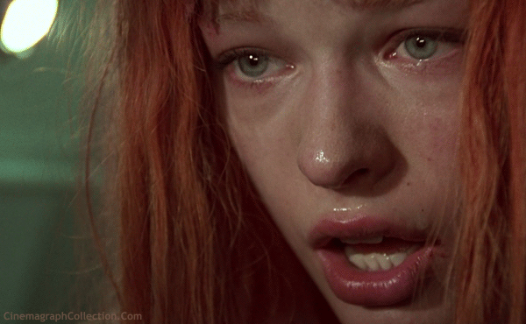
How to write the perfect story!
GCSE ENGLISH LANGUAGE WRITING (PAPER 1)

Slide 2
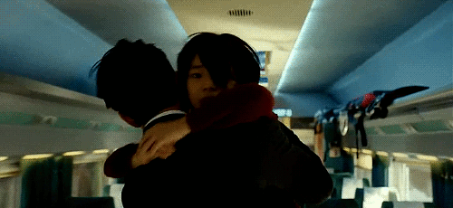
How to write the perfect story!
GCSE ENGLISH LANGUAGE WRITING (PAPER 1)

Slide 3

How to write the perfect story!
GCSE ENGLISH LANGUAGE WRITING (PAPER 1)

Slide 4

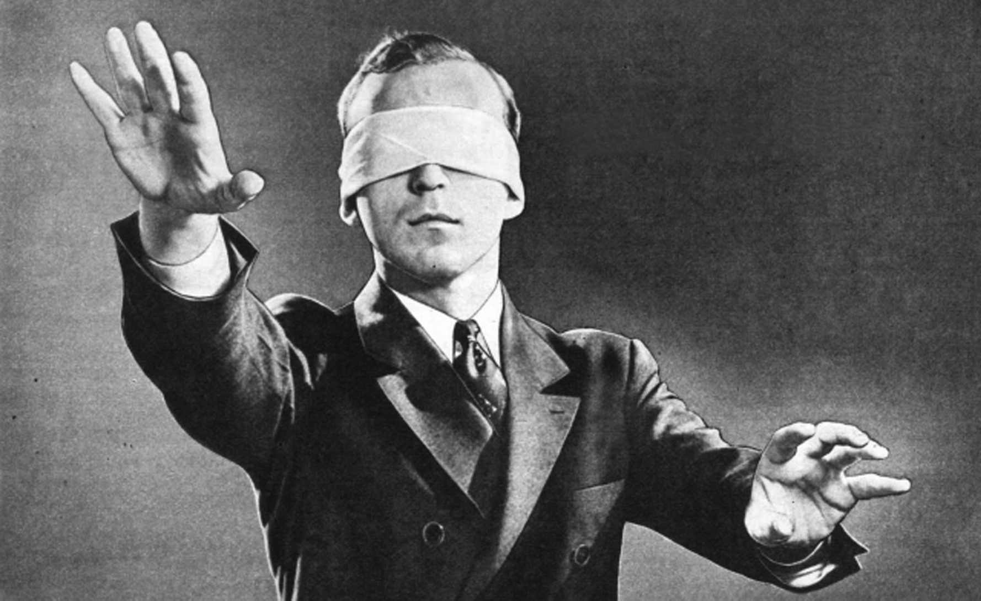

Slide 5
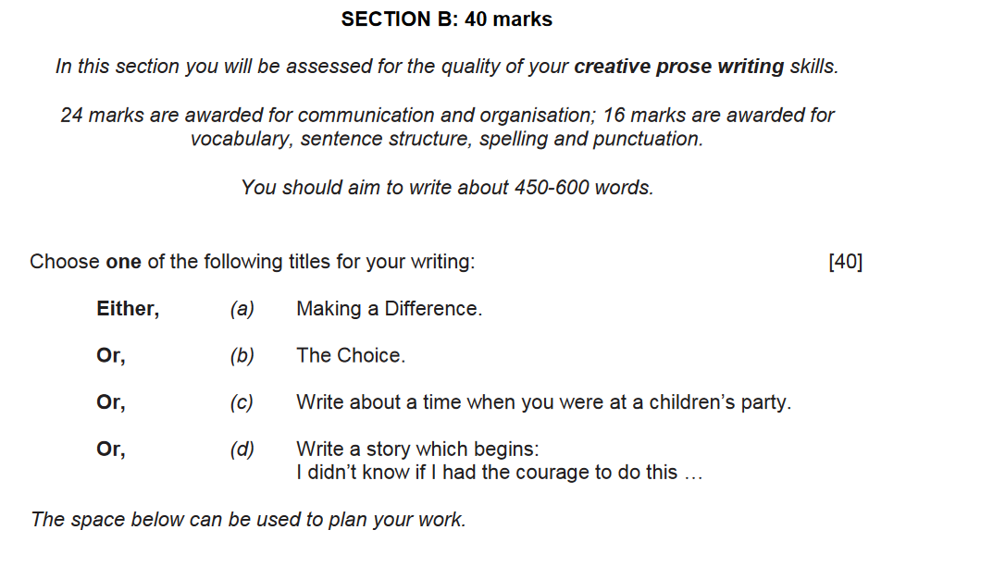
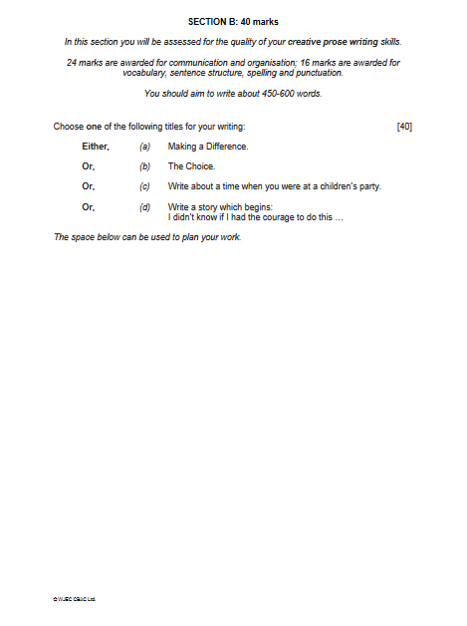

Slide 6
Narrative Writing is…
Written in the 1st person (I/ME) or 3rd person (He/She.
Tells a story, with beginning, middle, end.
Follows one character but often meets a number of characters (realistic)
Includes speech (dialogue).
Is event based – something happens.

Slide 7
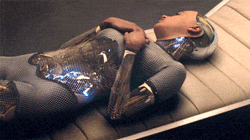
Features of Narrative Writing
  the plot this is what happens
  characters the people or animals in the story
  the setting where the narrative takes place

Slide 8
STORIES CAN BE TRUE OR FICTITIOUS.
THEIR ROLE IS TO INTEREST AND/OR ENTERTAIN THE READER.
YOU ARE MARKED OUT OF 40:
24 – HOW INTERESTING THE STORY IS (INCLUDING PLANNING)
16 - SPAG
YOU NEED 23 TO GET A ‘4’ (C) AND 27 TO GET A ‘5’ OR ABOVE.

Slide 9
THE WORD COUNT IS 450-600 WORDS
SHORTER THAN 450 IS ‘UNLIKELY TO SCORE A HIGH MARK.’
WORK LONGER THAN 600 ‘IS MORE LIKELY TO HAVE MISTAKES.’
SO...GO FOR 500-550 WORDS.
AVERAGE HANDWRITING = 2 ½ - 3 PAGES.
PC ON SIZE 12 FONT = 1 ½ PAGES

Slide 10
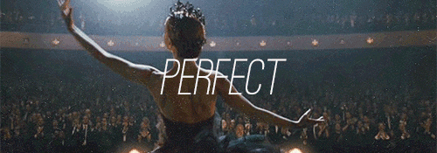
ORIGINAL – TOP MARKS

Slide 11
DECIDING ON YOUR STORY

Slide 12

FIRST OR THIRD PERSON?

Slide 13
FIRST OR THIRD PERSON?
FIRST (I)
EASIER TO WRITE.
GOOD FOR PERSONAL ACCOUNTS.
MAKES THE WRITING SEEM REAL.
GIVES WRITING MORE PACE.
THIRD (HE/SHE)
GIVES THE POINT OF VIEW OF OTHER CHARACTERS.
LESS PREDICTABLE AS YOU DON’T KNOW IF THE MAIN CHARACTER SURVIVES.
IF IN ANY DOUBT, GO FOR 1ST PERSON!

Slide 14
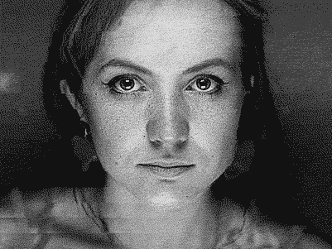
‘I’ doesn’t have to mean you!!!!

Slide 15
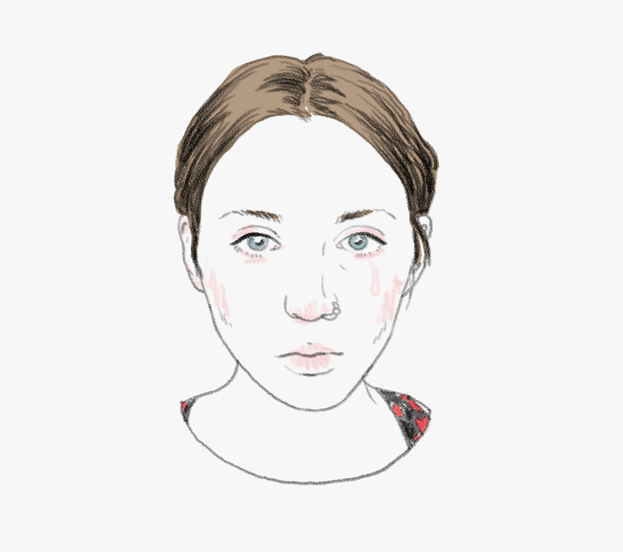

Slide 16
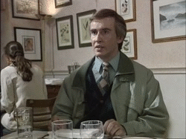

Slide 17
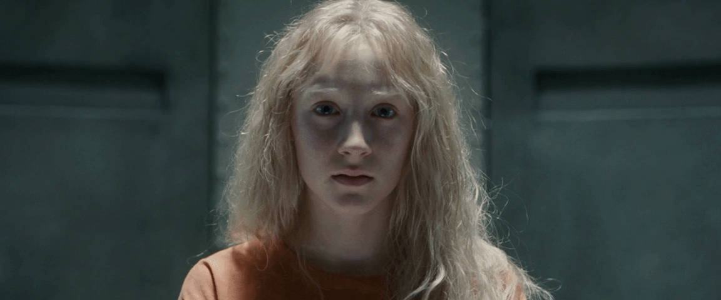

Slide 18


Slide 19


Slide 20
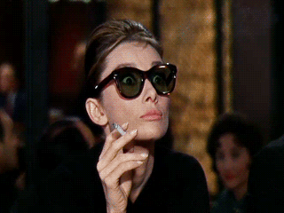

Slide 21
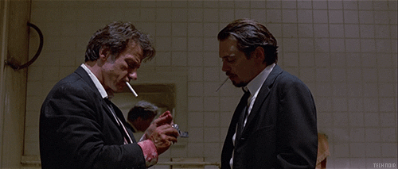

Slide 22
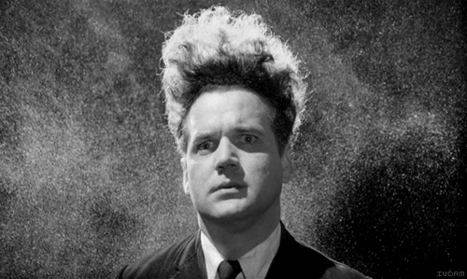

Slide 23
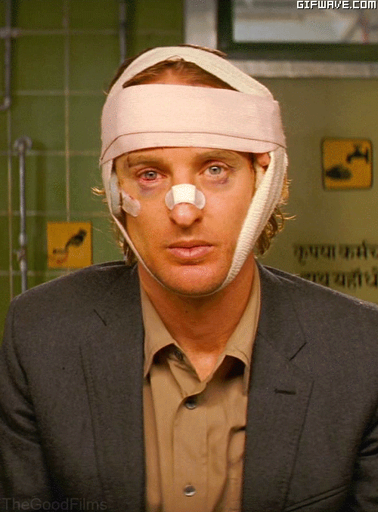

Slide 24
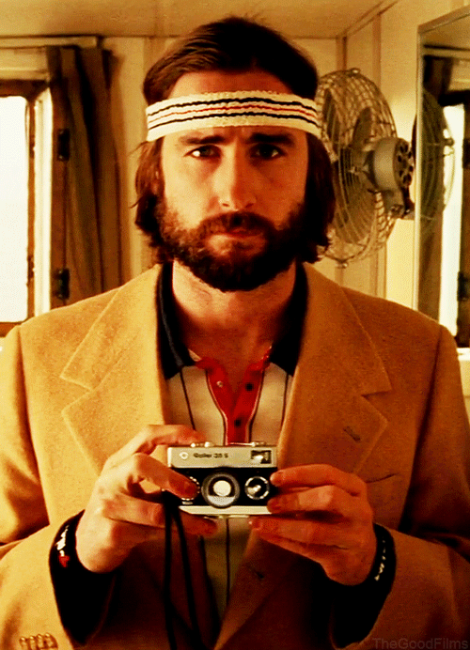

Slide 25
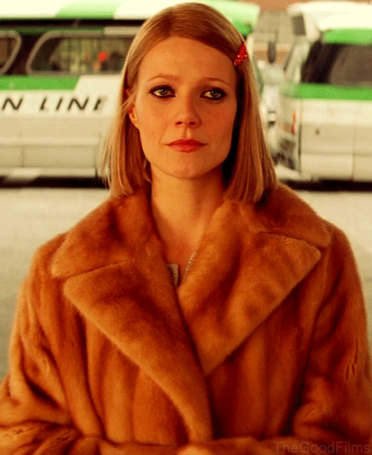

Slide 26
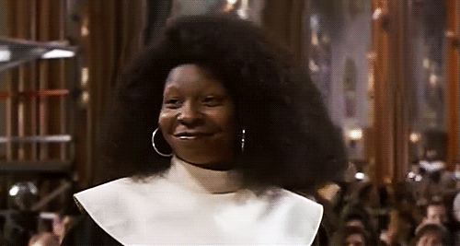

Slide 27
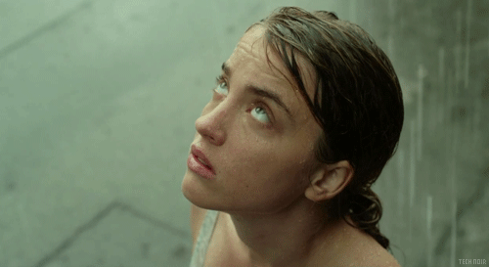

Slide 28
‘I’ doesn’t have to mean you!!!!

Slide 29
FIRST OR THIRD PERSON?
FIRST (I)
EASIER TO WRITE.
GOOD FOR PERSONAL ACCOUNTS.
MAKES THE WRITING SEEM REAL.
GIVES WRITING MORE PACE.
THIRD (HE/SHE)
GIVES THE POINT OF VIEW OF OTHER CHARACTERS.
LESS PREDICTABLE AS YOU DON’T KNOW IF THE MAIN CHARACTER SURVIVES.
IF IN ANY DOUBT, GO FOR 1ST PERSON!

Slide 30

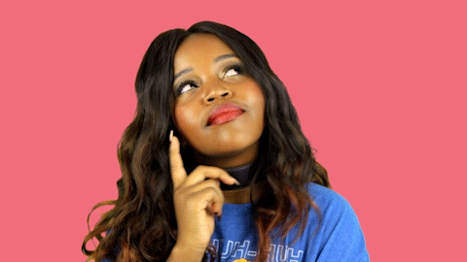


When does your story take place?
TIP: it is much easier from a SPAG point of view to do it all in the past!

Slide 31

Stories to avoid!
Fairy tales
Wizards
Going back in time
Teenage pregnancy
Drug abuse
Murder / Blood
DREAM ENDINGS!!!

Slide 32

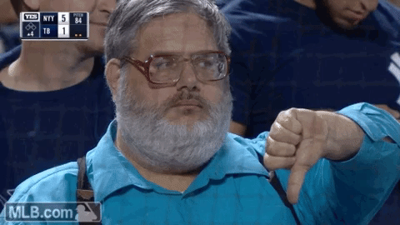
Teacher tip!
Try to set your story over a short period of time. Maybe even a few minutes.
Do not set it over days/weeks/months/years!

Slide 33
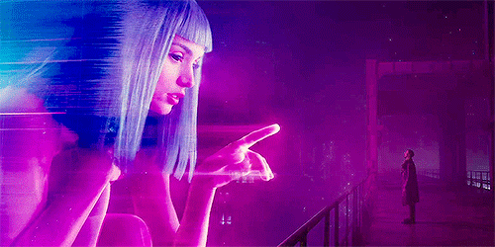
More action than physical description.

Slide 34
1. FUN TO WRITE
2. SURPRISE EXAMINER
3. WHAT CAN YOU DO IN 2 ½ PAGES?

Slide 35
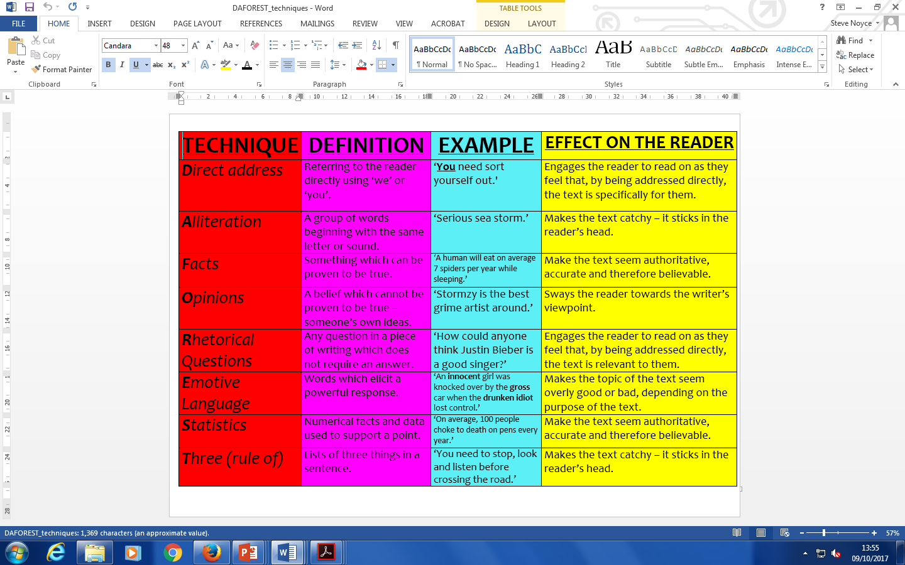

Slide 36
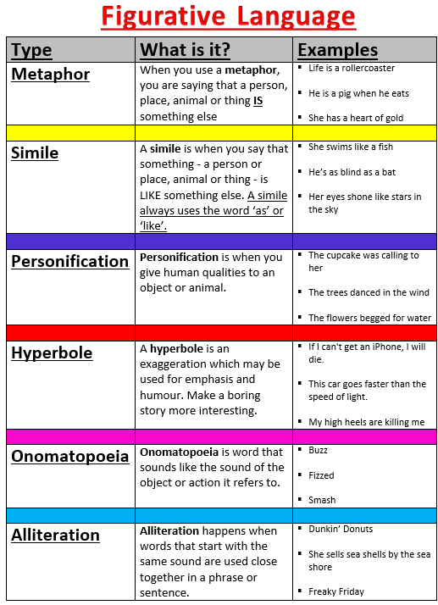

Slide 37

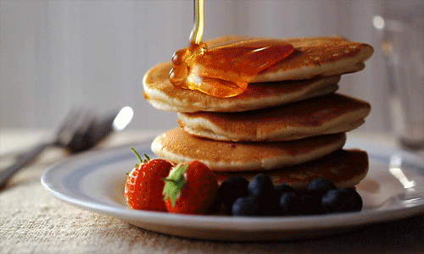
Sensory Language
The five senses is a way of creating imagery in the reader’s mind and to make them feel as though they are in the scene.

Slide 38
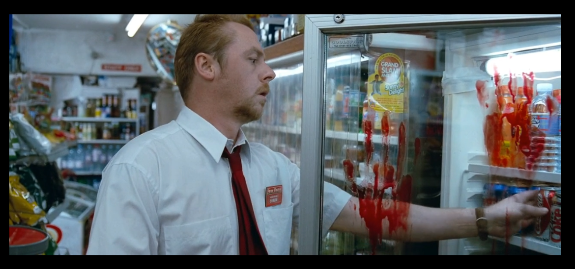
Show , don’t tell

Slide 39
SHOW, DON’T TELL
Showing creates mental images in the reader’s mind
When readers get a clear picture, they are more engaged in the story (draws them in).
This is an example of a rubbish sentence:
Laura was angry.

Slide 40

“LAURA WAS ANGRY.”
It is far better to describe in close detail what is happening to Laura’s body as he is getting angry.
Blood rushed to her ears. That familiar throbbing pulsed through her temples; her heart quickened and her pulse raced.

Slide 41
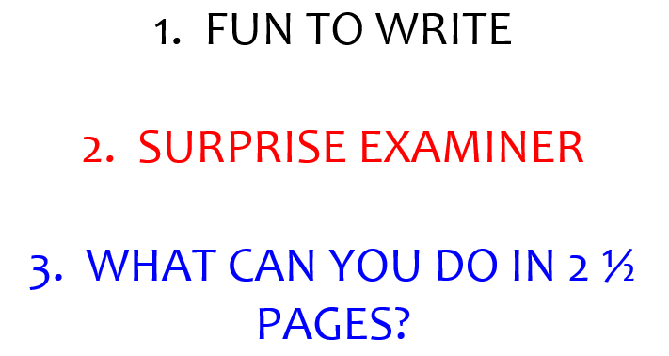
Creative Writing questions
1. The Best Christmas I Ever Had
2. The Surprise
3. Write a story that begins with the words:
“I didn’t know if I had the courage to do this.”
4. The Stranger

Slide 42
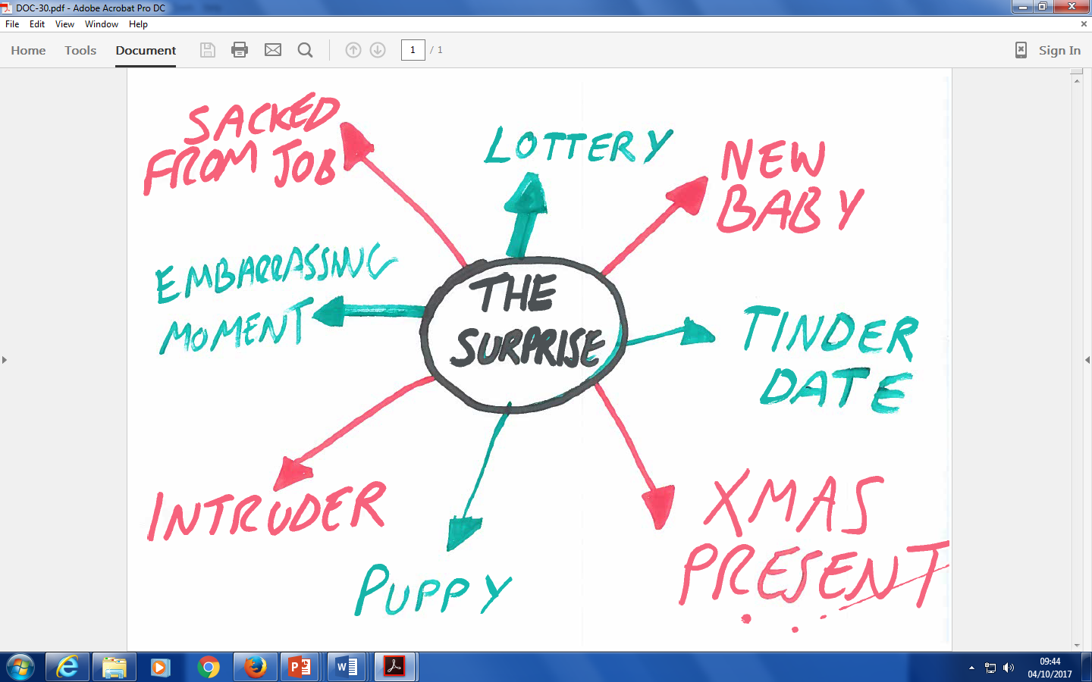

Slide 43
1. FUN TO WRITE
2. SURPRISE EXAMINER
3. WHAT CAN YOU DO IN 2 ½ PAGES?

Slide 45


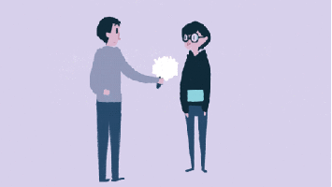

Slide 46
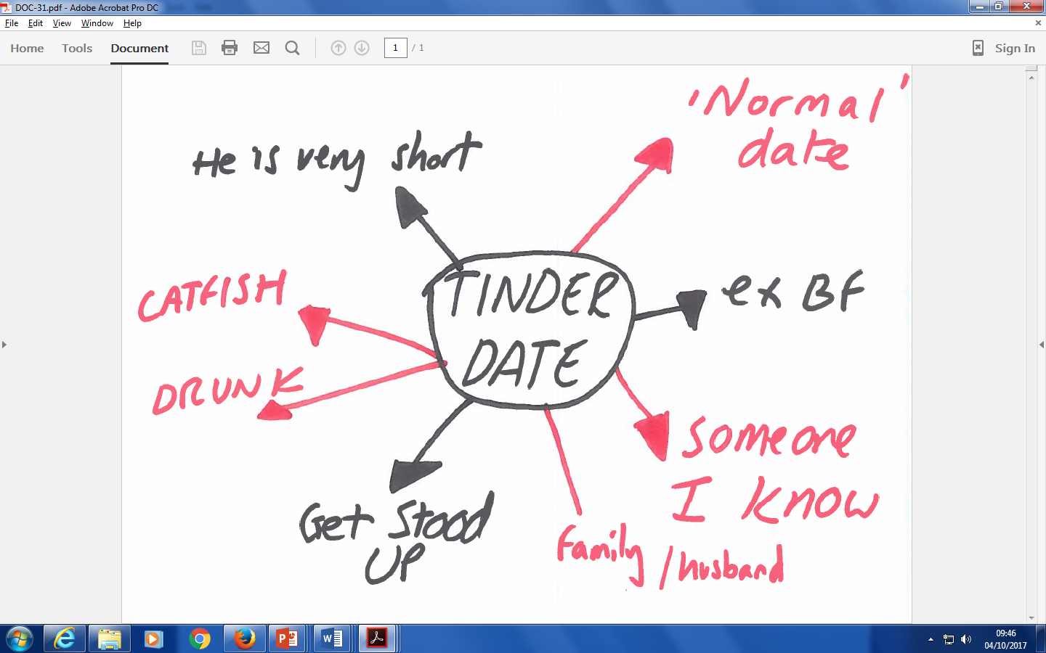

Slide 47
1. FUN TO WRITE
2. SURPRISE EXAMINER
3. WHAT CAN YOU DO IN 2 ½ PAGES?

Slide 48
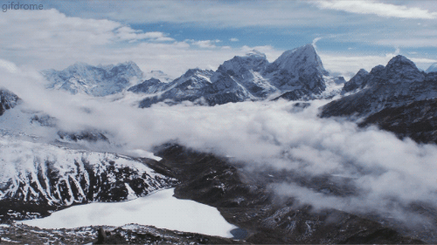
STRUCTURE

Slide 49

Narrative Structure Chart
Beginning: setting the scene and introducing the characters.
Development: the situation is developed; more characters introduced.
Problem: something happens to complicate the lives of the characters
Climax: a decisive moment is reached: matters come to a head; suspense is high.
Ending: matters are resolved & some sort of satisfactory end is reached.

Slide 50
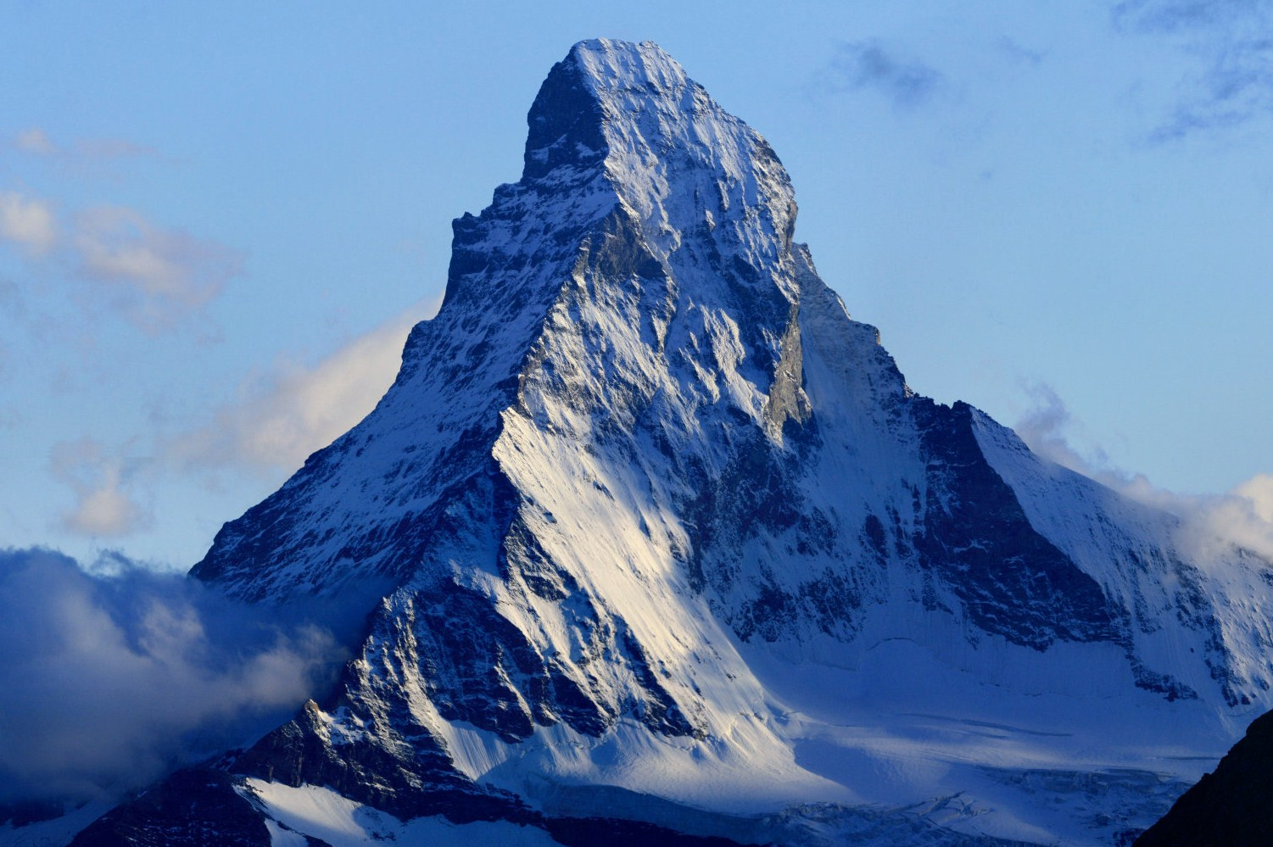
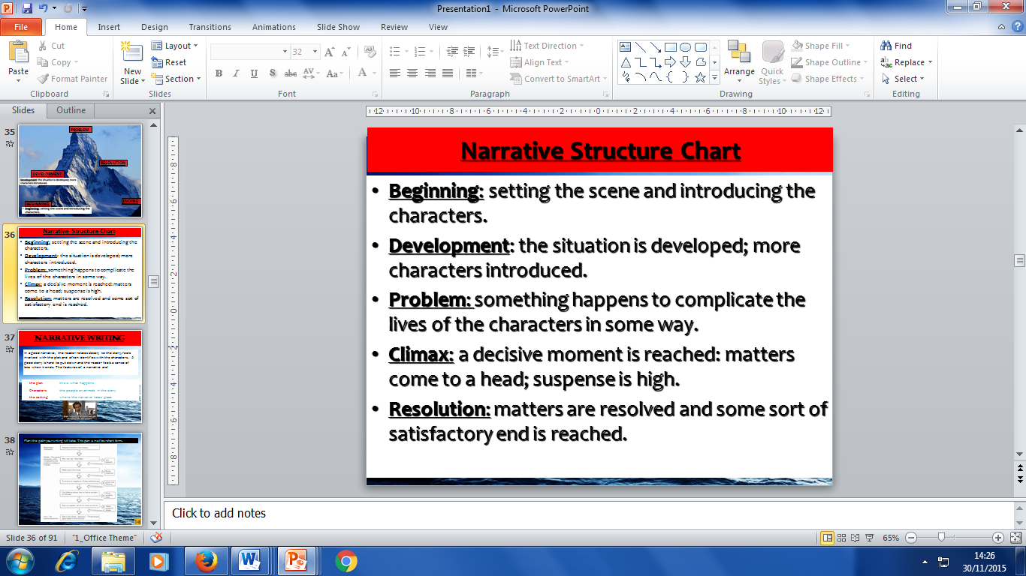
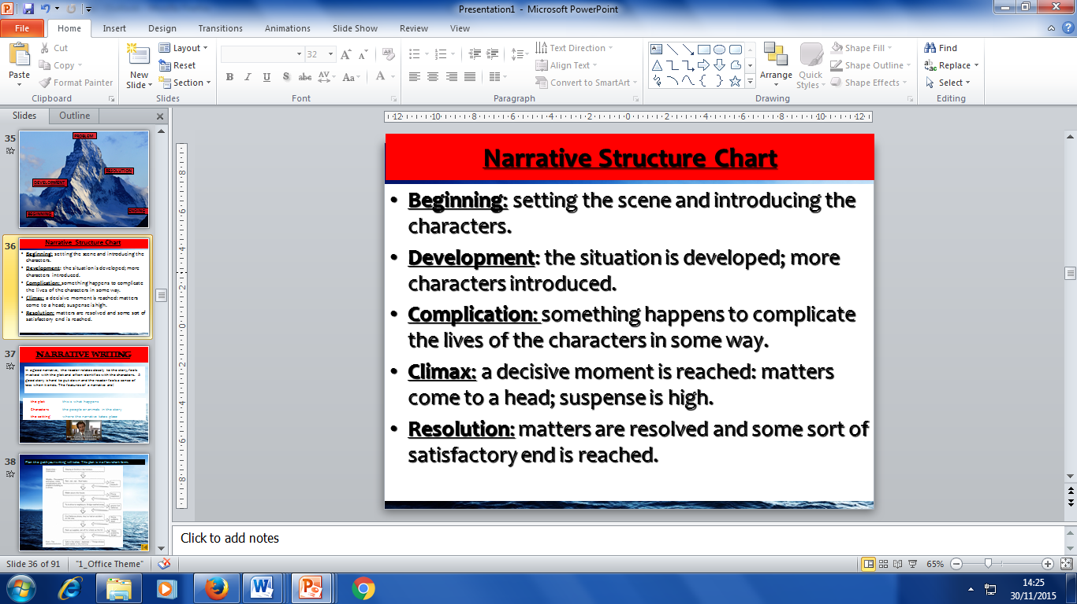
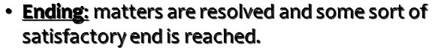
PROBLEM
CLIMAX
DEVELOPMENT
ENDING
BEGINNING

Slide 51
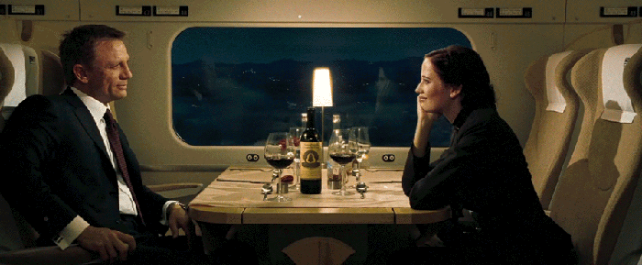

Slide 52
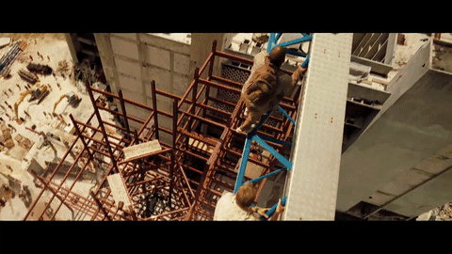

Slide 53
BEGINNING:
James Bond is playing poker in a luxury casino.
DEVELOPMENT:
He is called back to London and we meet the other characters.
PROBLEM
An evil genius is threatening to take over the world.
CLIMAX
James Bond saves the world.
ENDING
Bond sails into the distance with the girl.

Slide 54
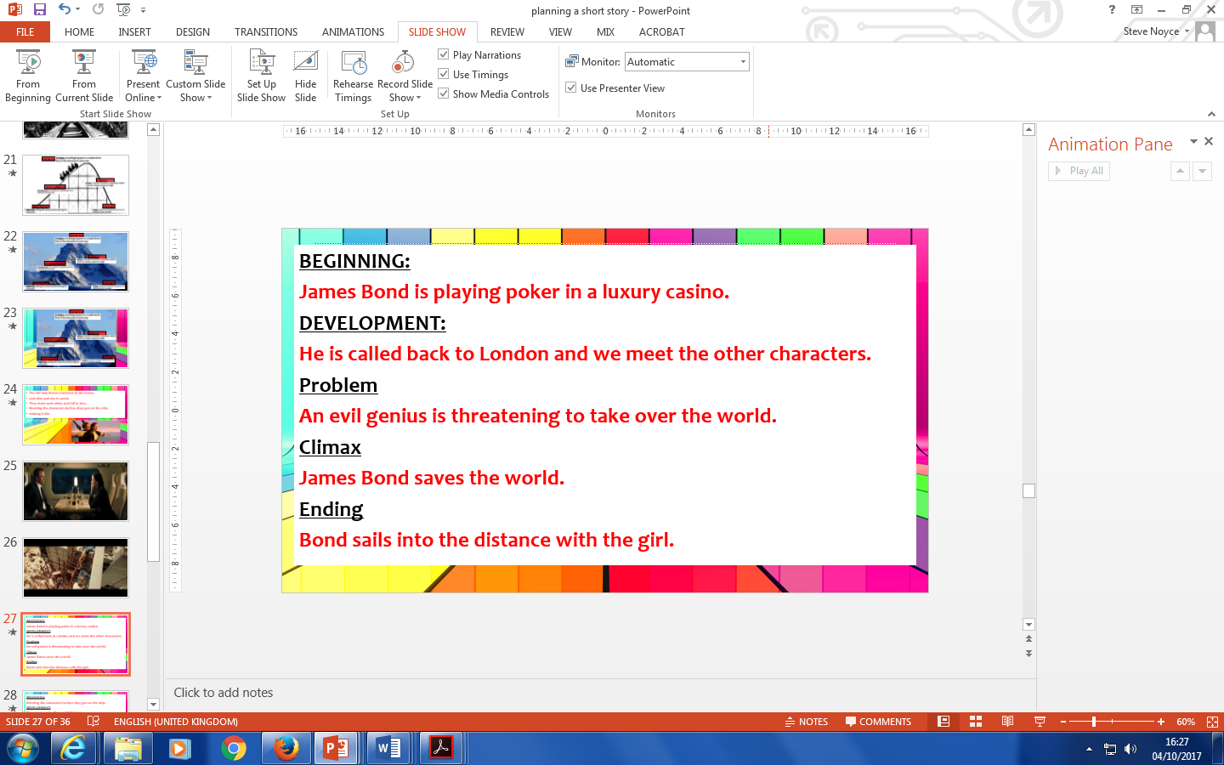
PROBLEM
CLIMAX
DEVELOPMENT
BEGINNING
ENDING

Slide 55
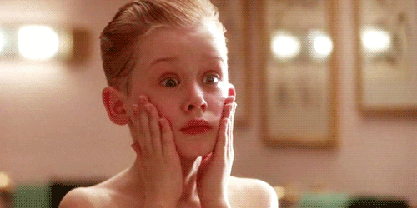

Slide 56
BEGINNING:
Meeting the characters in the house as they pack for a holiday.
DEVELOPMENT:
Kevin is told off and sent to bed.
PROBLEM
Kevin is left home alone and the burglars are introduced.
CLIMAX
Kevin defeats the burglars.
ENDING
The family arrive home and are reunited.

Slide 57
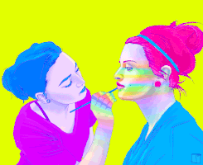
YOUR MAIN CHARACTER:
MALE OR FEMALE?
HOW OLD ARE THEY?
WHAT DO THEY LOOK LIKE?
WHAT IS THEIR PERSONALITY LIKE?
WHAT DO THEY DO FOR WORK?
WHAT DO THEY DO IN THEIR SPARE TIME?
DO THEY HAVE A FAMILY?

Slide 58
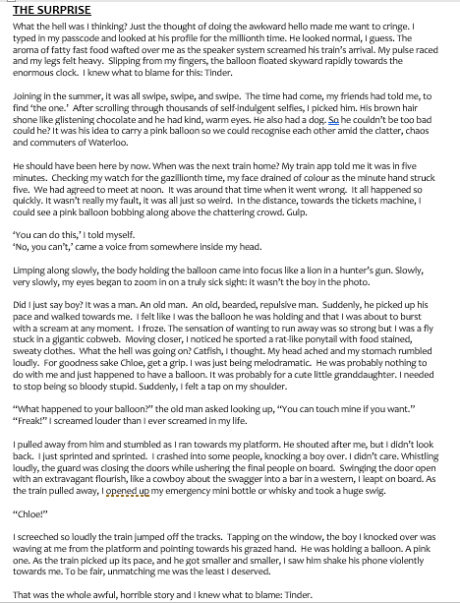


Slide 59
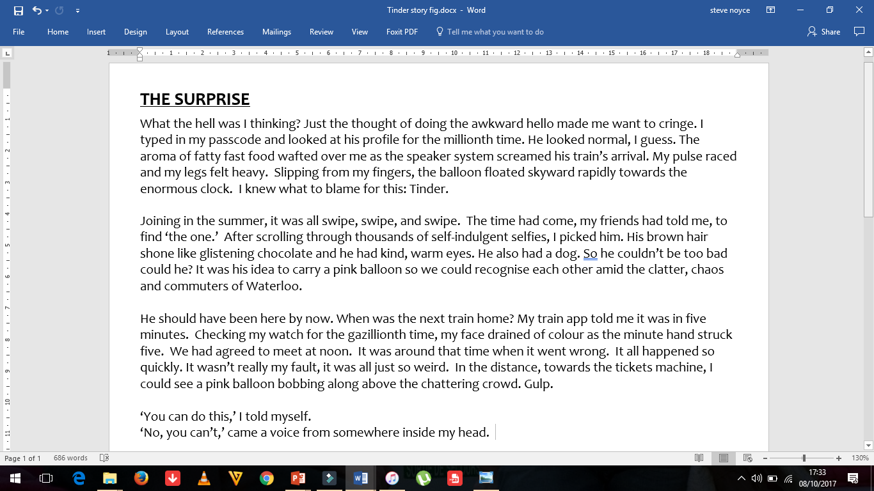

Slide 60
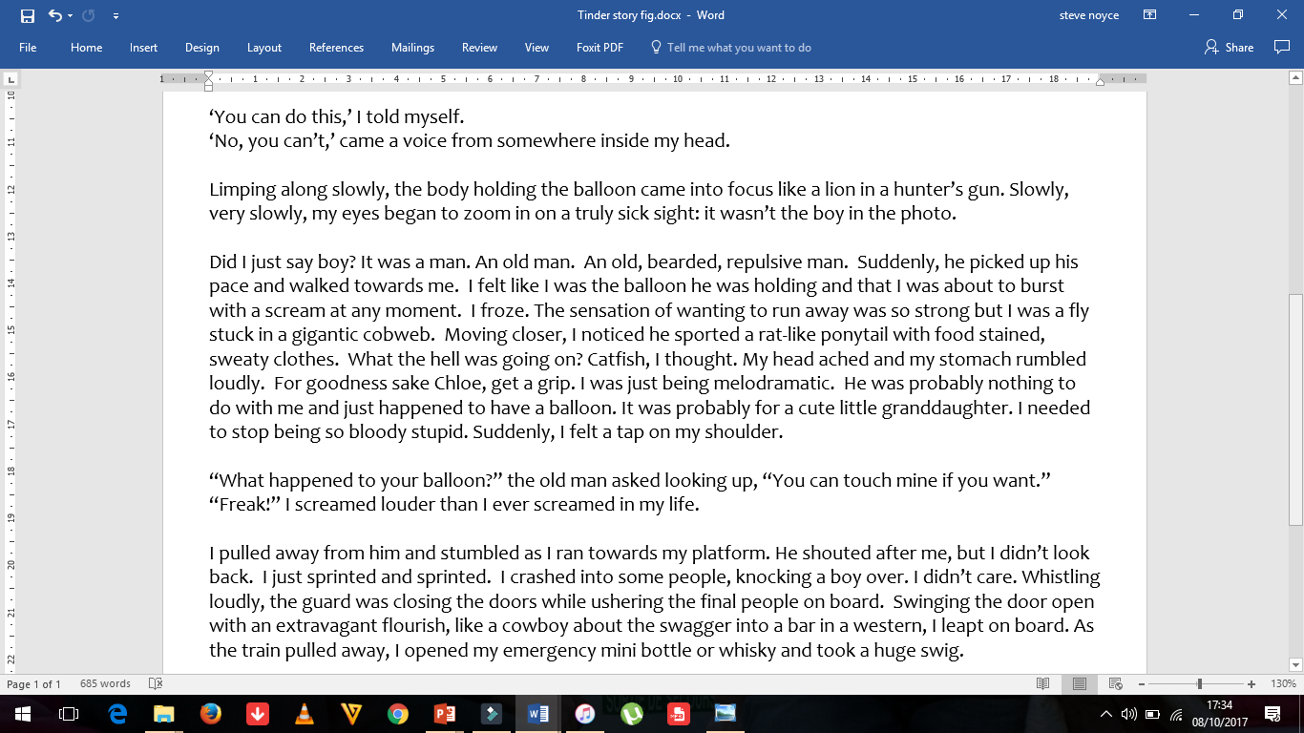

Slide 61
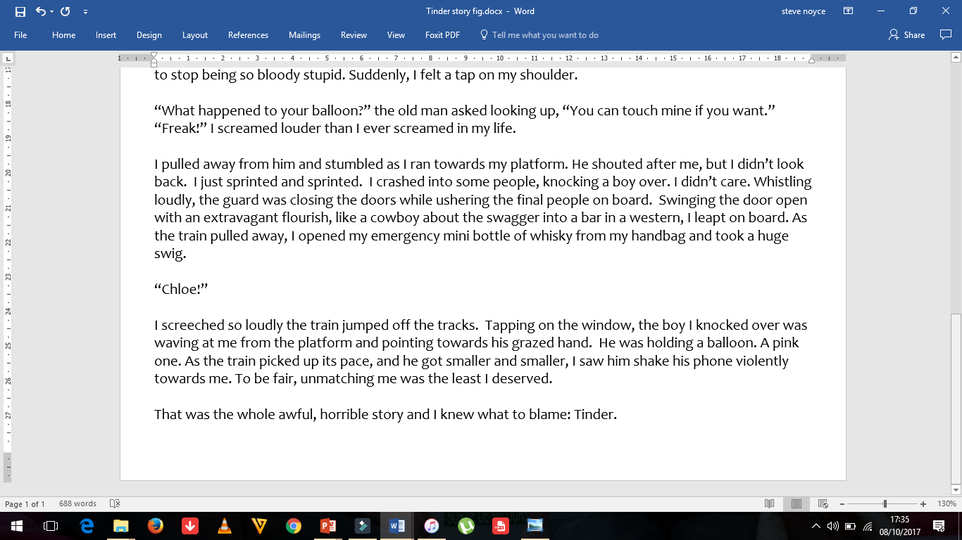

Slide 62
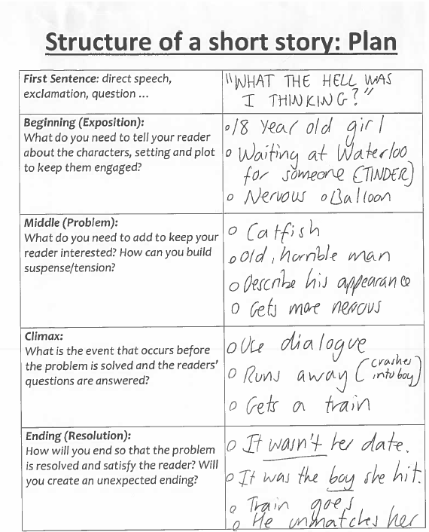

Slide 63
PROBLEM
Her date is not the person she is expecting.
Old man.
DEVELOPMENT
Tinder date
Describe her Tinder experiences.
CLIMAX
Runs away from him.
Gets on the train.
BEGINNING
Girl waiting at train station for someone.
ENDING
Her date wasn’t the man she ran away from.
Her date was the boy she crashed into.
He unmatches her.

Slide 64
THE
OPENING

Slide 65
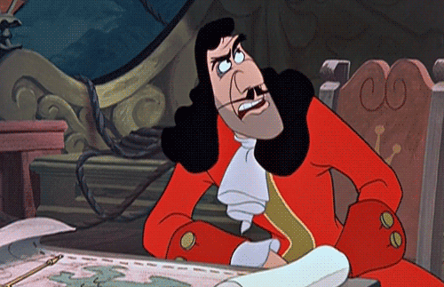
Part One – A Gripping Opening
Here you need to grab the reader’s attention and create a powerful impression.
You also need to introduce the main character, describe the setting and build mood and atmosphere to draw the reader in.
You need to ‘hook’
your reader.

Slide 66
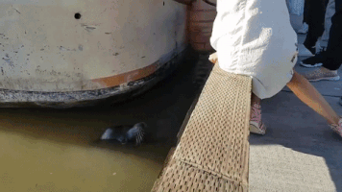
Opening Sentences
An opening sentence needs to grab the reader’s attention.

Slide 67
Dialogue:
“Hands in the air this is a stick up!” he hollered roughly.

Slide 68
A statement:
I never wanted a girlfriend.

Slide 69
Action:
Without a moment's hesitation, she lifted the revolver and fired.

Slide 70
Description of people:
Will Hunting looked ordinary for someone who had just solved one of the world’s most difficult maths problems.

Slide 71
Description of time:
As the clock struck twelve it echoed around the hall.

Slide 72
OPENING SENTENCE – TINDER STORY
What the hell was I thinking?

Slide 73
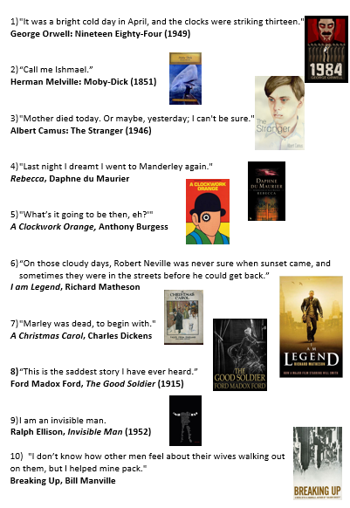
To write an opening sentence which will grab the reader’s attention.
Stories can start using the following ways:
Dialogue: “Hands in the air this is a stick up!” he hollered roughly.
A statement: “I never wanted a girlfriend.”
Action: Without a moments hesitation, Maude Drinkwater lifted the revolver and fired.
Description of people: Mr Sherman looked ordinary for someone who had just solved one of the world’s most difficult maths problems.
Description of time: As the clock struck twelve it echoed around the hall.

Slide 74
OPENING PARAGRAPH
What the hell was I thinking? Just the thought of doing the awkward ‘hello’ made me want to cringe. I typed in my passcode and looked at his profile for the millionth time. He looked normal, I guess. The aroma of fatty fast food wafted over me as the speaker system screamed his train’s arrival. My pulse raced and my legs felt heavy. Slipping from my fingers, the balloon floated skyward rapidly towards the enormous clock. I knew what to blame for this: Tinder.

Slide 75
Figurative Language

Slide 76
Figurative Language
What the hell was I thinking? Just the thought of doing the awkward ‘hello’ made me want to cringe. I typed in my passcode and looked at his profile for the millionth time. He looked normal, I guess. The aroma of fatty fast food wafted over me as the speaker system screamed his train’s arrival. My pulse raced and my legs felt heavy. Slipping from my fingers, the balloon floated skyward rapidly towards the enormous clock. I knew what to blame for this: Tinder.

Slide 77
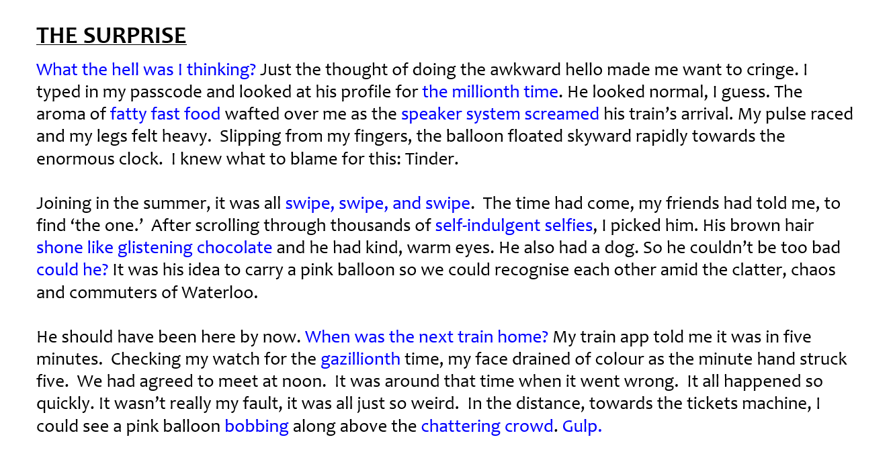
RHETORICAL
QUESTION
ALLITERATION & PERSONIFICATION
HYPERBOLE
ALLITERATION
REPETITION & POWER OF 3
ALLITERATION
SIMILE
RHETORICAL
QUESTION
HYPERBOLE
ALLITERATION
ONOMATOPOEIA

Slide 78
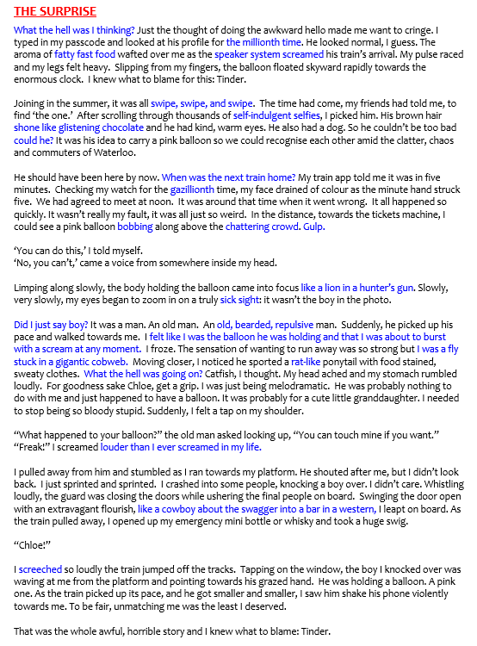
Figurative Language

Slide 79
Sensory Language
The five senses is a way of creating imagery in the reader’s mind and to make them feel as though they are in the scene.

Slide 80
Sensory Language
What the hell was I thinking? Just the thought of doing the awkward ‘hello’ made me want to cringe. I typed in my passcode and looked at his profile for the millionth time. He looked normal, I guess. The aroma of fatty fast food wafted over me as the speaker system screamed his train’s arrival. My pulse raced and my legs felt heavy. Slipping from my fingers, the balloon floated skyward rapidly towards the enormous clock. I knew what to blame for this: Tinder.

Slide 81

Sensory Language

Slide 82
Show , don’t tell

Slide 83

TRY TO NOT GIVE ALL THE DETAILS OF THE PLOT STRAIGHT AWAY.
MAKE THE READER WORK OUT WHAT IS GOING ON!

Slide 84
SHOW, DON’T TELL
What the hell was I thinking? Just the thought of doing the awkward ‘hello’ made me want to cringe. I typed in my passcode and looked at his profile for the millionth time. He looked normal, I guess. The aroma of fatty fast food wafted over me as the speaker system screamed his train’s arrival. My pulse raced and my legs felt heavy. Slipping from my fingers, the balloon floated skyward rapidly towards the enormous clock. I knew what to blame for this: Tinder.

Slide 85

Sentence starters

Slide 86
Sentence starters
Start with an adverb: “Carefully, John picked up the package.”
Start with a verb+ing: “Moaning, the teenaged walked off.”
Start with an adjective: “Shocked, I couldn’t move.”
Start with two adj: “Bored and exasperated, I stared at his exam.”
Start with a simile: “ As loud as a lion, I shouted to my mate.”

Slide 87
Sentence Starters
What the hell was I thinking? Just the thought of doing the awkward ‘hello’ made me want to cringe. I typed in my passcode and looked at his profile for the millionth time. He looked normal, I guess. The aroma of fatty fast food wafted over me as the speaker system screamed his train’s arrival. My pulse raced and my legs felt heavy. Slipping from my fingers, the balloon floated skyward rapidly towards the enormous clock. I knew what to blame for this: Tinder.

Slide 88

Sentence Starters

Slide 89

SENTENCE LENGTH

Slide 90


Slide 91
SENTENCE LENGTH
What the hell was I thinking? Just the thought of doing the awkward ‘hello’ made me want to cringe. I typed in my passcode and looked at his profile for the millionth time. He looked normal, I guess. The aroma of fatty fast food wafted over me as the speaker system screamed his train’s arrival. My pulse raced and my legs felt heavy. Slipping from my fingers, the balloon floated skyward rapidly towards the enormous clock. I knew what to blame for this: Tinder.

Slide 92

SENTENCE LENGTH

Slide 93

PARAGRAPH LENGTH
TRY TO MIX UP THE LENGTH OF YOUR PARAGRAPHS.

Slide 94


“I knew what to blame for this: Tinder.”
“I knew what to blame for this: Tinder.”

Slide 95
DEVELOPMENT

Slide 96
Joining in the summer, it was all swipe, swipe, and swipe. The time had come, my friends had told me, to find ‘the one.’ After scrolling through thousands of self-indulgent selfies, I picked him. His brown hair shone like glistening chocolate and he had kind, warm eyes. He also had a dog. So he couldn’t be too bad could he? It was his idea to carry a pink balloon so we could recognise each other amid the clatter, chaos and commuters of Waterloo.

Slide 97
Joining in the summer, it was all swipe, swipe, and swipe. The time had come, my friends had told me, to find ‘the one.’ After scrolling through thousands of self-indulgent selfies, I picked him. His brown hair shone like glistening chocolate and he had kind, warm eyes. He also had a dog. So he couldn’t be too bad could he? It was his idea to carry a pink balloon so we could recognise each other amid the clatter, chaos and commuters of Waterloo.

Slide 98
PROBLEM

Slide 99
YOUR ‘PROBLEM’ IN YOUR STORY SHOULD BE SMALL AND INTERESTING.

Slide 100
A GIRL IS WAITING FOR A BLIND DATE.
THE PROBLEM IS THE ‘DATE’ IS NOT THE PERSON SHE IS EXPECTING.

Slide 101
He should have been here by now. When was the next train home? My train app told me it was in five minutes. Checking my watch for the gazillionth time, my face drained of colour as the minute hand struck five. We had agreed to meet at noon. It was around that time when it went wrong. It all happened so quickly. It wasn’t really my fault, it was all just so weird. In the distance, towards the tickets machine, I could see a pink balloon bobbing along above the chattering crowd. Gulp.
‘You can do this,’ I told myself.
‘No, you can’t,’ came a voice from somewhere inside my head.
Limping along slowly, the body holding the balloon came into focus like a lion in a hunter’s gun. Slowly, very slowly, my eyes began to zoom in on a truly sick sight: it wasn’t the boy in the photo.
Did I just say boy? It was a man. An old man. An old, bearded, repulsive man. Suddenly, he picked up his pace and walked towards me. I felt like I was the balloon he was holding and that I was about to burst with a scream at any moment. I froze. The sensation of wanting to run away was so strong but I was a fly stuck in a gigantic cobweb. Moving closer, I noticed he sported a rat-like ponytail with food stained, sweaty clothes. What the hell was going on? Catfish, I thought. My head ached and my stomach rumbled loudly. For goodness sake Chloe, get a grip. I was just being melodramatic. He was probably nothing to do with me and just happened to have a balloon. It was probably for a cute little granddaughter. I needed to stop being so bloody stupid. Suddenly, I felt a tap on my shoulder.

Slide 102
CLIMAX

Slide 103
More action than physical description.

Slide 104
“What happened to your balloon?” the old man asked looking up, “You can touch mine if you want.”
“Freak!” I screamed louder than I ever screamed in my life.
I pulled away from him and stumbled as I ran towards my platform. He shouted after me, but I didn’t look back. I just sprinted and sprinted. I crashed into some people, knocking a boy over. I didn’t care. Whistling loudly, the guard was closing the doors while ushering the final people on board. Swinging the door open with an extravagant flourish, like a cowboy about the swagger into a bar in a western, I leapt on board. As the train pulled away, I opened my emergency mini bottle of whisky from my handbag and took a huge swig.

Slide 105
“What happened to your balloon?” the old man asked looking up, “You can touch mine if you want.”
“Freak!” I screamed louder than I ever screamed in my life.
I pulled away from him and stumbled as I ran towards my platform. He shouted after me, but I didn’t look back. I just sprinted and sprinted. I crashed into some people, knocking a boy over. I didn’t care. Whistling loudly, the guard was closing the doors while ushering the final people on board. Swinging the door open with an extravagant flourish, like a cowboy about the swagger into a bar in a western, I leapt on board. As the train pulled away, I opened my emergency mini bottle of whisky from my handbag and took a huge swig.

Slide 106
THE
ENDING

Slide 107
THE ENDING IS THE FINAL IMPRESSION THE READER HAS OF YOUR WRITING.
YOUR ENDING SHOULD BE INCLUDED IN YOUR PLAN.
THINK ABOUT TONE – HAPPY, SAD, OR FUNNY?
CRAFT YOUR FINAL SENTENCE CAREFULLY – THIS IS THE LAST BIT OF YOUR WRITING AN EXAMINER WILL READ.
DO NOT SAY IT WAS A DREAM!!!

Slide 108



STORY ENDINGS
Closed
When all the threads are neatly tied.
Open
When a story fails to provide satisfying closure and leaves the reader with questions/gaps that they need to fill in.
Twist
When a story takes an unexpected turn.

Slide 109

STORY ENDINGS
What were we expecting?
Ends with how it starts.
Makes the writing circular.
Twist
When a story takes an unexpected turn.

Slide 110
CLOSING SENTENCE
I knew what to blame for this: Tinder.

Slide 111


Slide 112
Replied
Answered
Responded
Coughed
Whispered
Stuttered
Expressed
Announced
Stated
Remarked
Commented
Mentioned
Observed
Guessed
Shouted
Hollered
Screamed
Sobbed
Cried
Laughed
Chuckled
Suggested
Said

Slide 113

DIALOGUE TAGS
YOUR STORY SHOULD NOT LOOK A LIKE A SCRIPT.

Slide 114

WHAT DOES THE WORD ‘DIALOGUE’ MEAN?
A conversation between two or more people as a feature of a book, play, or film.

Slide 115

Golden Rules of Dialogue
All dialogue must be contained in quotation marks.
“Let’s put another shrimp on the barbie,” Lloyd shouted.

Slide 116

Golden Rules of Dialogue
2) Before the end of the quotation marks, you must punctuate ( , ! ? . )
“Let’s not!” the girl shouted.
“Let’s not,” the girl said.

Slide 117
Golden Rules of Dialogue
3) New speaker, new line.
“Let’s put another shrimp on the barbie,” Lloyd shouted.
“Let’s not,” the girl said.

Slide 118
Golden Rules of Dialogue
4) Include who said what and how.*
“Let’s put another shrimp on the barbie!” Lloyd shouted.
“Let’s not,” the girl said.

Slide 119

Golden Rules of Dialogue
5) A quoted sentence begins with a capital letter.
“Man, you are one pathetic loser!” said Lloyd.

Slide 120



Slide 121
For a great grade, you will need to...
Use ambitious vocabulary.
Vary sentence structure and length.
Use the 5 senses to describe.
Describe setting.
Show what characters are like using dialogue.
Keep the ‘sense’ of the character and tone throughout.
Describe atmosphere and special techniques, such as similes and metaphors.

Slide 122

How to write the perfect story!

