Slide 1
Sentence Structure
Learning Objective:
To be able to identify and use different types of sentences to create different effects in my written work.
What do we mean by sentence structure?
Why might it be important to vary this in our writing?
Write down three reasons.

Slide 2
ALL will be able to identify different sentence types and the effects these have on our writing.
MOST will be able to use these to create different effects when writing.
SOME will evaluate and edit their work using this information, to directly manipulate your reader’s reactions to your writing.

Slide 3


Slide 4

Can you explain these terms?
Clause?
Conjunction?
Connectives?
Do you know your types of sentences?

Slide 5
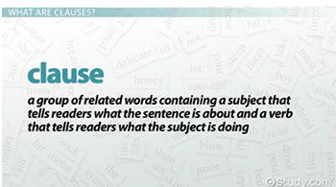
Clause
I graduated last year. (One clause sentence)
When I came here, I saw him. (Two clause sentence)
When I came here, I saw him, and he greeted me. (Three clause sentence)

Slide 6
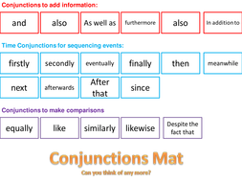
Conjunction
Conjunction - a word used to connect clauses or sentences or to coordinate words in the same clause (e.g. and, but, if ). https://www.youtube.com/watch?v=gFUSmdvei90

Slide 7
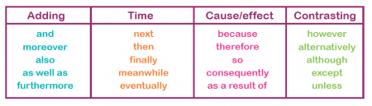
Connectives
A connective is a word that joins one part of a text to another.
Connectives can be conjunctions, prepositions or adverbs.

Slide 8
What is...
...a sentence with one verb?
...a sentence with two verbs using a coordinating conjunction?
...a sentence with two or more verbs, containing a subordinate clause?

Slide 9
Simple/Compound/Complex
– The Side Effects
Expresses one key idea
Expresses one key idea
Expresses several key ideas but revolves around one main one – the others might be bits of extra information – it gives us a detailed insight into something.
Expresses several key ideas but revolves around one main one – the others might be bits of extra information – it gives us a detailed insight into something.
Develops our knowledge of a situation...
Develops our knowledge of a situation...
Expresses two key ideas that are equally weight – this might balance an argument, give extra details...
Expresses two key ideas that are equally weight – this might balance an argument, give extra details...
Sudden – might add drama, tension, suspense...
Sudden – might add drama, tension, suspense...
Provides balanced alternatives.
Provides balanced alternatives.
Reflecting a person’s state of mind if troubled...
Reflecting a person’s state of mind if troubled...
Increases pace/brings writing to a peak.
Increases pace/brings writing to a peak.
Alternative ideas are pushed below the key one(s).
Alternative ideas are pushed below the key one(s).

Slide 10
For each of the topics below, begin your response with a simple sentence, then alter this to make it compound, and then complex.
Is homework really necessary?
Should fast food adverts be banned from T.V.?
Should people be prosecuted for what they say online? (e.g. twitter, facebook...).
When you finish, think of three reasons to vary your sentences.

Slide 11
Self-assessment
Using the traffic light system of Red, Amber and Green, do you
RED – Not understand any of the sentence types and struggle to tell the difference between them
AMBER – Feel more secure with some of the sentence types than others
GREEN – Feel totally secure in your understanding of sentence types.

