Slide 1
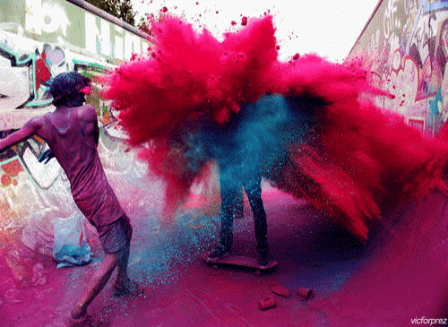
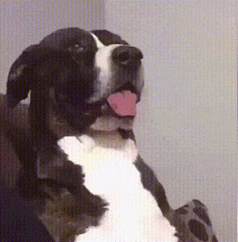
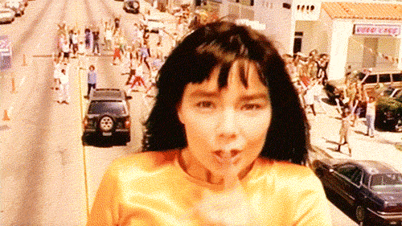
Sensory Language

Slide 2
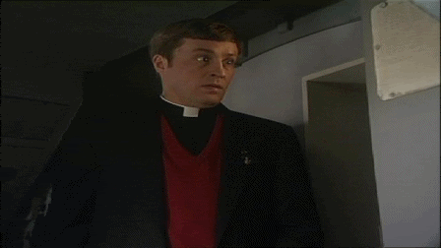
DO NOT TOUCH IT YET!

Slide 3

Describe what the sweet looks like in one sentence. Use a simile if you can. How do you feel not being able to touch it?
Pick it up and describe the feel of the outside as imaginatively as possible. Use at least 3 adjectives. Try a simile e.g. “The wrapper crackled like fireworks in the distance…”

Slide 4
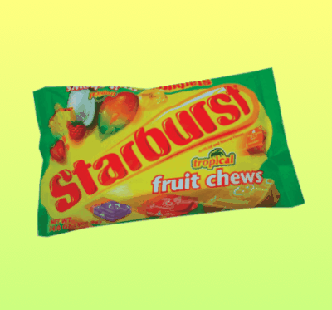
Now open it but don’t eat it!
Write down what the sweet feels like with the wrapper off e.g. “sticky, tacky….”
Smell the sweet and write a sentence which describes the aroma (don’t just write “fruity”!) Can you create a simile here?

Slide 5
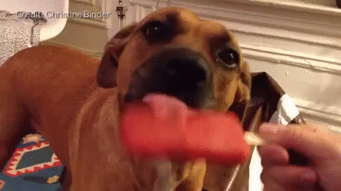
Now you can put the sweet in your mouth – don’t bite!
Describe the taste & the feel of your Starburst. Use a simile and an adjective!

Slide 6
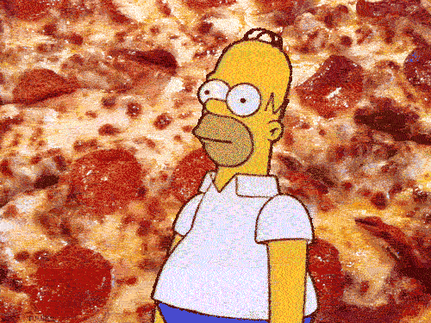
Now chew it!
Describe the sensation using onomatopoeia. What does it feel like? Has the taste changed?

Slide 7
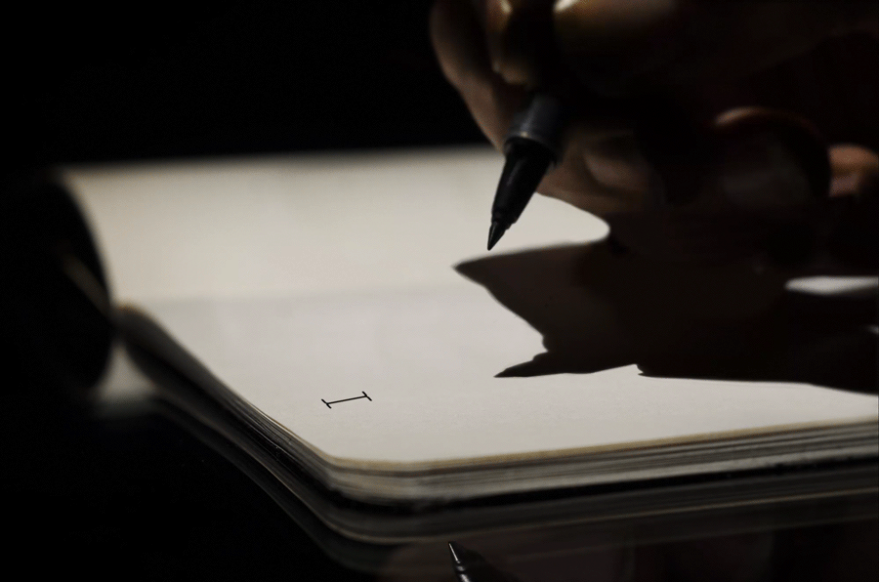
This is how writers make use of the 5 senses

Slide 8
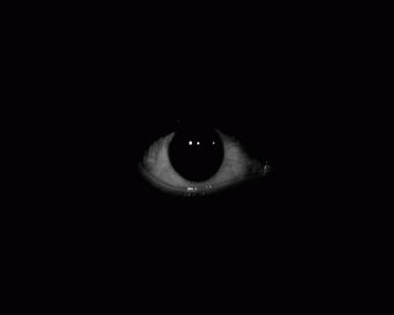
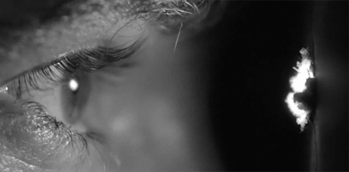
Sight

Slide 9
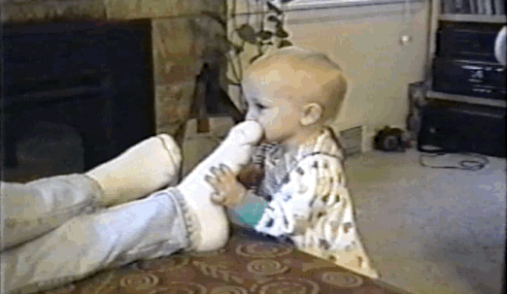
Smell

Slide 10
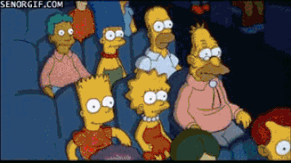
Sound

Slide 11
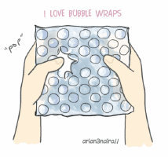
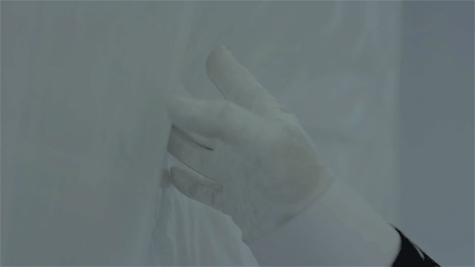
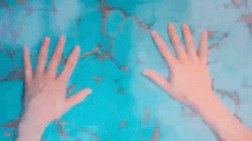
Touch

Slide 12
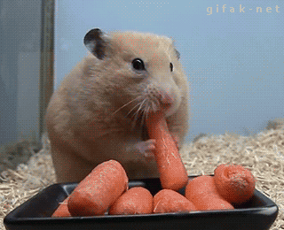
Taste

Slide 13


What are the five senses?
The five senses is a way of creating imagery in the reader’s mind and to make them feel as though they are in the scene.

Slide 14
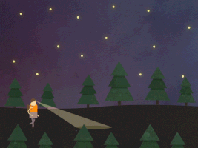
Boring Example
I slowed down as I walked to the top of the hill. I was really tired.

Slide 15

Sentence with sensory words
  My boots felt heavy and squelched as I trudged up to the top of the hill.
  Annoyingly, my boots felt heavy and squelched as I trudged up to the top of the hill.
Touch & Sound

Slide 16
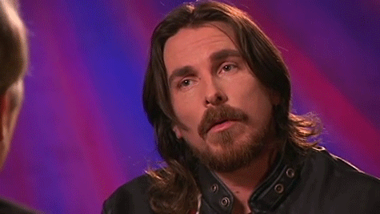
You are about to see a series of images;
For each image you see you must, write a sentence to describe what you see using sensory language.
Extension
Use an adverb or adjective to start the sentence.

Slide 17
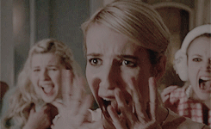

Slide 18
Screeching, the group of girls knew they were in real trouble.

Slide 19
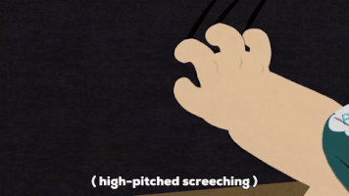
Screeching, the group of girls sounded like nails scratching down a blackboard.

Slide 20
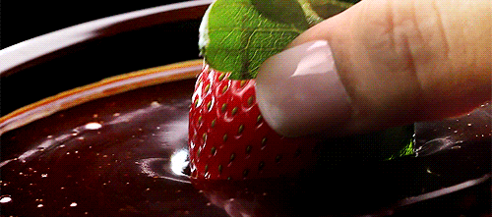

Slide 21
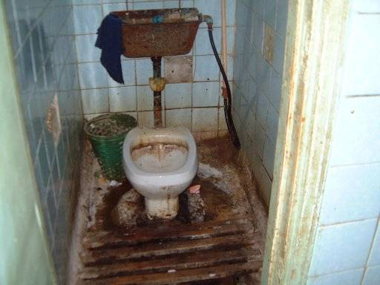

Slide 22
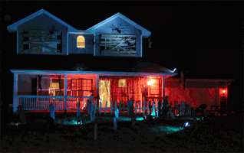

Slide 23
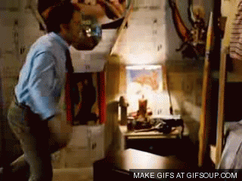

Slide 24
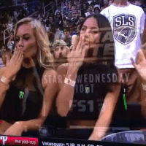

Slide 25
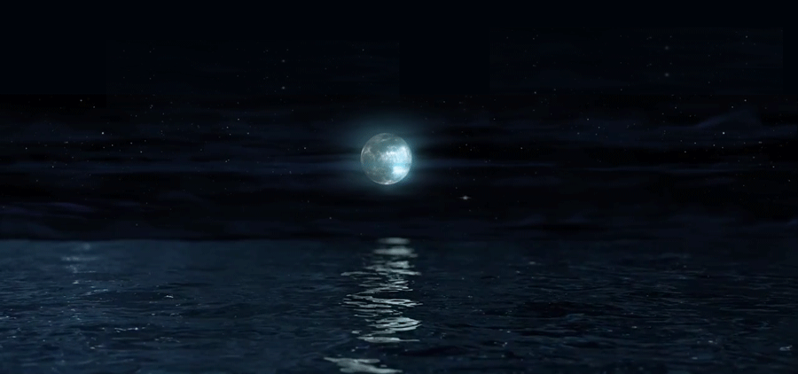
It was a frosty evening in early winter. Her fingers were cold as she had been typing on the computer. As she peered through the window, she saw the full moon shining. The clock was ticking on the shelf and the fire was crackling. She looked at the black and white cat licking and cleaning its fur by the fire. It was time for supper and as she opened a tin of salmon, the cat jumped up, smelling the fish and rubbing its head against her legs. She mixed the fish with some warm rice and sat down in the armchair by the fire and began to eat. She was hungry and the food tasted good. She watched the cat sniff at the empty fish tin. The cat padded up to her and she stroked its head. The cat purred with pleasure. Suddenly the telephone rang. She picked up the phone and listened. A gruff voice said …
1. Read the extract
2. Pick out 15 examples of sensory language
& say which sense it is describing.
Example – ‘gruff voice’ = sound

Slide 26
It was a frosty evening in early winter. Her fingers were cold as she had been typing on the computer. As she peered through the window, she saw the full moon shining. The clock was ticking on the shelf and the fire was crackling. She looked at the black and white cat licking and cleaning its fur by the fire. It was time for supper and as she opened a tin of salmon, the cat jumped up, smelling the fish and rubbing its head against her legs. She mixed the fish with some warm rice and sat down in the armchair by the fire and began to eat. She was hungry and the food tasted good. She watched the cat sniff at the empty fish tin. The cat padded up to her and she stroked its head. The cat purred with pleasure. Suddenly the telephone rang. She picked up the phone and listened. A gruff voice said …

Slide 27
Creative Writing questions
1. The Best Christmas I Ever Had
2. The Surprise
3. Write a story that begins with the words:
“I didn’t know if I had the courage to do this.”
4. The Stranger

Slide 28
THE STRANGER

Slide 29
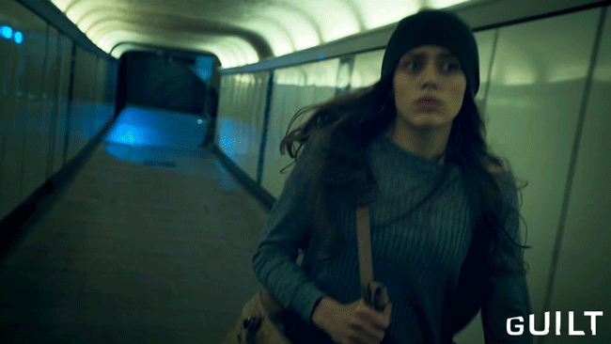

Slide 30
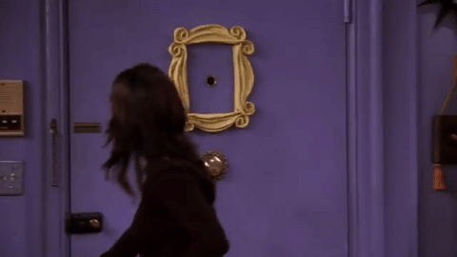

Slide 31
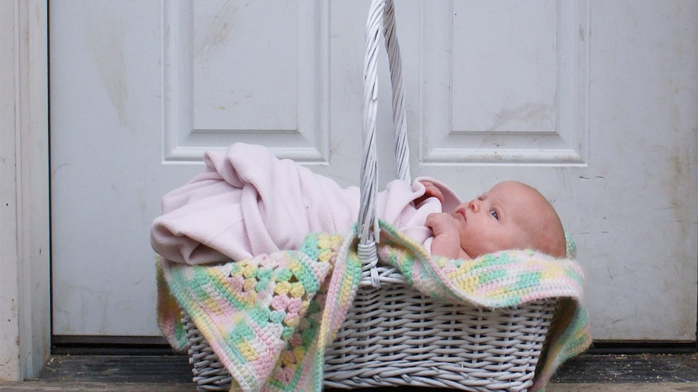

Slide 32
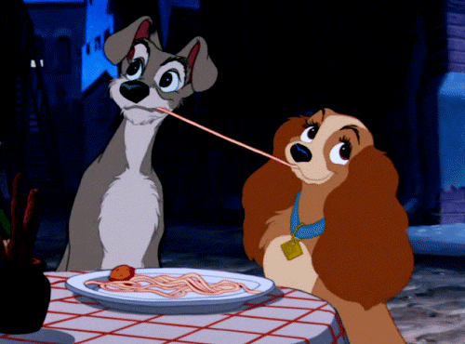

Slide 33
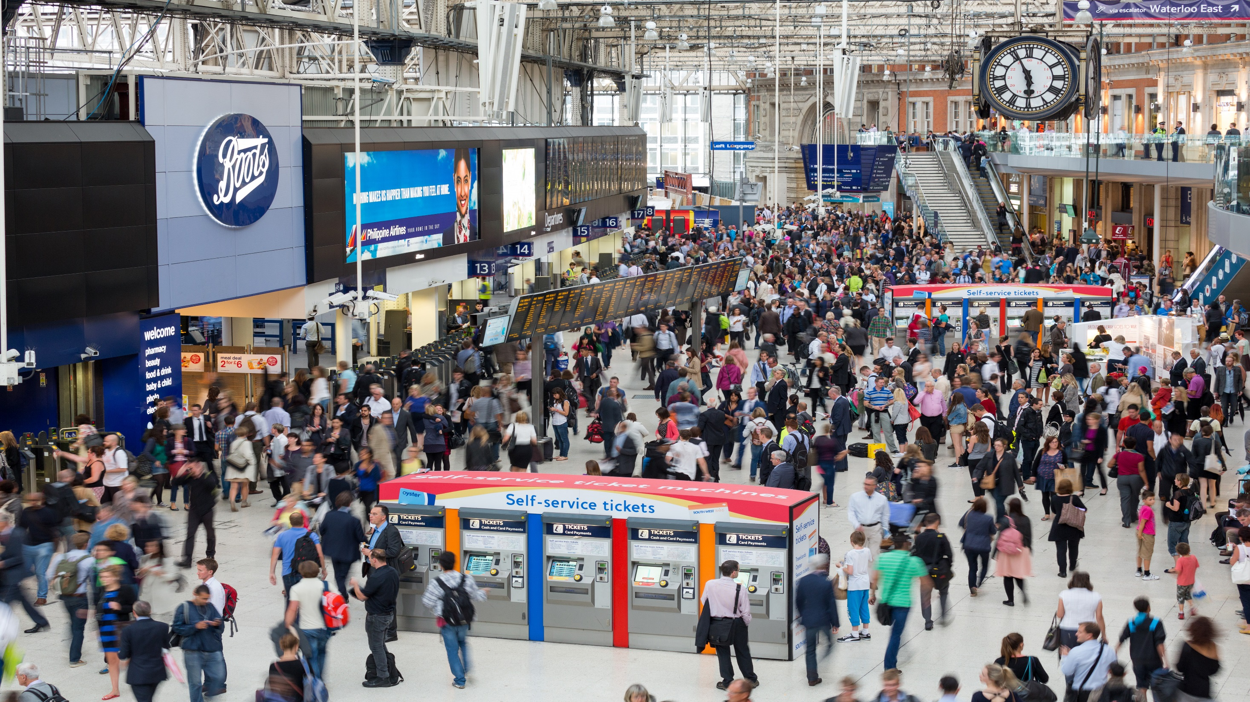

Slide 34
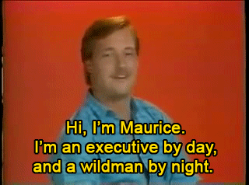
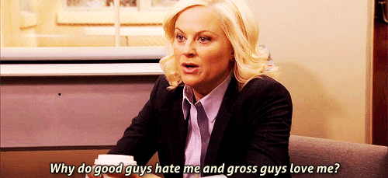
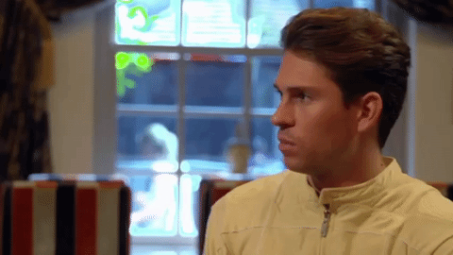
DATING

Slide 36
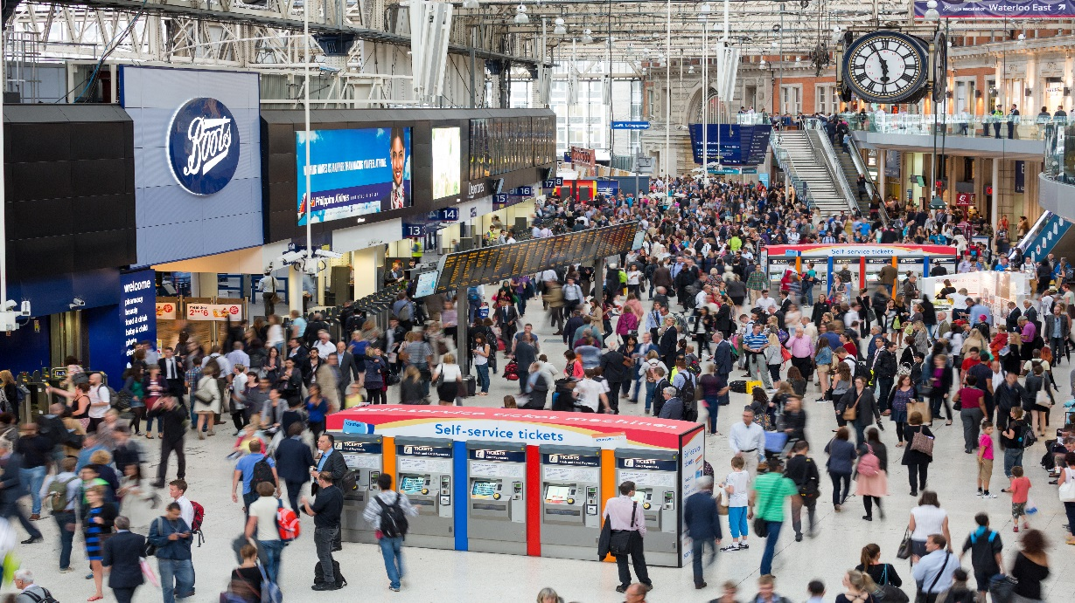
The Stranger – meeting a blind date at London Waterloo Station
two things you can see
two sounds you can hear
two things you can almost taste
two things you can touch/feel
two things you can smell
two similes
one onomatopoeia
one hyperbole
one alliteration
one personification

Slide 37
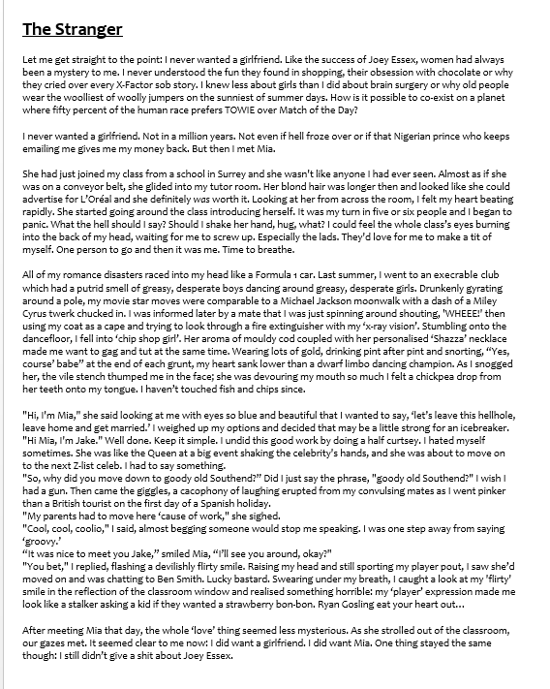
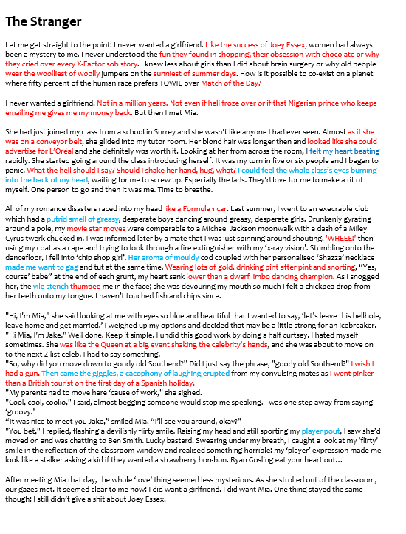
Figurative & Sensory Language Task
Highlight and annotate half of the ‘A’ grade example.
One colour for figurative language and one for sensory language.

Slide 38
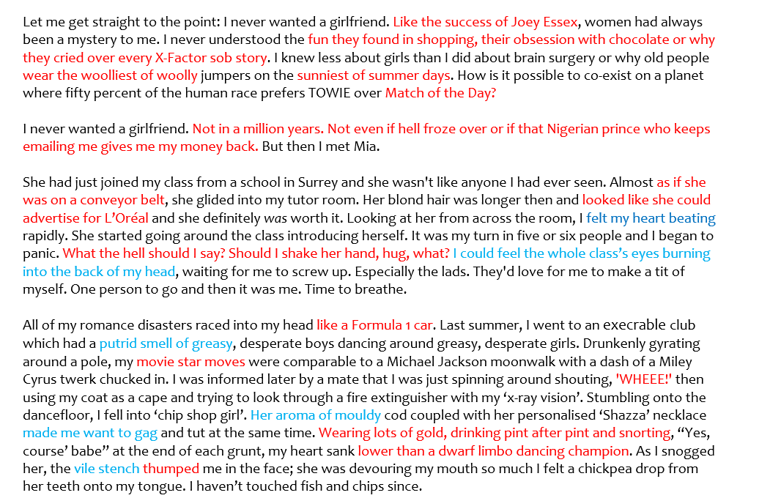
SIMILE
ALLITERATION
POWER OF 3
R QUESTION
HYPERBOLE
SIMILE
TOUCH
R QUESTION
SIMILE
ONOMATOPOEIA
ALLIT
POWER OF 3
SIMILE
SMELL
SMELL & TASTE
ONOMATOPOEIA

Slide 39
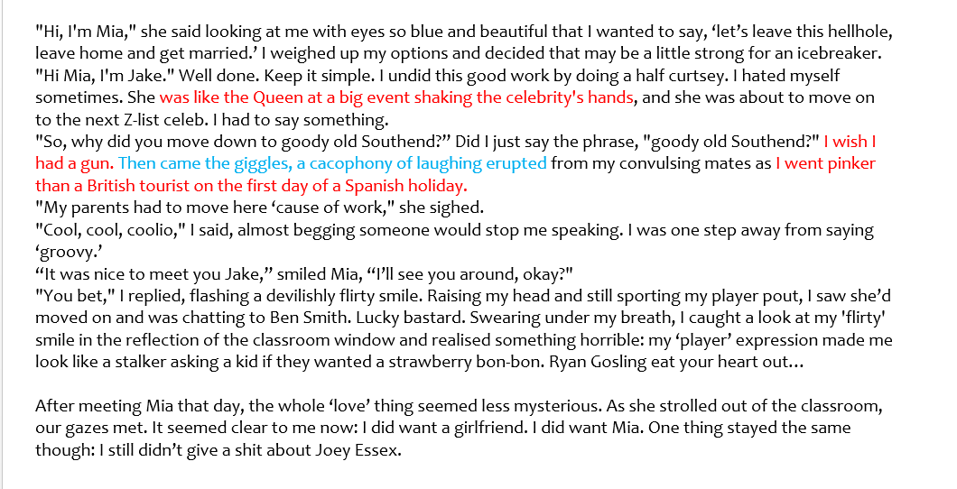
SIMILE
HYPERBOLE
SIMILE
HYPERBOLE
SOUND

Slide 40
Simile
Direct comparison between two unlike things, using like and as. Example: She is as busy as a bee.
Metaphor
A comparison between two things – saying something IS something. NOT using like, as.
Examples: The classroom was a zoo.
Personification
Gives qualities of a person to an animal, an object, or an idea.
Example: The chocolate bar was screaming for me to eat it.
Onomatopoeia
Words that mimic the sound e.g. boom, crash, fizzle etc.

