Slide 1
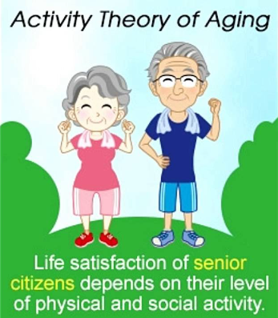
Activity theory

Slide 2
Activity theory: Robert Havighurst
Activity theory was proposed as an explanation to ageing by Robert Havighurst in the 1960s.
His ten year study of older people showed that, rather than an inevitable decline in interest in life and isolation, older people tend to adjust to the ageing process.
His theory is based on the assumption that social and psychological needs of older people remain the same

Slide 3
Activity theory: Robert Havighurst
He recognised that this may involve adjusting to changes in health and/or mobility but theorised that older people’s needs can be satisfied by taking on new roles following retirement such as charity work, joining social groups or learning a new skill.
Research supports his theory. Many older people look forward to retirement, viewing this part of their lifespan as an opportunity to pursue new hobbies and interests and to meet new friends.
When people remain physically and socially active, their overall satisfaction and wellbeing is increased.
This is important for reducing the risk of illness and increasing longevity.

Slide 4
What sort of activities?
Physically able
Golf
Walking groups
Fishing
Travel parties
Bowls
Classic dance
Senior swim sessions
Less able
Cards; bridge group
Dominoes social group
Wheelchair gardening
Disabled travel group
Wine tasting group
Wheelchair fitness class
Coffee morning craft

Slide 5
Reminiscence therapy
One theory is that older people need to engage in telling their life story, reminiscing or reviewing their life to help create self-esteem and confidence.
Coleman (1994) argued that some types of reminiscence therapy can be useful for helping individuals cope with the effects of ageing, but that there are wide differences in individual needs.

Slide 6
Reminiscence therapy
This is a treatment that uses all the senses — sight, touch, taste, smell and sound — to help individuals for example with dementia remember events, people and places from their past lives. As part of the therapy, care partners may use objects in various activities to help individuals with recall of memories.
Components of reminiscence therapy can include simple activities, such as conversation, as well as more advanced clinical therapies to help bring memories from the distant past into present awareness.
Storytelling about past events can help individuals with dementia feel less isolated and more connected to the present, experts say

Slide 7
Reminiscence therapy: Alzheimer’s
For people with Alzheimer’s and other forms of dementia, personal identity can seem to slip away as cognitive abilities decline.
But even as individuals begin to lose touch with current events, they may hold onto cherished memories.
Photographs, treasured objects and favorite songs all can help stimulate fond thoughts of the past for people with dementia.
The strong bond to familiar people and places is the basis for a special form of therapy that helps individuals with dementia recall their personal histories.

Slide 8
Benefits for Individuals with Alzheimer’s
In many cases, recent memories deteriorate first for people with Alzheimer’s and other forms of dementia.
By sharing memories from the past through reminiscence therapy, people with dementia can develop more positive feelings while reducing stress and agitation.
With minimal prompting — including simple questions, photos, songs or the beginning of a family story — individuals with dementia may recall memories from childhood and young adulthood.
Reminiscing about memories can help people feel more confident in their abilities and provide them with the opportunity to talk about what holds meaning for them. In addition, engaging in conversation about the past can provide relief from boredom and symptoms of depression, and it helps preserve family stories for later generations.

Slide 9
Case Study - application
Margery is 65 years-old and about to retire from her job in advertising. She enjoys her job and has many friends at work.
Margery plans to take up painting when she retires. She has already booked herself a painting holiday. She has also been asked by a friend to help out at a local charity shop.
Justify how Margery’s plans when she retires may impact on her health and well-being with reference to the Activity Theory.

