Slide 1
Ageing & Health & Social Care Provision
How psychosocial theories of ageing impact.
This power point & the activities will assist you in completing unit 4, M2 & D2.

Slide 2

Starter.
At what age do people retire from work?
Write your answer on the whiteboard

Slide 3
At what age do people retire from work?
From 1 October 2011, employers can no longer force employees to retire at the age of 65.
Not everyone will retire.
https://www.youtube.com/watch?v=yn0P3SPB22I
How do these changes link to the psychosocial theories of ageing?

Slide 4
Health & Social Care
Health & Social care services aim to provide the most appropriate care to meet individuals needs.
Historically the two services were separate but there is now increasing overlap or integration of the two aspects of care.
THE SINGLE ASSESSMENT PROCESS (SAP) was introduced in the National Service Framework for Older People (2001), Standard 2: person centred care.
Aims to ensure that the NHS & social care services
treat older people as individuals and enable them to
make choices about their own care.
https://www.youtube.com/watch?v=GfaU-1VbM2k

Slide 5
How is this care provided?
Most care is provided by the public sector and funded by taxes.
Health Care
Health care provision” means the provision of health care services as part of the comprehensive health service in England continued under section 1(1) of the National Health Service Act 2006.
Funded by the Department of Health
Provided directly or indirectly by the NHS.
This health care system meets people health needs although dental, optical and prescription are paid for unless a person is under 18 or elderly.
Social Care
Social care provision” means the provision made by a local authority in the exercise of its social services functions.
Funded through Local authorities
Some people need practical & emotional support to lead an active life and do the everyday things that most of us take for granted.
The social care system provides this support for those who need it to help them keep their independence and dignity

Slide 6
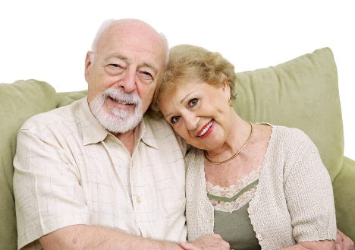
Social Care Services for the Elderly
Local Authorities provide
Home help
Information & Advice
Sheltered/supported housing
Lunch clubs
Social worker support
Day centres
Service user organisations
Some may provide Residential Care for the Elderly however most buy in these services from the private sector

Slide 7
Health Care Services for the Elderly
NHS provides
General Practitioner
Occupational therapy
Dental Services
Hospital Services
District Nursing services
Pharmacist
Physiotherapy
Optical services
Chiropody

Slide 8
Health & Social Care Provision for the elderly
Will all older people need health & social care support?
The majority of people will remain in their own home and be supported by friends, family and maybe social services.
However all are entitled to some state benefits

Slide 9
General Health & Social Care Provision for the Elderly
Travel Benefits
Free bus passes
Community transport Schemes - Dial a ride, social cars or taxi card schemes.
Shop mobility schemes - help people shop in town centres by lending wheelchairs and scooters.
Blue Badge parking scheme for those with disabilities
Financial Benefits
State pension
Pension Credit
Winter fuel payments
Health benefits
Free prescriptions
Free eye tests.
Other Benefits
Free TV licences for the over 75’s.

Slide 10
Think about it
How are do the universal benefits for the elderly link to the psychosocial theories of ageing?
Be ready to feedback your ideas to the class in 5 minutes
Theories
Financial benefits
Travel Benefits
Health Benefits
TV licence

Slide 11
Feedback (Some expected Reponses)
Disengagement Theory
– Private & State Pensions allow people to disengage from work.
Activity Theory & Continuity Theory
– Private Pensions may allow people to undertake activities they couldn’t when working.
- Travel benefits – help to maintain social contact and independence.
Health Benefits- maintain health & independence and current lifestyle.
Free TV licence – can help to prevent social isolation.

Slide 12
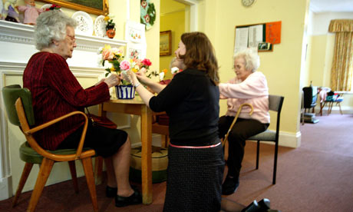
Activity:
Where might older people live?
Jot down your ideas and be ready to feedback.

Slide 13
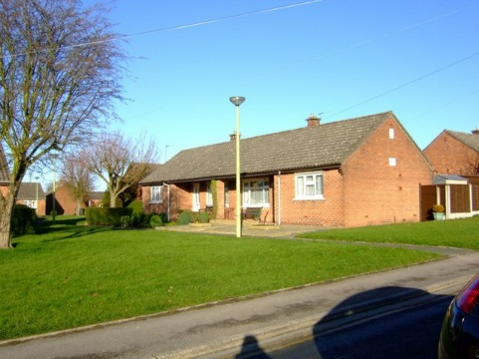
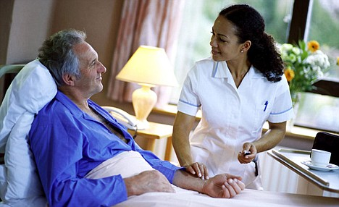
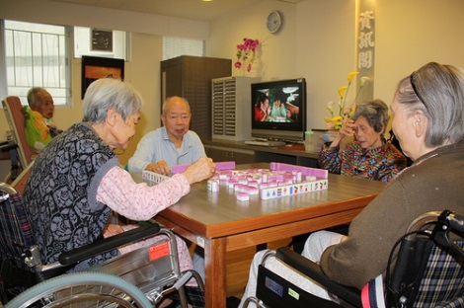
Where might older people live?

Slide 14

Types of care settings to meet the needs of the elderly:
  Home Care/ Community Care (domiciliary Care)
  Day Centre
  Sheltered housing
  Care homes
Research (using the internet and books) care
settings.
What services does it provide?
How does the setting meet the elderly clients needs and provide a good quality of life for the elderly person?

Slide 15

Home Care/ Community Care
As we previously identified most elderly people will live in their own homes.
However they may need support to stay in their own home.
http://www.bbc.co.uk/learningzone/clips/community-care-for-the-elderly/5624.html

Slide 16
Social Care Provision to assist the Elderly maintain independent living.
Home Care - provides a range of care tasks,
- personal care such as washing and dressing
- domestic tasks.
More intense home care tasks - assistance with catheter care, assistance with specialised feeding, assistance with stoma care and/or assistance with skin care etc. This service is provided by a Home Carer who is trained to an enhanced level and receives support and guidance from a District Nurse.
Telecare - an alarm system with a 24 hour response service.
Meals Service
Special equipment or adaptations to the home.
Luncheon clubs
Access to daytime groups including those offering entertainment, exercise and activities to develop skills or help with memory.

Slide 17
How does home care link to the Psychosocial theories?
Activity
– provides assistance to maintain activity.
Disengagement
– contact with carers prevents isolation, provides limited social contact.

Slide 18
Difficulties of Home Care
Families may find it difficult to provide support – Discuss why this may be so?
Social Services support – this may be limited due to the problems of providing care the a growing elderly population

Slide 19
How does Sheltered housing link to the Psychosocial theories?
Activity theory
– enables person to remain independent but provides support if required. Prevents isolation.
Disengagement
Reduced as living in a community with social
support if required- allows choice in the degree
of social activity.
May involve moving away from friends. If
have to move area may loss contact with
social network – eg church, clubs.

Slide 20
How does residential care link to the Psychosocial theories?
https://www.youtube.com/watch?v=UfoSv_MCRBo
Activity Theory
– provision of events - include games such as bingo, day outings, memory games etc. All of these active provisions will benefit the residents as they keep them engaged and stimulated as they may not use their mental ability in their day to day life. The outcome can give elderly individuals a sense of accomplishment whilst taking part in these tasks.
http://www.bbc.co.uk/learningzone/clips/computer-games-for-the-elderly/7333.html

Slide 21
Disengagement Theory
– residents have to option to participate.
Homes try to retain contact with family,
friends and the community – opportunities to
attend church, outings.
Negative effect – Family & friends may
reduce their visits over time.

Slide 22
Useful articles
http://homepages.uwp.edu/takata/dearhabermas/powell01bk.html
http://www.bbc.co.uk/news/business-24629576

