Slide 1
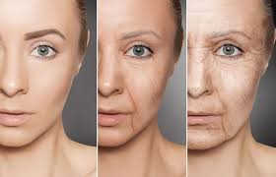

Unit 4: P5 & M3
Physical & Psychological Changes associated with Ageing

Slide 2
Assignment 3 Learning outcomes (L03) P5 M3 Understand Physical and Psychological changes of ageing.
Refer to unit 4 specification.
Lesson Focus P5, M3
P5 Explain the physical and psychological changes which may be associated with ageing.
M3 discuss the effects on self esteem and self- confidence of the physical changes associated with ageing.
Work Placement evidence
Don’t forget work experience will help you with your report. Many of you are on placement in residential/nursing care homes for the elderly and will have practical, visual, observational experience -residents in later life aged 65+ and the effects of ageing. You can reference this in your report for P5 & M3.
Confidentiality
Remember to protect the identity of resident’s in your report.

Slide 3
Key Command Words
Explain – Set out in detail the meaning of something, with reasons. Start with the topic then give ‘how’ or ‘why’.
Discuss – Provide a thoughtful and logical argument to support the case.

Slide 4
Assignment 3 P5 M3 - Vocational Scenario
Your editor is very impressed with your recent article on Human Growth and Development for your chosen celebrity.
NHS England, in partnership with , Public Health England and Saga have asked you to join their team to work together to produce an article on Saga’s Magazine on-line website Health and well being section - A Guide to Healthy Ageing.
This guide will have a section that informs the reader about the Physical and Psychological changes that may be associated with ageing. (P5)
It will also include an article discussing the effects on self esteem and self confidence of the physical changes associated with ageing. (M3)

Slide 5

Saga Magazine https://www.saga.co.uk/magazine
Saga Magazine provides support, advice & information for the over 50s ranging from health issues, retirement, money & pensions to gardening tips, recipes, celebrities and dating.

Slide 7
Effects of Ageing
Ageing begins as soon as adulthood is reached and is as much a part of human life as are infancy, childhood, and adolescence. (covered earlier in Unit 4 LO 1 – P1 M1 D1)
As the human body ages it undergoes various changes, which are experienced at different times and at varying rates among individuals.
Most people start to feel the effects of ageing after they are well into adulthood.

Slide 8
Physical & Psychological Changes - Activities
Individual task (15 mins)
On your small blank human body outlines; Identify & label Physical and Psychological changes associated with ageing to the relevant areas of the human body outline.
Small Group work (10 mins)
In your small group compare and contrast with each other what you have identified on your own diagrams.
From your discussions bridge any gaps and identify & label the key Physical and Psychological changes to areas of the human body on the A3 (large diagrams).
Make sure you have added any omissions to your own small diagrams.
Feedback to the large group.

Slide 9
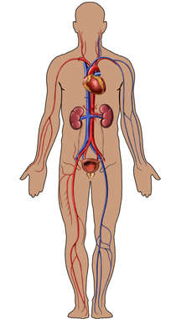
Ageing - Physical Changes

Slide 10
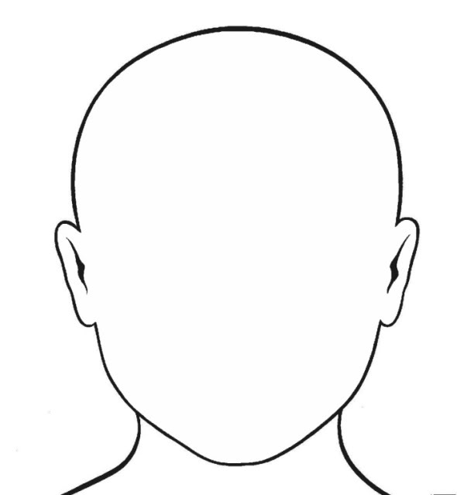
Activity: Ageing - Physical Changes

Slide 11
Activity: Ageing -Psychological Changes

Slide 12
P5 M3 Physical changes:
Hormones; menopause;
Cardiovascular system, e.g. atherosclerosis, coronary heart disease;
Respiratory system, e.g. emphysema, chronic obstructive pulmonary disease;
Nervous system, e.g. motor neurone disease, degeneration of the sense organs, degeneration of the nervous tissue, cognitive changes;
Muscular-skeletal, e.g. rheumatoid arthritis, osteoarthritis, effects of degenerative disease, muscle wasting due to poor absorption of nutrients;
Skin, e.g. loss of elasticity, effects of exposure to ultra violet rays, effects of smoking;
The effects of illnesses that are more common in ageing (Homework)
P5 M3 Psychological changes:
Effects on confidence; effects on self-esteem;
Effects of ageism;
Effects of, e.g. role changes, loss of a partner, retirement, increased leisure time, financial concerns, culture, religion, beliefs;
L0 3 P4 M2 D2 to be covered in later
lessons.
Theories of ageing, e.g. social disengagement, activity theory; application to current health and social care provision –

Slide 13
Task
Your team have been split up into pairs/three and have been assigned a Physical or Psychological change to investigate.
You and your partner/s will then present a key summary of this change associated with ageing back to your whole team via a 5 minute PPT slide show with relevant images to illustrate. Ready to present in Col 5 lesson Friday 29/3/19.
Remember to reference your PPT throughout and produce a list of resources used at the end of your PPT slides.
The PPT that each pair/three have produced will be collated into a whole booklet that you can use to help with your own independent research and report explaining the Physical or Psychological changes of ageing.

Slide 14
Homework
P5 Write a short report (approx. 750 words) on the effects of key illnesses that are more common in ageing.
https://www.ageuk.org.uk/information-advice/health-wellbeing/conditions-illnesses/
https://www.england.nhs.uk/2017/10/half-of-adults-aged-55-and-over-have-experienced-common-mental-health-problems-say-age-uk/
Submit Tuesday 2/4/19

Slide 15
Stretch and Challenge – Scientific Study of ageing
Gerontology is the scientific study of old age, the process of ageing, and the particular problems of old people.
This includes biological (physical), sociological, and psychological changes.
The goal of research in gerontology is to identify the factors that influence these changes.
Application of this knowledge can reduce the severity of some disabilities commonly associated with ageing.
As a result of gerontology, several theories of ageing have been developed – two key ones being Social Disengagement Theory and the Activity Theory.

Slide 16
Learn more about gerontology and health and social care careers
https://www.sciencedirect.com/topics/neuroscience/gerontology
https://www.indeed.co.uk/Gerontology-jobs

Slide 17
Video clips : Activity theory and social disengagement theory (future learning LO 3 P4 M2 D2 Assignment 4)
https://www.youtube.com/watch?v=Vv4YmAji5is
https://www.youtube.com/watch?v=miYcqwHNObg

