Slide 1
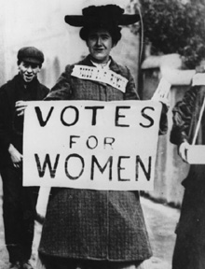
Feminism

Slide 2
Feminism
Feminism is an alternative conflict theory, like Marxists, feminists see society as being fundamentally divided but between the sexes rather than between classes. Feminists believe that women are unfairly treated and they want to change society so that there is equality between men and women.
Feminist sociology stresses the importance of gender divisions in society and it portrays these divisions as working to the overall advantage of men. It is men who rule society and who have the power in most social situations – in relationships, in families, in schools and so on. This situation is called patriarchy.

Slide 3
Patriarchy
A social organisation which believes the man is head of the house
A lot of gender stereotypes come from socialisation…
In what ways do you think our upbringing & socialisation could influence gender inequalities?

Slide 4
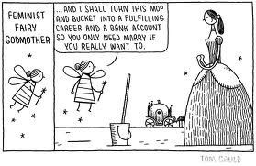
Feminists are in favour of equal opportunities for men and women, and of equal relationships in all areas of life.

Slide 5
There are three main types of feminist approach:
Marxist feminism
Radical feminism
Liberal feminism
You need to discuss each of these in your assignment so make notes on your hand-out as we go along…

Slide 6
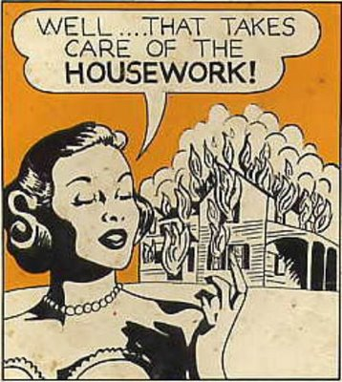
Marxist feminism
See women, especially working class women as oppressed by both capitalism and men.
Women produce the next generation of workers and look after the husbands and the next generation of workers They are dominated by their husbands and are subsiding industry.
The family would not be ready for work if someone did not take responsibility for domestic life and this remains the responsibility of the women.

Slide 7
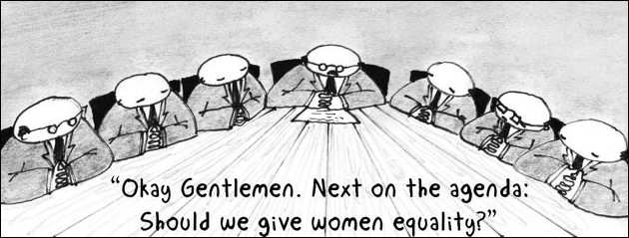
Radical feminism
For radical feminists, it is not capitalism that dominates women, but men.
Men dominate women and the family is seen as a patriarchal institution.
They see the socialisation of women as housewives and mothers as a form of oppression and this oppression as a characteristic of nuclear family life.

Slide 8

Liberal feminism
They would argue that changes have taken place. They believe that , through changing attitudes and legislation such as the Equal Pay Act (1970)and the Sex Discrimination Act (1975) there is more equality.
Liberal feminists believe that improvements will continue by means of legislation and policy.

Slide 9
Socialisation
Women are socialised into caring roles

Slide 10
Activity
What gender stereotypes do you think you encountered as a child?
Hint:
Think about what your parents roles were?
What toys did you buy or want when you were a child?
What was your favourite colour?
What did you want to be when you were older?
How would people describe you as a baby? Eg. Cute/ Pretty

Slide 11
Socialisation
Make notes on the comments on the
Blue baby & the Pink baby
Play:5 Mins – 7 Mins

Slide 12
Reflect
How do Health & Social Care professionals reflect wider inequalities in society?

Slide 13
Assignment
Now you can complete the Feminism section of P1
Outline the three main feminist approaches
Explain how women are socialised into caring roles

Slide 14

ism

Slide 15
Introduction
The perspectives we have already looked at focus on large groups and whole institutions to see how they influence behaviour and shape society.
Interactionism is different to this, this perspective focuses on smaller groups rather than looking at whole social institutions to see how society is shaped.
Interested in what goes on within (rather than between) social institutions and interactions between people.

Slide 16
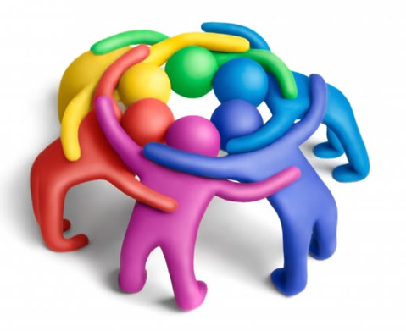
What kind of groups do Interactionist’s study?
They study diverse groups such as the interactions between ….
  Teenage gangs and older people
    Teachers and students
      Patients and visitors on hospital wards
  They study how the groups respond to each other
They see our behaviour as being a result of…
  How we interpret situations within smaller groups
    How we see ourselves in relation to other people in the group
      Examples?

Slide 17
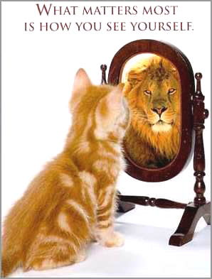
Self image
Interactionist’s study the complex interactions between people, their family and friends and their links with the professional services.
They believe that these relationships have as much influence as any medical diagnosis on whether people decide they are ill or not.

Slide 18
Impact of self image
When people are ill they……………
Label themselves as ill e.g. having a cold or being ‘under the weather’
They can attach a label to themselves.
Others can attach a label to them…….such as, who?
The labels can be either quite positive or negative.
Some labels have a stigma attached to them, can you think of some examples?

Slide 19
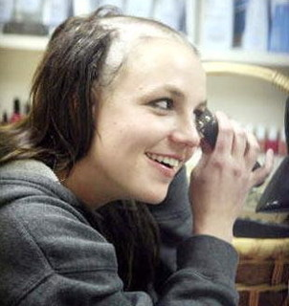

The stigma is attached due to the interpretation of the illness by the people who place the label.
Examples from popular culture?

Slide 20


Stigma of labels
Some people may not state they are ill, due to an attached stigma
E.g. HIV – Gay sex
STD – Promiscuous
THRUSH - Promiscuous

Slide 21
Labelling
CONSIDER WHAT THE ISSUES MIGHT BE WITH LABELLING? (P1)
e.g. Once diagnosed with, and labelled as having depression, what might happen ?
A main concern with labelling is that once a person is labelled as having an illness, that individual can fall into a negative cycle.
This can have an impact on whether they recover or not.

Slide 22
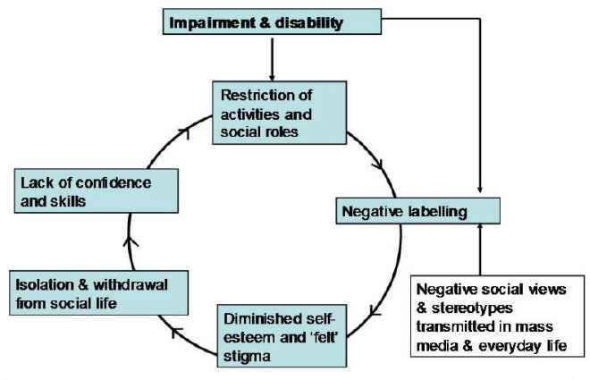
Impact of Labelling

Slide 23
Assignment 1
You can now complete Task 1 (P1)
Interactionism
Explain how interactionism influences individual behaviour.
  How do we interpret ourselves?
    How are we influenced by others? (Health & Social care professionals/family)
      We have the power to choose how we behave
        How do our interactions with others shape our self-image?

Slide 24
Assignment 1
You can now complete Task 1 (P1)
Interactionism
Outline the issue of labelling and the effects of being stigmatised.
  What is labelling?
    What is stigma?
    What is the issues with labelling? - Outline the NEGATIVE CYCLE and link to depression
      People may not admit they’re ill due to stigma

